Slide 1
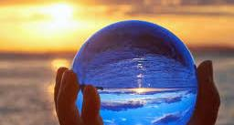


New Generation of Oxygenation Systems
Mirko Belliato, MD
Chief of the Advanced Respiratory Intensive Care Unit
U.O.C. Anestesia e Rianimazione 1
Fondazione IRCCS Policlinico San Matteo, Pavia, Italy
Member of EuroELSO Steering Commitee

Slide 2
Disclosures last 5 yrs:
Advisor, consultant and congress speaker for Hamilton Medical AG, Bonaduz, Swiss
Advisor, consultant and congress speaker for Eurosets srl, Medolla, Italy

Slide 3
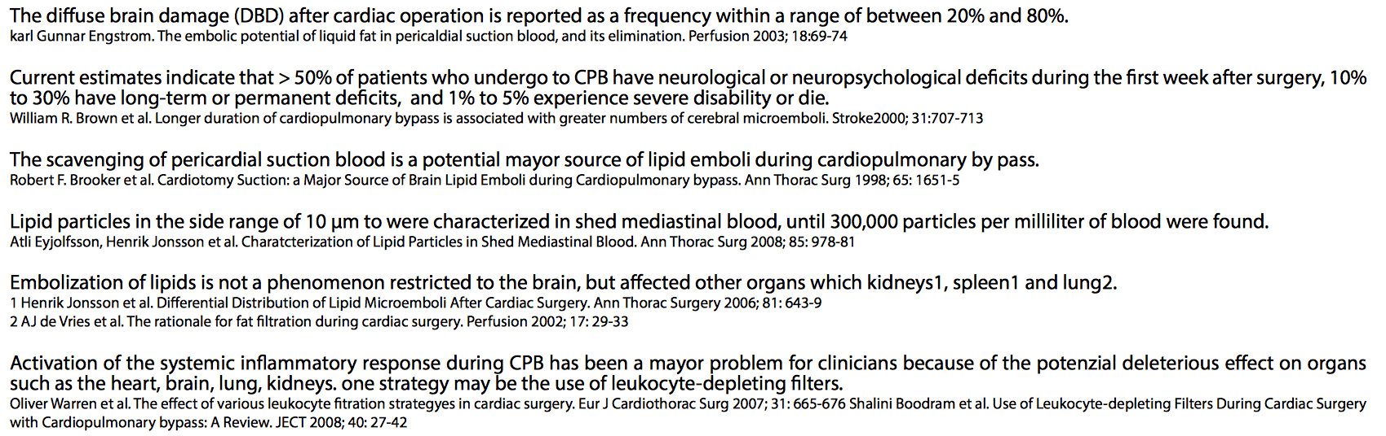
What are the clinical issues nowadays?

Slide 4
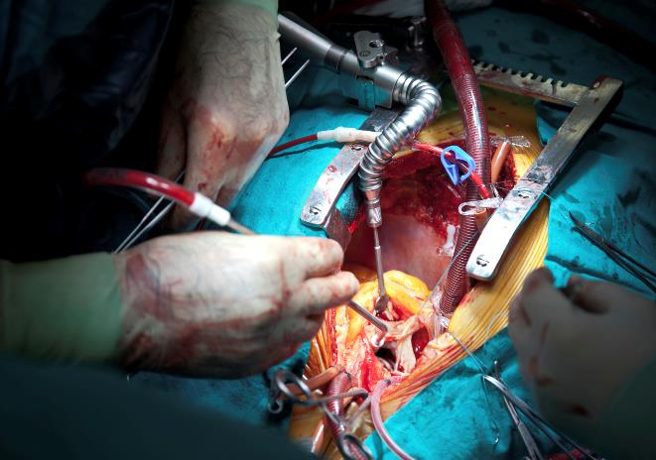
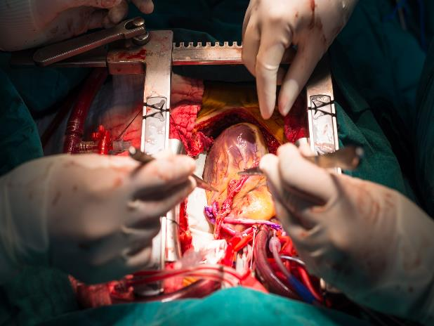
SCAVENGING of
PERICARDIAL SUCTION BLOOD

Slide 5
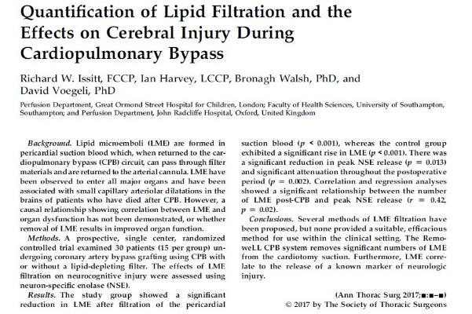
Significant reduction in LME after fitration and in peak NSE (neuron-specific enolase) using a scavenger system CPB system.

Slide 6
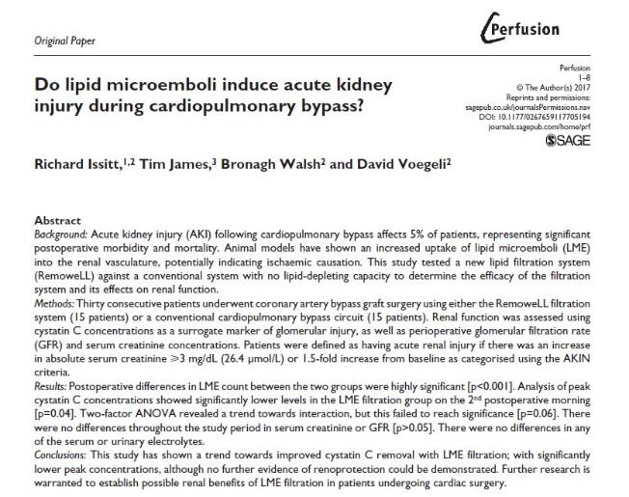
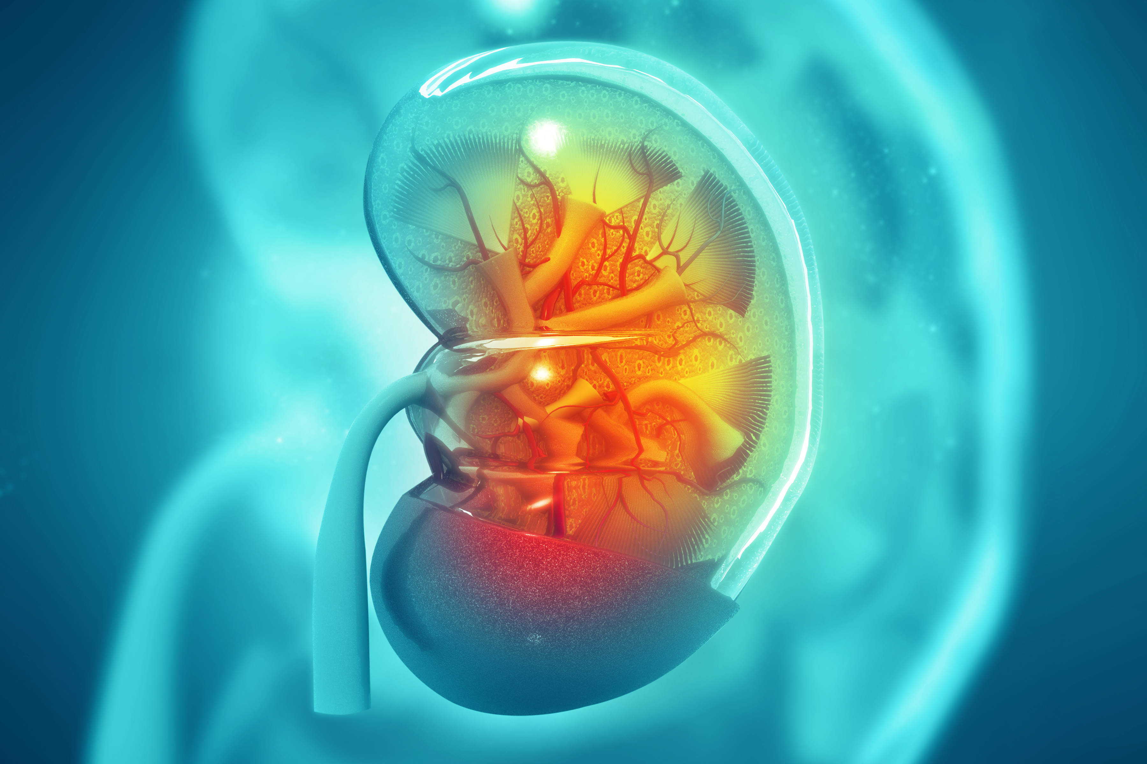
Renal function was assessed using Cystatin C and serum creatinine concentrations. Using a filtration system significant lower level in LME and cystatin C concentration

Slide 10

It should remove fat particles in two ways: in the filtering layer, through a mechanism similar to that responsible for the removal of leucocytes, and by the spontaneous separation of lipids, which tend to float in the upper layer of the supernatant, when blood is left to sediment in the reservoir.
How it works an efficient cardiotomy reservoir?

Slide 11
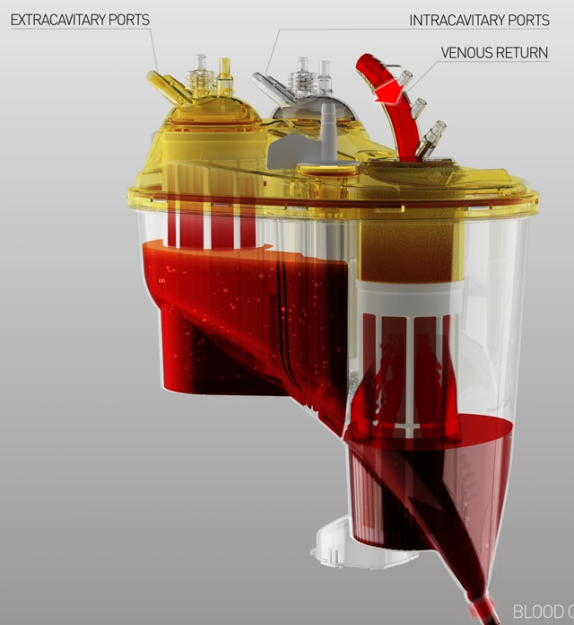
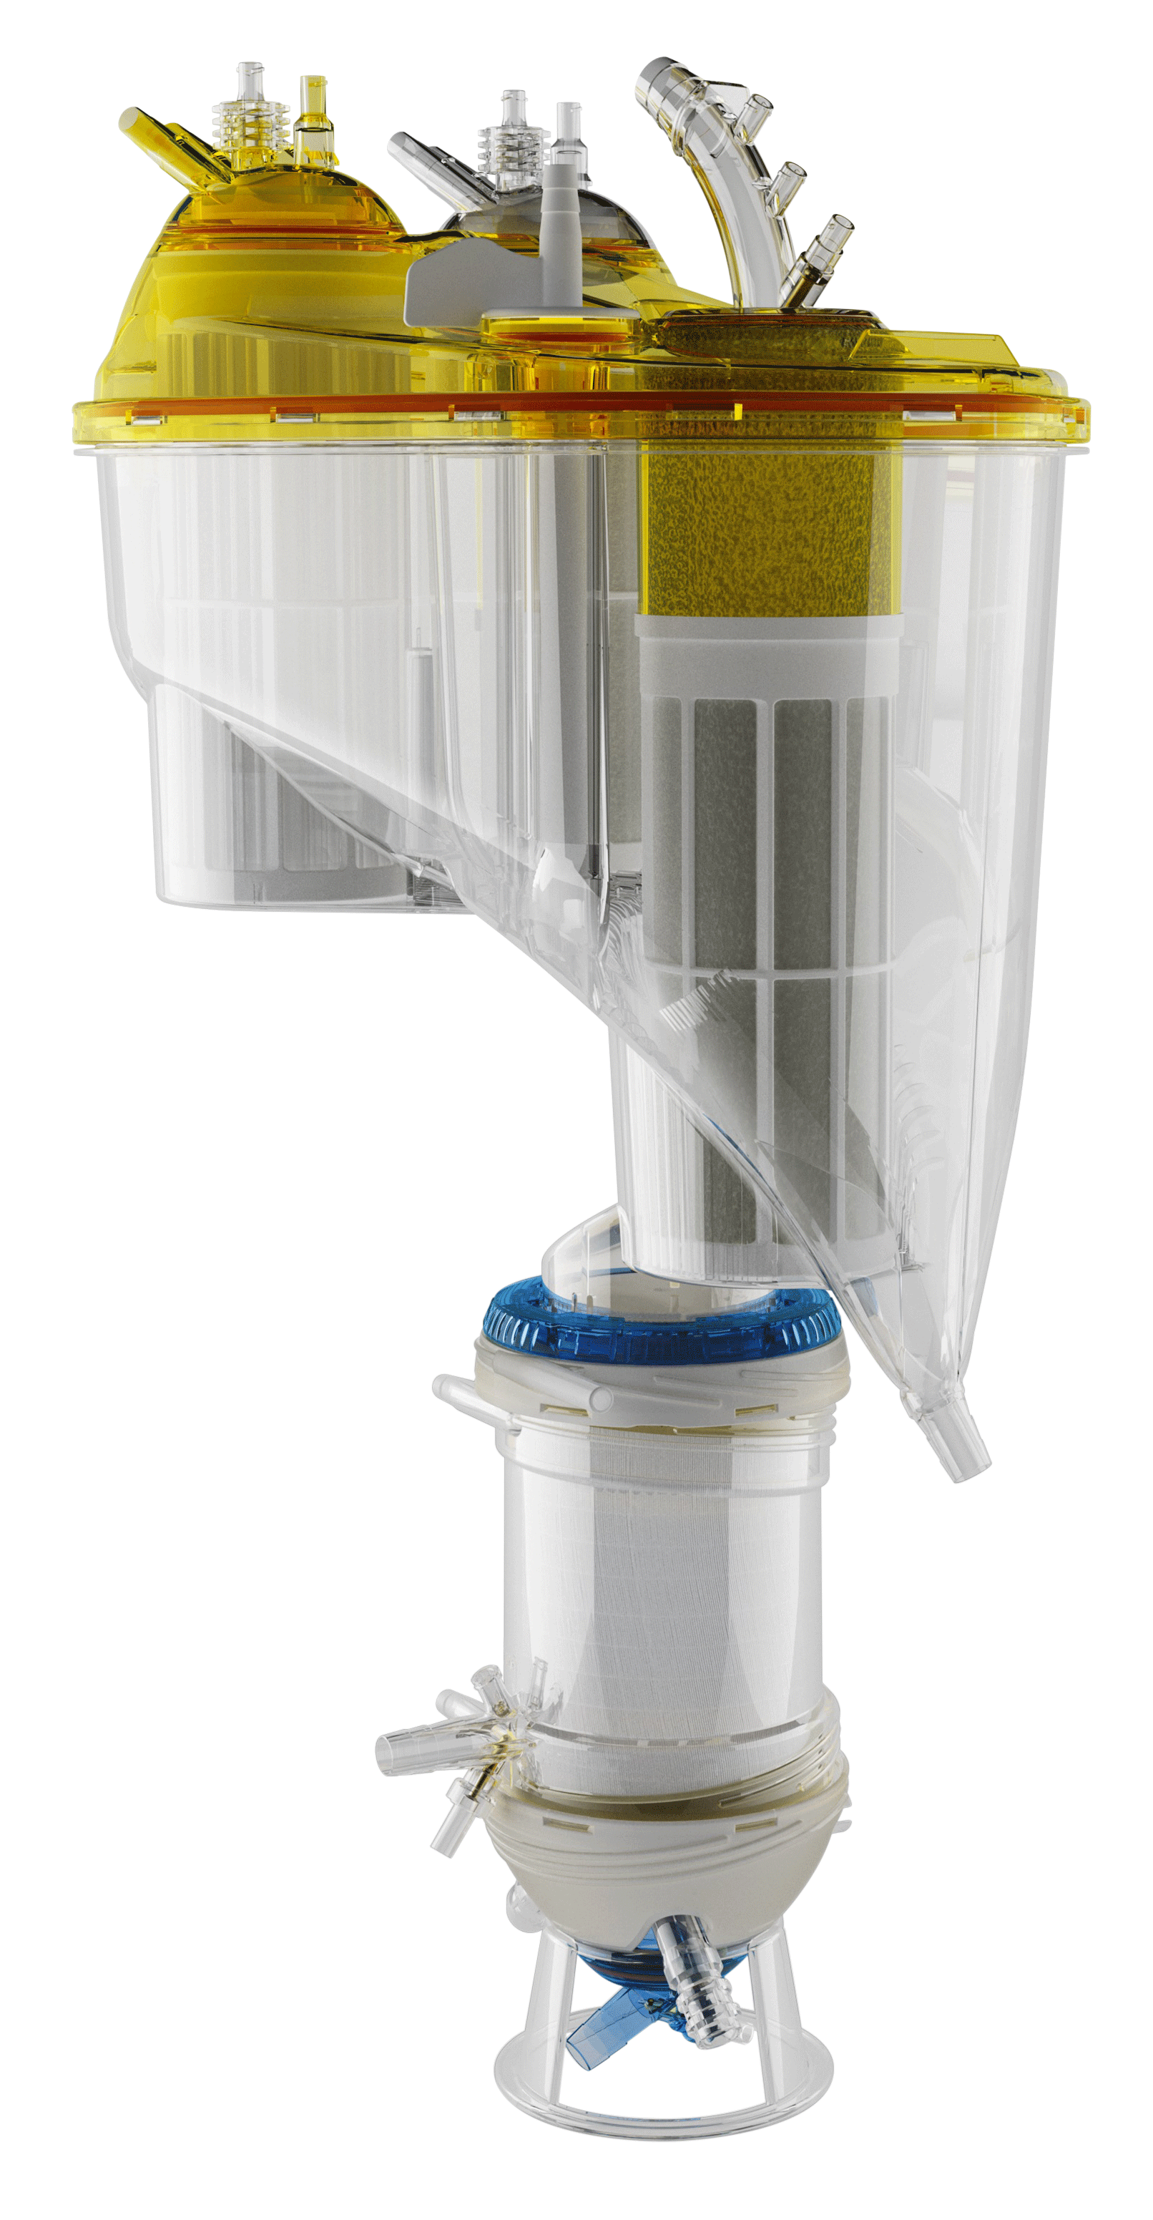
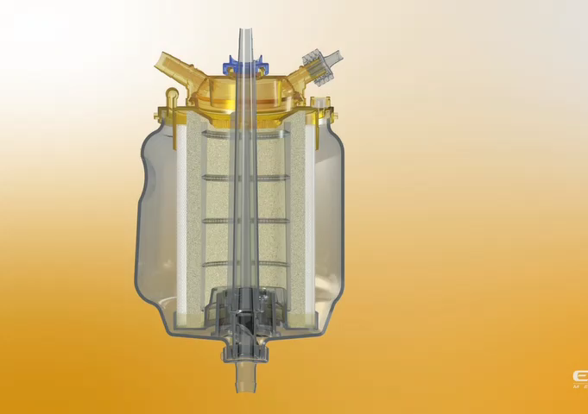


An example of lipid and leucocyte filtration by a new cardiotomy revoir:
Extra-cavitary
Intra-cavitary
800ml
cardiotomy
4,5L
Lever
to transfer blood
Same as Horizon

Slide 12
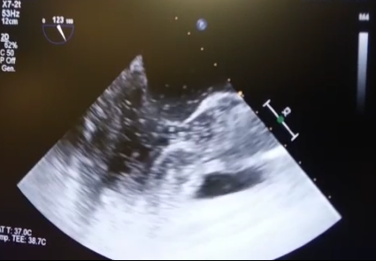
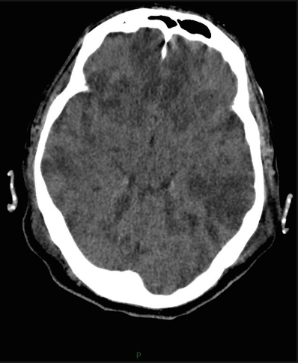
AIR EMBOSLISM DURING CPB

Slide 13
Micro-emboli counts

Slide 14
Size of Micro-emboli

Slide 15
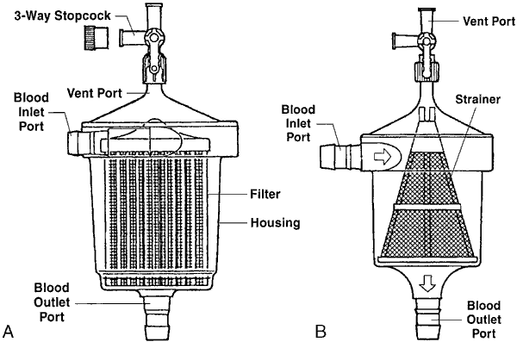
Types of arterial filters
Non-integrated arterial filter

Slide 16
Types of arterial filters
Integrated arterial filter:
  Inside the oxy- membrane
  After the oxy- membrane

Slide 18
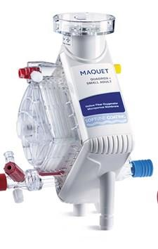
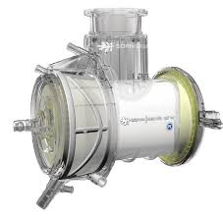
Oxygenator with Integrated post-membrane filter
Geitnge Quadrox IF
Sorin Inspire 6F M

Slide 19
Oxygenator with Integrated outside-membrane filter
Terumo Capiox FX25

Slide 20
Oxygenator with Integrated into-membrane filter
Medtronic Fusion

Slide 22
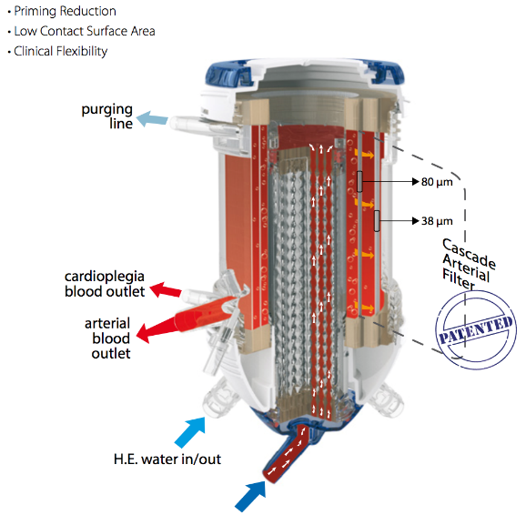
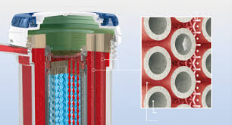

Oxygenator with fully integrated membrane filter and steel heater
Stainless Steel H/C assuring that H₂O₂ does not migrate from water side to blood side

Slide 23
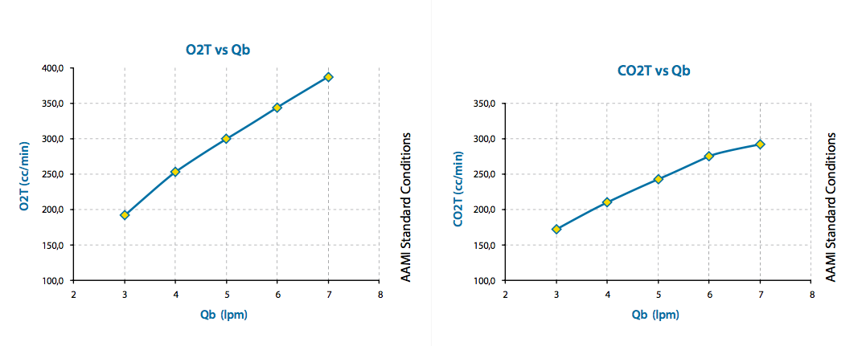
OXYGENATOR: gases transfer

Slide 24
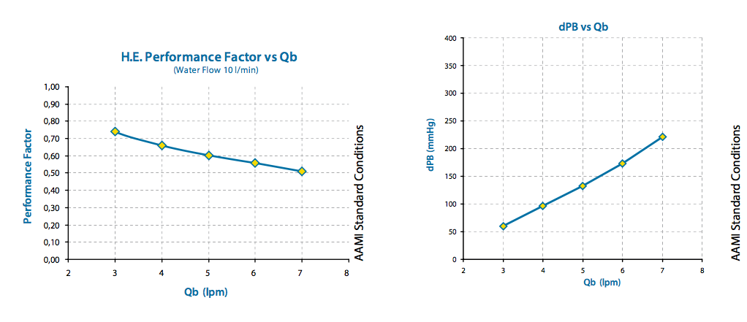
OXYGENATOR

Slide 25
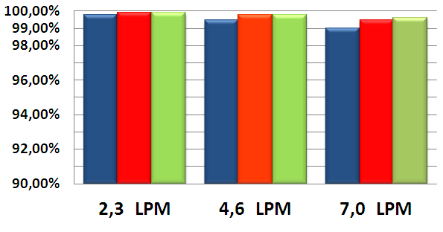

Comparison with similar
 |  | % AIR REDUCTION
 | n | 2,3 LPM | 4,6 LPM | 7,0 LPM | p value
A.L.ONE AF PLUS | 5 | 99,80% | 99,50% | 99,00% | ns
Fusion | 5 | 99,90% | 99,80% | 99,50% | ns
FX25 | 5 | 99,90% | 99,80% | 99,60% | ns
A.L.ONE AF PLUS
FUSION
FX25
Data are expressed as
mean percentage efficiency of
gross air removal

Slide 26
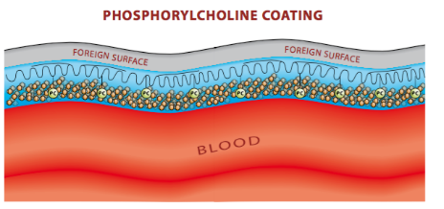
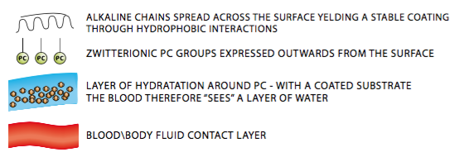
COATING
Phosphorylcholine is the predominant headgroup found in the outer layer of cell membranes.
PC has a natural affinity for water and binds water tightly around itself.
As a result, the outer layer of the cell memebranes does not promote clots formation (thrombosis).

Slide 27

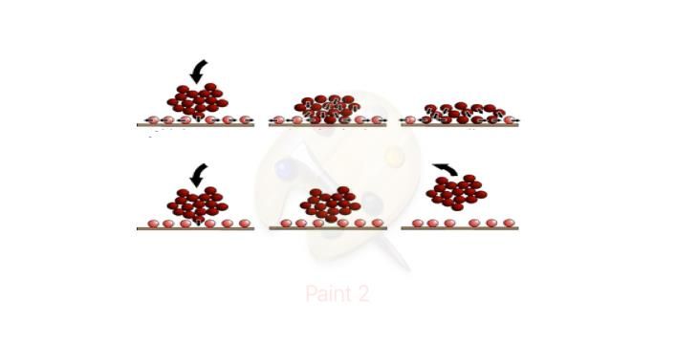
COATING
The PC head group has a high affinity for water.
Devices coated with PC have a permanent water layer on the surface.
The water acts as a barrier to protein and cell adhesion
NON COATED MATERIAL
Initial contact anchoring spreading
Foreign surface
COATED MATERIAL
Initial contact no anchoring no binding
UNCOATED MATERIAL
PC COATED MATERIAL
Lewis A.L. (2000) Colloids & Surf B: Biointerfaces 18: 261-275
Zwaal RFA, et al. Nature, 1977, 268, 358; Hayward JA & Chapman D, Biomaterials, 1984, 5, 135

Slide 28
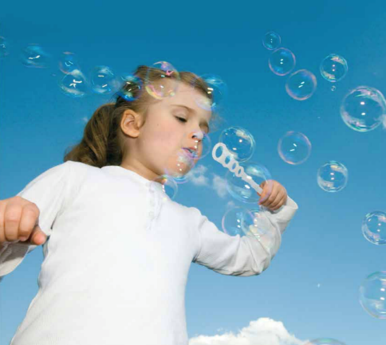
What I ask to a new oxygenation system, today?
Reduced micro-embolic activity
Optimized priming
High performance gas exchange
Optimized pressure resistance
Blood warming/cooling with no risk of contamination
Advanced and bio-compatible coating of the membrane

Slide 29



THANKS !!!!
Belliato 2019

