Slide 1



New Concepts in ECLS
Mirko Belliato, MD
Chief of the Advanced Respiratory Intensive Care Unit
U.O.C. Anestesia e Rianimazione 1
Fondazione IRCCS Policlinico San Matteo, Pavia, Italy
Member of EuroELSO Steering Commitee

Slide 2
Disclosures last 5 yrs:
Advisor, consultant and congress speaker for Hamilton Medical AG, CH
Advisor, consultant and congress speaker for Eurosets srl, Italy

Slide 3
Summary
New monitoring on ECMO performance, patient’s organs recovery and patient-ECMO interaction
Hybrid ECMO
New ECMO devices (multi-purpose, from OR to transport)

Slide 4
We can describe the patient metabolic condition as:
Oxygen need
CO₂ production

Slide 5
In a patient with stable metabolic conditions:
The total intake must be equal to the O₂ needs
Oxygen delivery = V’O2 [ml/min ]
VO₂ML
VO₂NL
Consumption of O₂
Notes:
We know that in stable metabolic conditions the oxygenation power is the sum of the VO2 ML and VO2 natural that is an indicator of the consumption of the oxygen by the patient

Slide 6
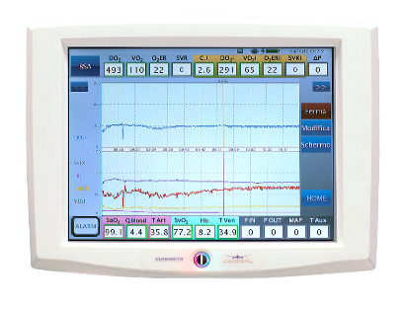
How to measure continuously the V’O₂ ML ?
Landing® Real Time Monitor, EUROSETS S.r.l. - Medolla (MO), Italy

Slide 7

V’O₂ML on line monitoring
V’O₂ML monitored is based on oxygen content approximation obtained from continuous measurements of saturation and haemoglobin with not invasive infrared/spettrophotometry method.

Slide 8
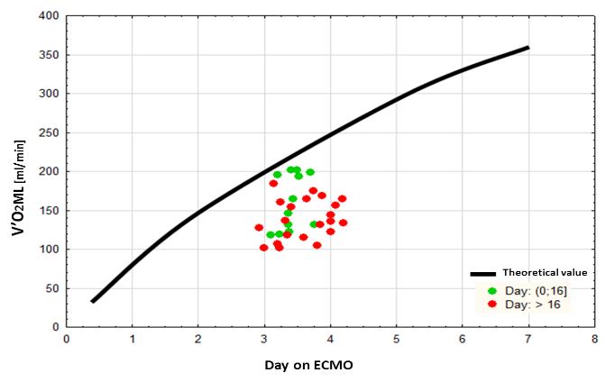

Oxygenator aging: V’O₂ML
Oxygen transfer from membrane lung (V’O₂ML) during the entire period of use of the first oxygenator, an ECMO Adult Oxygenator (by Eurosets^{tm}). Actual values are plotted together with the factory theoretical relationship between V’O₂ML and blood flow
Blood Flow [L/min]
Belliato et al. J Clin Monit Comput DOI 10.1007/s10877-016-9927-4

Slide 9
In a patient with stable metabolic conditions:
The total CO₂ removal must be equal to the CO₂ production
CO₂ removal = V’CO2 [ml/min]
VCO₂ML
VCO₂NL
CO₂ production
Notes:
At a stable metabolic condition the total Co2 removal is the sum of the VCO2 ML and VCO2 natural lung that is an indicator of the production of CO2 of the patient

Slide 10
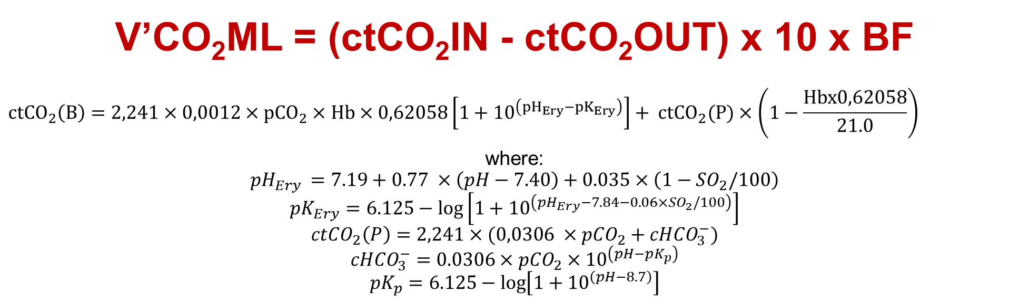
V’CO₂ML measurement
V’CO₂ML = (ctCO₂IN - ctCO₂OUT) x 10 x BF
$${ctCO}_{2}\left(B\right)=2,241×0,0012×{pCO}_{2}×Hb×0,62058\left[1+{10}^{\left({pH}_{Ery}−{pK}_{Ery}\right)}\right]+ {ctCO}_{2}(P)×\left(1−\frac{Hbx0,62058}{21.0}\right)$$
where:
$${pH}_{Ery }=7.19+0.77 ×\left(pH−7.40\right)+0.035×\left(1−{SO}_{2}/100\right)$$
$${pK}_{Ery}=6.125−\log\left[1+{10}^{\left({pH}_{Ery}−7.84−0.06×{SO}_{2}/100\right)}\right]$$
$${ctCO}_{2}\left(P\right)=2,241×(0,0306 ×{pCO}_{2}+{cHCO}_{3}^{−})$$
$${cHCO}_{3}^{−}=0.0306×{pCO}_{2}×{10}^{\left(pH−{pK}_{p}\right)}$$
$${pK}_{p}=6.125−\log\left[1+{10}^{\left(pH−8.7\right)}\right]$$

Slide 11
V’CO₂ML not invasive measurement

Slide 12
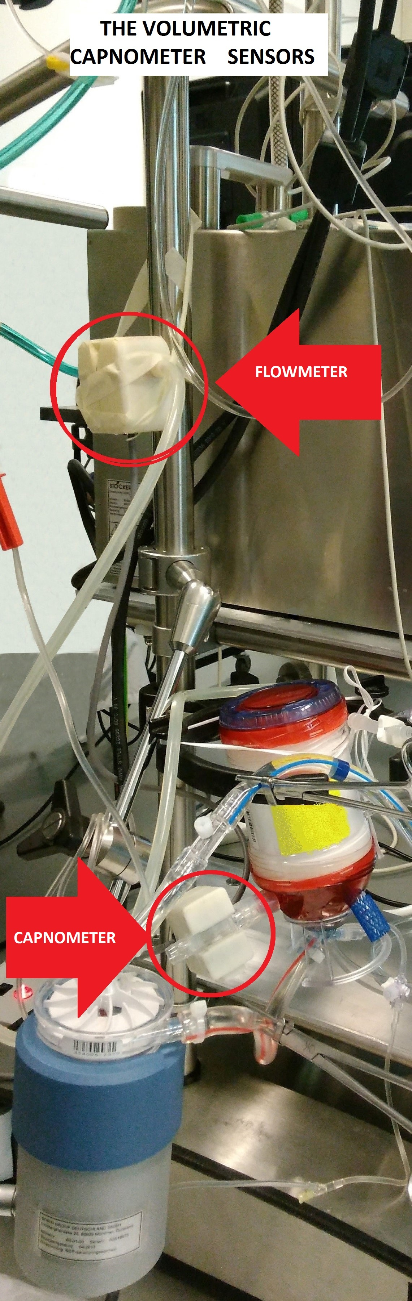
How to measure continuously the V’CO2 ML?
Landing® Real Time Monitor, EUROSETS S.r.l. - Medolla (MO), Italy

Slide 13
“..The volumetric capnometer used in conjunction with the ECMO oxygenator is reliable for continuous monitoring of V′CO2 and useful for oxygenator dead space calculation..”

Slide 14
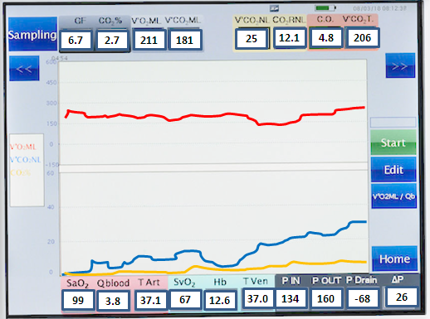

Index | Units | Ranges | Meaning
GF | l/min | 0,0-20,0 | Measured sweep gases
eCO2% | % | 0,0-8,0 | CO2 concentration in exhausted gases
Landing® Real Time Monitor, EUROSETS S.r.l. - Medolla (MO), Italy

Slide 15
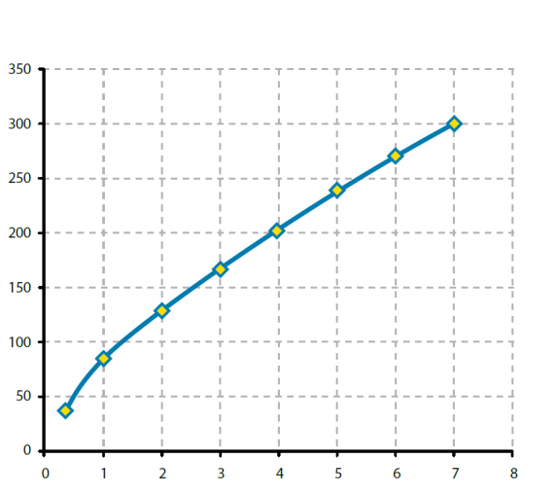

V’CO₂ as Index for Aging
V’CO₂ML vs B.F.ECMO
Blu curve:
Theorical V’CO₂ML with
BF : GF =1:1
of Eurosets ECMO oxy
V’CO₂ML (ml/min)
ECMO Blood flow

Slide 16
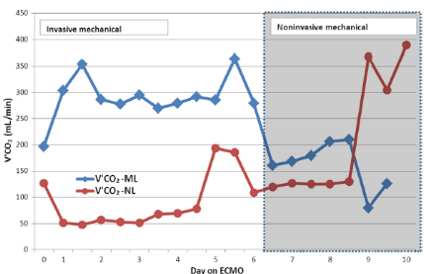
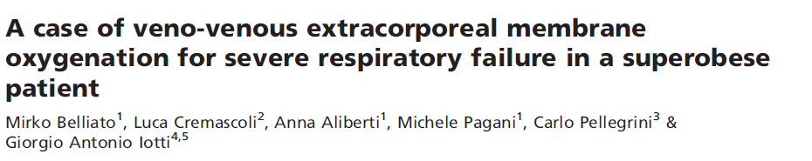
Partitioning of V’CO₂ during ECMO:

Slide 17
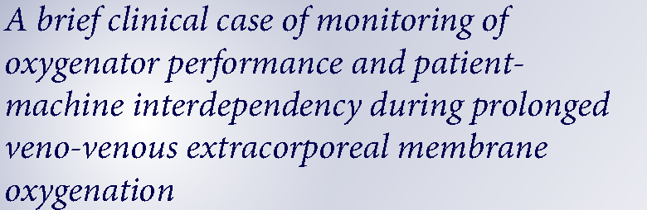

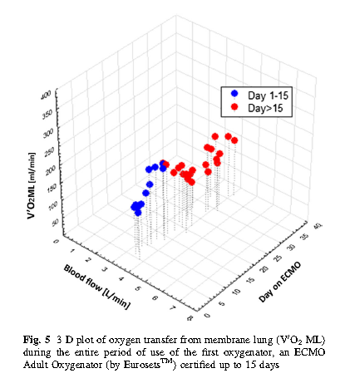
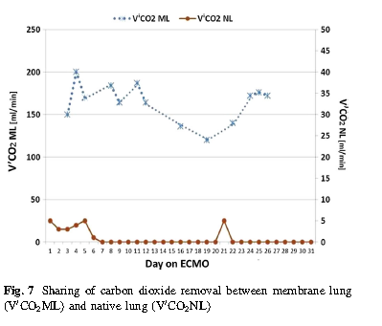

Slide 18
A Full Support Systems: the hybrid ECMO
The simultaneous use of the two ECMO configurations may represent a novel strategy of advanced treatment to be applied on selected groups of patients such as: ARDS patients supported by VV ECMO suffering from concurrent cardiac failure, typically right-heart dysfunction.

Slide 19
When do we use the V-VA ECMO?
ARDS severe with bi-ventricular cardiac failure
ARDS severe with left ventricular cardiac failure
ARDS severe with septic shock
Bi-ventricular failure

Slide 20
Hybrid ECMO configurations

Slide 22
Flow matching:

Slide 23
How to describe your ECMO?

Slide 24
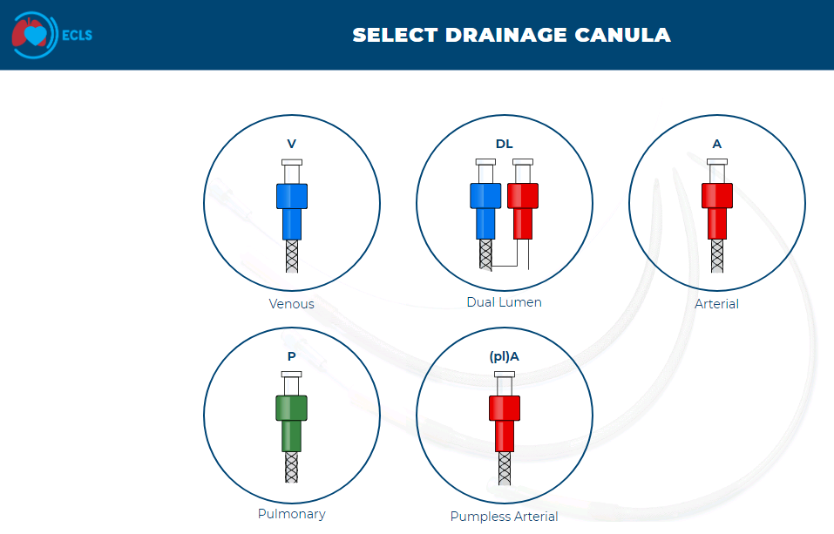
https://ecls.eurosets.com/

Slide 25
How to select an appropriate ECMO device?
SOURCE: ELSO guideline for ECMO transport, last update May 2015
Best technology available (pumps, disposable, monitor, etc)
Device safety in case system fails (e.g. backup and battery)
Oxygenator adequate performance
Circuit flexibility
User-friendliness, easy device management, easy interface
Built in blood sensors and transducers
Less resources (intra hospital efficiency optimization)
Notes:
Semlificare il visual

Slide 26
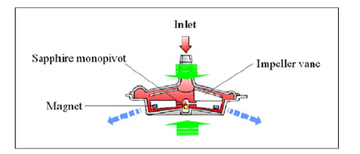
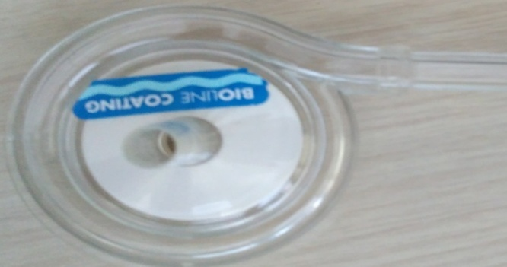
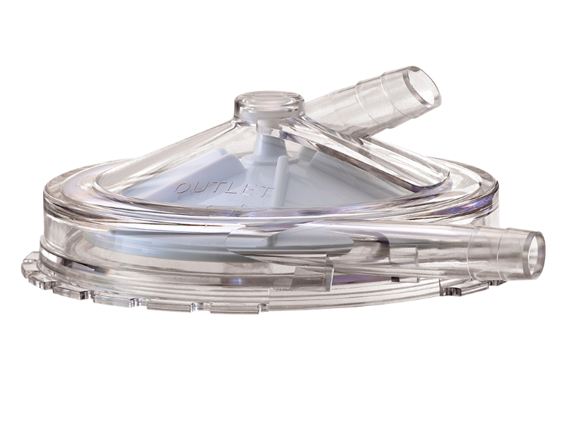
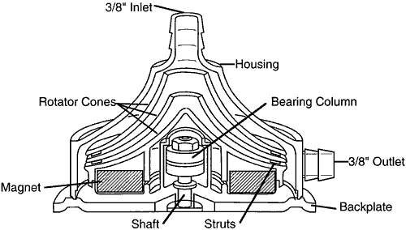
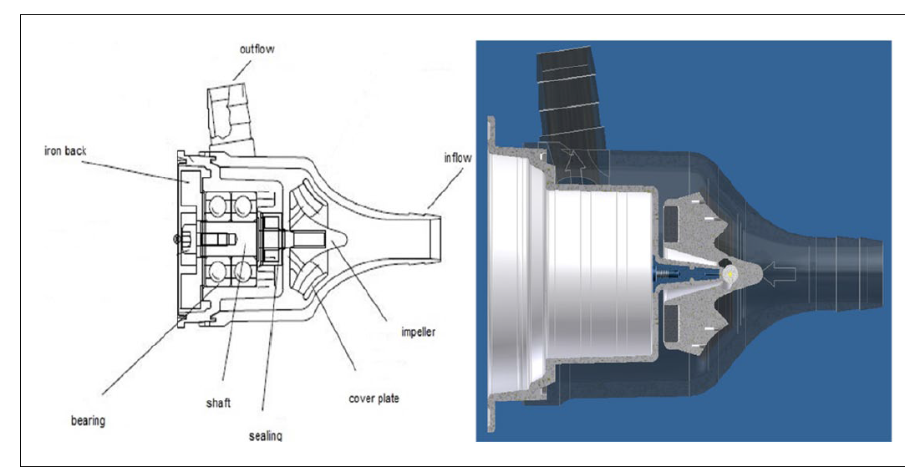
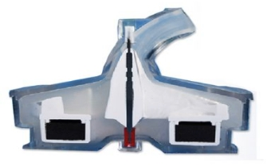
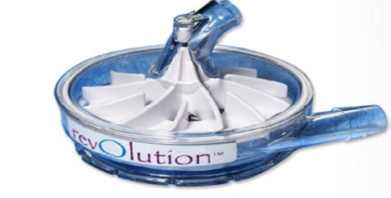
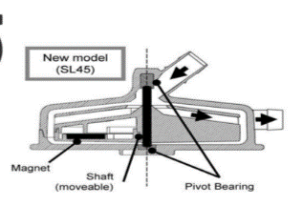
Centrifugal pumps available till now:
RotaFlow
Medtronic BIO-Pump: Affinity, BPX-80 and BP-50
Sorin Revolution 5
Medos DP3
Terumo CAPIOX SL

Slide 27
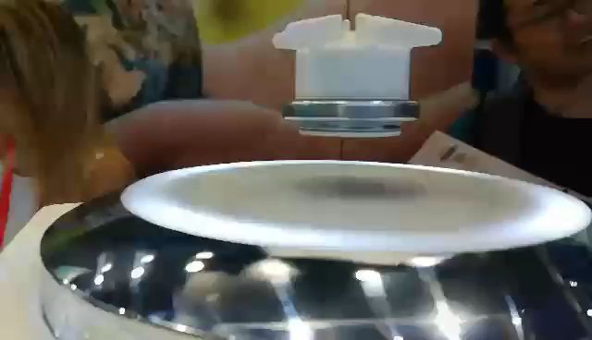

Magnetic leviation
Belliato 2019

Slide 28
Advantages using Magnetic LEVITATION Centrifugal Pump
  Magnetically levitated centrifugal pumps require no direct contact between the impeller and the pump housing, with following advantages:
      eliminating particle or heat generation,
      reducing hemolysis,
      reducing thrombus formation,
      lowering risk of mechanical failure (no bearing).
SOURCE: ECMO in Adult Patient, A.Vuylsteke et al. Cambridge uni press 2019
Belliato 2019

Slide 29
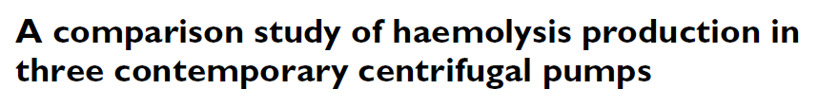
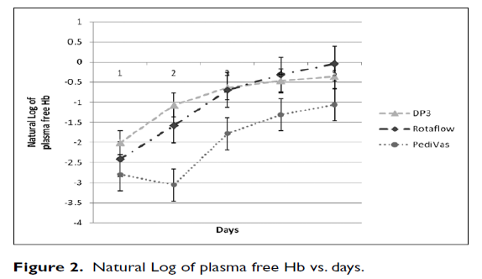

Belliato 2019

Slide 30
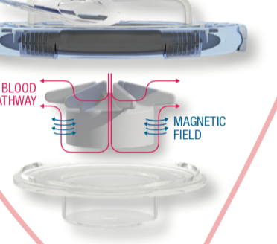
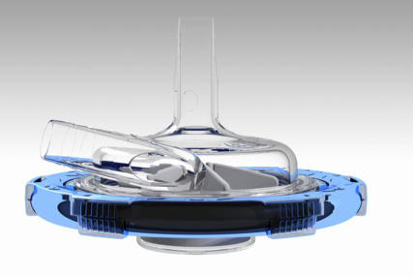
Magnetic LEVITATION Centrifugal Pump
No bearings
Belliato 2019

Slide 31
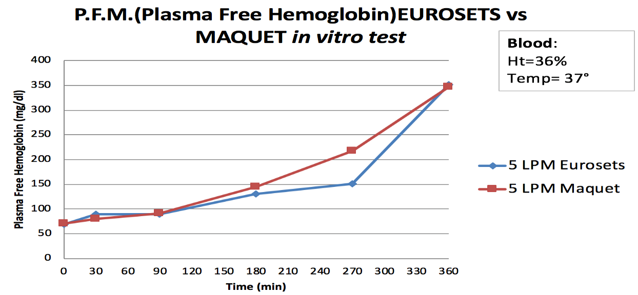
FreeHb in vitro test: ECMOlife vs Rotaflow pump
ECMOlife
Rotaflow
Lab data with bovine blood
Belliato 2019

Slide 32
FLUID DYNAMIC OF ECMOlife
FLUID VELOCITY
The result confirms the absence of areas with excessive speed , hence:
Low shear stress generation
Low Hemolysis
Low heat generation
PRESSURE DISTRIBUTION
ABSENCE OF STAGNATION AREAS
Souce: CFD test
Belliato 2019

Slide 33
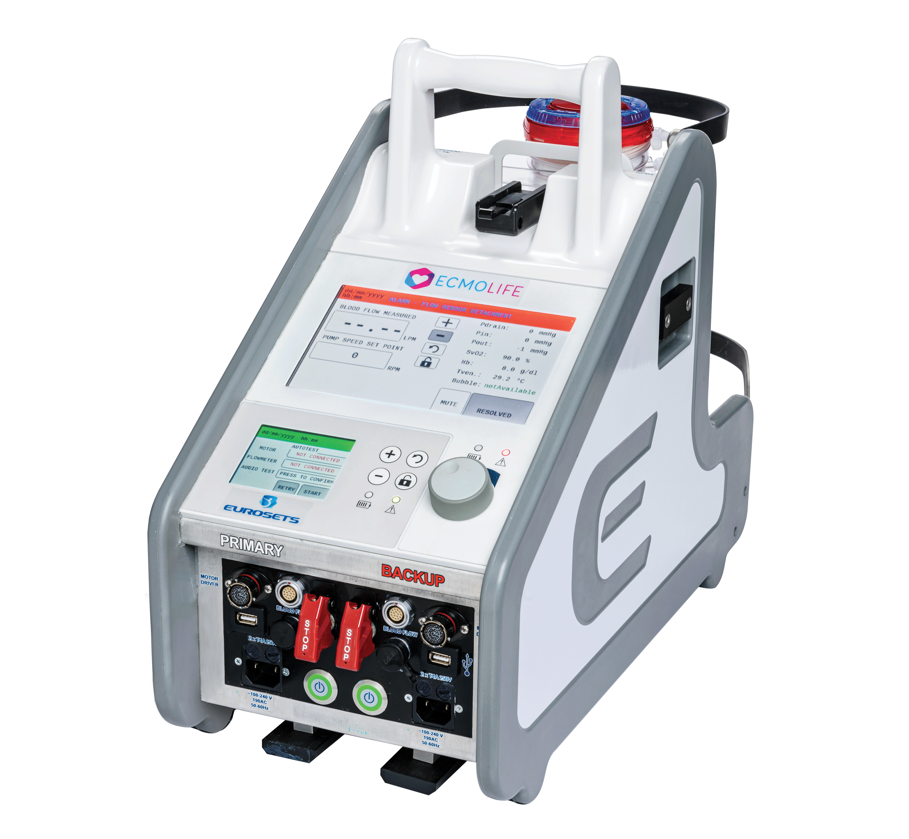
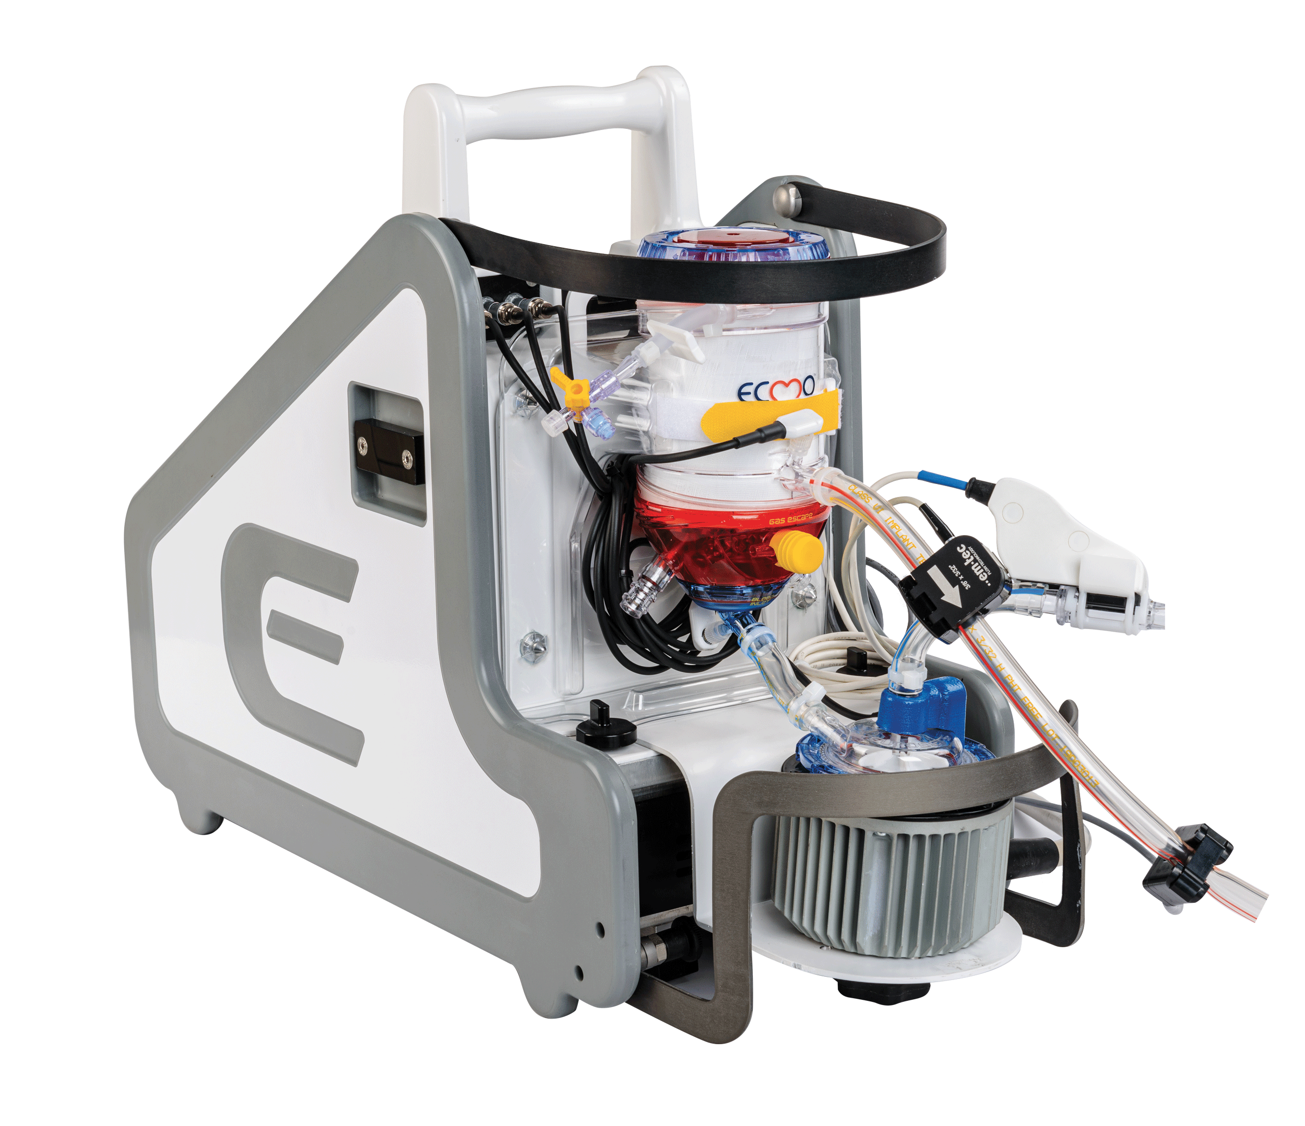
Could we merge the “best” technology with in portable system?

Slide 34
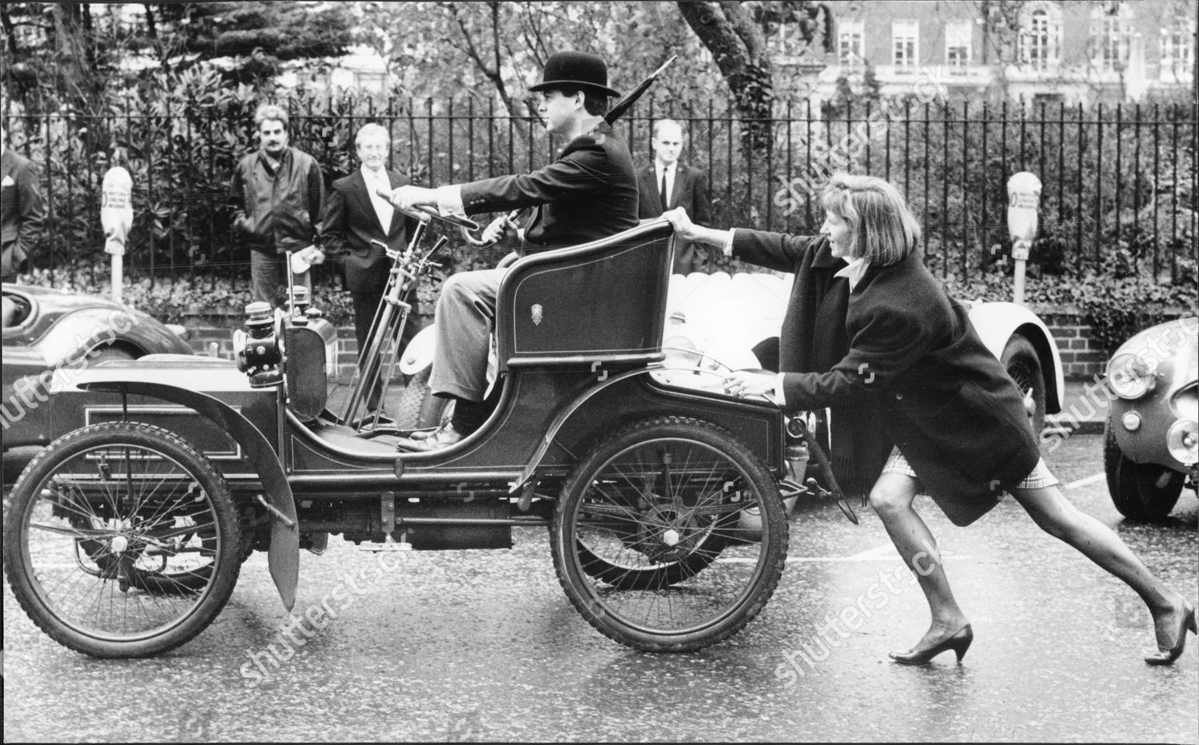
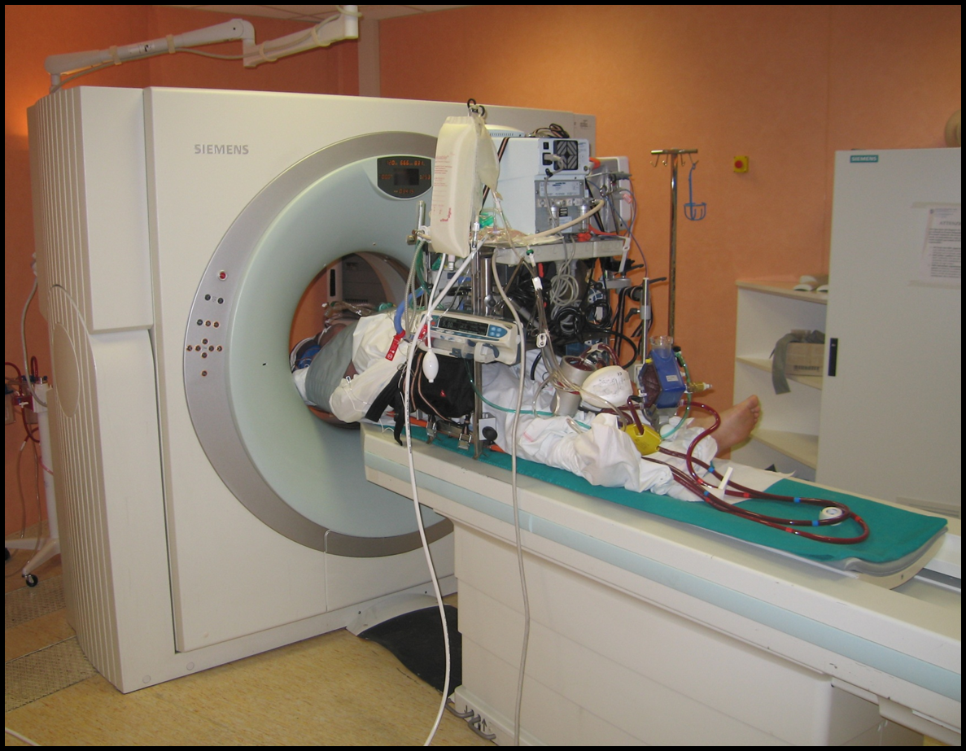
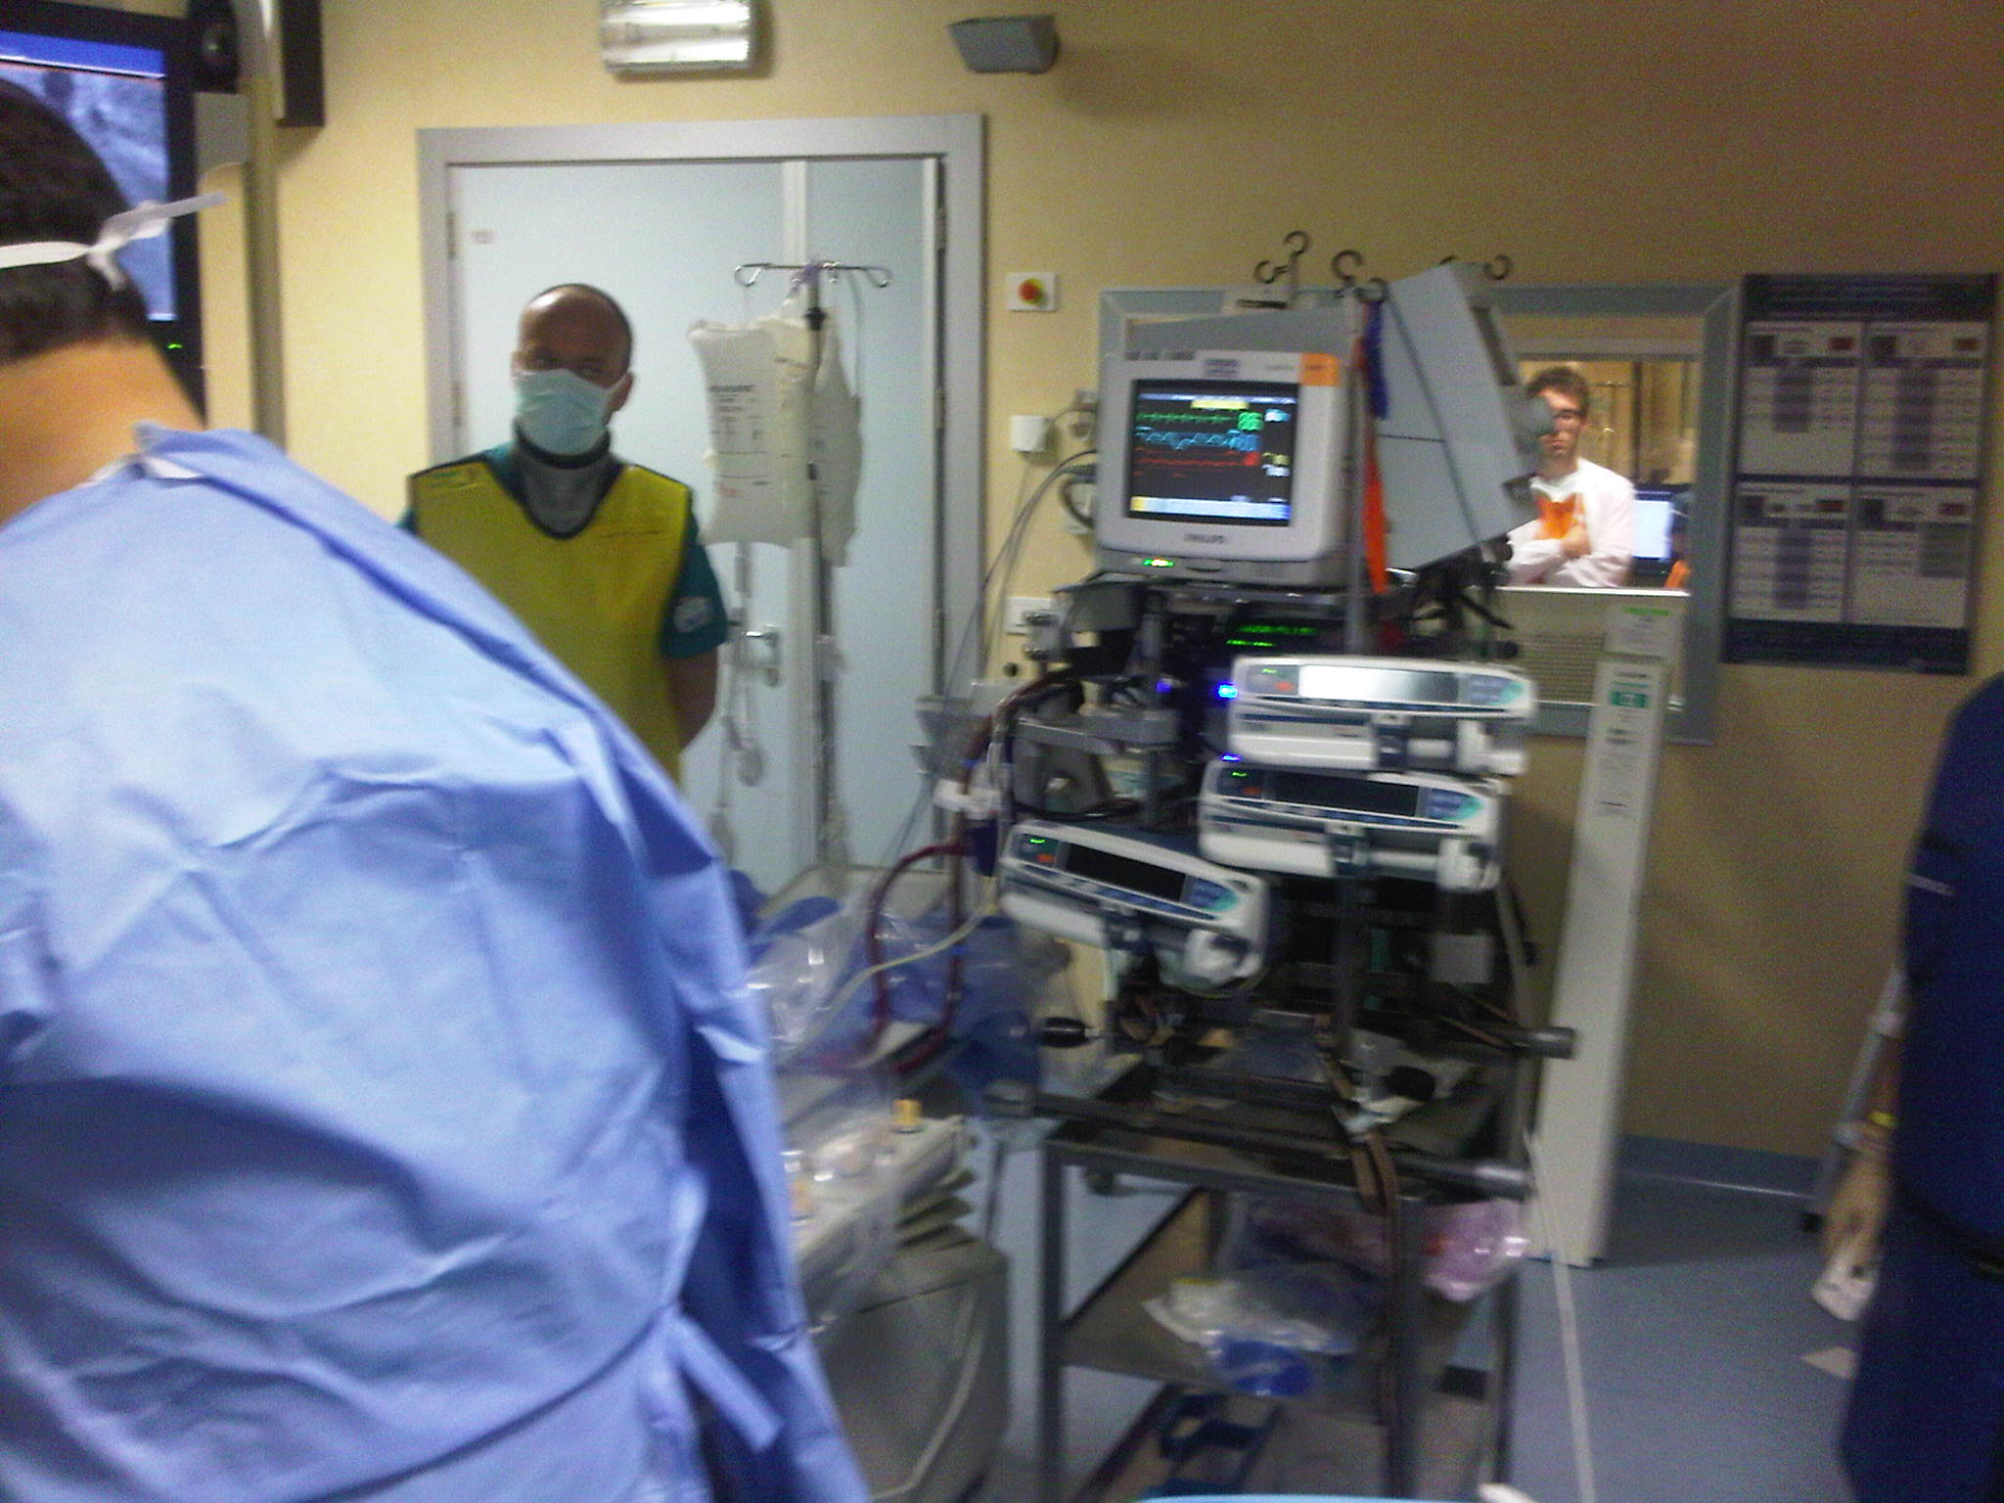
Intra-Hospital transport
CT SCAN
CATH Lab
Belliato 2019

Slide 35
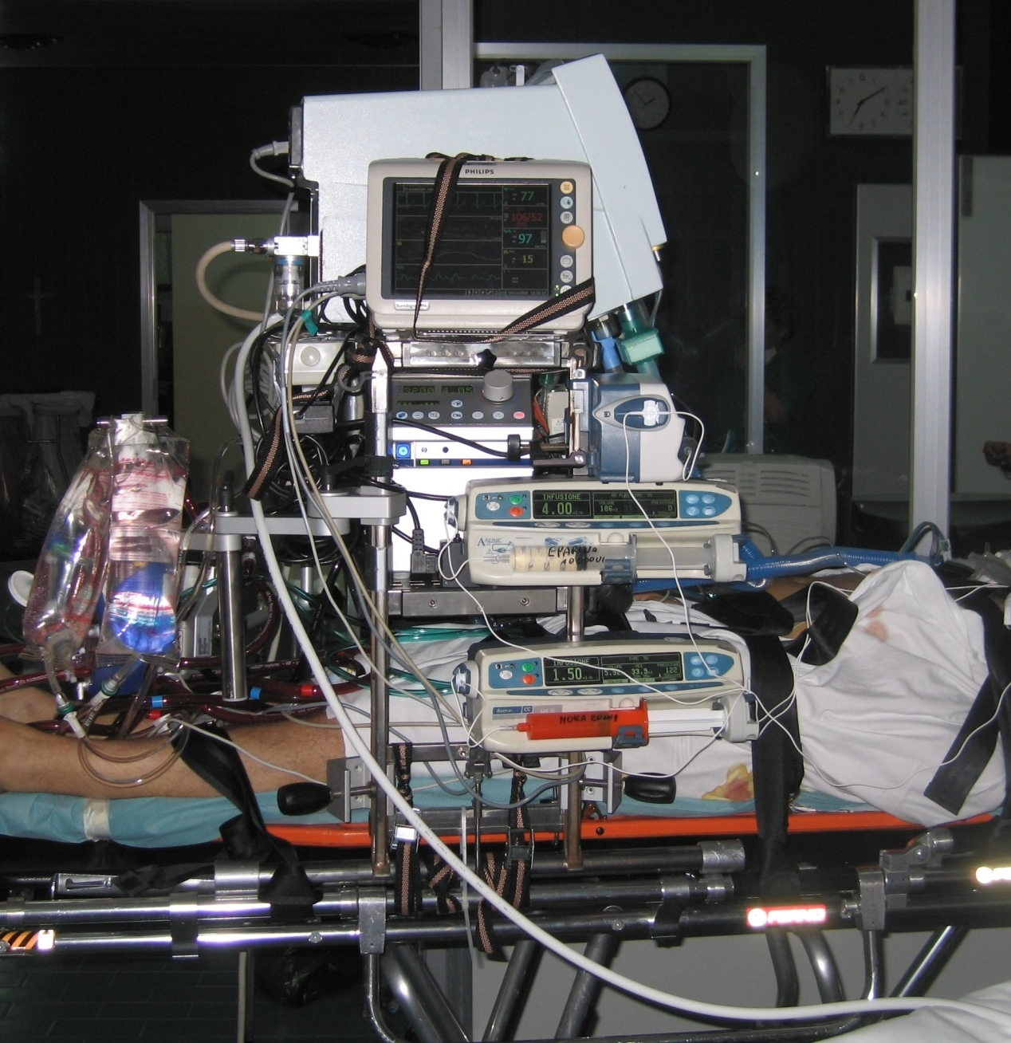
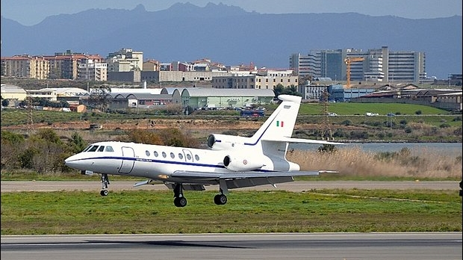
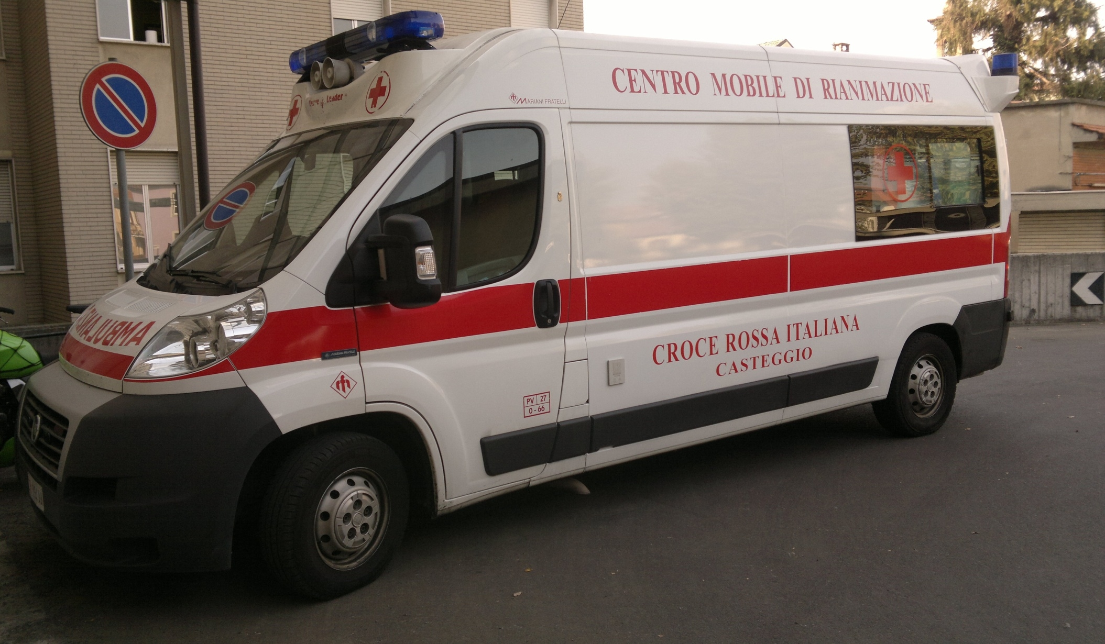
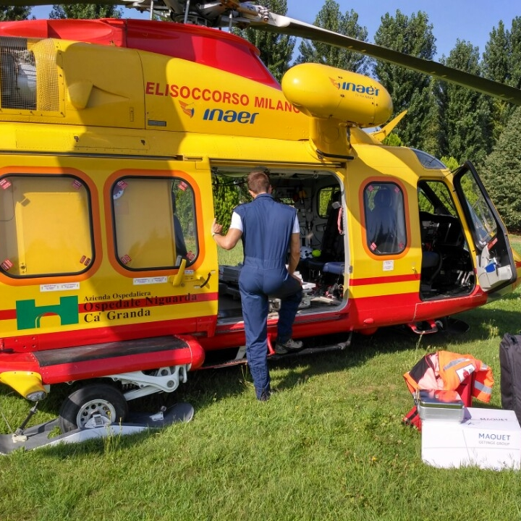
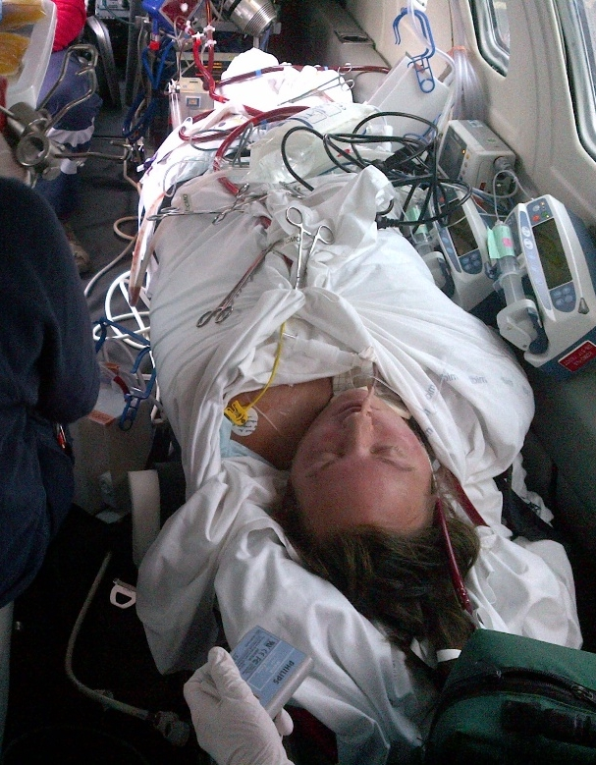
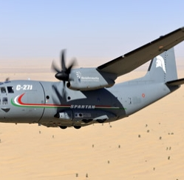
INTER-HOSPITAL TRANSPORT

Slide 36
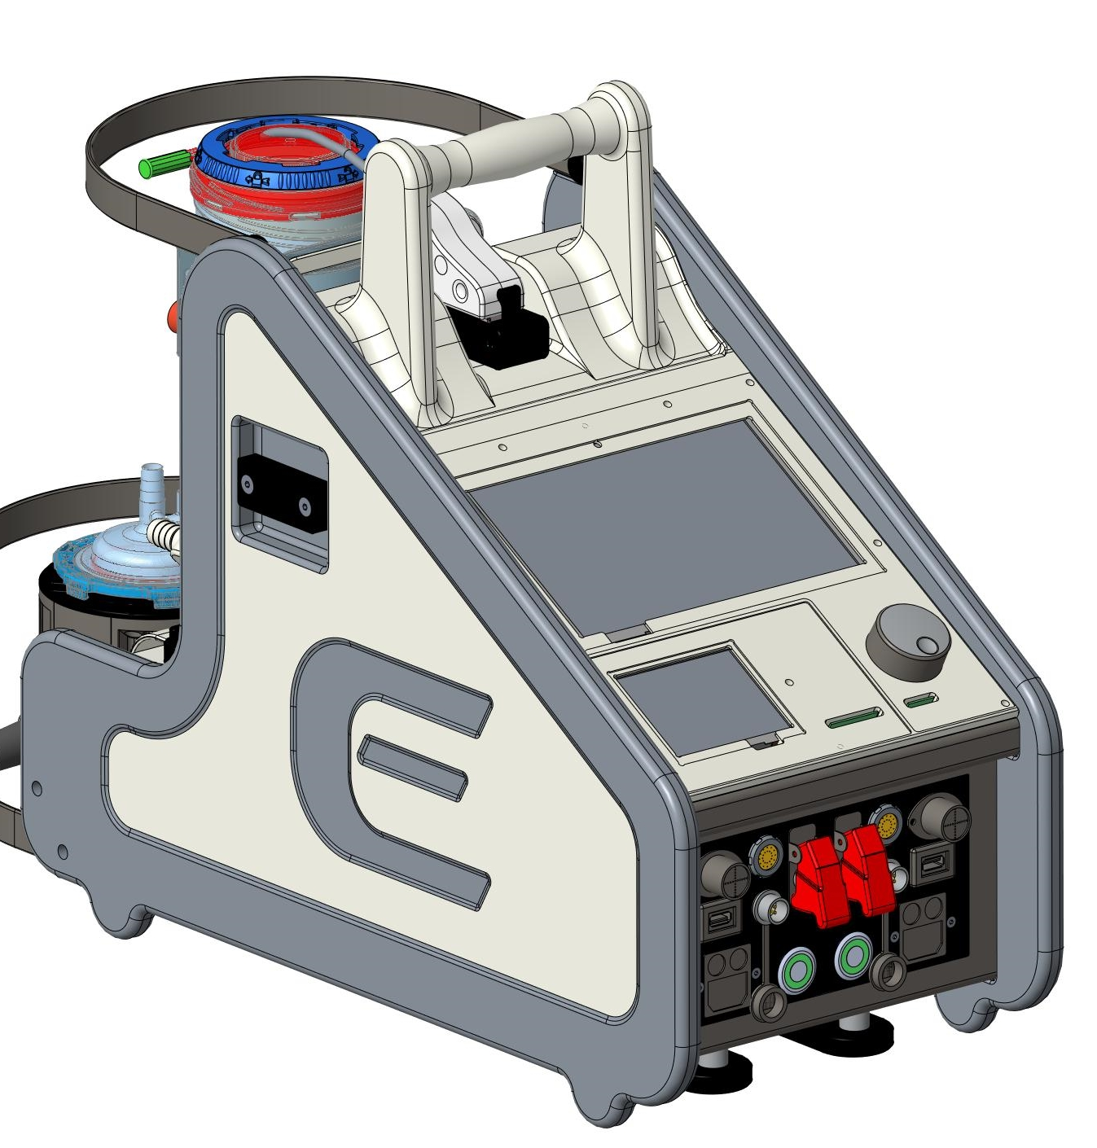
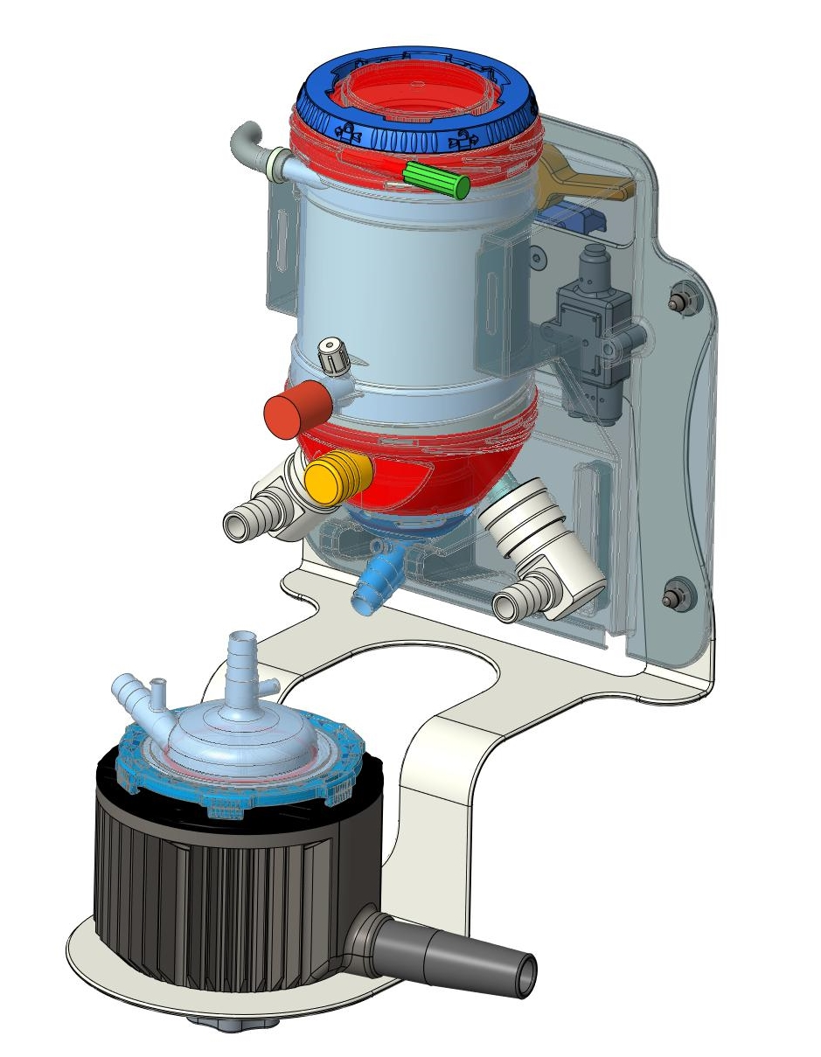
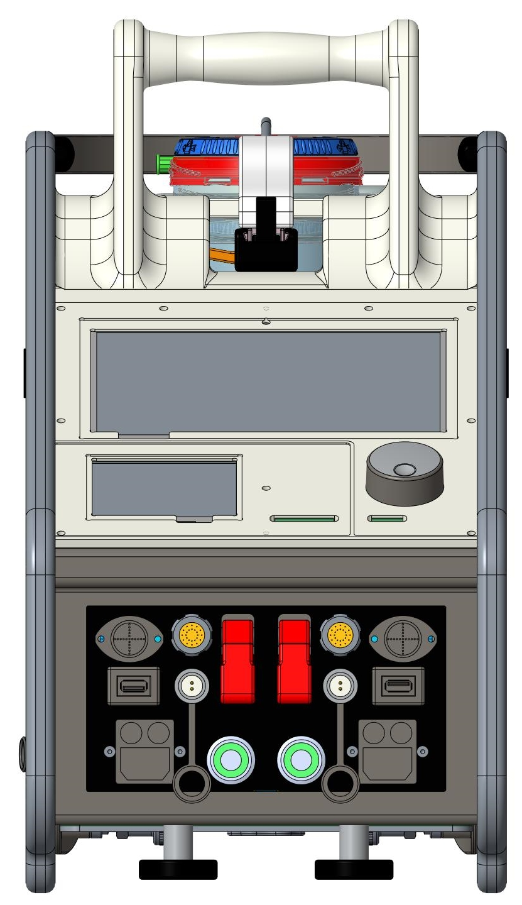

Circuit Fixing Plate
Adult ECMO
Fixing lever
1
Aluminum plate
Flexible: possibility to fix the plate on:
    Back side
    Right side
    Left side
    Trolley (any sides)
    Any bar 25x10mm
Fixing pins
Aluminum plate
1
Single use organizer
2
3
2
3
Knob to fix the pump driver
Belliato 2019

Slide 37
HOT POINTS OF A NEW ECMO SYSTEM
Fully magnetic levitation technology
Back up unit integrated
Embedded sensors: P_{drain}, P_{in}, P_{out}, SvO₂, Hb, T_{ven}
Dedicated ECMO set
14 days validated , PC coated
Dedicated trolley for inter-Hospital use fitting to any stretchers.
External battery power bank
Belliato 2019

Slide 38



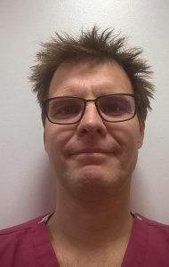
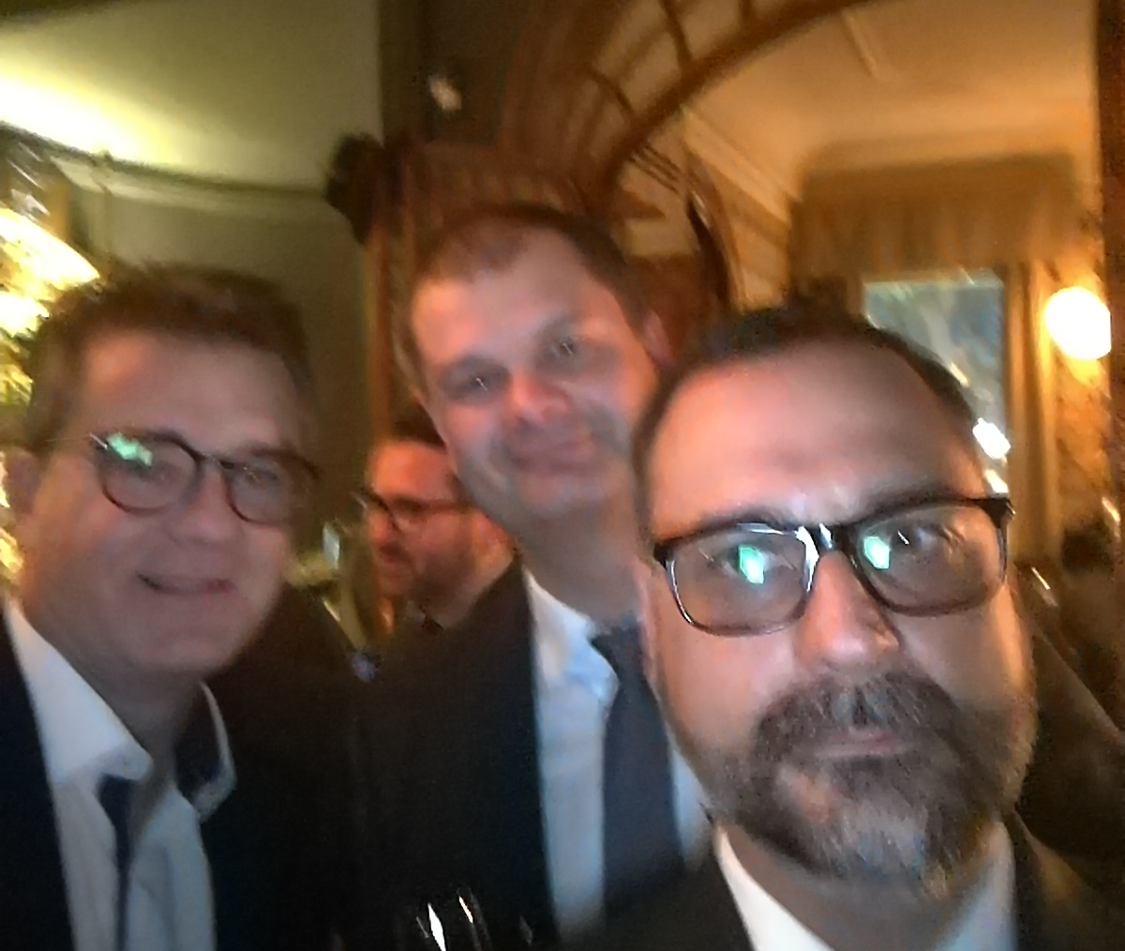
THANKS !!!!
Belliato 2019

