Slide 1

Turkish Perfusion Symposium
November 8-10th, 2019
Patricia Fanelli MT, CCP
Chief Clinical Officer
Comprehensive Care Services Inc.
Plymouth, Michigan, U.S.A

Slide 2

Patricia Fanelli MT, CCP
Chief Clinical Officer at Comprehensive Care Services
Nation’s Largest Perfusionist Owned and Operated “Perfusion & Extracorporeal Services Provider”
Currently Servicing over 150 Cardiac Hospitals in 18 States
Support over 60,000 Surgical procedures annually and over 75,000 hours of ECMO patient Monitoring annually (2018)
Over 450 Clinical Staﬀ Nationwide
Read more reviews:
www.linkedin.com/in/patty-fanelli-35459876
Comprehensive Care Services

Slide 3


Transforming Clinical Perfusion practice into a "High Reliability Organization."

Slide 4
What is a High Reliability Organization (HRO)?
High reliability organizations (HRO) are organizations that operate in complex, high-hazard domains for extended periods without serious accidents or catastrophic failures
Organizational culture and processes that radically reduce system failures and effectively respond when failures occur
100%
Reliability

Slide 5



Classic Examples of High HROs
Aircraft Carriers
Nuclear Power Plants
Air Traffic Control
“Flight operations at sea is the closest to the ”edge of the envelope” – operating under the most extreme conditions. In the least stable environment…”
“With nuclear power, the energy density makes the potential hazard obvious….”
“Air traffic controllers play a “high stakes three-dimensional chess game” every day.”

Slide 6

Do We Qualify?
HROs share extremely high degrees of responsibility on the individual and collective skills of the human operator.
"PERFUSIONISTS”
“How many times could this operation [Pump Run] have failed with catastrophic results and it did not fail?”

Slide 7
Healthcare needs High Reliability Organizations
“High reliability organizations are organizations (HRO) with systems in place that make them exceptionally consistent in accomplishing their goals and avoiding potentially catastrophic errors”
-Quint Studer
Notes:
Why?
Because........

Slide 8
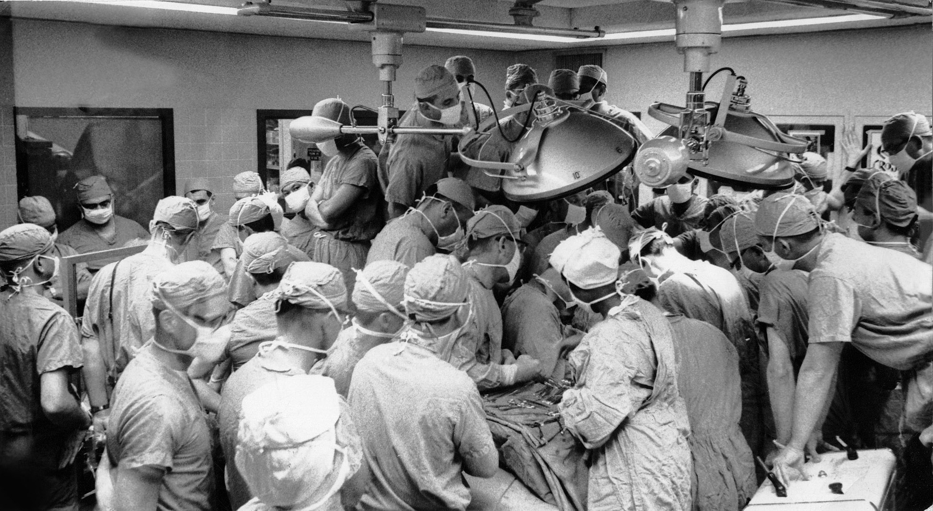

What Is a High Risk Organizational Environment?
*Hypercomplex
*Interdependent Teams
*Extreme Hierarchical Differentiation
*Multiple Decision Makers in Complex
Communication Network
*Need for Frequent Immediate Feedback
*Compressed Time Constraints
NOT Performing well in this industry can have “FATAL’ results
PERFUSIONIST WORLD?????

Slide 9


5 traits of high reliability organizations What makes an HRO
an HRO?
Notes:
If we want to classify ourselves as a “High reliability Organization” than we need to understand there characteristics

Slide 10
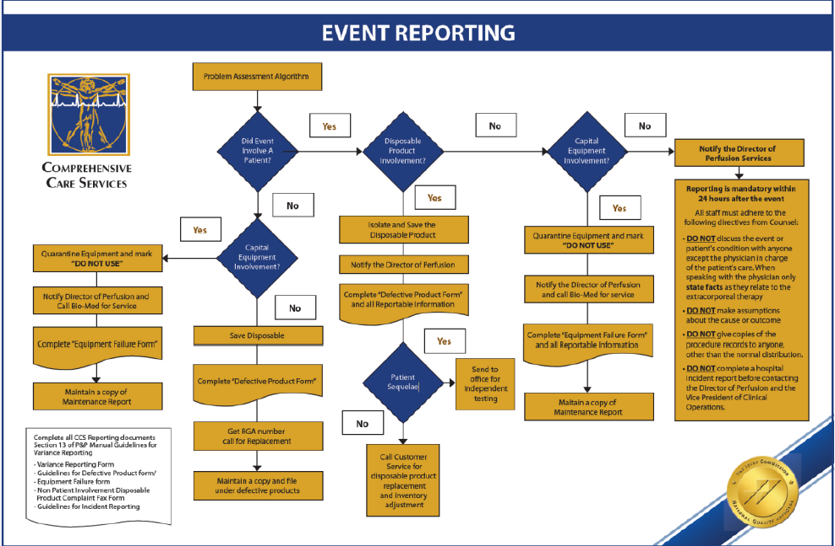
#1 Preoccupation with Failure
For HROs errors and failures are high value opportunities
HROs focus like a laser on failure: they give “continuous attention to anomalies that could be symptoms of larger problems.”
Everyone in the Department is focused on errors and near misses
  Learn from them
  Figure out how to prevent recurrence
Finding and Fixing problems is “EVERYONE’S” responsibility
Chief Perfusionist supports and encourages this approach

Slide 11
“The absence of errors or accidents leads not to complacency but to a heightened sense of vigilance for the next possible failure”
Agency for Healthcare Research and Quality

Slide 12


Perfusionist should be encouraged to report errors and near misses
Challenge: Fear/Shame reporting errors
Notes:
The challenge in Healthcare

Slide 13
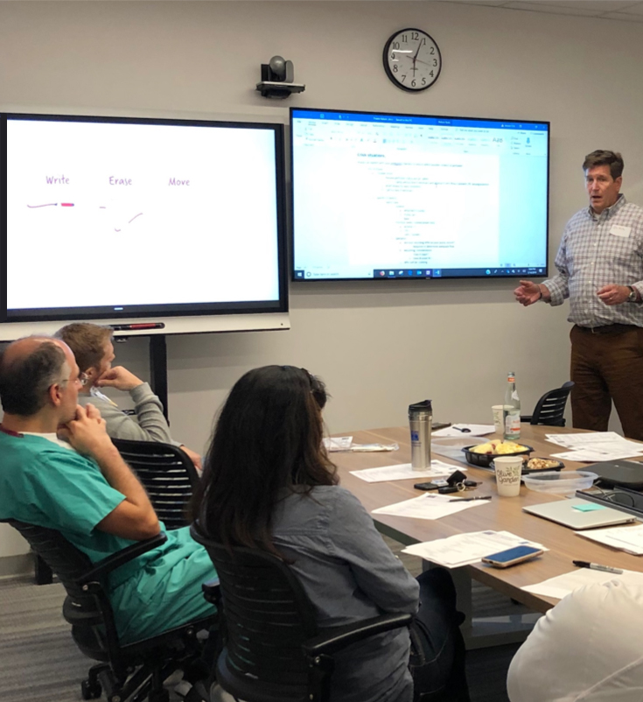
#2 Reluctance to Simplify
HROs do not oversimplify the reasons
for failure.
Track all failures large and small
Restrain temptations to simplify through checks and balances, reviews, and multiple perspectives…root cause analysis
Don’t cut corners

Slide 14
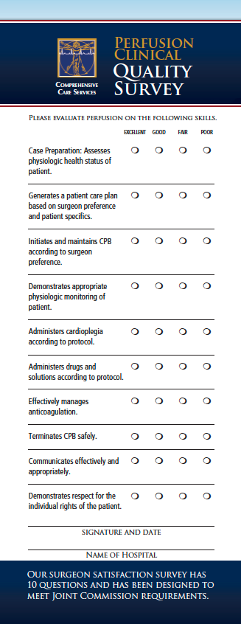
#3 Vigilance/Sensitivity to Operations
HROs do not assume that the continuous outcomes will be the same as planned, assumed, or hoped for.
Pay close attention to operations and maintain awareness of what is and isn’t working
Don’t make assumptions
Ask questions
Use data to make decisions and track outcomes

Slide 15
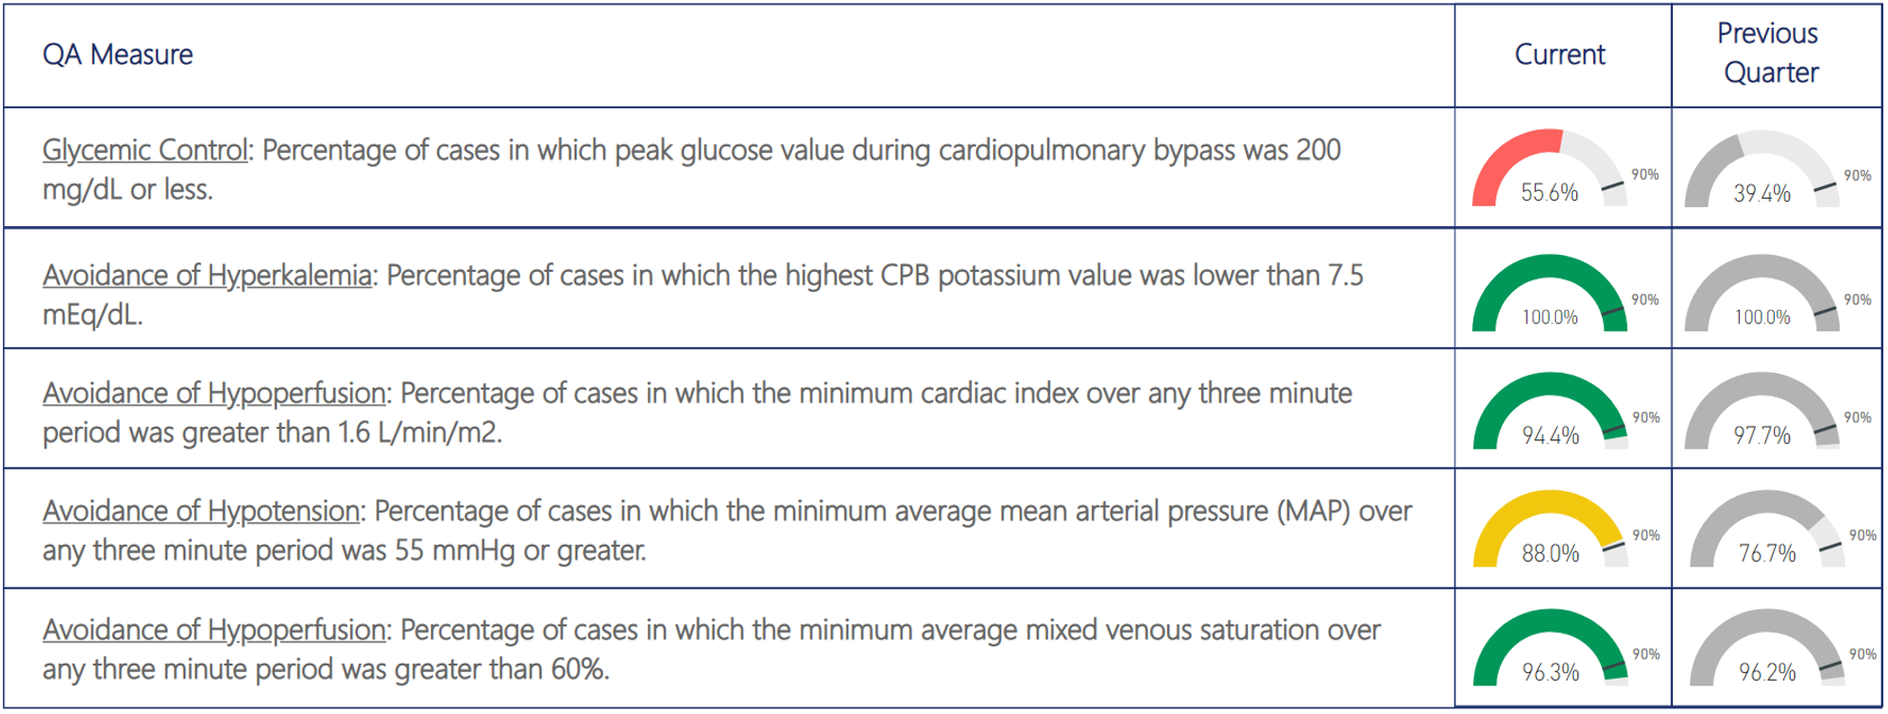
Comprehensive Data & Compliance Analytics

Slide 16
Communicate, communicate, communicate:
Integrate frontline team practices that improve communication.
How? Team meeting, Pre-procedure briefs, debriefing and Structured handoffs

Slide 17
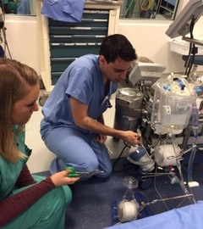
#4 Commitment to resiliency
Imagine for every possible scenario and train for it
All personnel must know how to respond
to failures
Sensitivity to operations’ ability to recover from adverse incidents
TRAIN-TRAIN-TRAIN

Slide 18
“The Hallmark of an HRO is not that it is error-free but that errors don’t disable it.”
Managing the unexpected; sustained performance in a complex word,
Weick KE, Sutcliffe KM

Slide 19
Emergency management/white boarding/ simulation practice practice practice

Slide 20
#5 Deference to expertise
ADULT
ECMO
Expertise, rather than authority, takes precedence in an HRO.
When conditions are high-risk, and circumstances change rapidly, on-the-ground subject matter experts are essential for urgent situational assessment and response.
TRANSPORT
PEDI ECMO
ECLS
Leaders must identify who in the organization has what specialized knowledge
These experts help other employees develop their skills and keep them up to date
VAD
NEONATAL ECMO

Slide 21
”…people in HROs know that in a crisis or emergency the person with greatest knowledge of the situation might not be the person with
the highest status and seniority.”
Agency for healthcare research and quality

Slide 22
Challenge: Organizational hierarchy Surgeons, Directors, Perfusionists, Fresh Grads, Students.

Slide 23
Error management
Mitigate
Trap
Avoid
Notes:
How do HRO’s focus on Error Management
Avoid – 2 person checklist / Safety devices / up to date Policies and procedures
Sterile cockpit – during bypass limit distraction and interruptions NO CELL PHONES!
TRAP – 2 person verification– Blood administration policy
verify action – repeat back to the surgeon
MITIGATE – Train for all senarios Emergency management program –white boarding / simulation / and reporting mechanism near misses to learn from situations!

Slide 24

Event
Policies and Procedures
The Swiss Cheese Model
Culture
Individual
A System Model of
Accident Causation
Technology
Unclear policies
Poor standardization
Used in Risk Analysis and Risk Management
Communication failure
Staffing shortages
Overconfidence
Distractions
Complacency
Inadequate training
System
failure
Poor maintenance
Clumsy technology
Notes:
The Best way to explain how an error occurs was done by James Reason in 1997 using the “Swiss Chees Model”
Each slice of swiss cheese represents a protective barrier
These barriers help to prevent errors and keep patients safe
Within each barrier are holes constantly opening and closing
Example: policies don’t cover everything, an individual may get distracted or interrupted during a critical time during bypass
You know where I’m going with this
When there is momentary alignment of holes we have a system failure!

Slide 25
An example
Traveler covering at Hospital due to staffing shortage
Running late traffic issues
Does quick checklist – NO 2 man checklist @
this hospital
When he checks O2 line ball on regulator doesn’t drop (un noticed)
Goes on bypass high CO2, turns up sweep CO2 continues to go up
Checks everything over and over again, cannot find a problem
CO2 80’s notifies surgeon he has to change out
the oxygenator
One last look and finds a 2nd gas filter on the outlet of the Forane regulator
And it was cracked

Slide 26
Build your safety management systems
With the understanding that:
Safety is everyone’s job
Embedded at all levels Top down
Humans are fallible
System defenses need to be designed / redesigned to protect patients with continuous improvement and active engagement of staff across
the organization
Culture of
Safety
Notes:
Hardest thing when you are building your Safety management system is to build a CULTURE of safety!

Slide 27
How does your Perfusion Department become a “High Reliability Organization?”
Updated Policies and Procedures
Yearly Competencies
Strick compliance on Maintenance of Equipment
Use of all Safety Devices at all times
2 man Checklists
Yearly Audits of program
Sentinel Event and Incident reporting mechanism
Compliant comprehensive Pump Record
Education/Training/In-services is Mandatory
Communication – Communication - Communication
Quality and Safety Meeting
Leadership Training
Develop a strong “Culture of Safety”
Comprehensive Emergency Management Program

Slide 28

Process Improvement
IMPROVE is a home-grown acronym that frames process improvement
*Identify the problem
*Measure the problem
*Problem analysis
*Remedy selection
*Operationalize the remedy
*Validate the results
*Evaluate the results over time

Slide 29
If you do nothing else you must have:
“Comprehensive Emergency Management Program”

Slide 30
Emergency Management Program
Set Goals:
A Successful program:
100% success rate for each simulated scenario
Improved comfort and familiarity with new devices
and/or procedures
Uniform communication in the event of
a crisis situation
Multidisciplinary planning and development of each mock scenario
Assessment metrics to define success or failure
Dedicated non-clinical time for perfusion personnel to develop, implement, and improve the Perfusion
Simulation Program
Mandatory participation from all perfusionists on an annual basis
Failure is intended to identify correctable gaps in knowledge or procedural skill and to ensure a uniform response in high risk situations

Slide 31
Examples of some scenario’s
Massive air embolism
Oxygenator failure/Oxygenator Changeout
Mechanical failure-Arterial pump-head changeout
Quest CPS failure (if used)
ECMO
Air management
Circuit clot/change
Cannula migration
Power failure- Hand crank use
Misplaced or migrating Aortic Cannula
Medication errors
(unlabeled, expired drug error)

Slide 32
“We cannot change the human condition.
But… we can change the conditions under which humans work.”
James Reason
Notes:
Failure is inevitable – we are all fallible. Countermeasures are based on the idea that "we cannot change the human condition, but we can change the conditions under which humans work”.

Slide 33


Personal Approach
vs. System Approach
Personal Approach
System Approach
Focuses on the unsafe acts
human failure
There must be someone “responsible”, or someone to “blame” for the failure
Errors seen as consequence not cause
Aim to build defenses
and safeguards
Notes:
HROs take you from a Personal Approach to a Systems Approach
Moving from a Person Approach to a System Approach to failure helps move from ‘blameworthy’ to ‘blameless’ failure, and learning opportunities.

Slide 34
Statutory Compliance
Error
Management
Failure is an
opportunity
Refrain from Simplifying
HROs are committed to
excellence
Quality and Safety
Vigilance /
Sensitivity to
Operations
EM and
Deference to Expertise
Regulatory Adherence
Process
Improvement

Slide 35

Thank you
Comprehensive Care Services Inc.
31330 Schoolcraft R Suite 200 Livonia, MI 48150

