Slide 1
Perfusion Information Management Systems: Quality, Safety, Compliance and Clinical Decision Support Engines

Slide 2
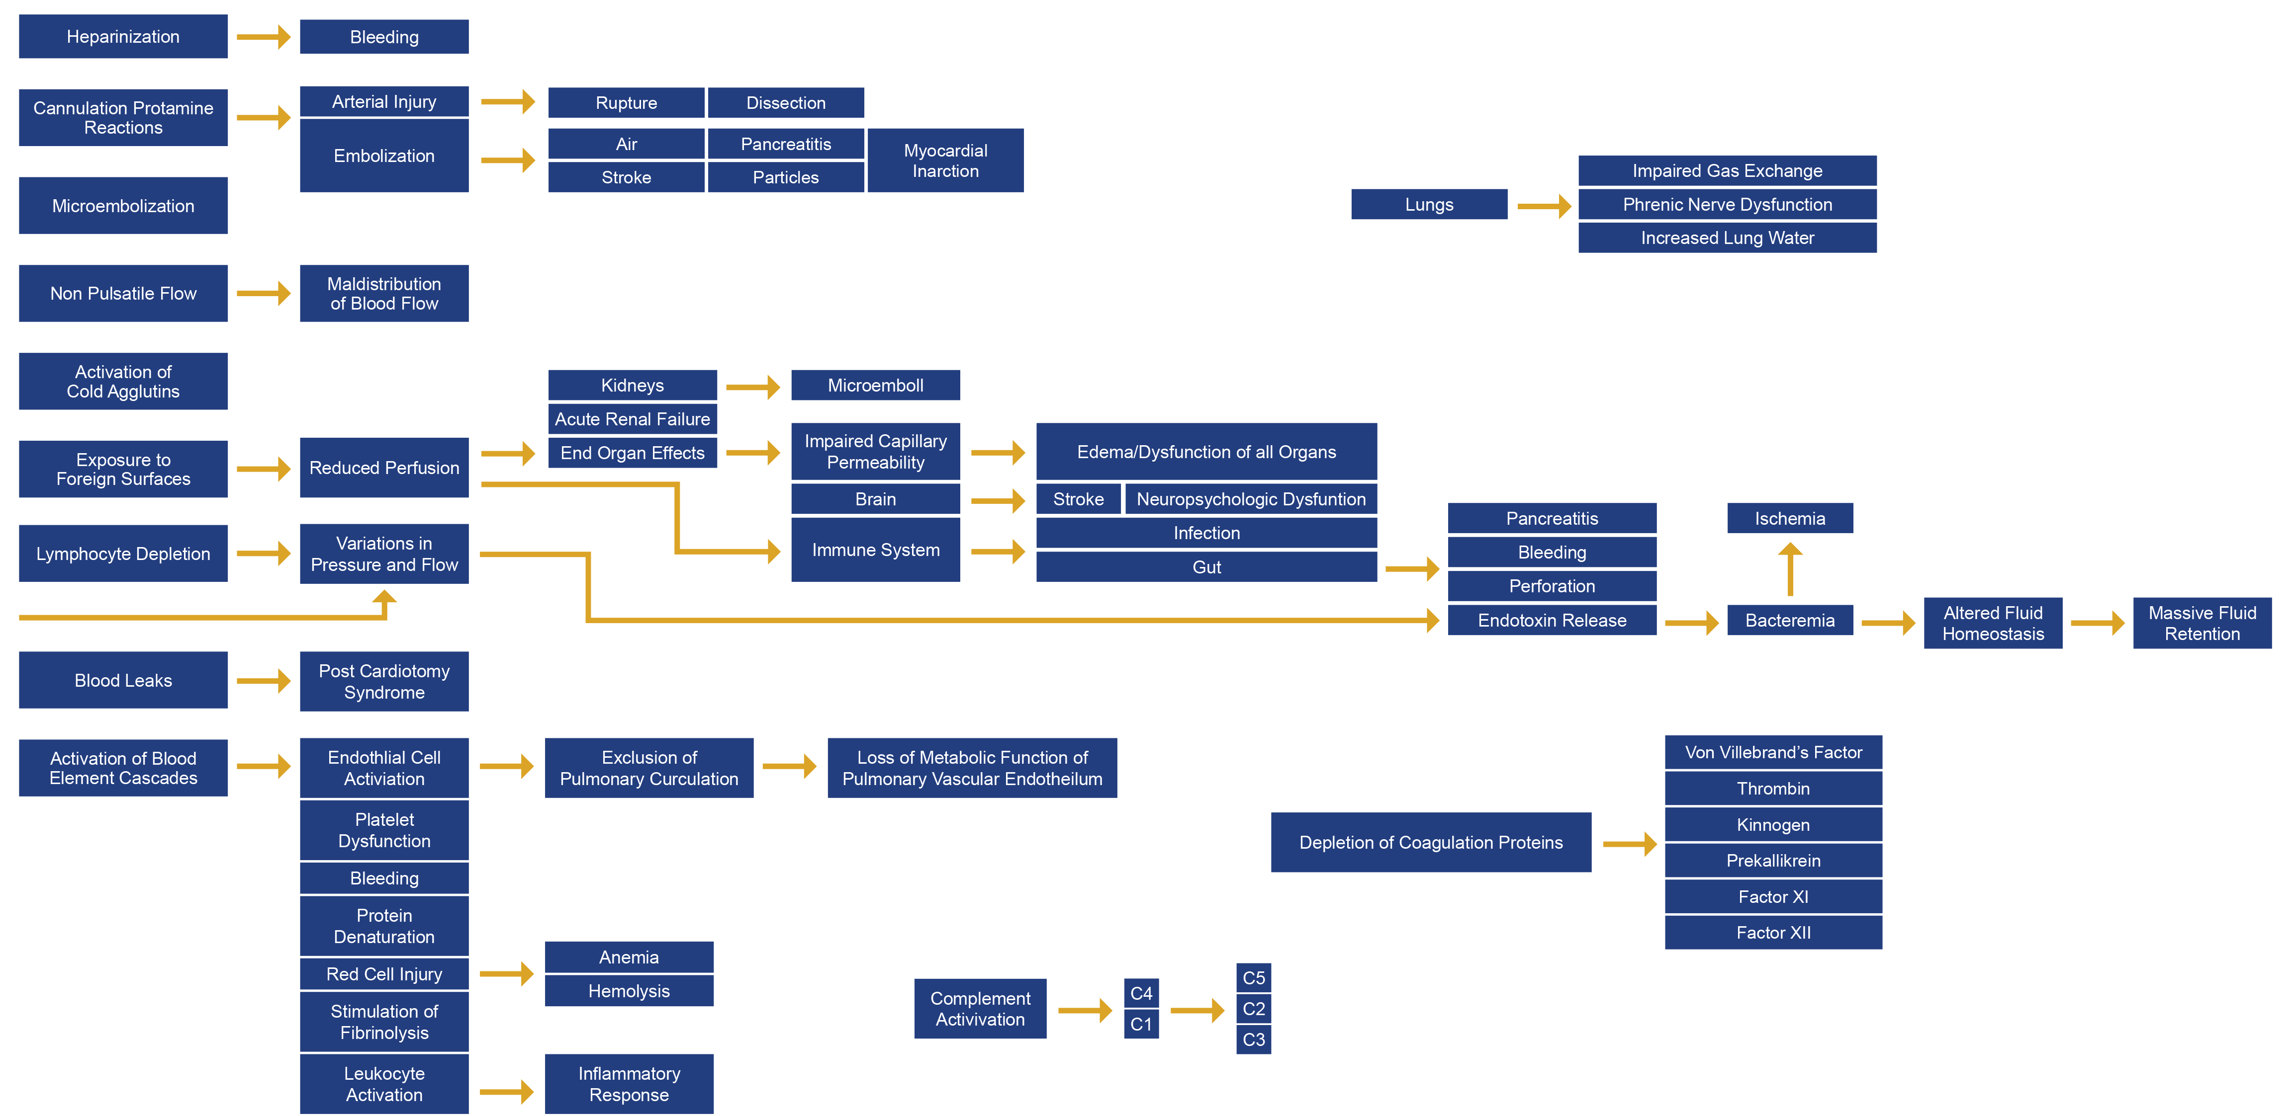
EXPLOSIVE EFFECTS OF BYPASS
Notes:
We all know the explosive effects of bypass but see them in a diagram is very powerful. For the last 60 years we have studied the effects of Cardiopulmonary Bypass on the body.

Slide 3
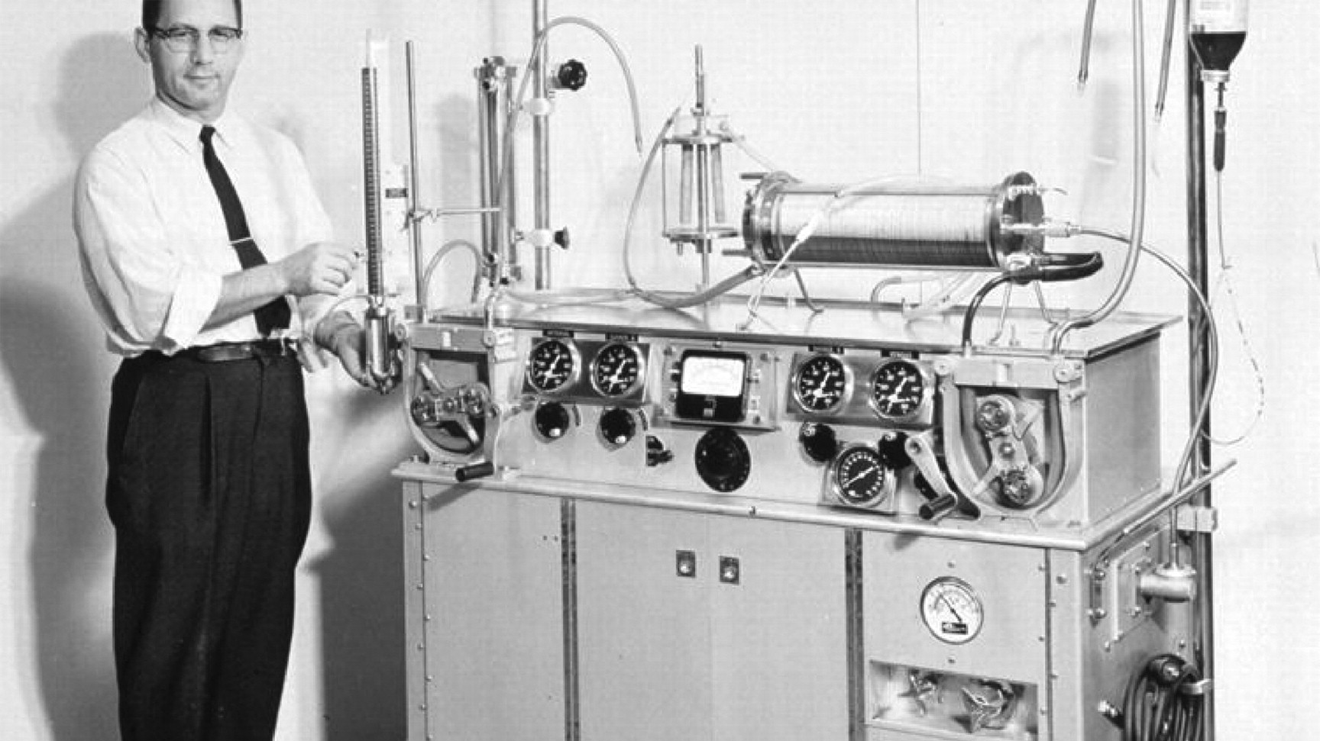
21st Century of Extracorporeal Circulation
Notes:
We have come a long way since the first. successful human-heart surgery assisted by a heart-lung machine. 1953: __Philadelphia surgeon John H. Gibbon Jr. We have revolutionized the HL machine over the last 60 years

Slide 4
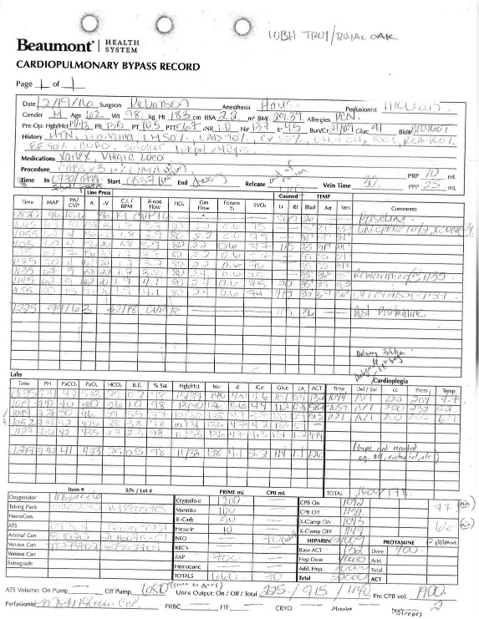
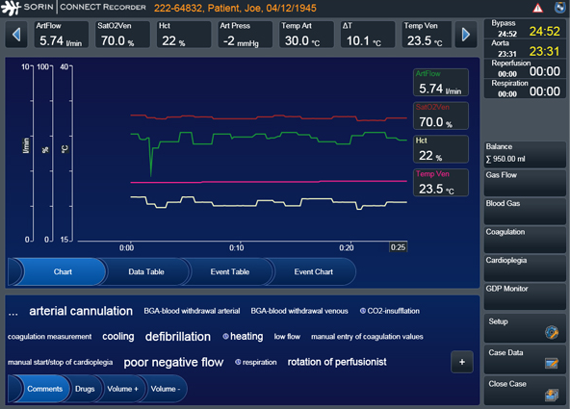
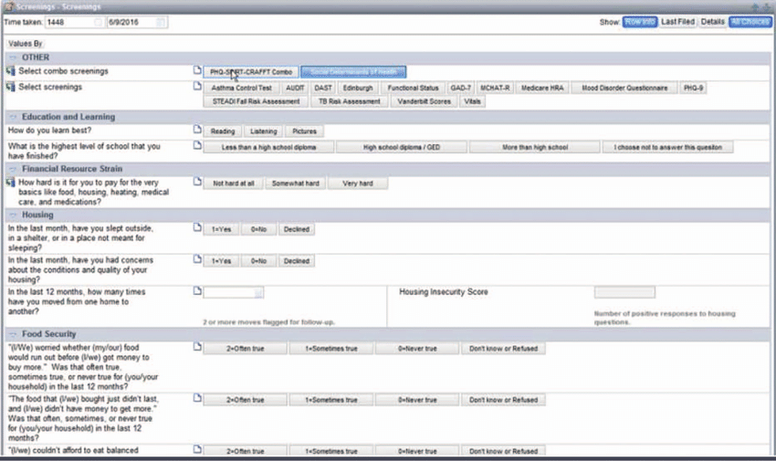
Improvements vs Innovation Innovation
Paper
Epic
Connect
Notes:
So 0ne might ask themselves WHY in this day and age are we still paper charting
Paper chart are inaccurate, error prone, unorganized and provides 0 discrete data. The perfusionist has to fill in all vital and device data manually and it take our focus away from the patient. This is analogous to texting and driving. Texting and driving is dangerous on the road. Taking a perfusionists focus away from the patient is dangerous in the OR.
click - EHR EPIC
Epic offers little automation. Everything has to be customized to that account with little automation. And does not integrate any other devices into the record
click - Sorin Connect
Only integrates with Sorin devices
Connect does not integrate any other devices in the room into the record

Slide 5
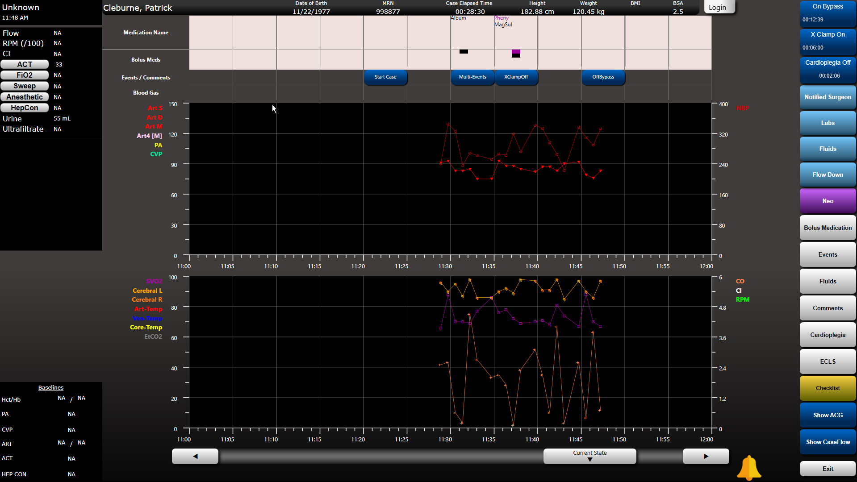
An Enterprise Solution is the Future of Perfusion
Notes:
Enterprise solutions
PIMS provides device agnostic integration.
Are capable of facilitating a care team model of “patient care” from the OR into the ICU in real time
Technology that will allow scalability into the future
Spectrum Viper
Talis Clinical
Not to pit one against the other but I have experience with Talis so I will talk to that

Slide 6
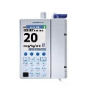
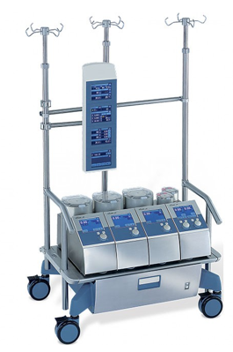
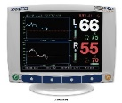
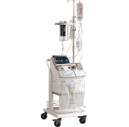
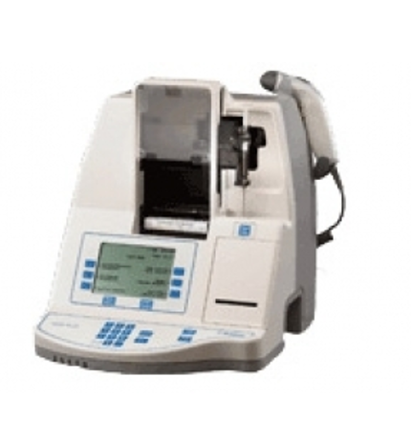
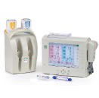
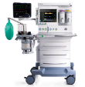
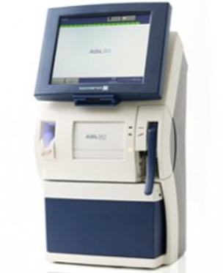
Real time/ Automated Integration with all HIT Systems and all Medical Devices in the Cardiac OR
Connect
Integrate
“Intelligize”
Disseminate
Notes:
So what does that mean Real time /Automated Integration????????
Leveraging Automated Record Keeping (ARK) the ARK-Cockpit automatically pulls and displays information from:
HLM Machines
Physiologic Monitors
Hospital EMRs, Lab Systems, ADTs, Scheduling, Pharmacy and many other bi-directional HIT Interfaces

Slide 7
Enterprise Solutions Designed to Drive Best Practices
Barcode scanning assists facilities
Inventory controls
Inventory controls
Case Entry
Pre-Bypass Checklists
Automated / Smarter
Clinical Documentation
Care Team Clinical Management and Support
Pump Set-up
ECMO & ATS Applications
Data Warehouse
Dashboards and Quality
Reporting Capabilities
Auto-populates a surgery schedule and patient history data from an EMR
Interfaces with lab, pharmacy and decentralized pharmacy systems
Valuable clinical surveillance over multiple ECMO patients
Barcode scanning facilitates supply chain and safety through accurate/rich data capture
PIMS share the data that it
collects with all members of the care team surgeon, anesthesiologist, perfusionist and nurses
OR and into the ICU
2 person Pre-bypass and pump setup checklists and checklists for devices like ATS or VAD
Clinical best practices through alerts and notifications
Ability to house surgeon protocols
PIB care plan
Notes:
These Enterprise solutions are designed to drive Best Practices HOW –
click-It can auto-populate a surgery schedule and patient history data from an EMR.
It can interface with lab, pharmacy and decentralized pharmacy systems.
click- Barcode scanning facilitates supply chain and safety through accurate/rich data capture
click-It incorporates Pre-bypass and pump setup checklists and checklists for devices like an ATS or VAD
click-It serves as a process control tool helping an organization standardize its workflows and clinical best practices through alerts and notifications
It provides constant vigilance over patients through Advanced Clinical Guidance
click- PIMS shares the data that it collects with all members of the care team (the surgeon, anesthesiologist, perfusionist and nurses) to drive improved patient care and safety beyond the OR, into the ICU and across the entire continuum of care
click-valuable clinical surveillance over multiple ECMO patients
click-Dashboards allow an organization to more efficiently use its most valuable operational resources
click- barcoding assists with inventory controls and ordering

Slide 8
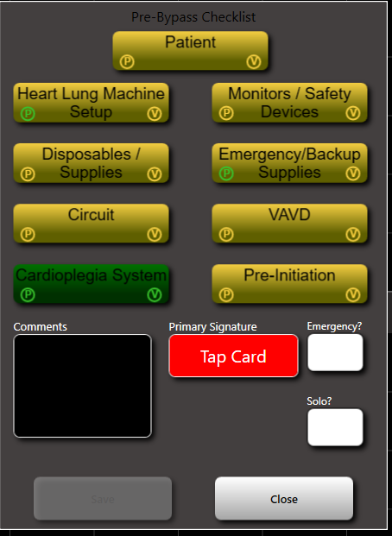
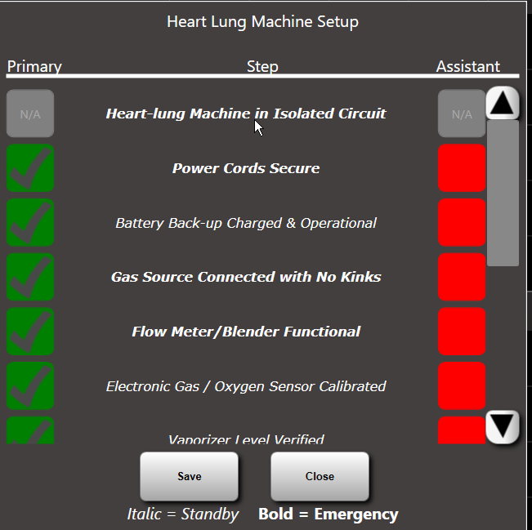
Workflow Checklist
Pre-bypass and pump setup checklists – customizable
Two person read/verify
Color Coded buttons serve as visual status indicators
Yellow incomplete/green complete
Checklist is completed by 2
People one being primary
Perfusionist
Integrated checklists for other ancillary services ATS/ECMO/VAD
Perfusion Safety

Slide 9
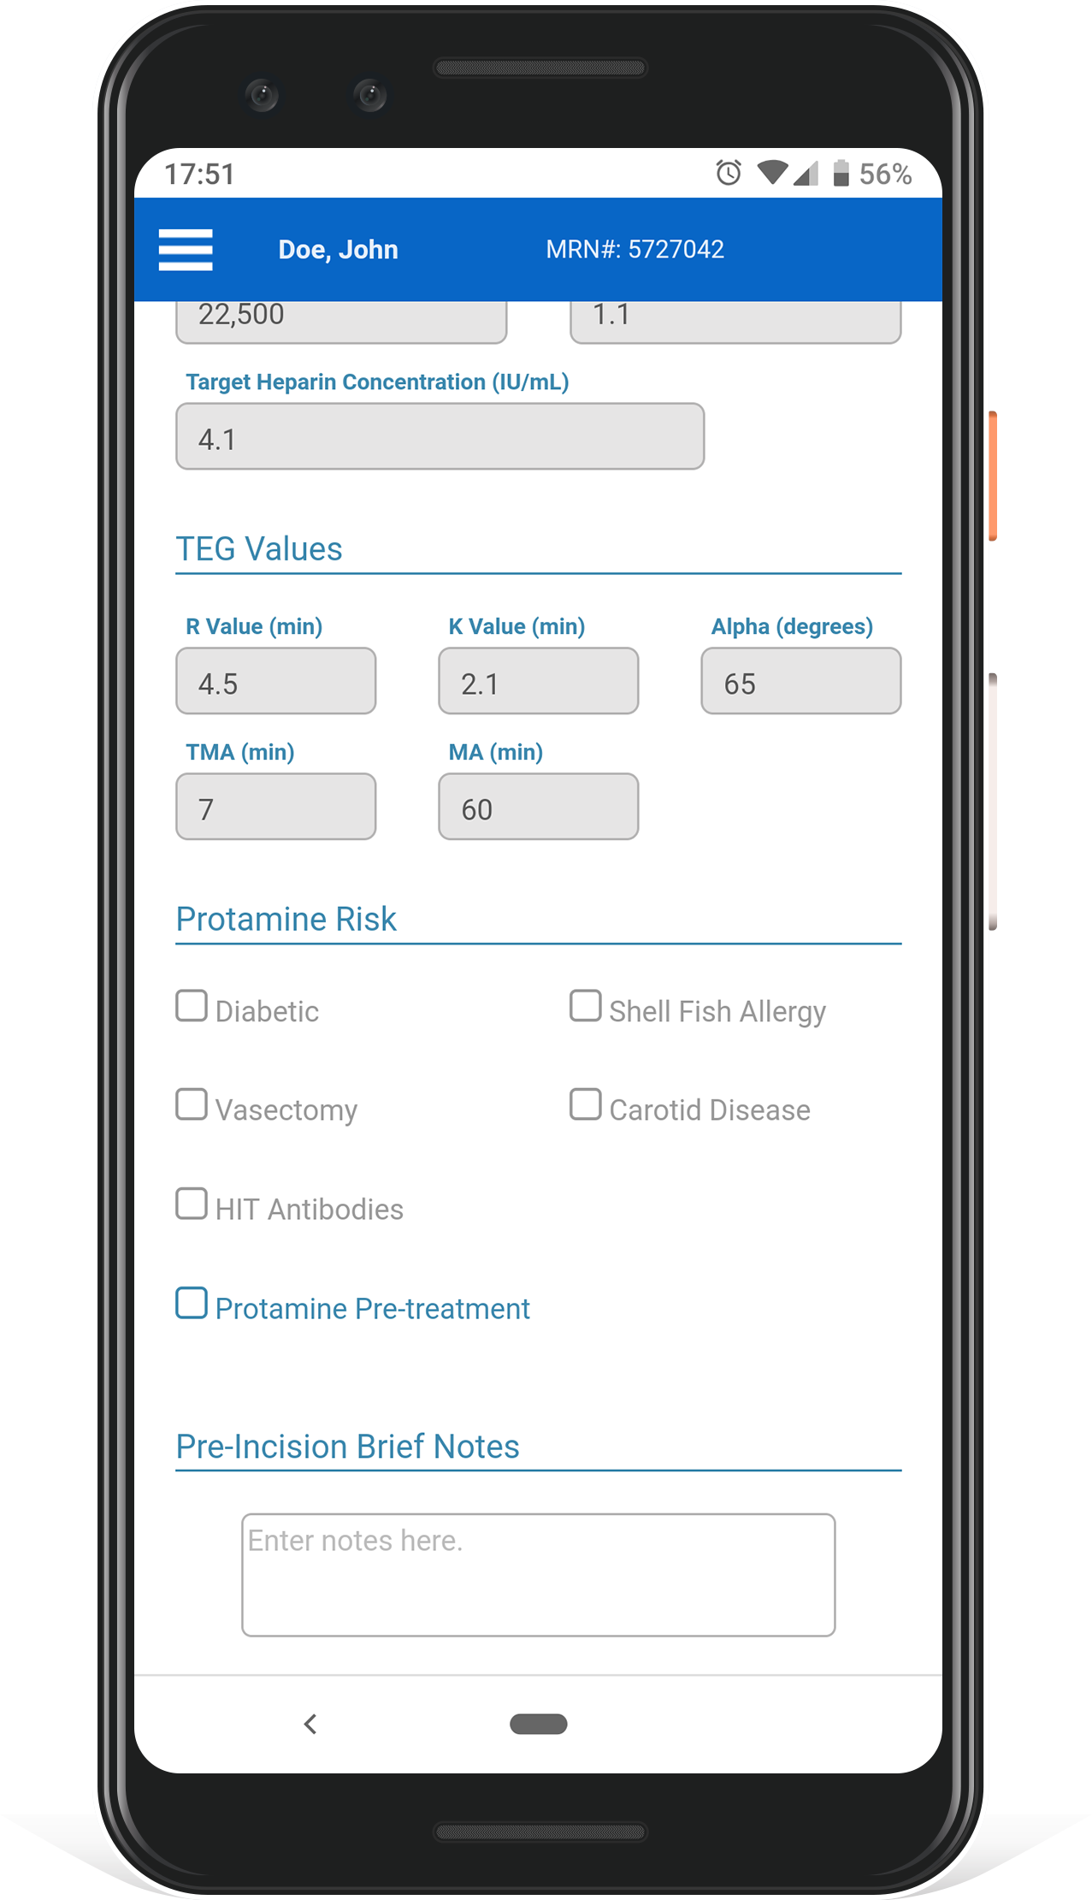
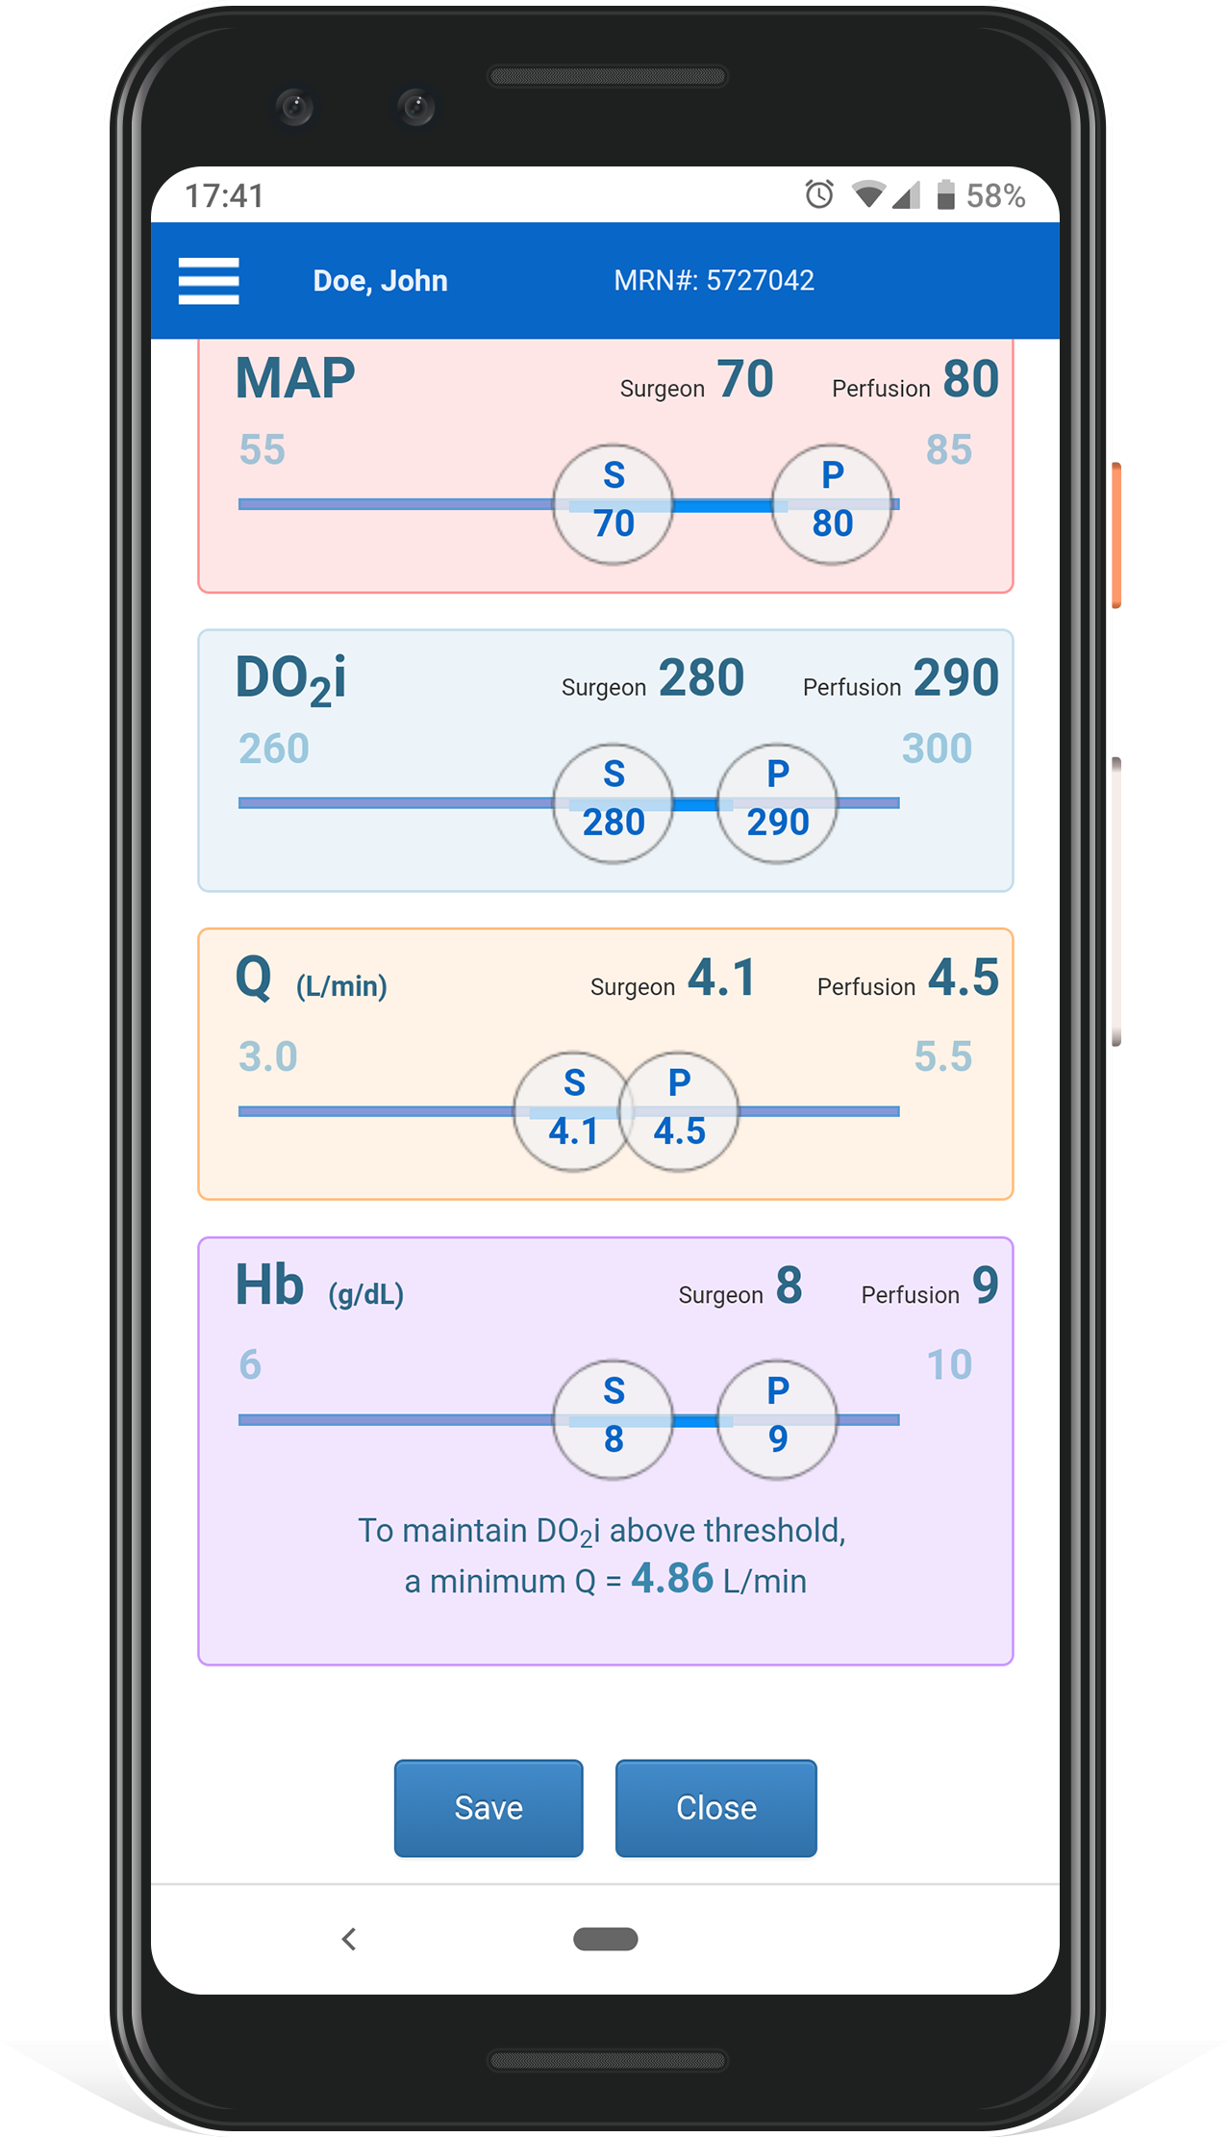
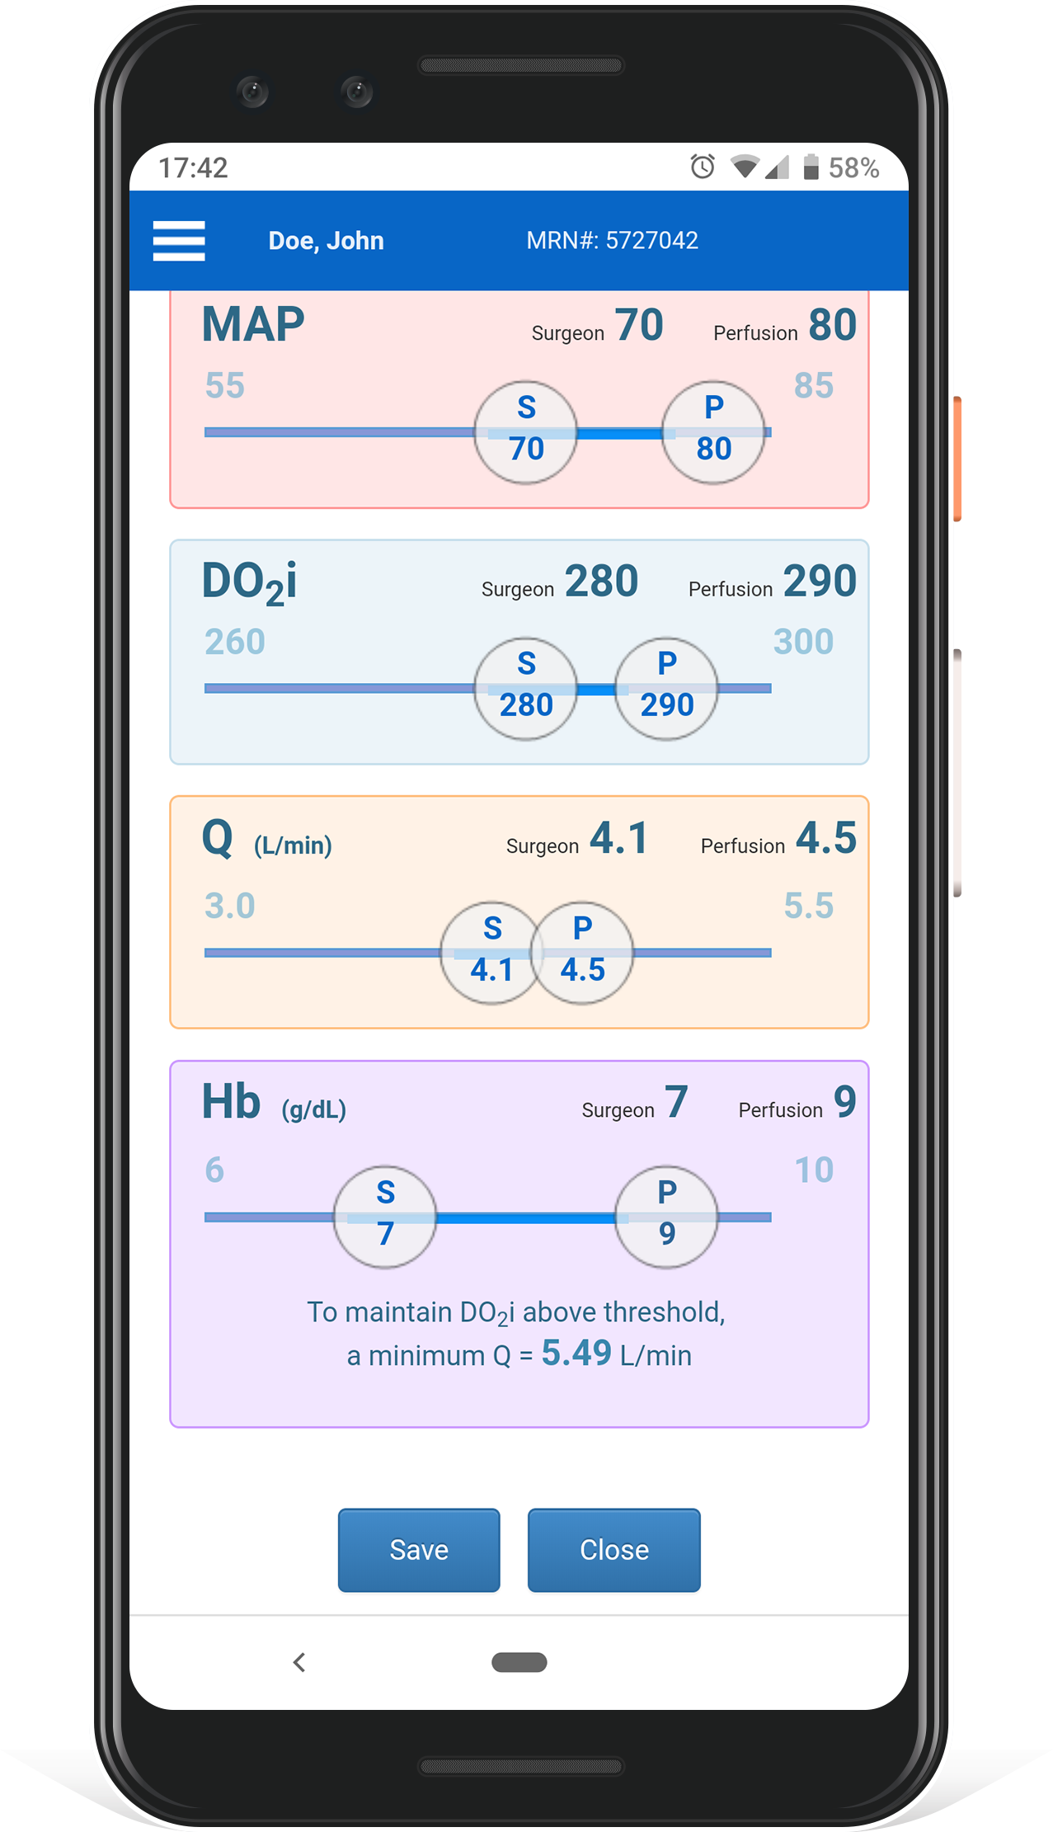
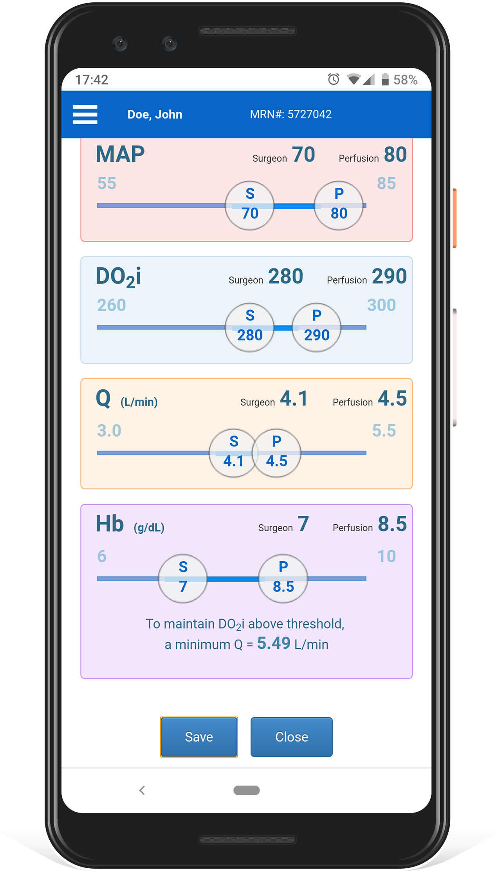
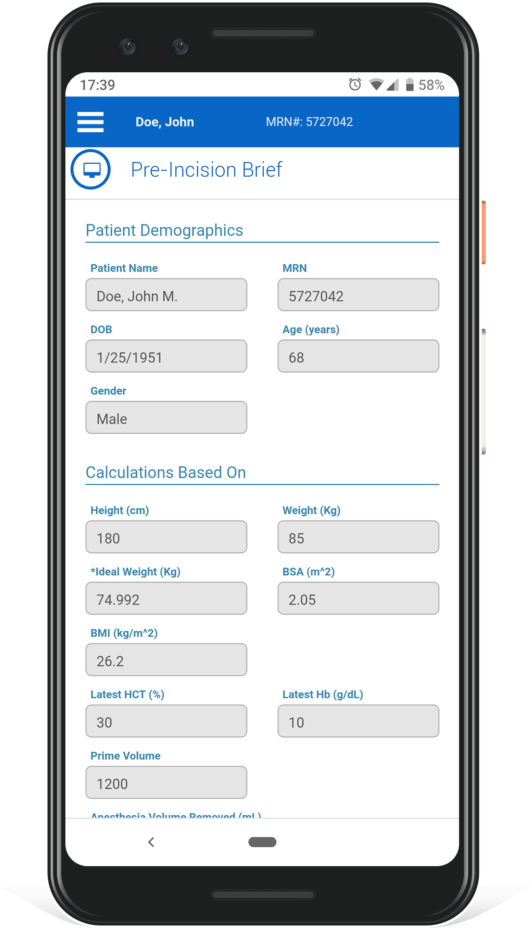
Workflow – Pre-Incision Brief
Demographics of the case are organized on a Mobile or Cockpit View
Critical values automatically calculated
Customizable key PIB variables example: MAP, DO2i, Q, Hb
PIB is defined now “save it” Personalized key parameters are now set with corresponding alerting metrics
Notes:
Click - Demographics of the case organized on a Mobile or Cockpit View of key parameters of the Pre-Incision Brief (PIB).
Click – Critical values that would typically be collected manually and calculated. Instead the PIB automates this process and provides opportunities to further document clinical initiatives.
Click - Screen with 4 key variables MAP, DO2i, Q, Hb. Ideally, every team should set patient specific clinical targets to optimize therapeutic delivery.
-Notice that each parameter has 2 threshold buttons. The required order for the surgeon is in the “S” button and a earlier warning target can be input for the Perfusionist in the “P” button. Both buttons slide to impose alerting metrics.
Click - as you adjust these parameters more intelligence is revealed. For example will I have enough flow “Q” to drive my hemodilution strategy for the patient. Or will flow, get me enough DO2i to properly oxygenate the patient.
Click- Now the order is defined, I “save” it, and then memorialize the personalized oxygenation prescription for the patient.

Slide 10
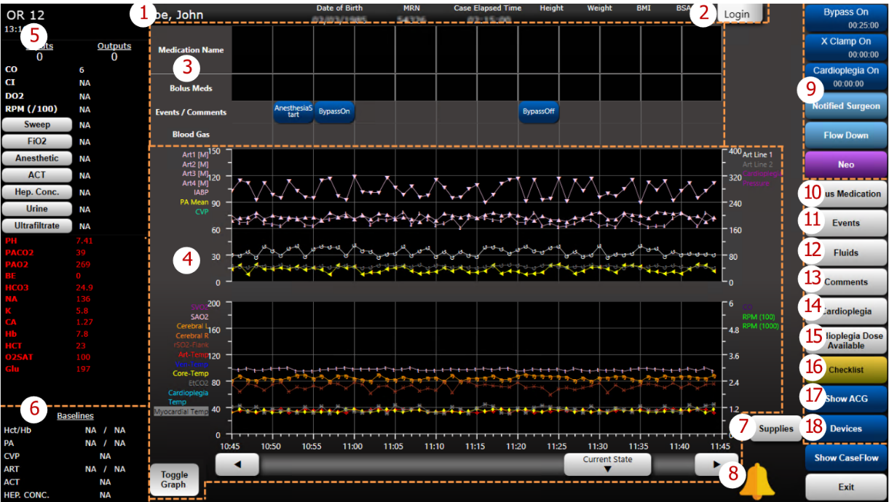
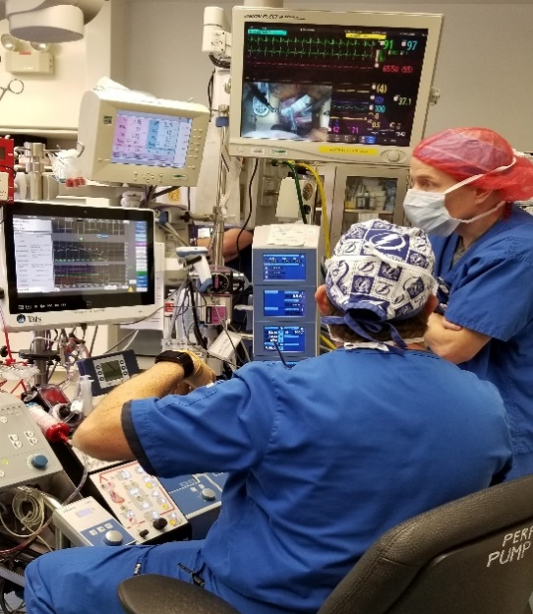
Cockpit Design
Good automation reduces “workload”
Real-time information
Multiple information, integration, displays,
alerts, and notifications all in one place
Decrease distractions
Notes:
Getting closer to the aviation and automotive cockpit design
It was not that long ago when a car dashboard consisted of a speedometer, RPM gauge and an odometer. Keep your eyes on the “GAS” gauge!

Slide 11
“A dashboard is a visual display of the most important information needed to achieve one or more objectives:
consolidated and arranged on a single screen so the information can be monitored at a glance”
Stephen Few
Notes:
Talis Clinical had a team of Perfusionist working on this to advise what data needed to be displayed and how it should be displayed. Our experience is that they make changes quickly to the dashboard when needed!

Slide 12
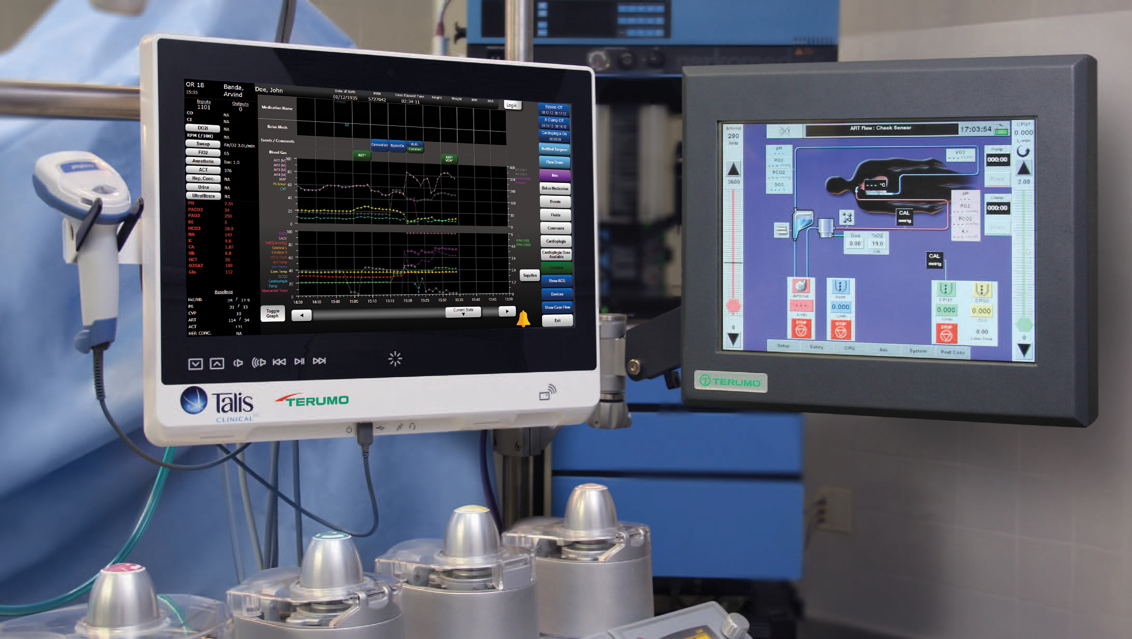
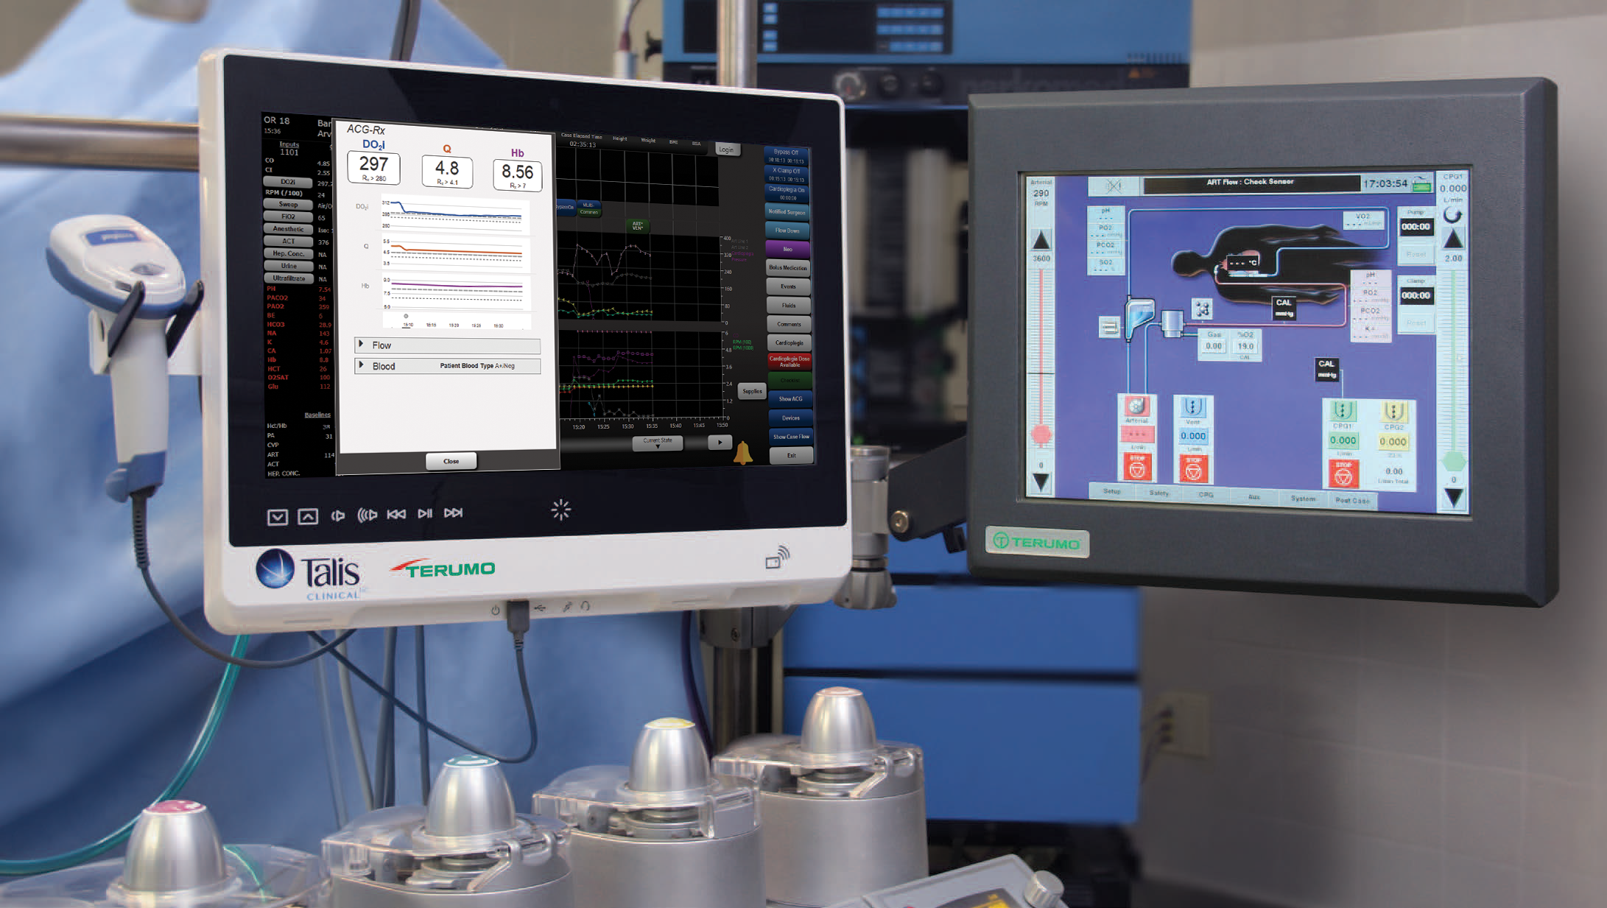
Notes:
Here is another look at the Talis Cockpit display on a Terumo System 1 HLM

Slide 13
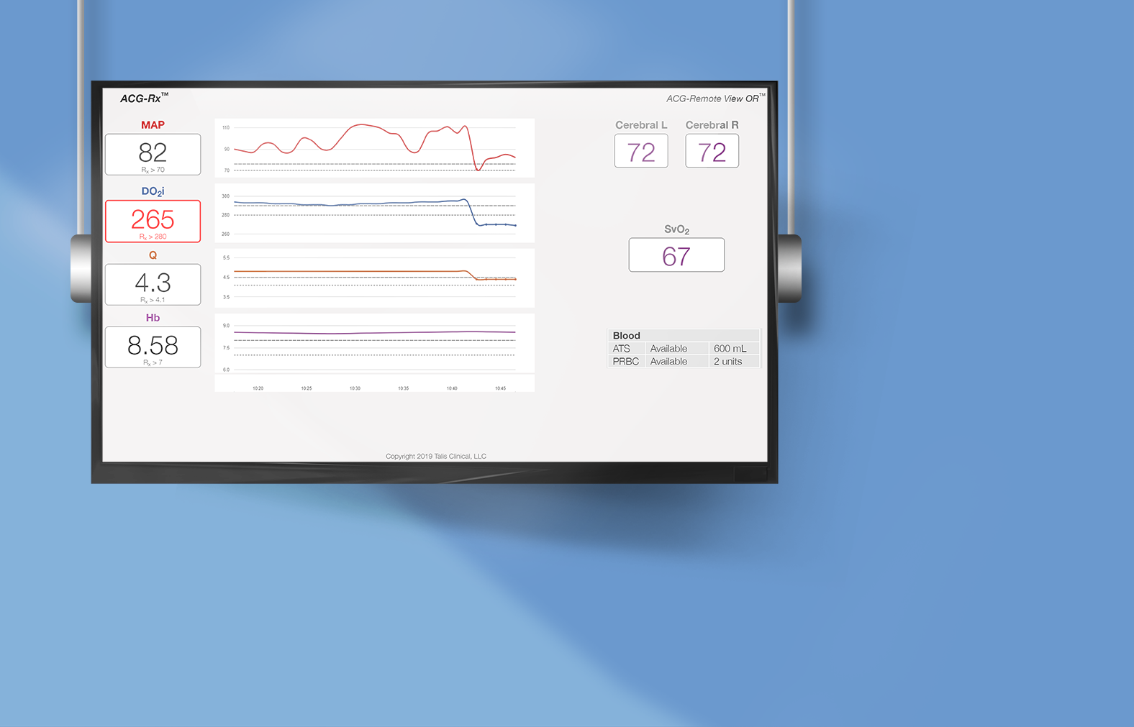
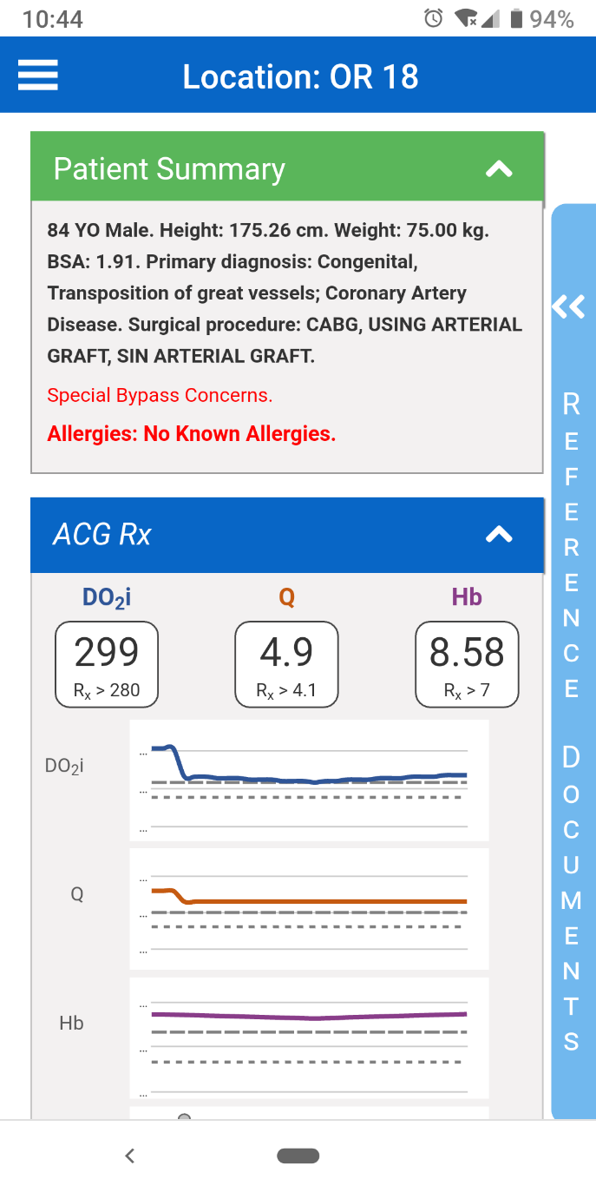
Notes:
Click 1- The entire surgical team can benefit in the OR with a dashboard view of the Prescription. We display the parameters thoughtfully so even the surgeon can look up and see critical information.
Click 2- Outside the OR, supervisors and key supporters can see the encounter view which includes a real-time Prescription update.

Slide 14
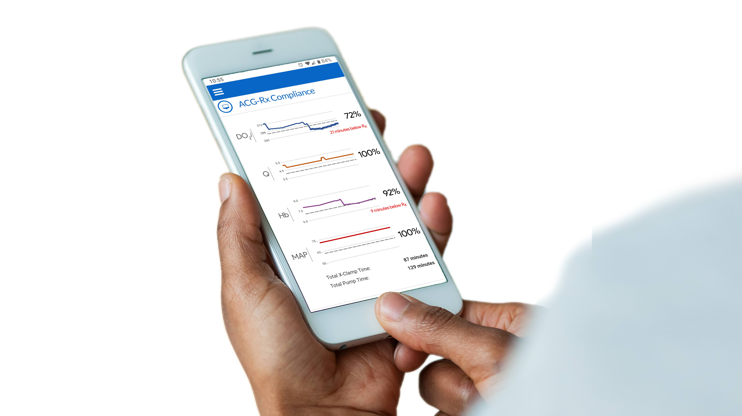
Compliance Scorecard – Handoff Tools
You can view aggregate compliance with a Perfusion Care Plan as soon as a patient is off Bypass
Provide Handoff Tools for ICU and Surgeon
Notes:
At the end of the case the perfusionist can view their compliance with care plan if needed share this with the surgeon and the ICU

Slide 15
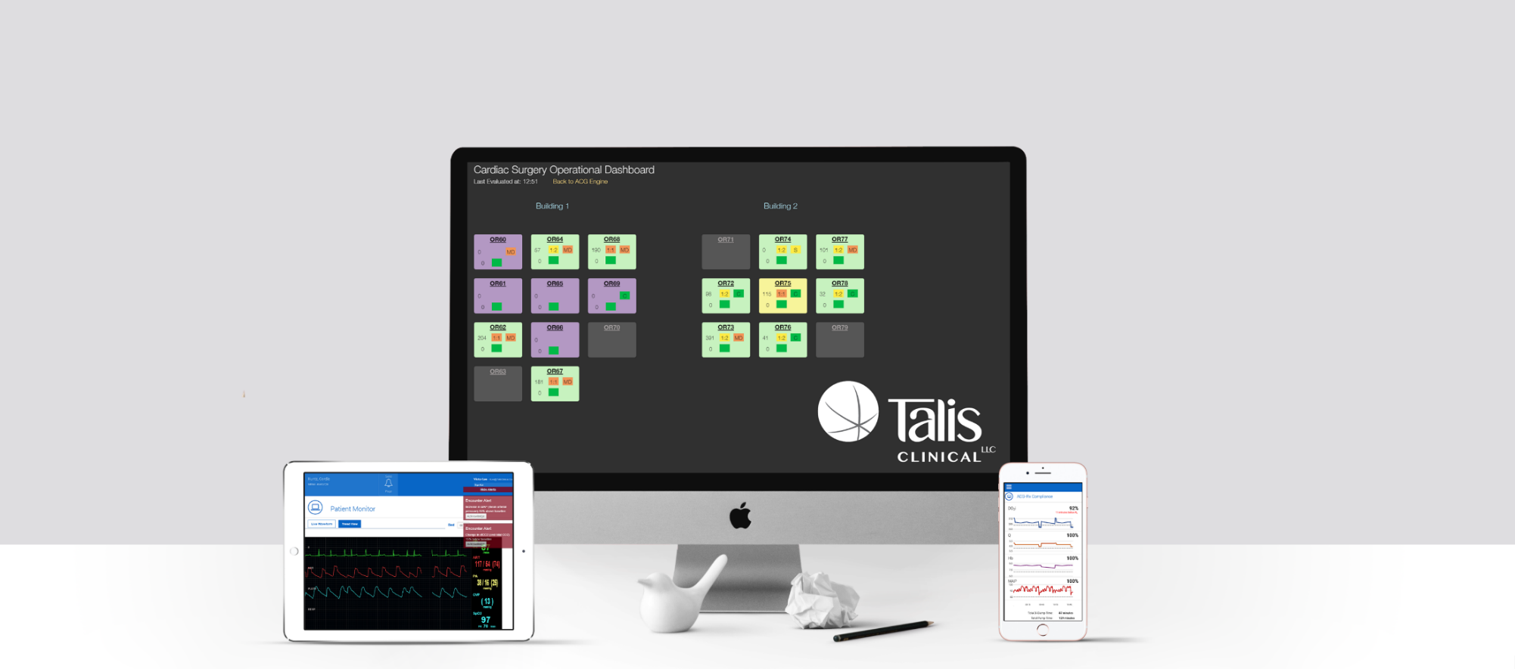
Remote Live View - OR/ICU
Vigilant Surveillance
Real-time clinical information
“Best Friend” not “Big Brother”
Notes:
The Remote Live View allows the clinical team to remotely monitor the patient in real-time clinical information is further enhanced with the alerts and notifications
Remote clinical views expose specific patient conditions in each room, allowing team members access to all available information.

Slide 16
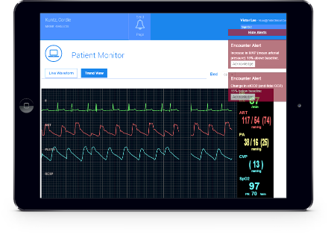
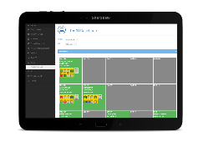
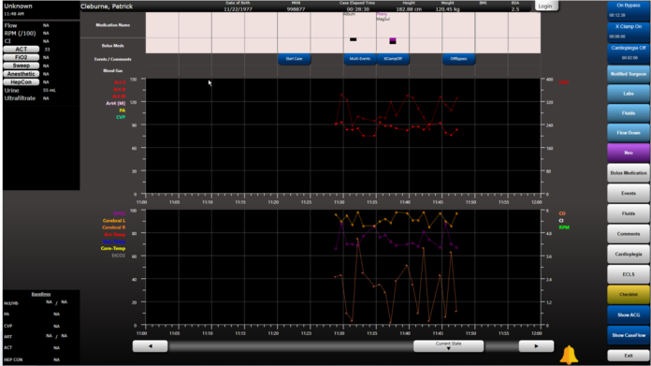
Cloud Based Guidance Engine aggregates patient and procedure information in real-time to generate:
Reminders
Verifications
Smart context based clinical and operational alerts
What is ACG Perfusion?

Slide 17
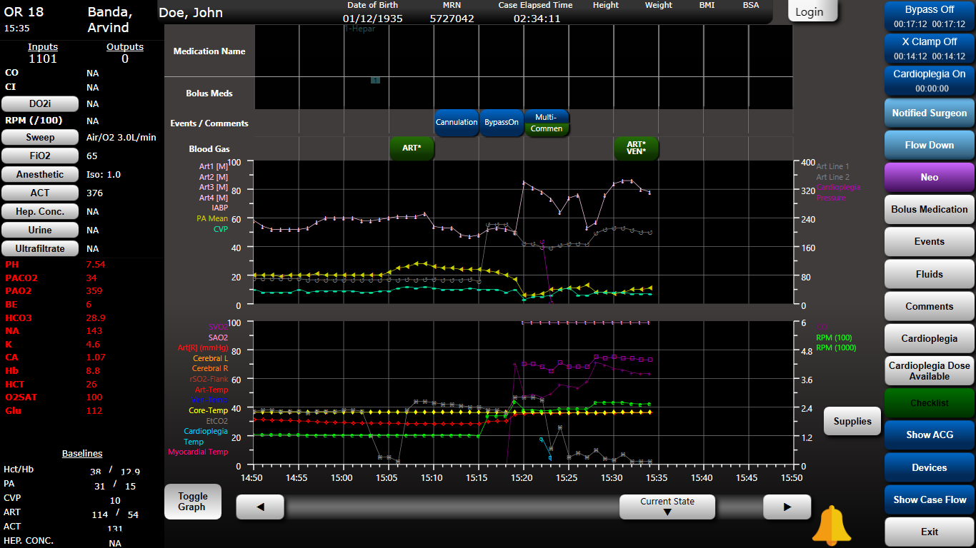
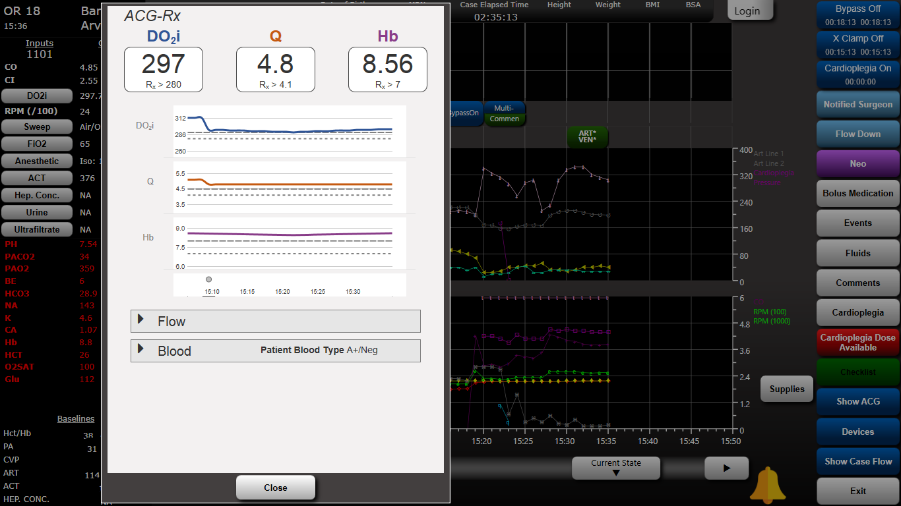
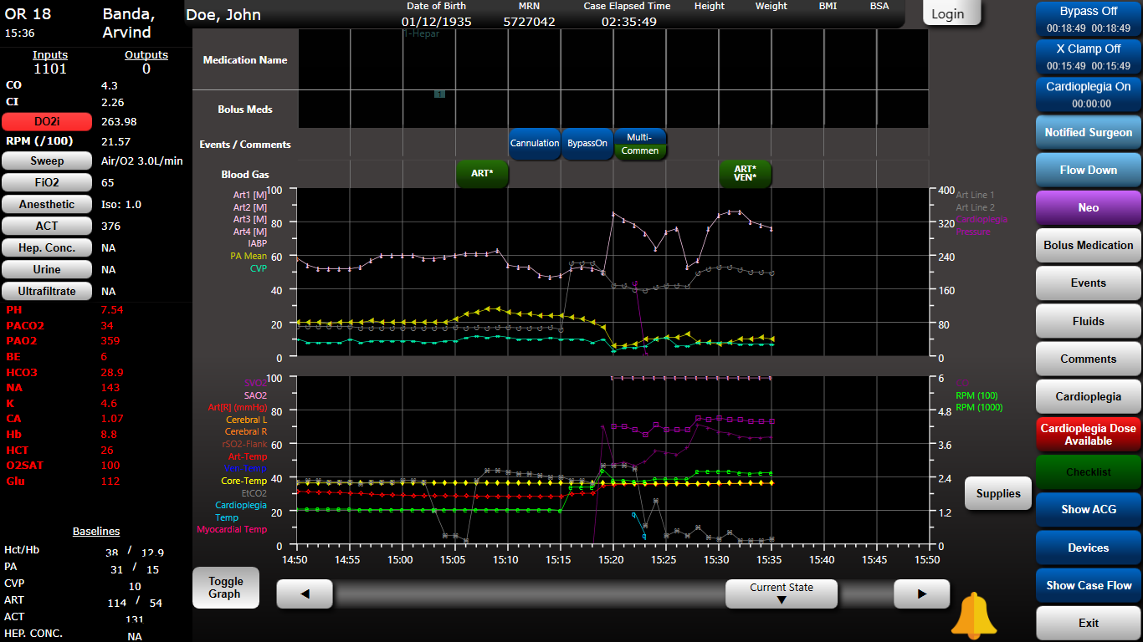
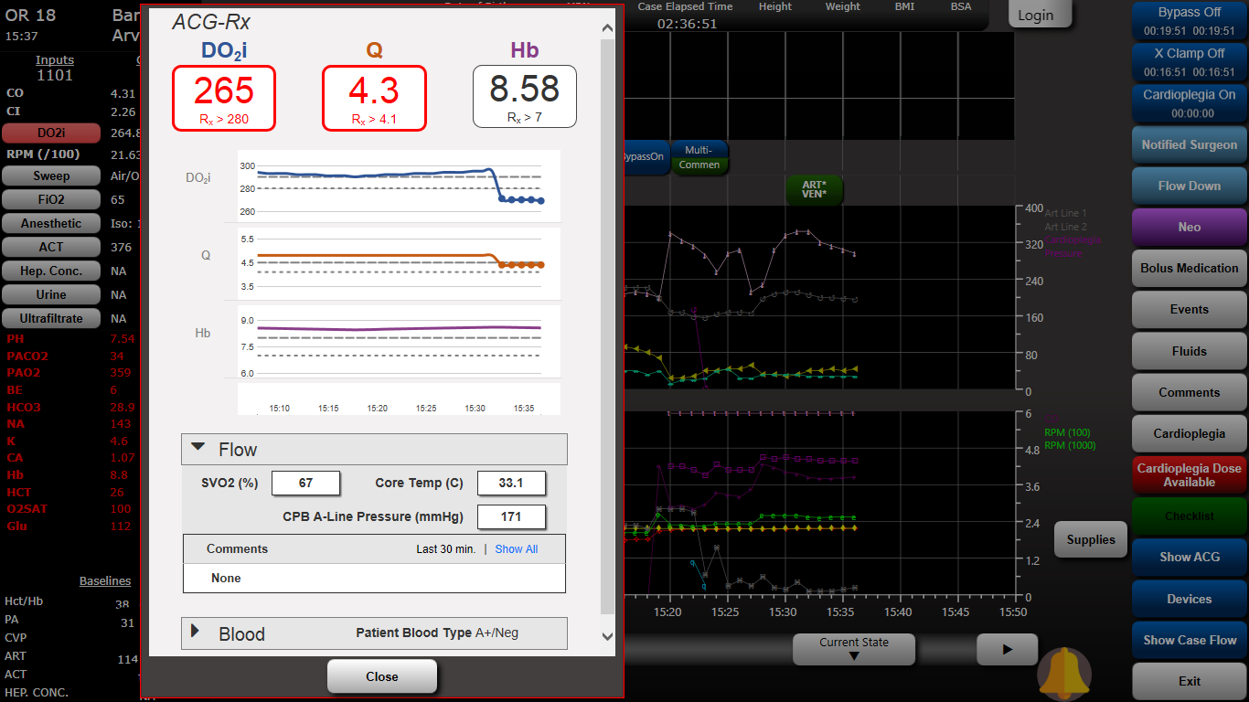
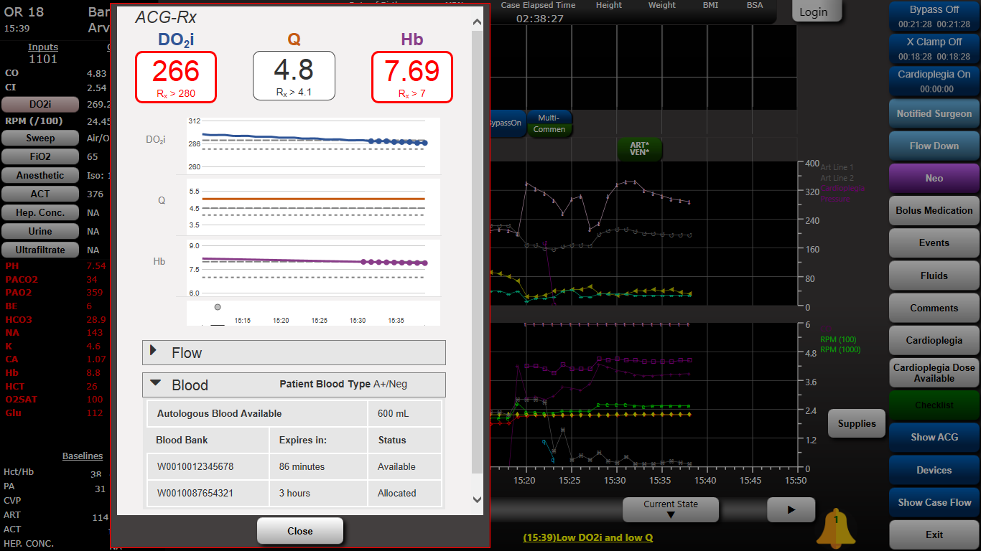
Notes:
ACG Advanced Clinical Guidance’s lets look closer
Click 1- The Cockpit DO2i indicator is flashing red. And an alert is scrolling as a notification below. Perfusionist are made aware of best practice violations as they happen and in near real-time.
Click 2- Acknowledging the alert exposing actionable data. The tool provided smart parameters for improved decision making.
Low DO2i may be attributed to flow or dilution which reveals key Blood Bank parameters.

Slide 18
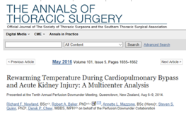
Tools for at Risk Patients
Avoidance of hyperglycemia
Avoidance of hyperthermia
Volume management CUF/MUF/Z-BUF
Oxygen delivery optimization
The duration of hyperthermic perfusion - rewarming temperature greater than 37*C was an independent predictor of AKI.
Avoidance of hyperthermic perfusion may be more beneficial in reducing AKI than avoidance of rewarming.
Newland, Richard F., et al. "Rewarming temperature during cardiopulmonary bypass and acute kidney injury: a multicenter analysis." The Annals of thoracic surgery 101.5 (2016): 1655-1662.
*Prospectively collected, multi-institutional and propensity matched
Notes:
The literature is very clear on Hyperthermia and AKI. ACG is a tool for at Risk patients

Slide 19
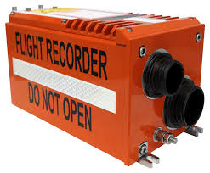
Systems Goals
Provide clinical leaders new tools for :
Patient safety and compliance initiatives
Outcomes research
Operational management
Provide Point of Care clinicians
new methods to Identify harmful trends
Empower Quality and Compliance officer’s quality
initiative tools and ensure alignment with best practices
Notes:
examples:
safety devices turned on

Slide 20
Clinical and Operational Guidance
Guidances are highly configurable and can be leveraged as:
Global - Organizationally Based
Surgeon – Specific clinical preferences
Perfusion R_{x} – Patient condition specific for high risk patients.
Clinical and Operational Guidances can communicated by multiple modes of transmission:
Pagers
Texts
Cockpits
Surveillance Dashboards

Slide 21
Mobile tools let you easily view information from anywhere in real-time
Advanced Clinical Guidance Following Surgery: CVICU / ICU

Slide 22
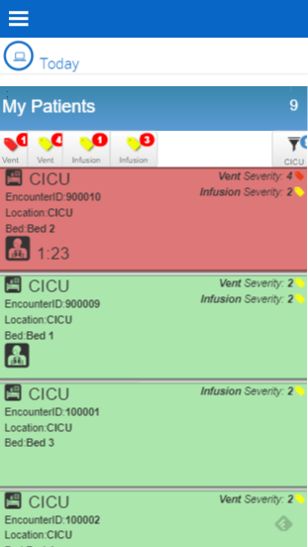
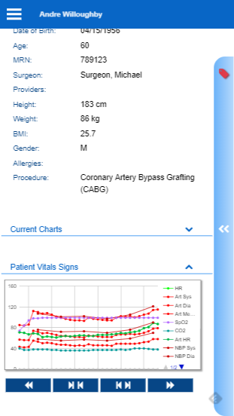
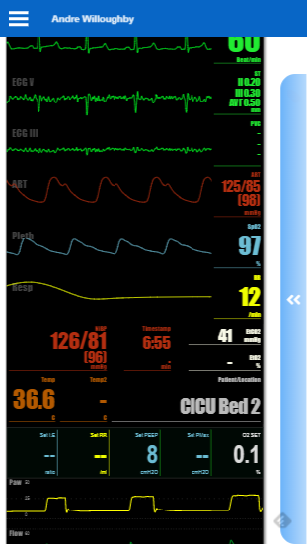
Surgeons Remote View ICU
Access pt. specific information by selecting patient
This data includes wave forms, trending phycological data, blood Gas data etc.
Notes:
Here is a great example of the Surgeons remote view

Slide 23
Comprehensive Data & Compliance Analytics
Notes:
QA, QI improvement process are dependent on having access to clean clinical data across all patient populations.
Allows compliance to be measured by Hospital, Department, Procedure and individual Best Practice Protocols.
Data can be used to analyze outcomes and trends for an individual patient or patient population.

Slide 24
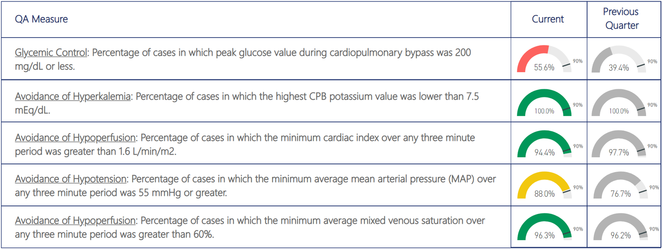
Comprehensive Data & Compliance Analytics

Slide 25
Perfusion EHRs ≠ PIMS
Process | Perfusion EHR | Talis PIMS
Clinical documentation workflow to capture compliance and billing data | ✓ | ✓
Integration with Heart Lung Machine | ✓ | ✓
Real time / automated integration with all HIT systems and all Medical Devices in the Cardiac OR | ? | ✓
Alerts and notifications to support adherence to best practices | ? | ✓
Embedded Smart-checklists |  | ✓
Advanced Clinical Guidance's to detect deteriorating conditions |  | ✓
Barcode scanning to facilitate supply chain and safety through accurate/rich data capture |  | ✓
RemoteViews to engage the entire care team at the right time with right tool |  | ✓
Precise administration of Surgical Care Plan |  | ✓
Notes:
PIMS provides device agnostic integration.
It also offers platform agnostic HIT system integration – It can auto-populate a surgery schedule and patient history data from an EMR.
It can interface with lab, pharmacy and decentralized pharmacy systems.
It serves as a process control tool helping an organization standardize its workflows and clinical best practices through alerts and notifications
It incorporates Pre-bypass and pump setup checklists and checklists for devices like an ATS or VAD
It provides constant vigilance over patients through Advanced Clinical Guidance
Barcode scanning facilitates supply chain and safety through accurate/rich data capture
Our PIMS shares the data that it collects with all members of the care team (the surgeon, anesthesiologist, perfusionist and nurses) to drive improved patient care and safety beyond the OR, into the ICU and across the entire continuum of care
Dashboards allow an organization to more efficiently use its most valuable operational resources

Slide 26
Healthcare needs High Reliability Organizations
“High reliability organizations are organizations (HRO) with systems in place that make them exceptionally consistent in accomplishing their goals and avoiding potentially catastrophic errors”
-Quint Studer
Notes:
Ok lets go back wo the definition of a High Reliability Organization

Slide 27
Structuring HRO into Perfusion Information
Management System
Leverage technology to radically improve safety, quality of care and workflow
Operational improvements, better decision making, evidence based care
Clinical Guidance : standardization, supervision, reporting, GDC
Data to revolutionize care and OUTCOMES!
STOP
DISTRACTED
PUMPING

Slide 28
The future of perfusion quality & safety
≠
Rich Device
Data
√
Labs
∑
∆
Events
✓
Meds
PACU
QCDR
+
ERAS
Real
Time
↕
Orders
EHR
%
≤
Billing
Real-time Clinical / Operational Alerts - Guidances - Notifications
OR
$
Op
Metrics
∞
ICU
Team
IQ
RT
PAT
ADT
ER
Notes:
I believe the future of perfusion quality and safety is an Enterprise solution that has real-time clinical and operational alerts– guidance's and notifications taking our patients for the OR to the ICU

Slide 29
For every ONE THOUSAND patients touched by a CPB Machine:
FOUR HUNDRED will suffer a BRAIN INJURY
THREE HUNDRED will suffer ATRIAL FIBRILLATION
THREE HUNDRED will suffer KIDNEY INJURY
We NEED to do BETTER.
YOU NEED SOLUTIONS that UNLOCK YOUR DATA making it SMARTER and MORE USABLE

Slide 30
Thank you
Comprehensive Care Services Inc.
31330 Schoolcraft R Suite 200 Livonia, MI 48150

