Slide 1
My Journey to Perfusion
Roaya Braqa

Slide 2
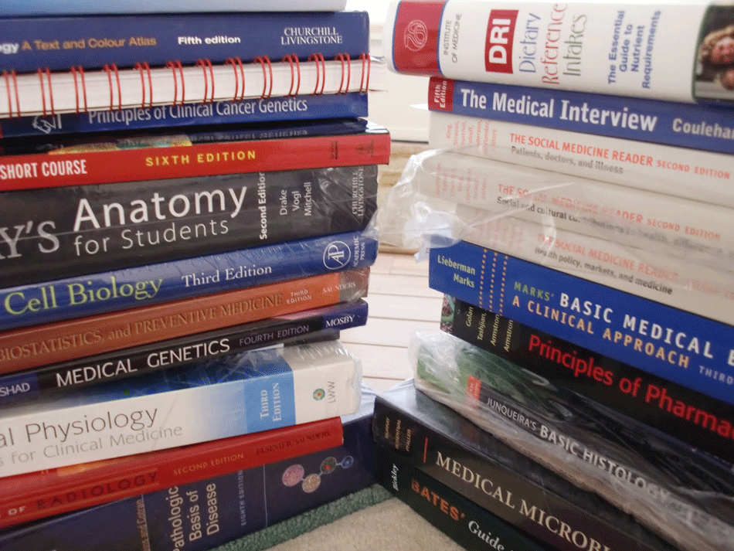
Background

Slide 3
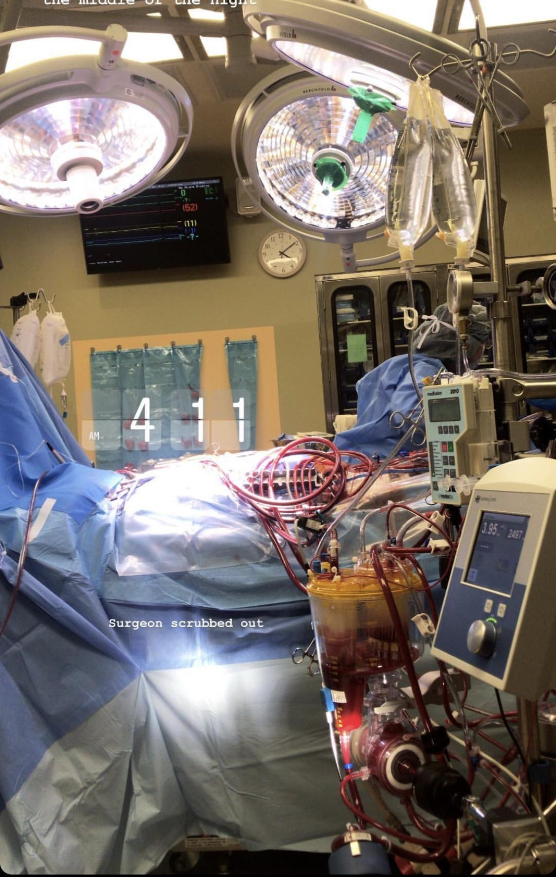
Discovering Perfusion
Networking
Prerequisites
Bachelor's degree

Slide 4
Life as a Perfusion Student
Two-year Masters Program
Didactic year
Clinical Rotation Year
American Board of Cardiovascular Perfusion
Basic Science
Clinical Application

Slide 5
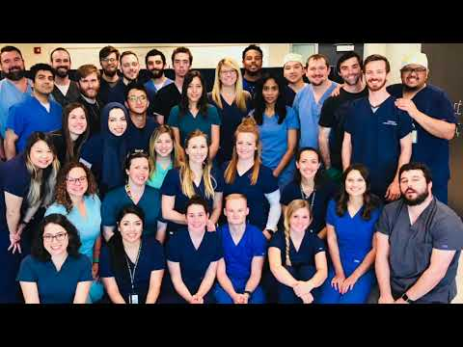
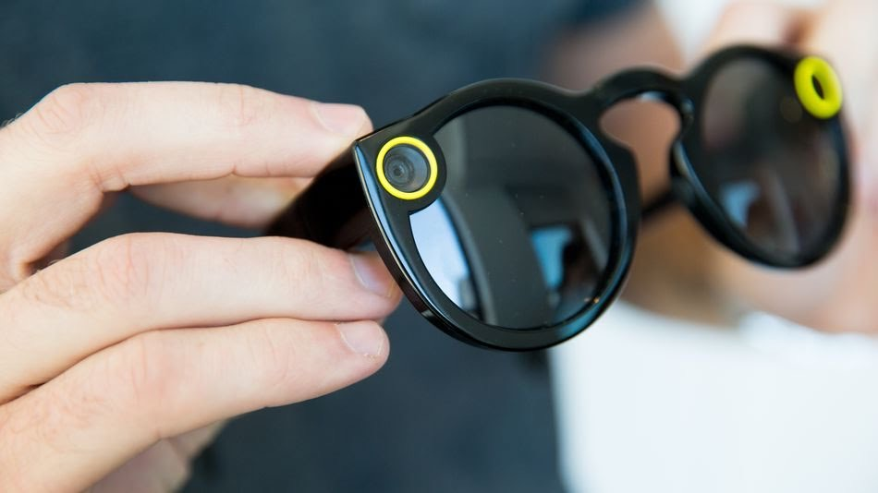
My Journey Video

Slide 6
Teşekkür ederim

