Slide 1


EUROPEAN BOARD OF CARDIOVASCULAR PERFUSION
AND TURKEY
Tamer SARI, MS
EBCP Turkish Delegate
Klinik Perfüzyonist
Bayındır Hastanesi, 2017

Slide 2
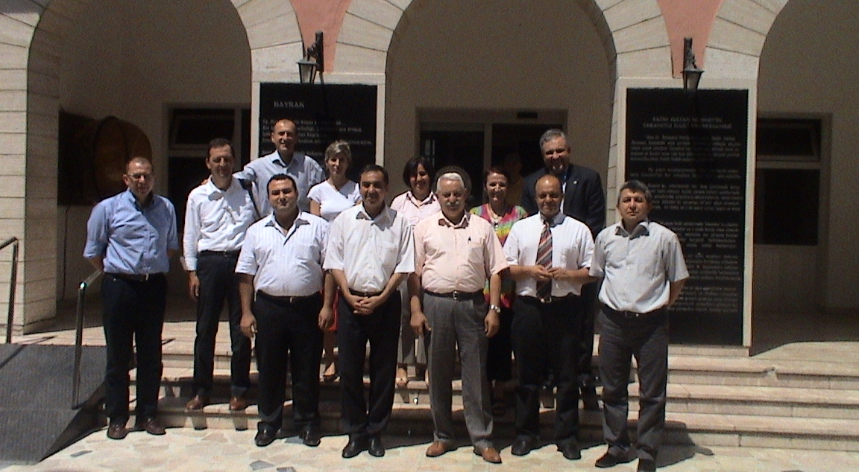
FIRST COMMISION MEETING BEFORE RECOGNATION
10 Agust 2010

Slide 3
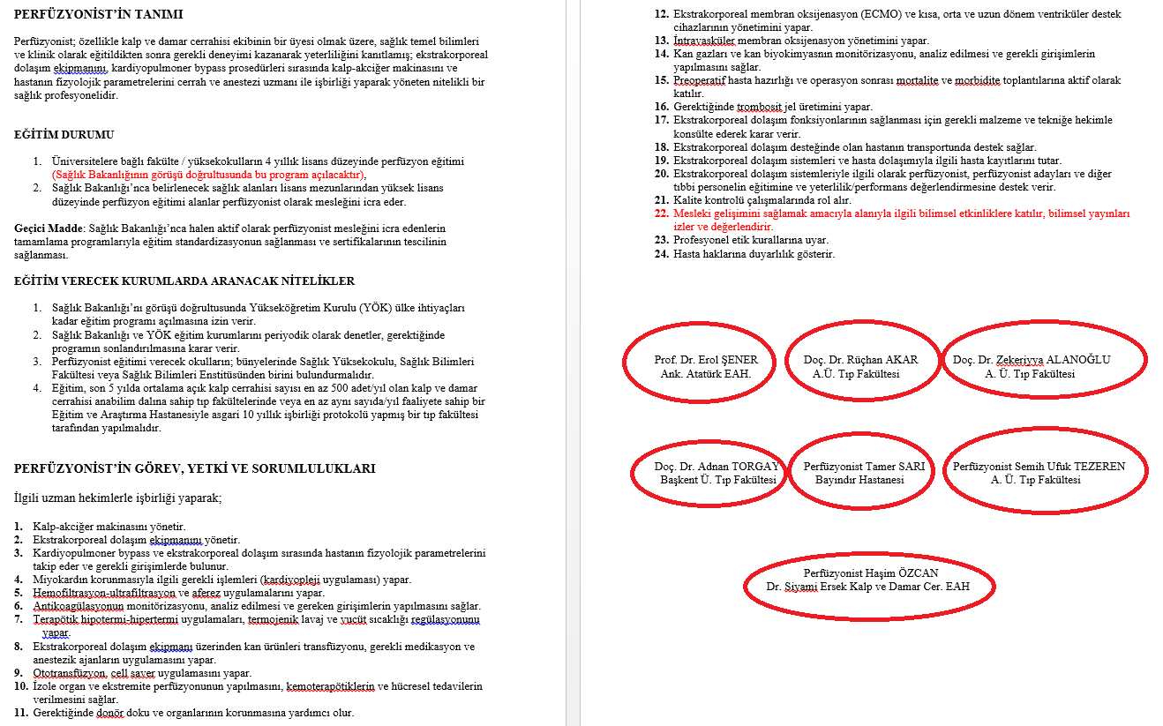
WHO IS PERFUSIONIST AND WHAT IS RESPONSIBLTY (MINISTRY OF HEALTH) COMMISSION 2010

Slide 4
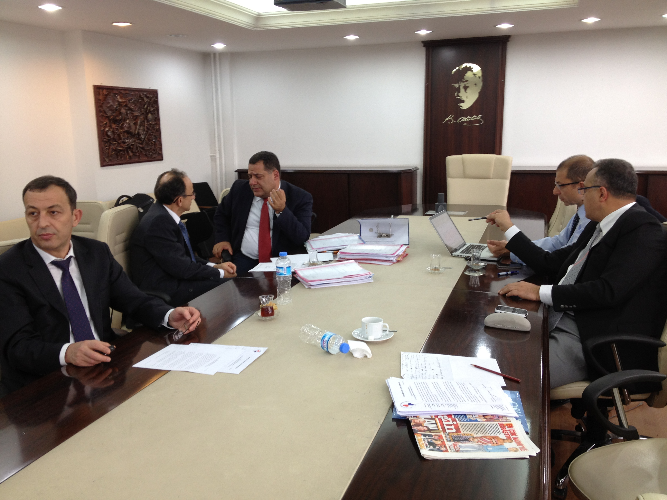
ONE OF COMMISSION IN MINISTRY OF HEALTH

Slide 5
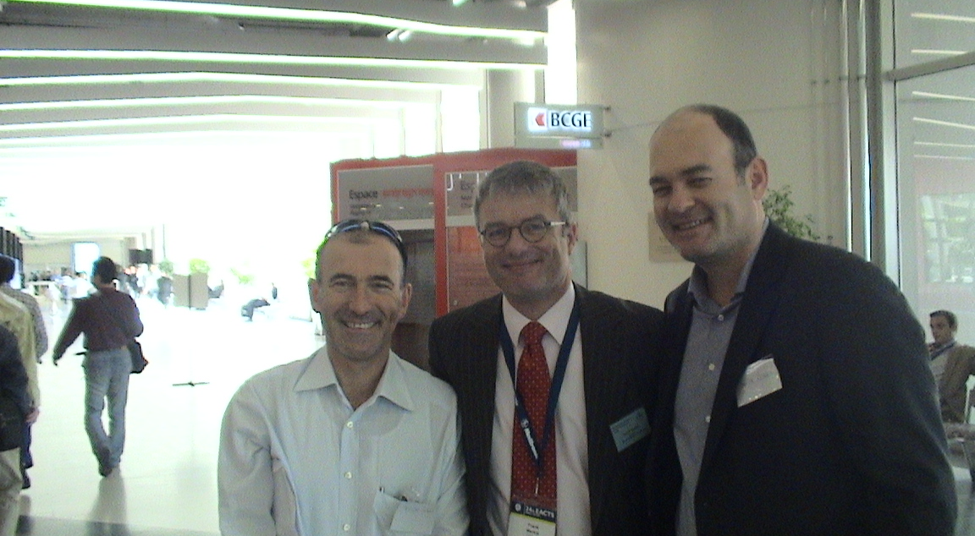
Tamer Sari, Frank Merkle, Omür Ozmen
SWISS 2011

Slide 6
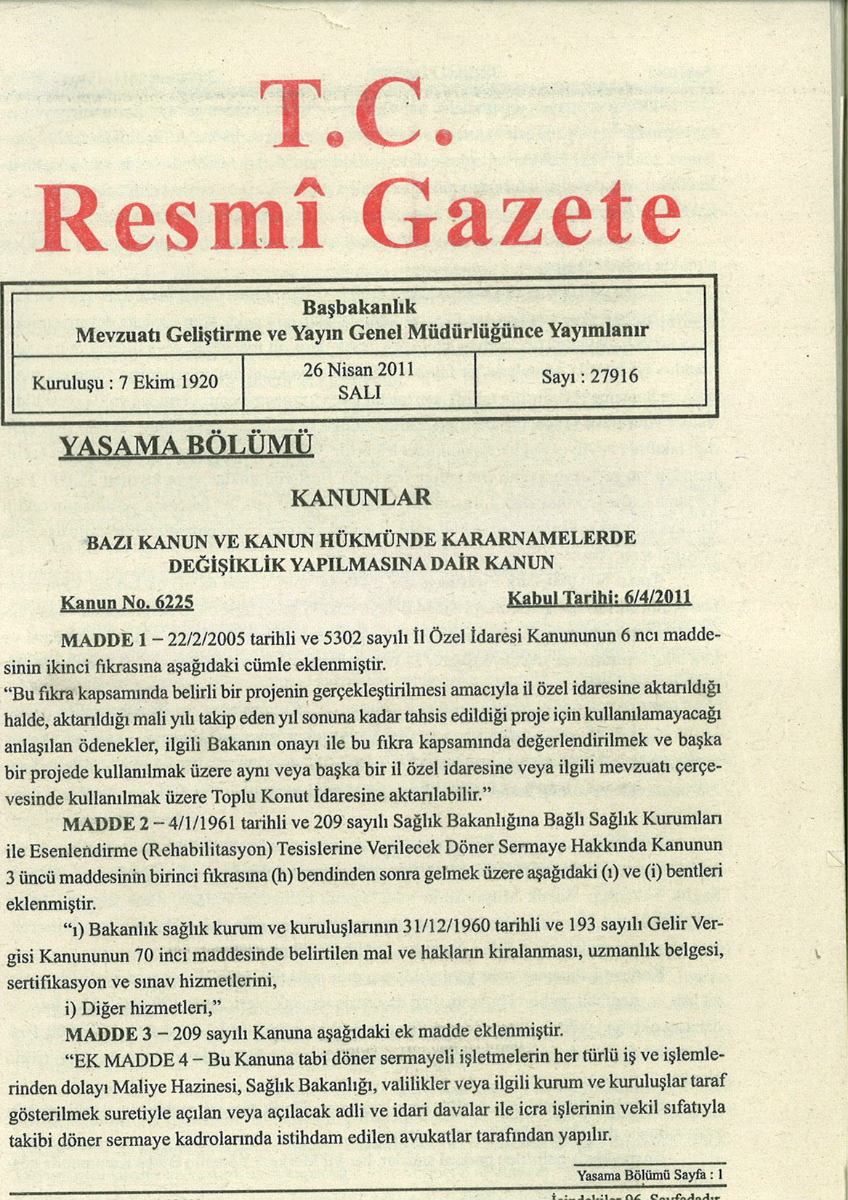

Slide 7
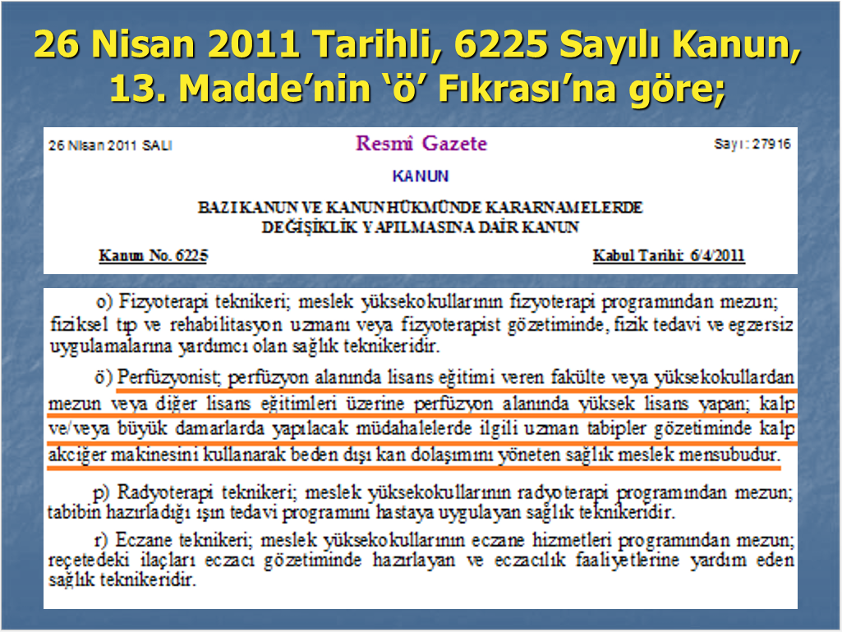

Slide 8
Grand national assembly of Turkey
The Definition of Perfusionist as a Profession
4 year perfusion education as a bachelor degree
2 year master's in perfusion following bachelor's degree
Grandfather Licence( one week training and licensure examination by ministry of health)

Slide 9
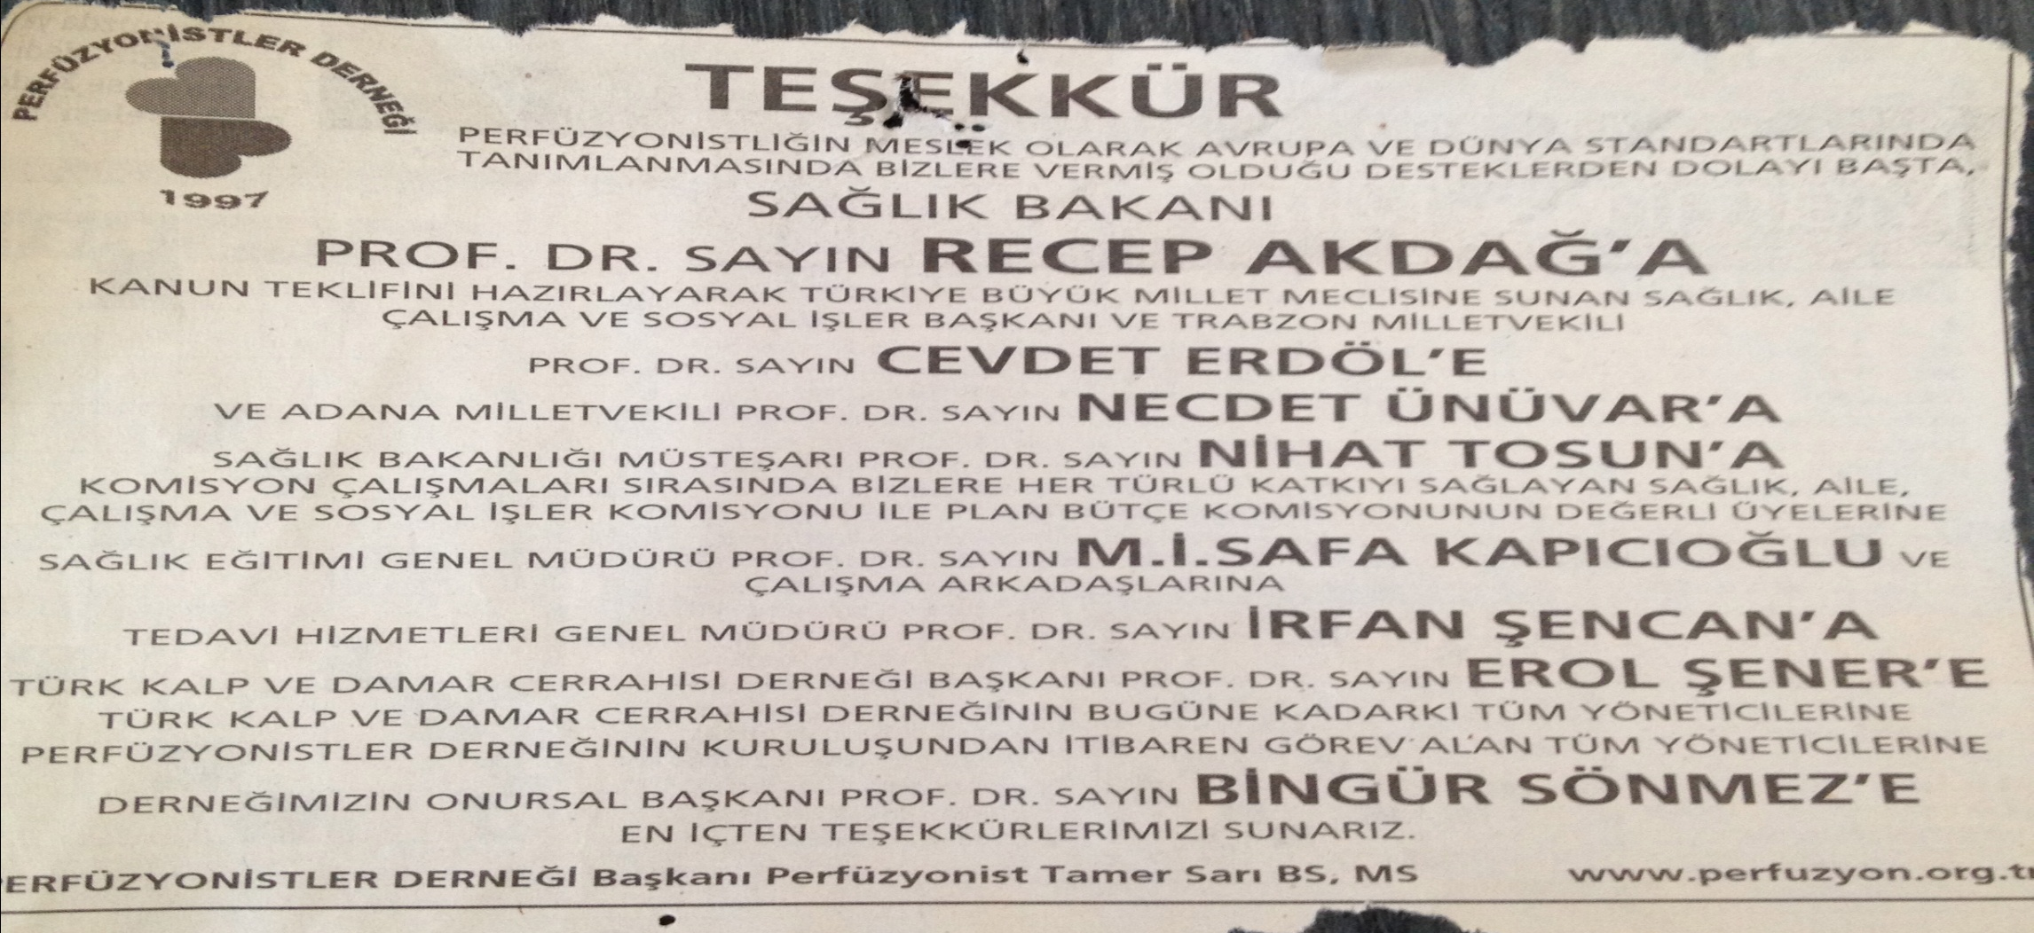

Slide 10

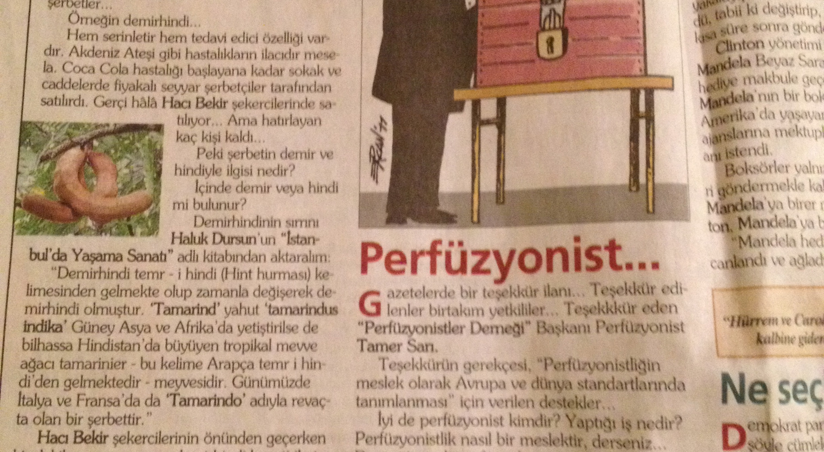

Slide 11
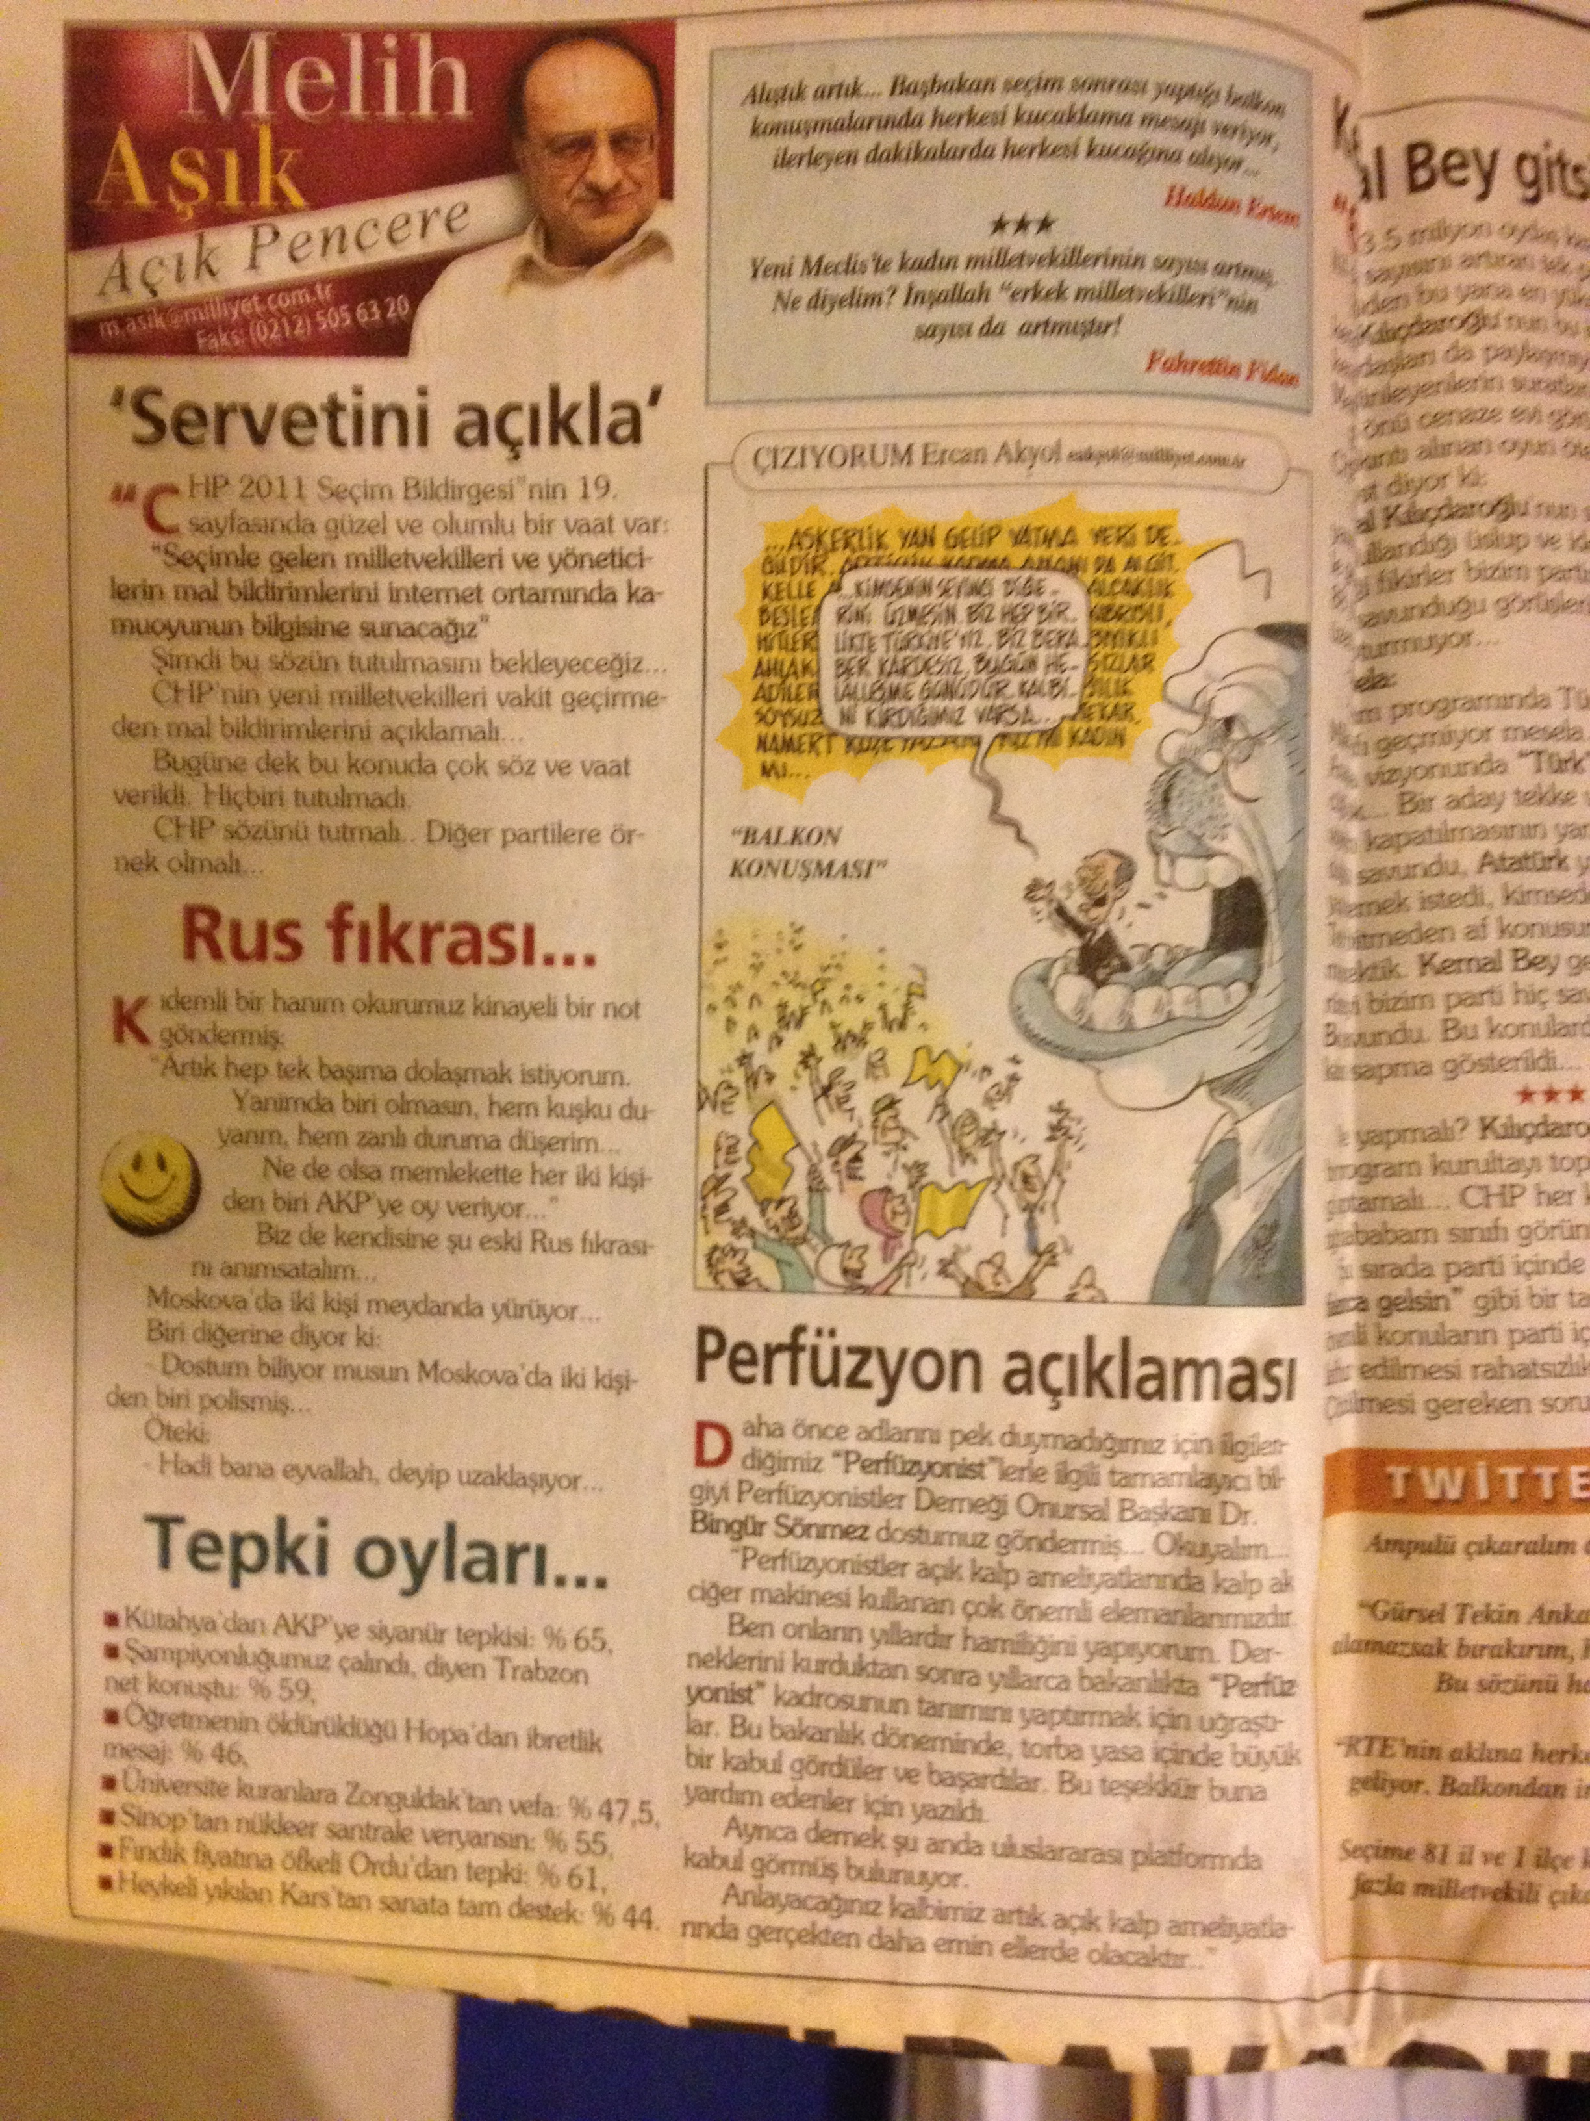

Slide 12
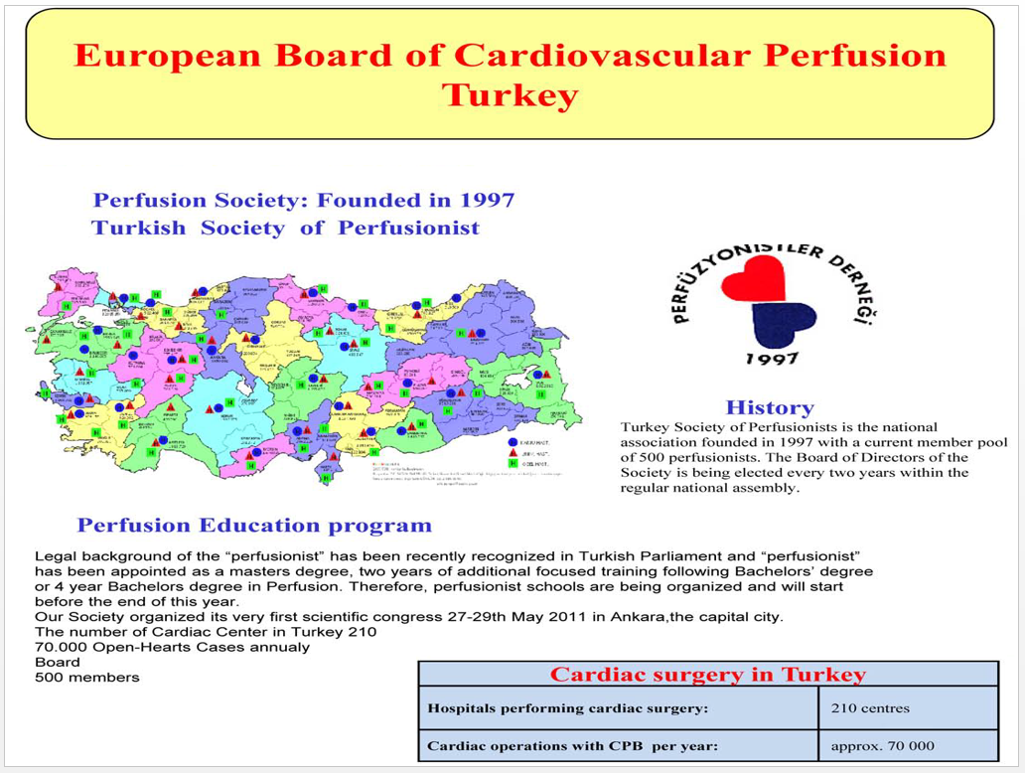

Slide 13
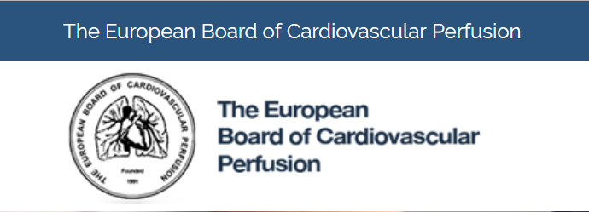
Turkish Society admitted to Associate Membership Category
EBCP Associate Membership 2011

Slide 14
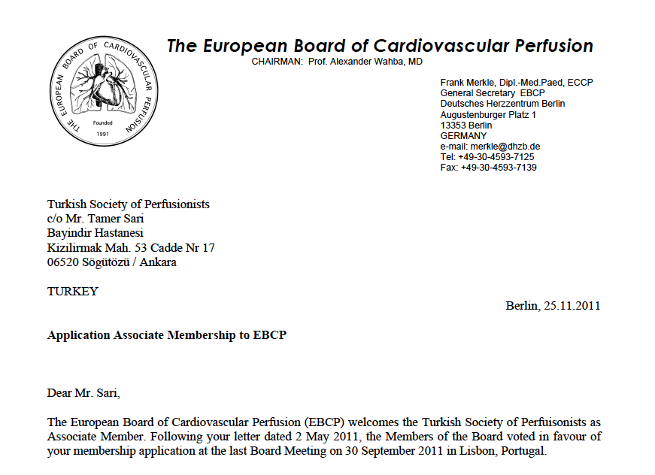

Slide 15
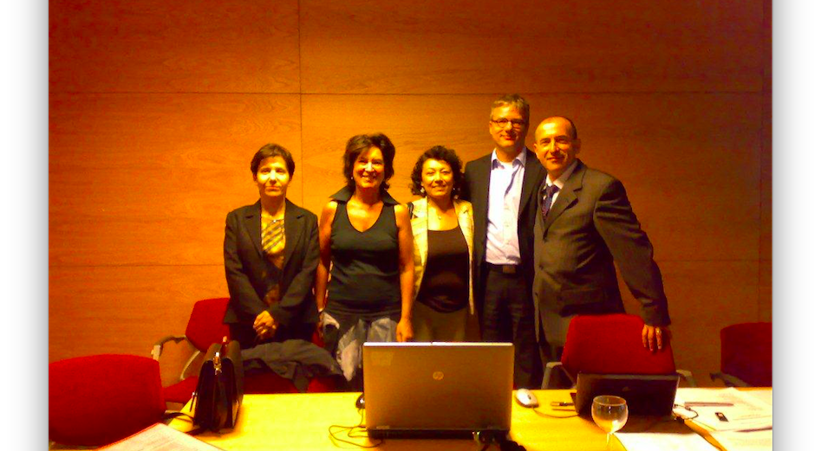
EBCP Board Meeting Lisbon
EBCP PİC (2).jpg

Slide 16
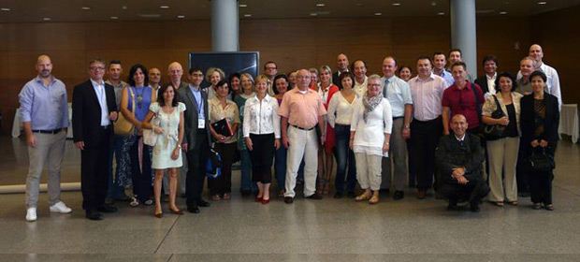
EBCP Board Members and Delegates

Slide 17
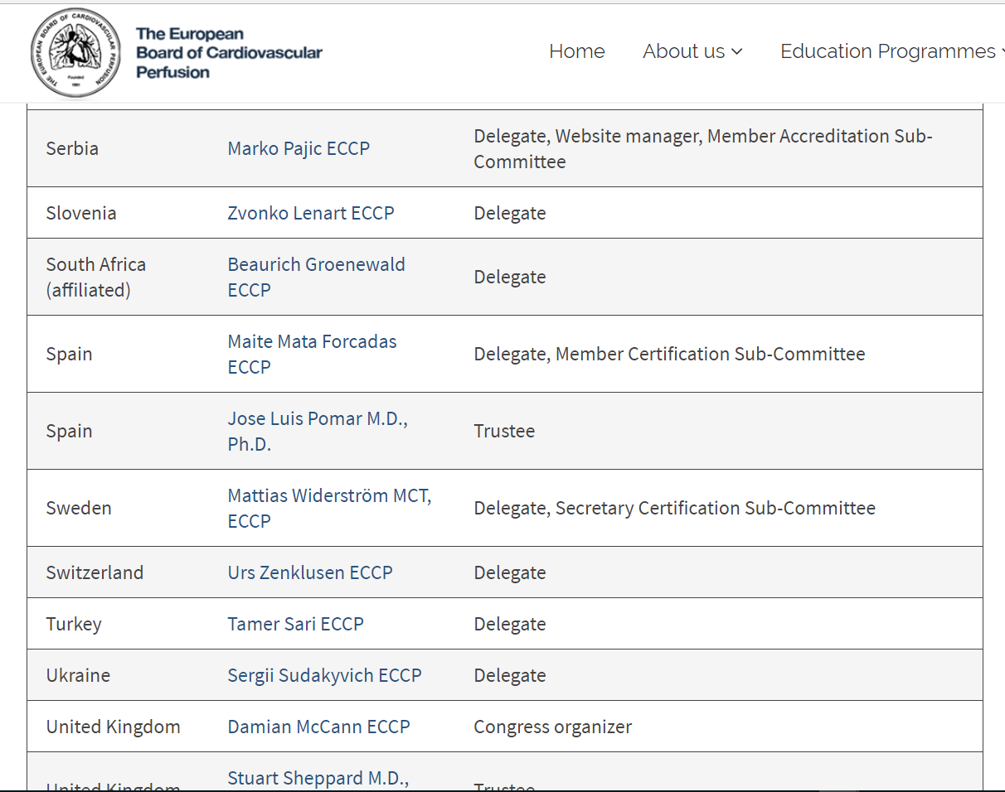

Slide 18
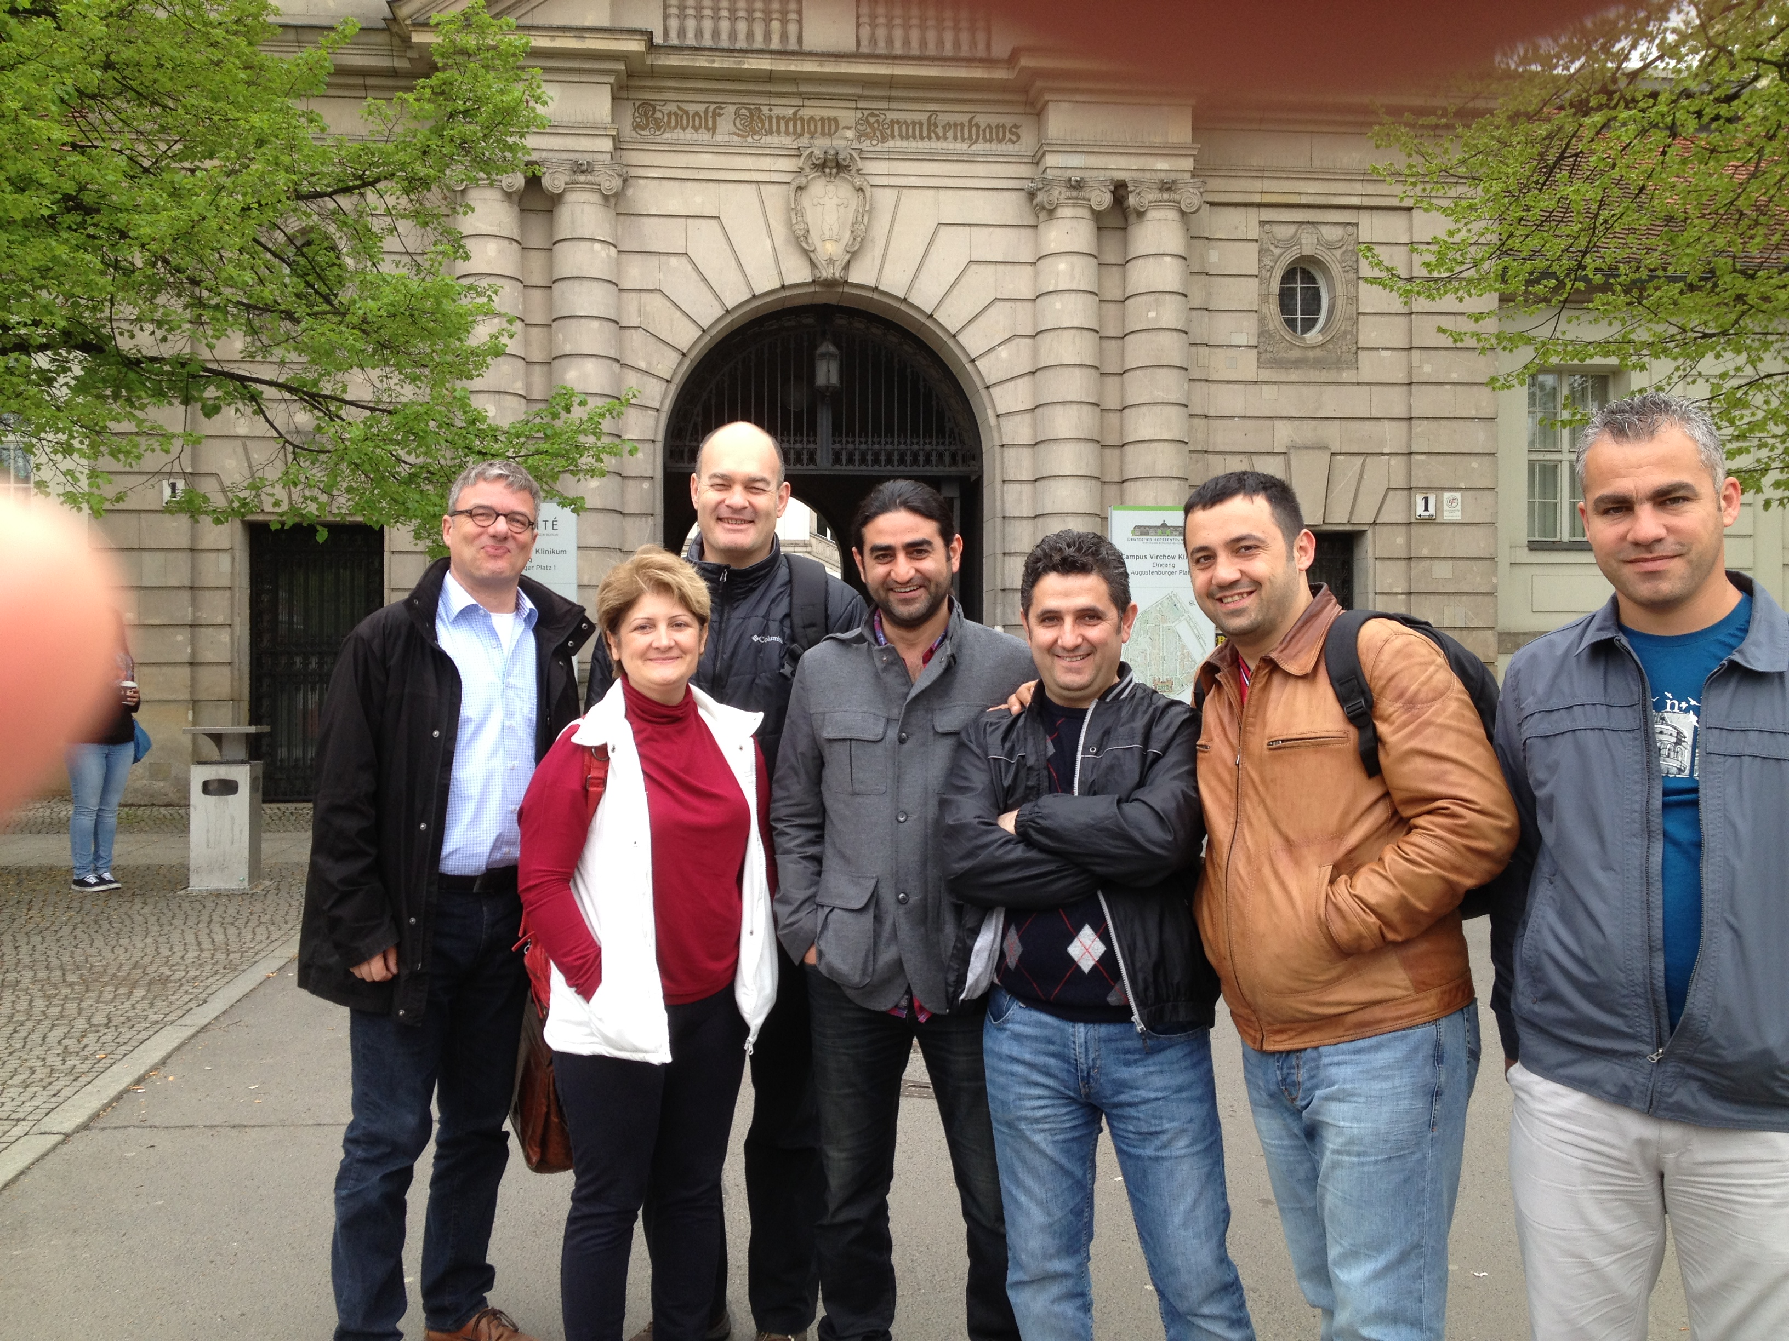
Deutsches Herzzentrum Berlin

Slide 19
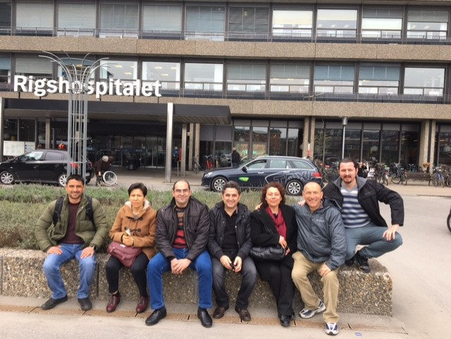

Slide 20
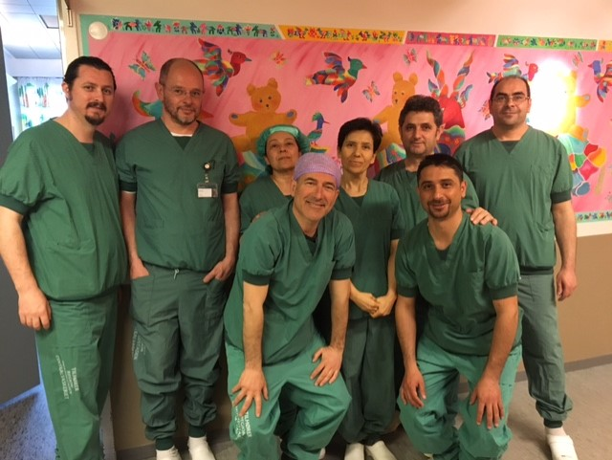

Slide 21
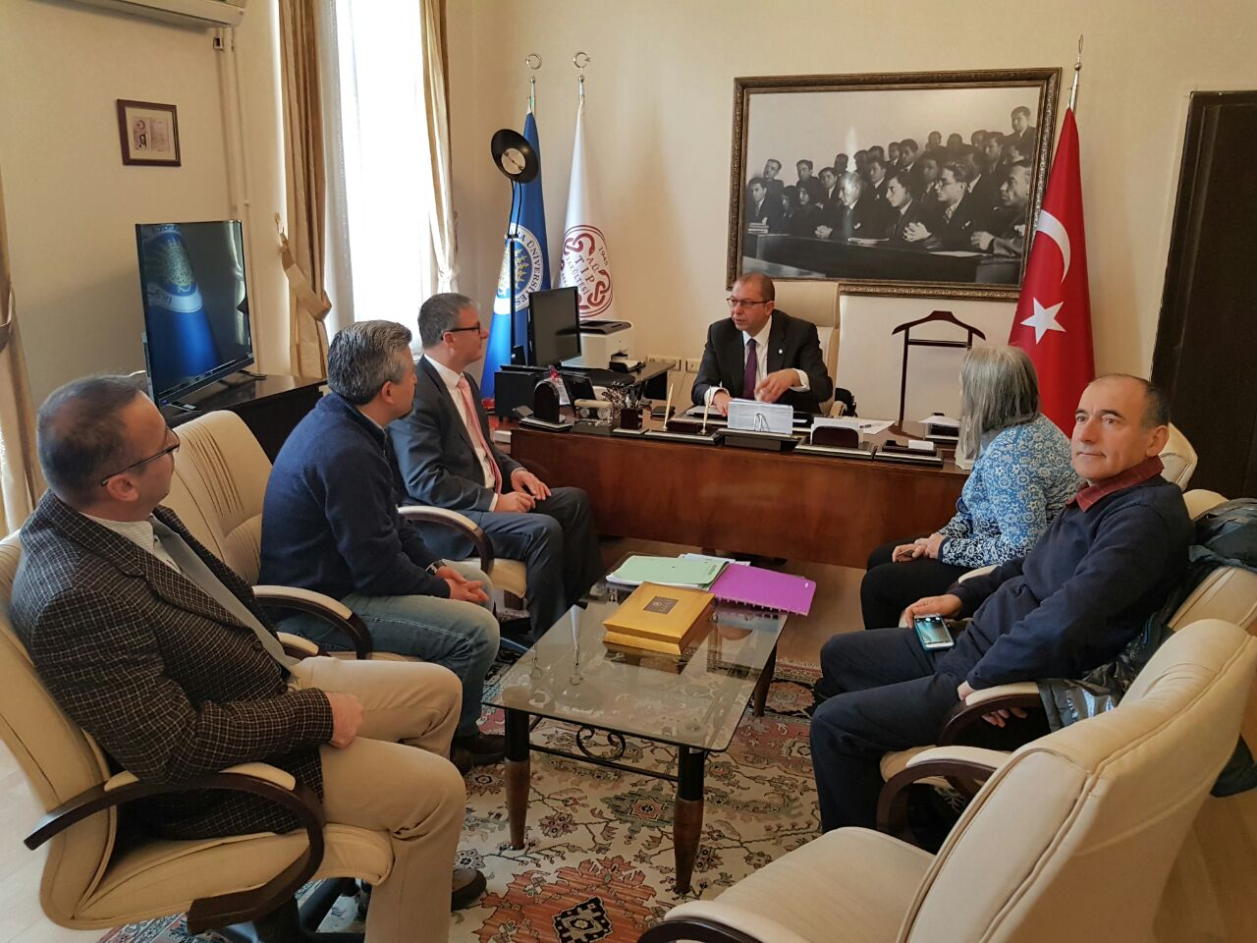
19 Aralık 2016

Slide 22
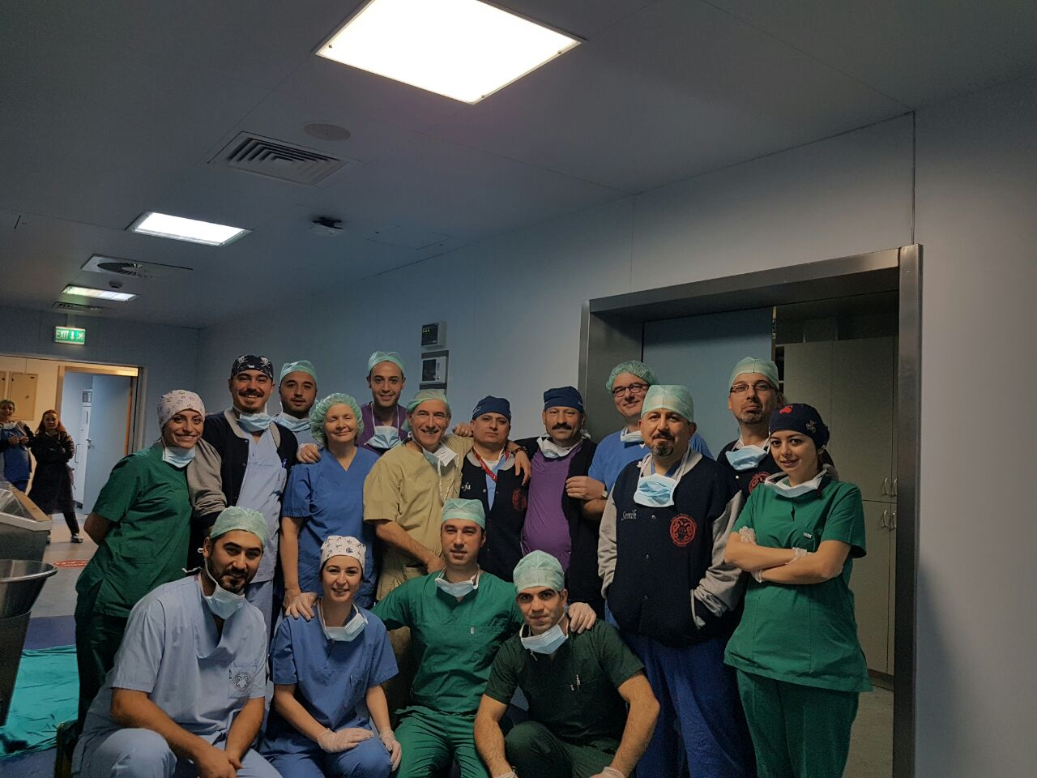

Slide 23
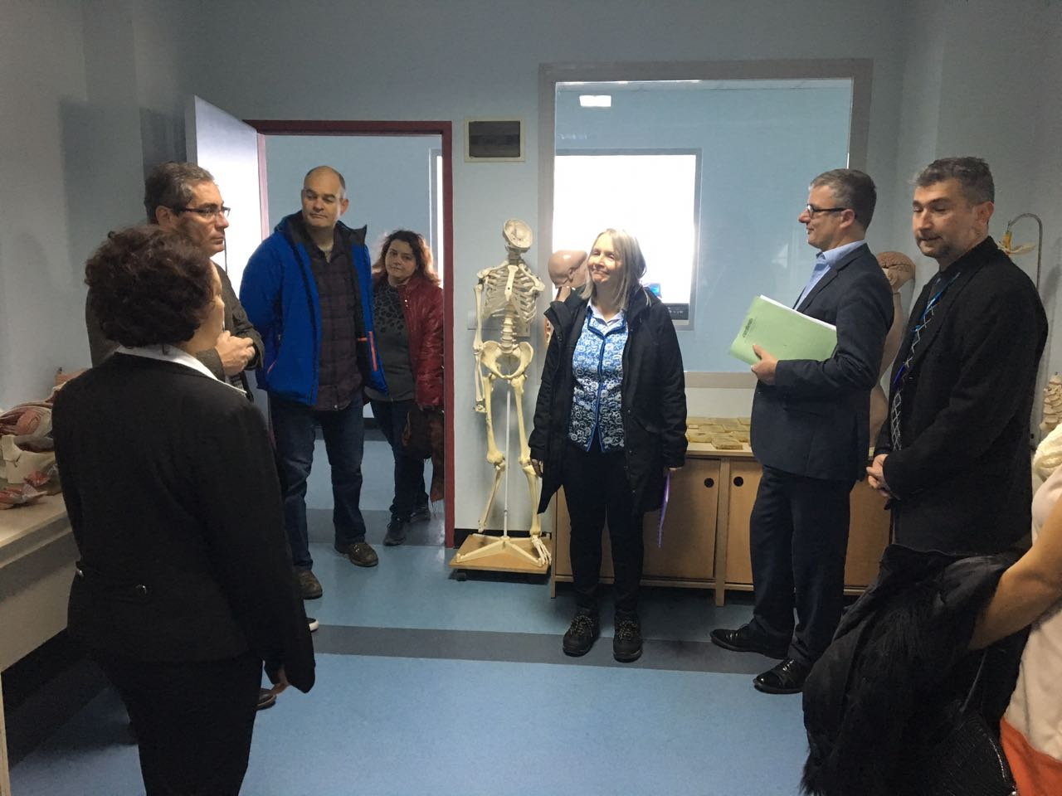
20 Aralık 2016

Slide 24
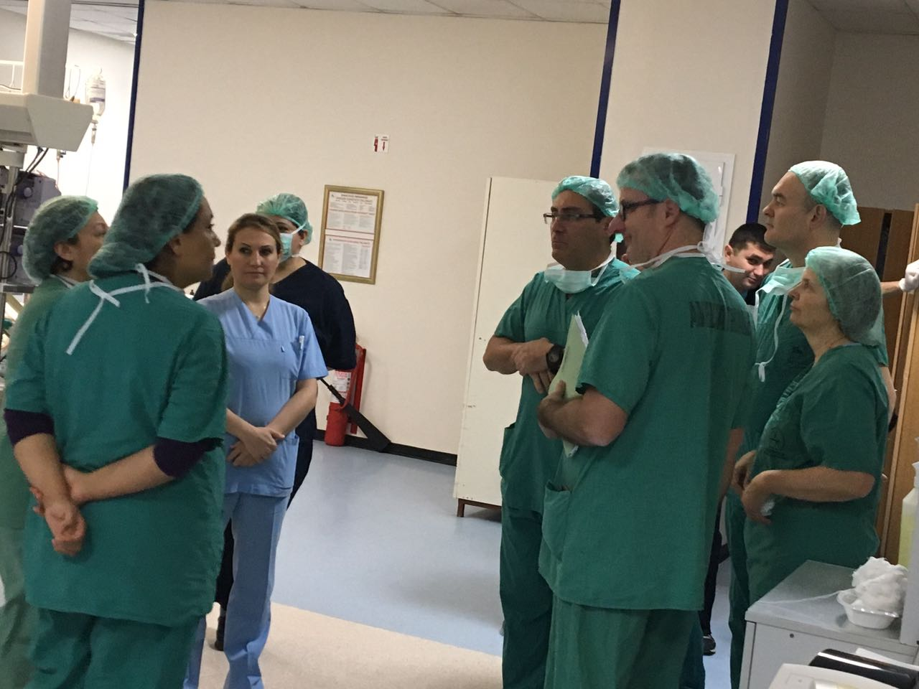

Slide 25
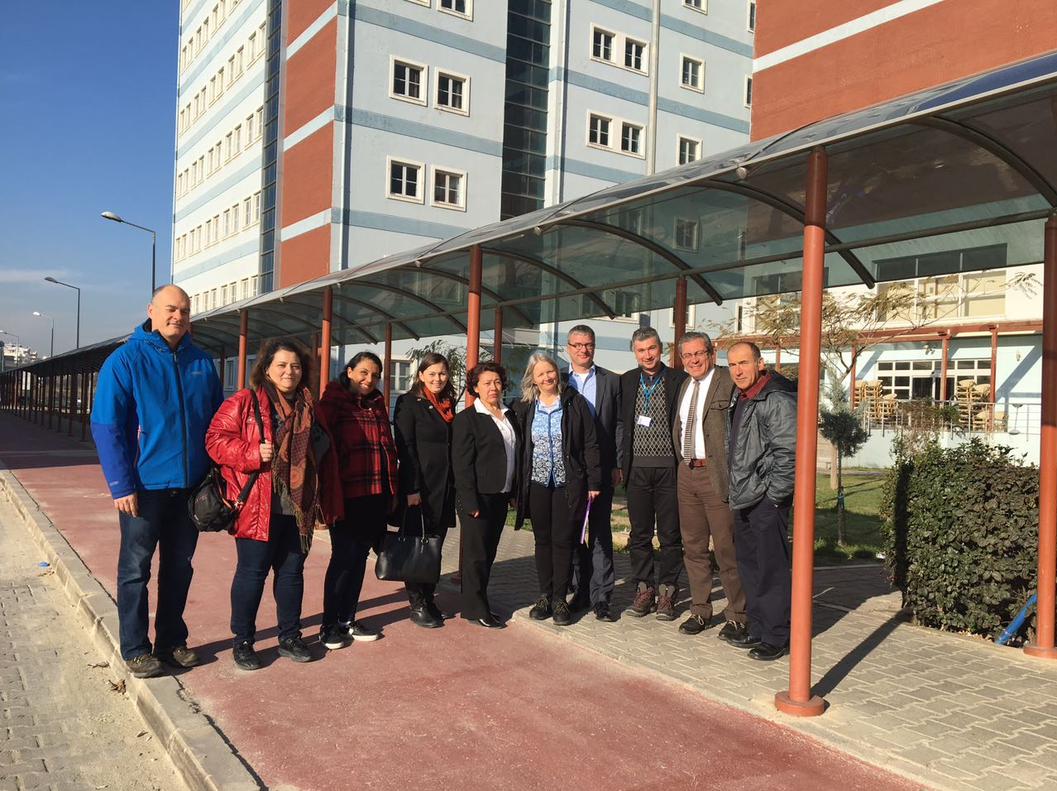

Slide 26

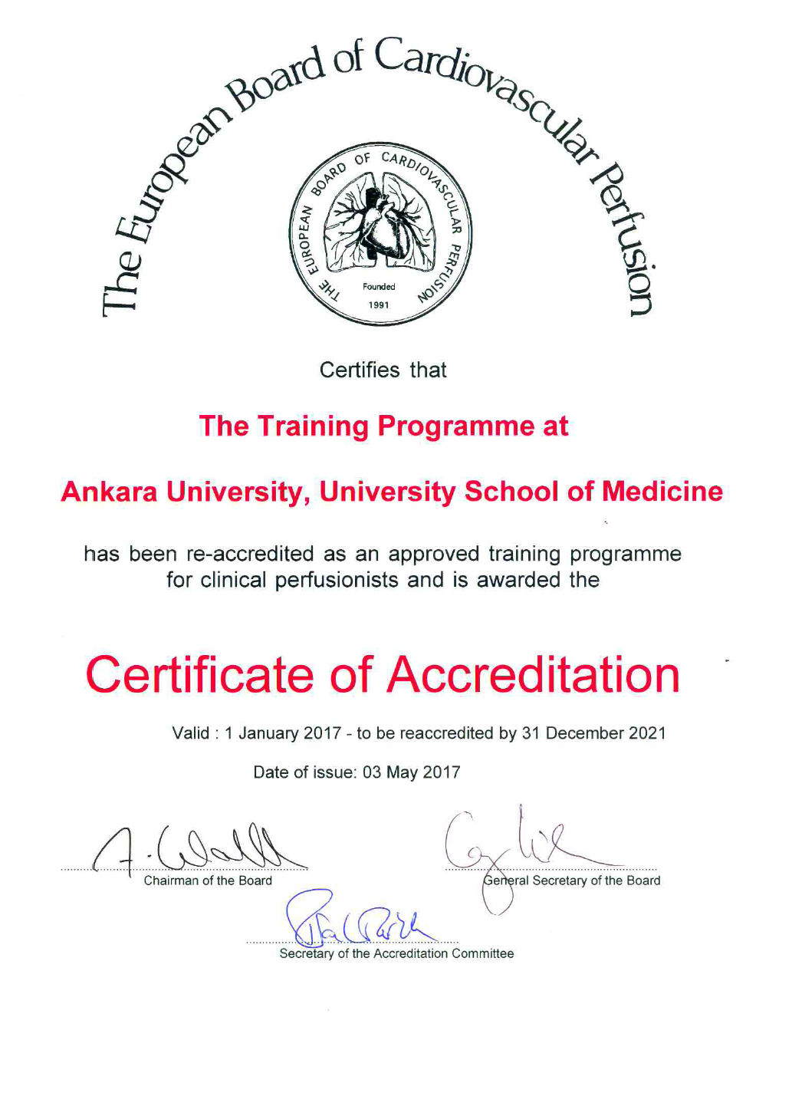

Slide 27
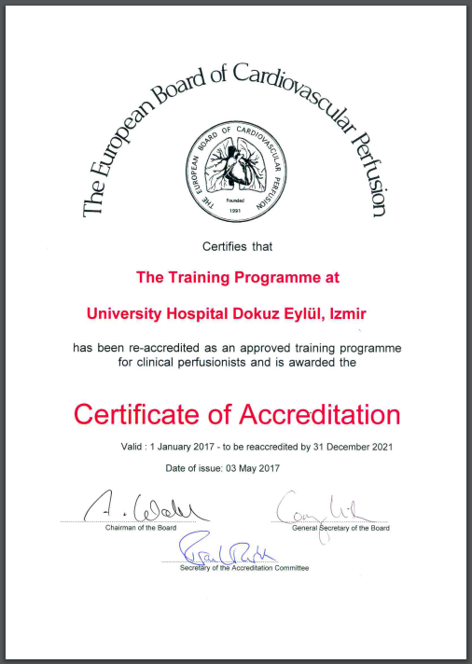

Slide 28
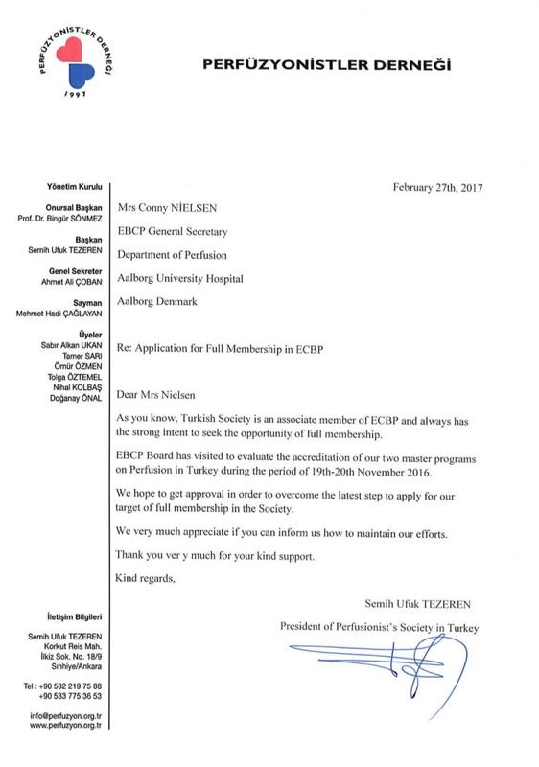

Slide 29
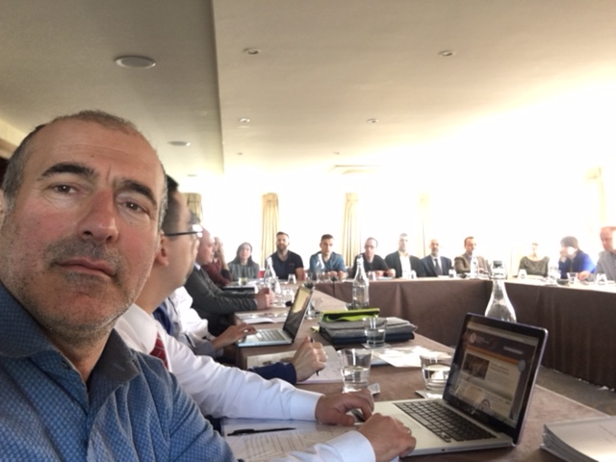
Dublin, İreland, 2017

Slide 30
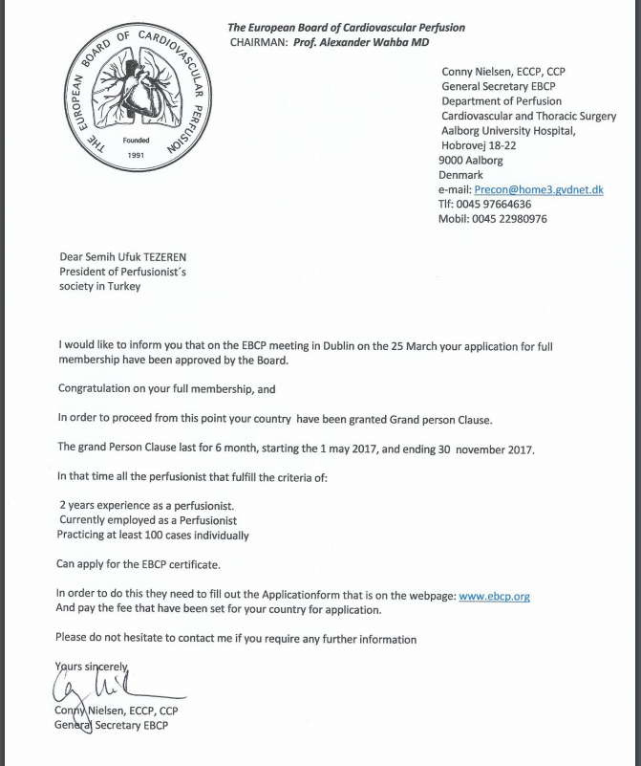

Slide 31
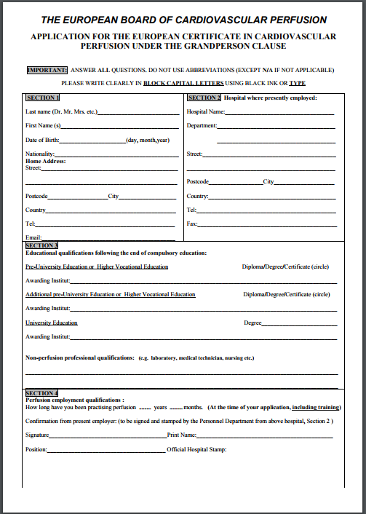

Slide 32
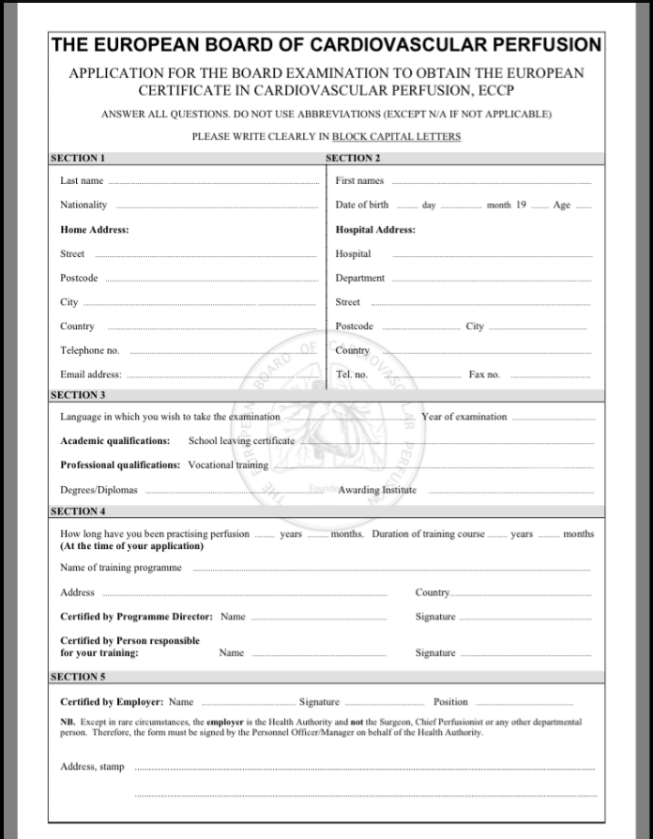

Slide 33
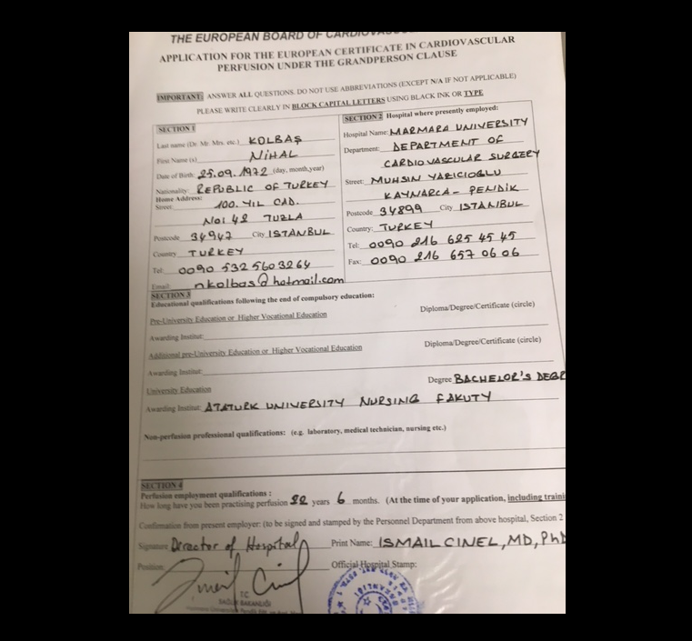
172 ÜYE BAŞVURU YAPMIŞTIR

Slide 34
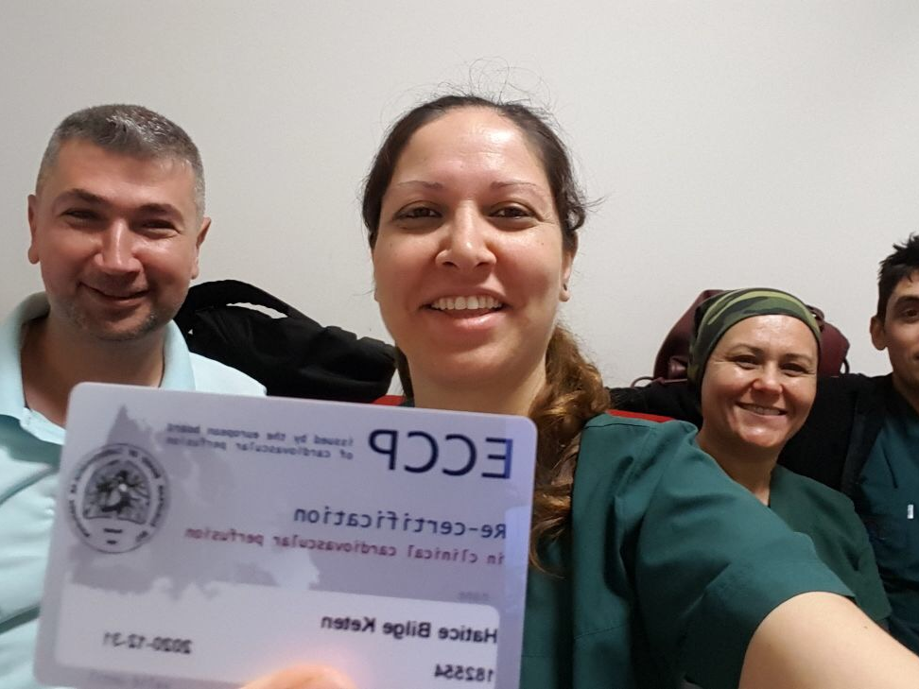
NOW WE HAVE ECCP

Slide 35
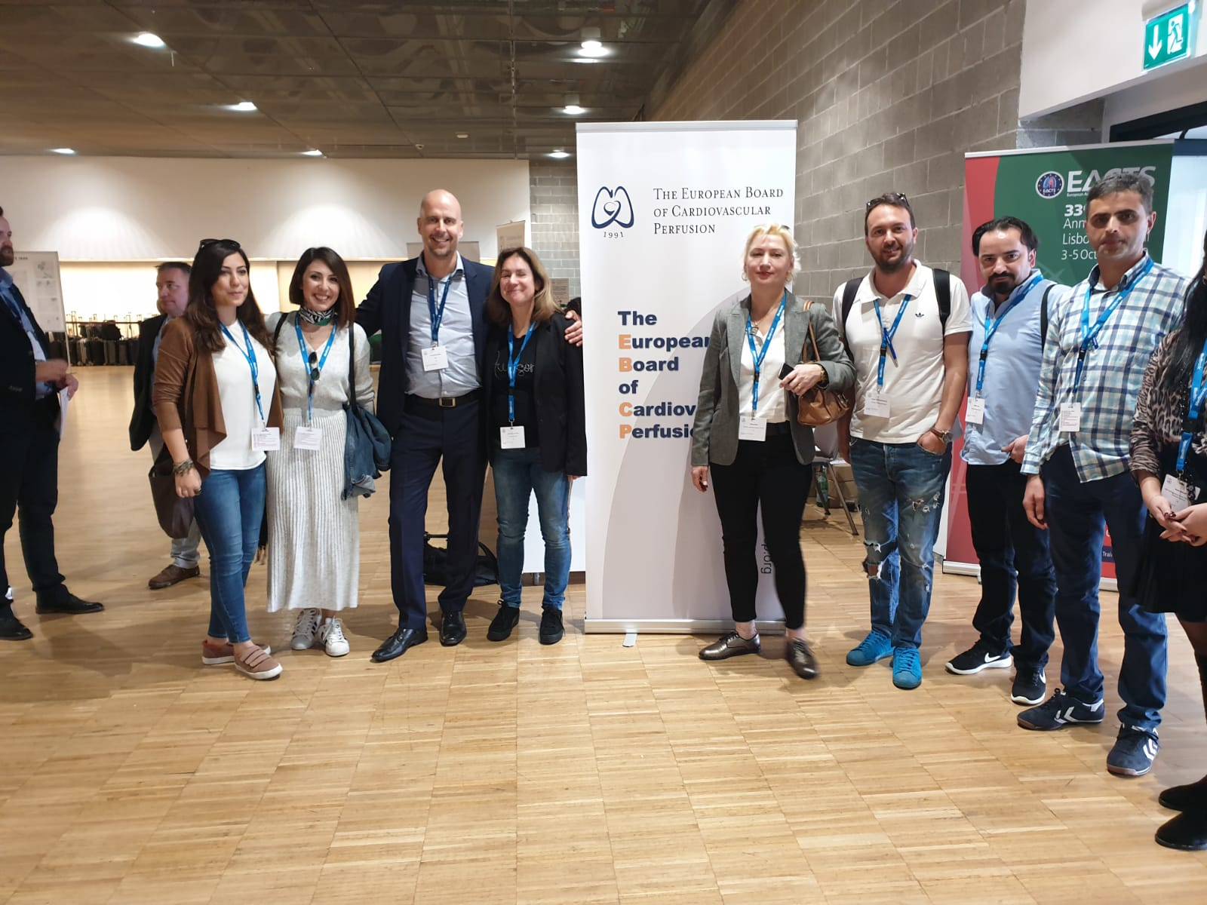

Slide 36
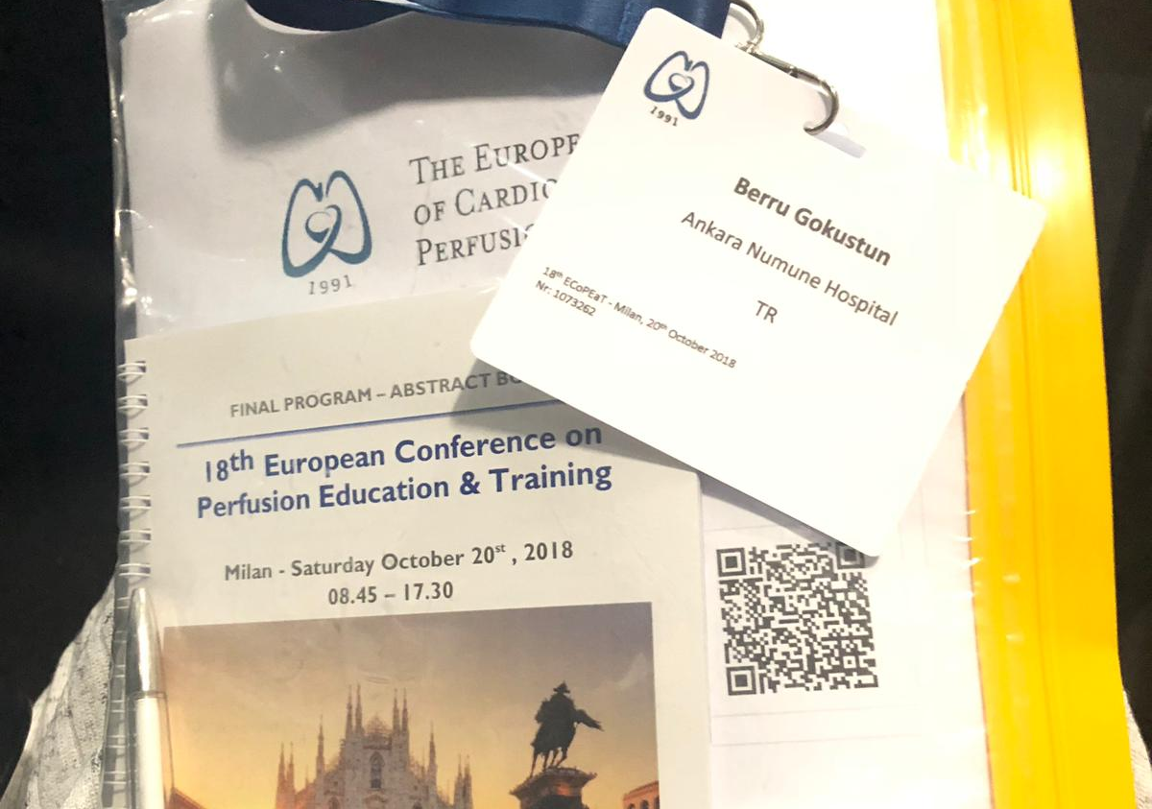

Slide 37
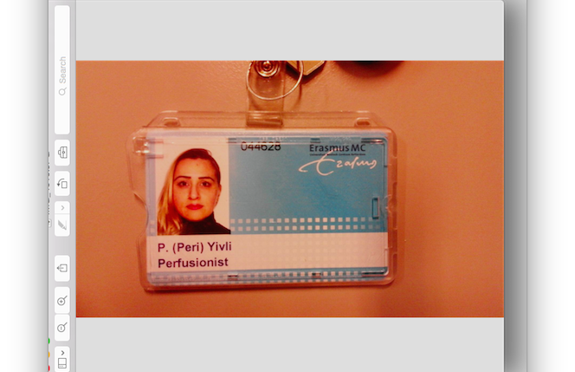

Slide 38
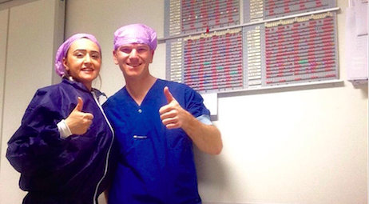

Slide 39
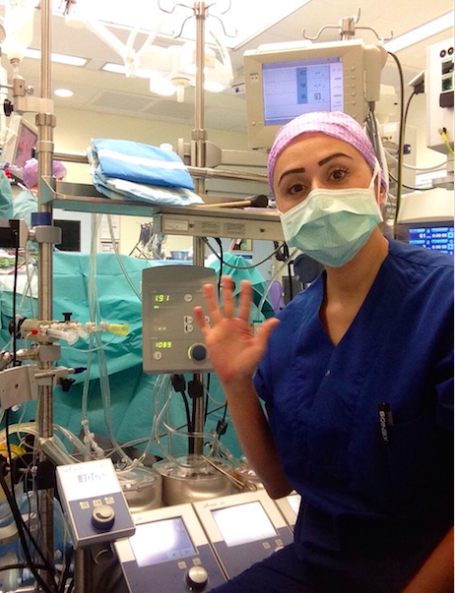

Slide 40
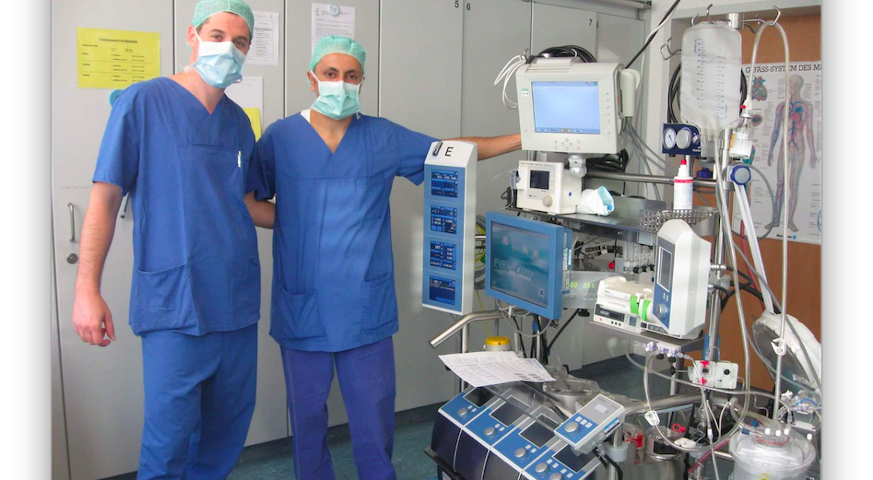

Slide 41
PERFUSION SCHOOLS
TWO ACCREDITED MASTER DEGREE SCHOLL ANKARA UNIVERSITY AND DOKUZ EYLUL UNIVERSTY IN IZMIR AND THEY WOULD LIKE APPLICATE FOR REACREDITED
TWO BACHELOR DEGREE (4 YEAR) PERFUSION SCHOOLL
USKUDAR UNIVERSITY IN ISTANBUL
GELISIM UNIVERSTY IN ISTANBUL

Slide 42
PERFUSION MASTER SCHOOLS
AND IN DIFFERENT REGIONAL CITY IN TURKEY
15 MASTER'S DEGREE PERFUSION SCHOOL AND THEY ARE NOT ACCREDITED

Slide 43
BOARD EXAM 2020 ONLINE
15 APPLICANT FROM MASTER ACCREDITED SCHOOL
4PASS
11 DID NOT PASS

Slide 44
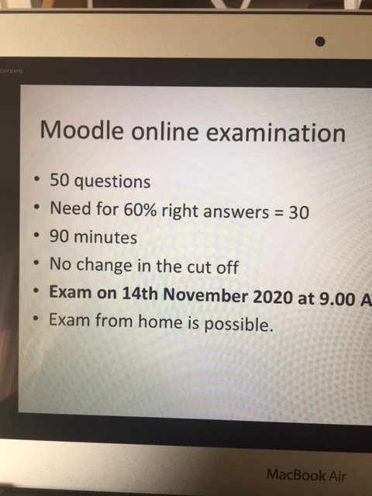
2020 Board exam

Slide 45
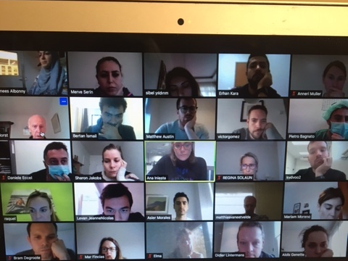
Board exam 2020

Slide 46
BOARD EXAM 2021
THERE IS 13 APPLICANT FOR EXAM

Slide 47
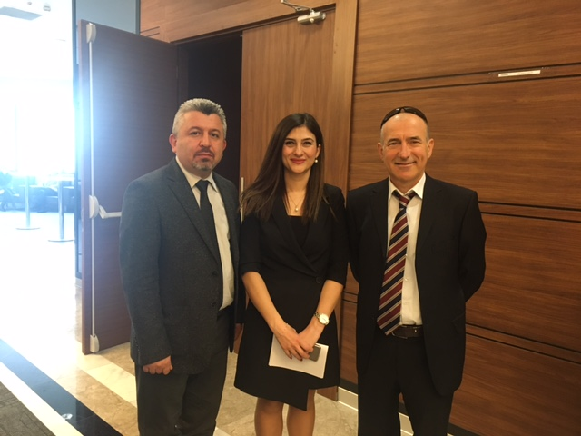
March 2020 Commision in Ministry of Health

Slide 48
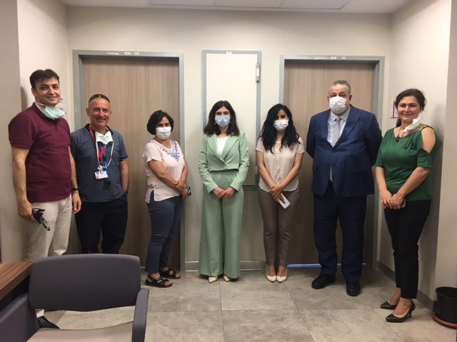
JUNE 2020 WHAT IS THE RESPONSIBILTIES AND DUTIES OF PERFUSIONIST PREPARE WRITTEN DOCUMENTS AND EDUCATIONAL ANALYSE

Slide 49
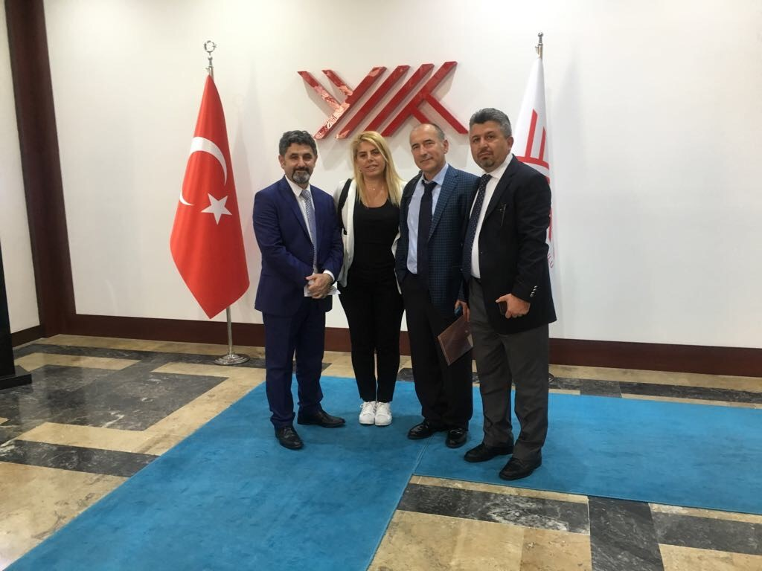
Visit to Council of Higher Education

Slide 50
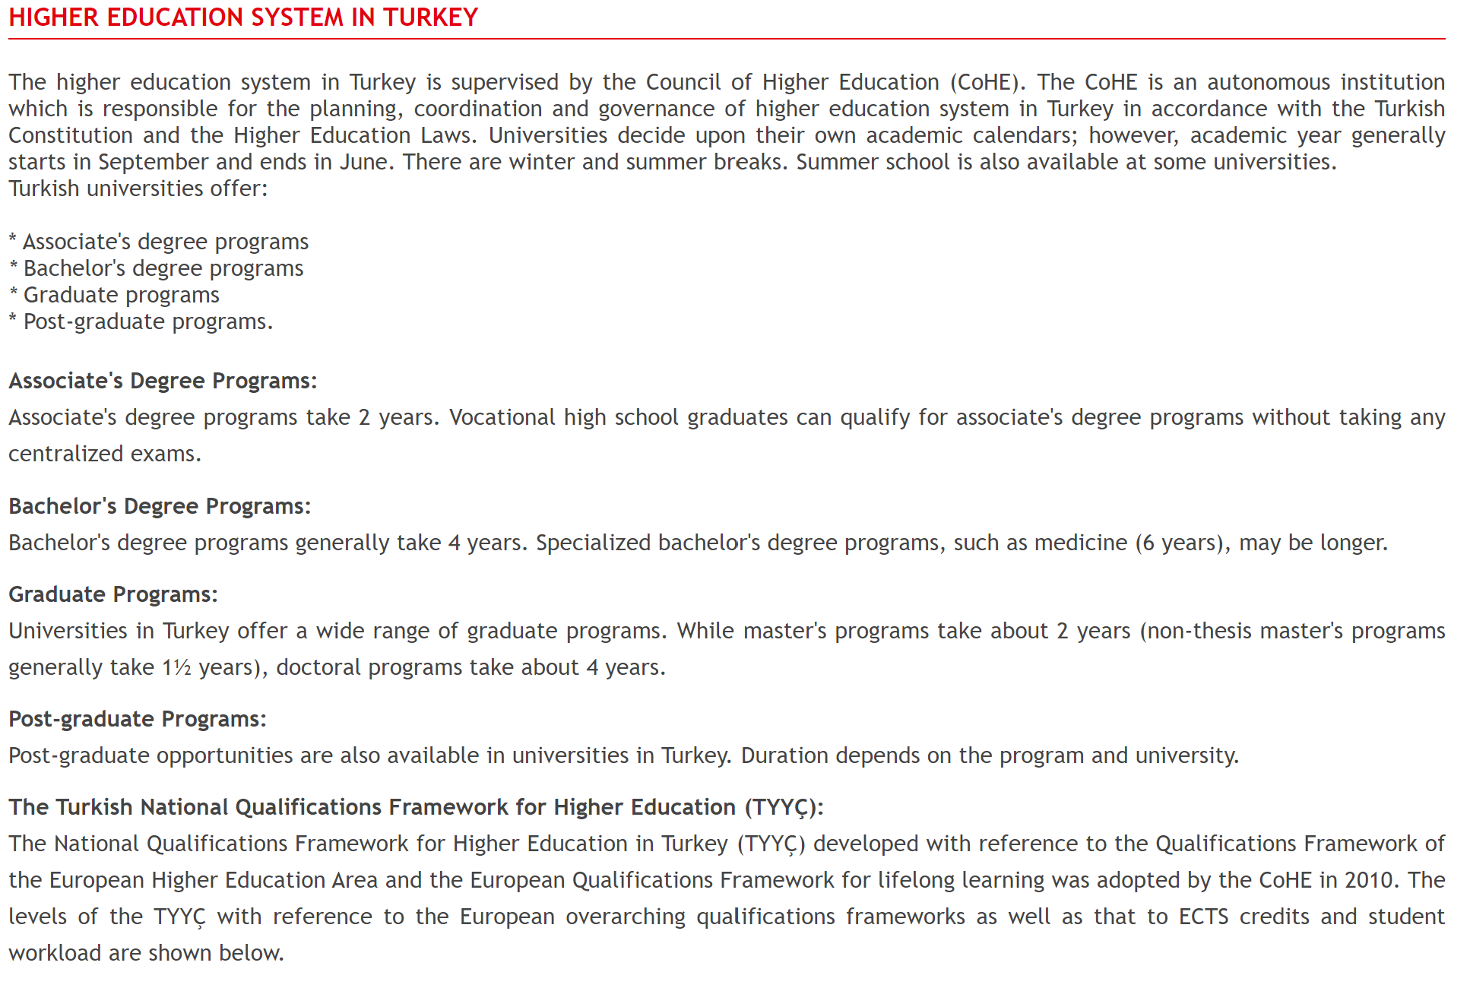

Slide 51
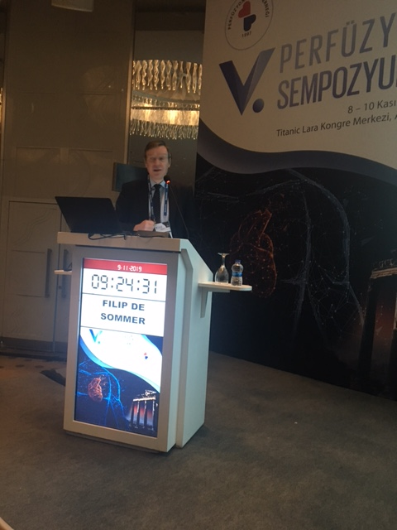

Slide 52
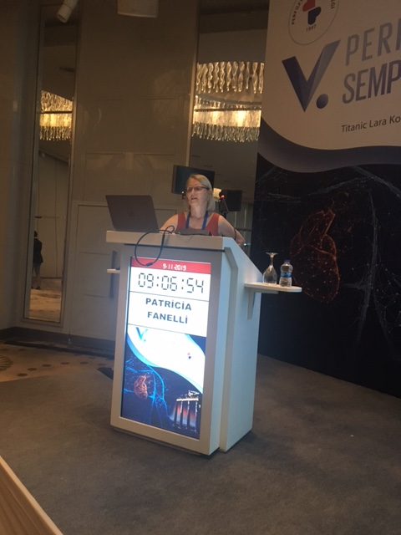

Slide 53

VI.PERFUSION SYMPOSIUM

Slide 54
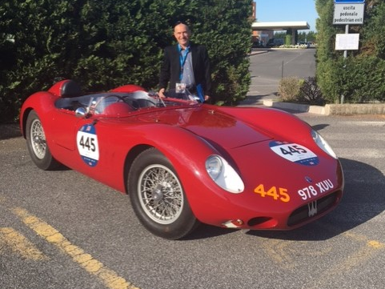
AFTER HARD WORK MY GIFT

Slide 55

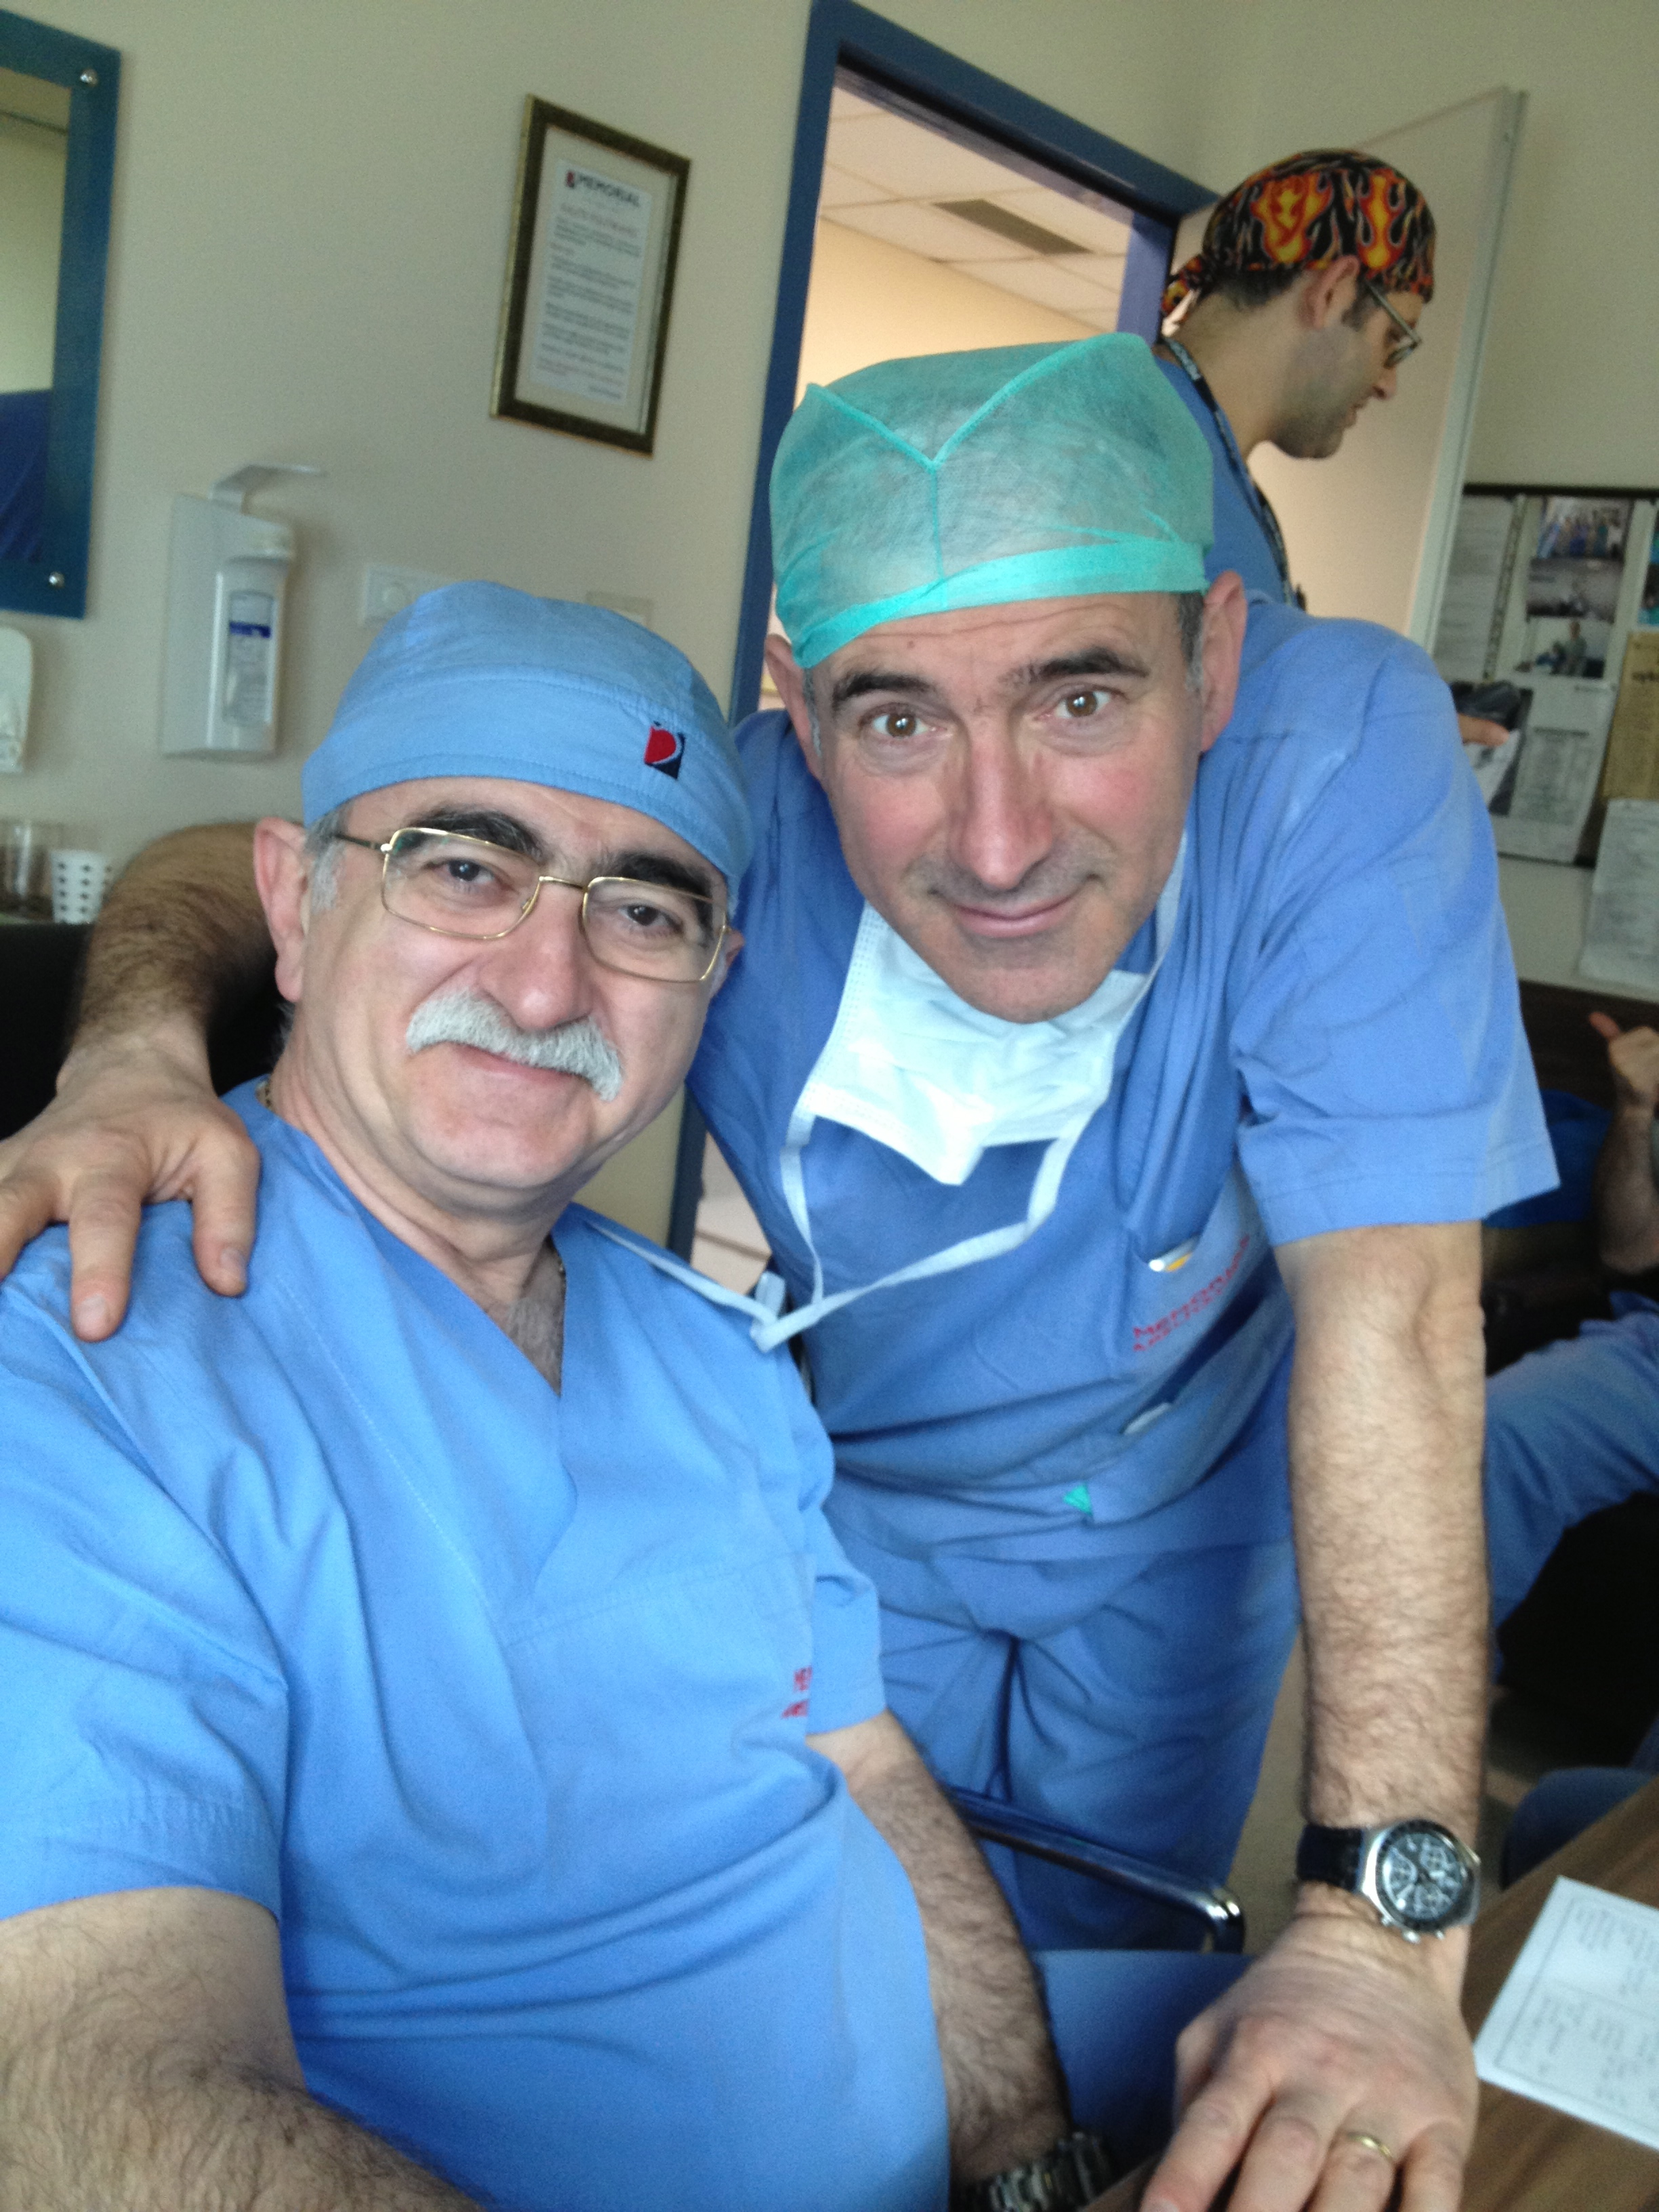
Prof. Dr. Bingür SÖNMEZ
SONSUZ TEŞEKKÜRLER…

Slide 56
THANK YOU VERY MUCH
THANK YOU VERY MUCH
THANK YOU VERY MUCH

