Slide 1
Management algorithms and artificial intelligence systems for cardiopulmonary bypass
Ignazio Condello, PhD
Anthea Hospital,GVM Care & Research
Bari,Italy

Slide 2
Management algorithms and artificial intelligence systems for cardiopulmonary bypass
Disclosure: Livanova Consultant
Eurosets Consultant
Ignazio Condello, PhD

Slide 3
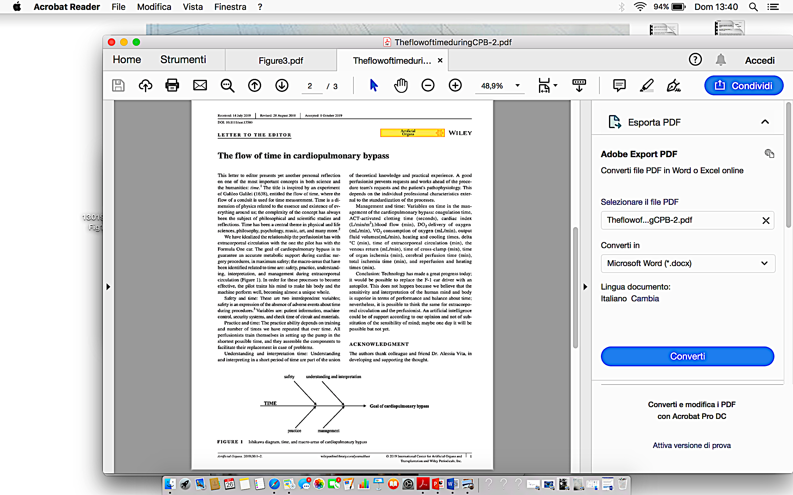


Slide 4
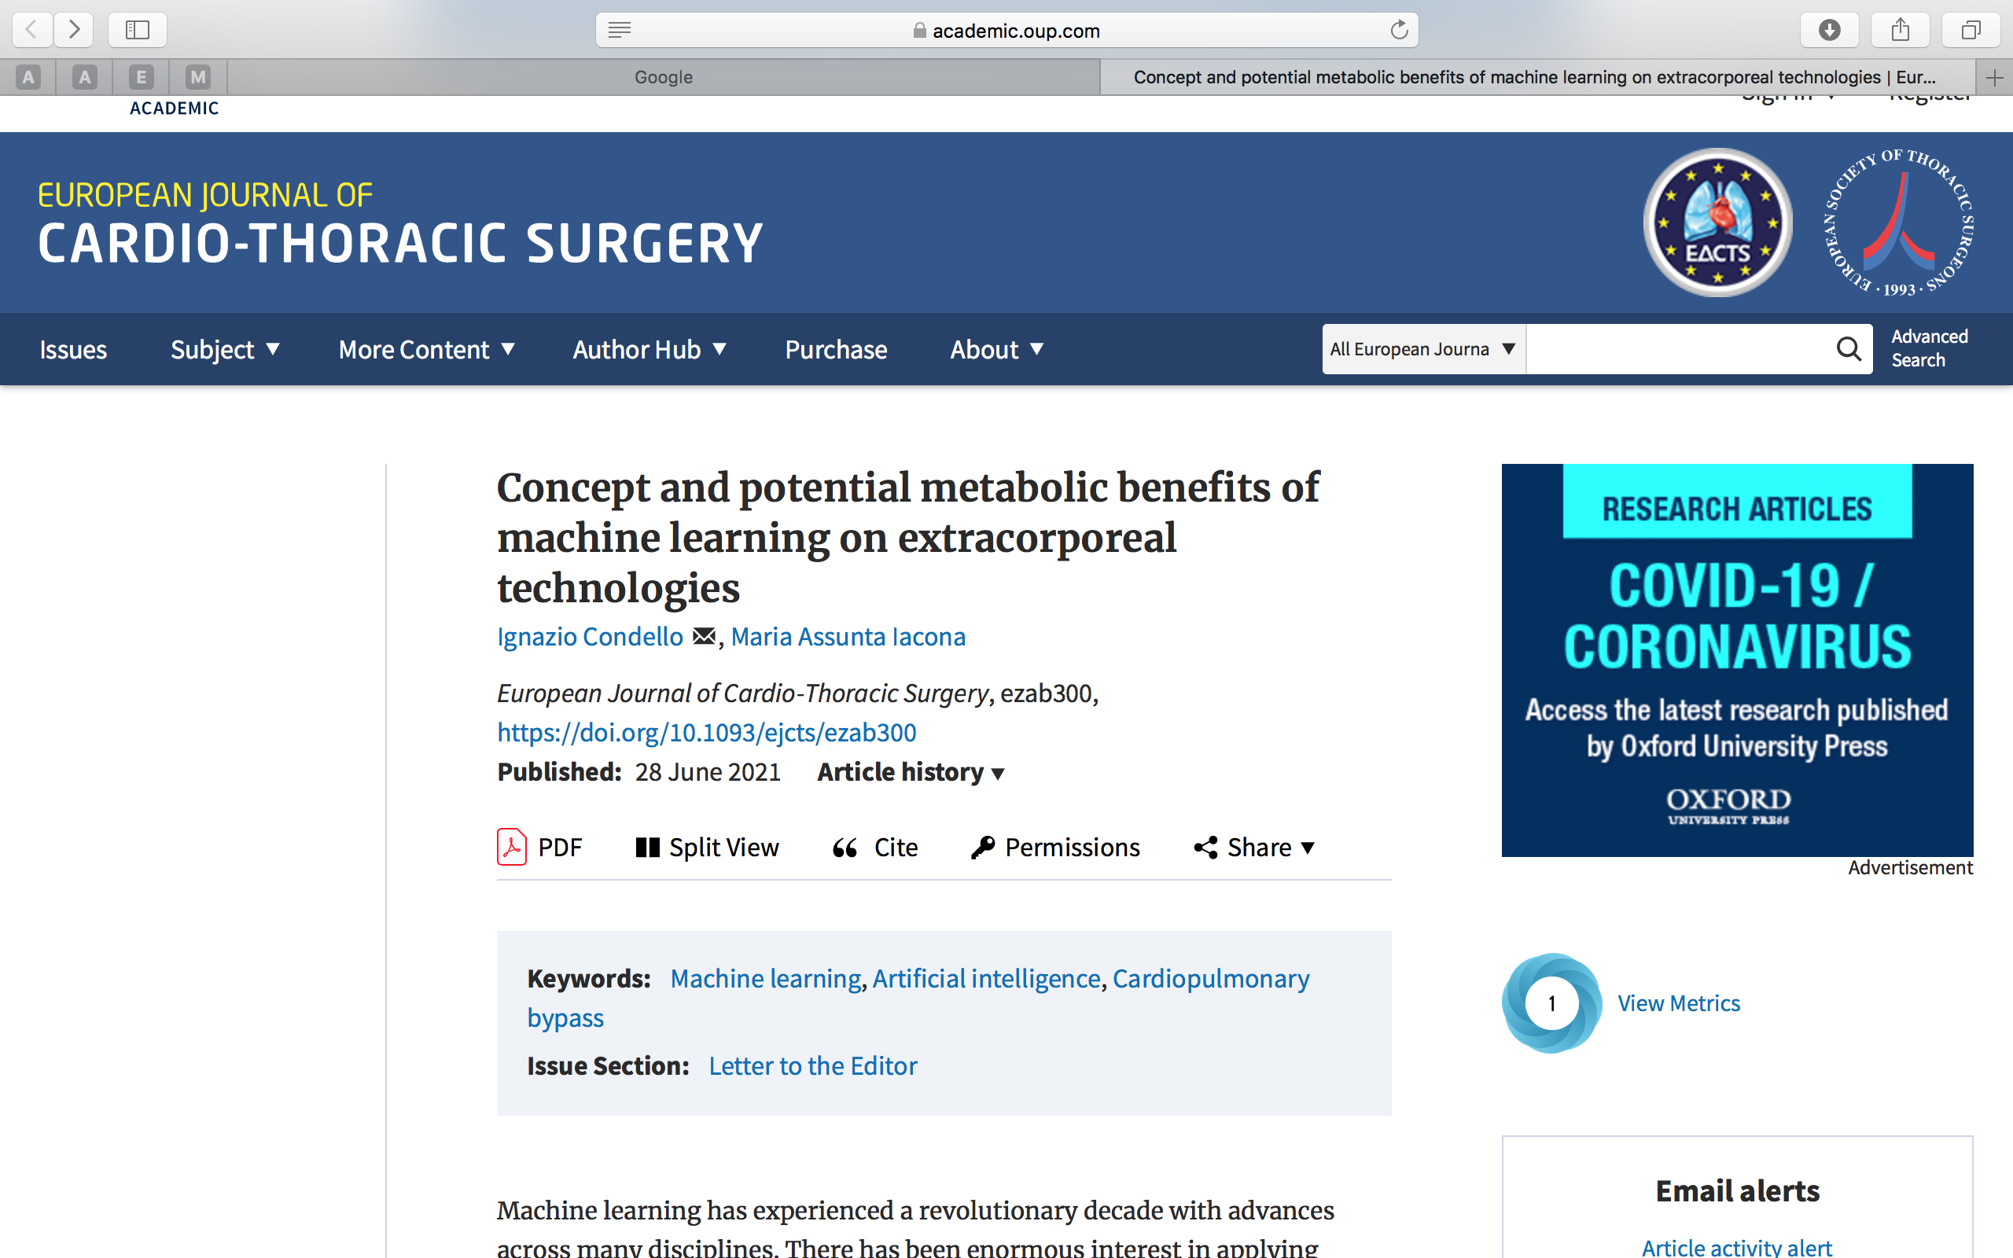
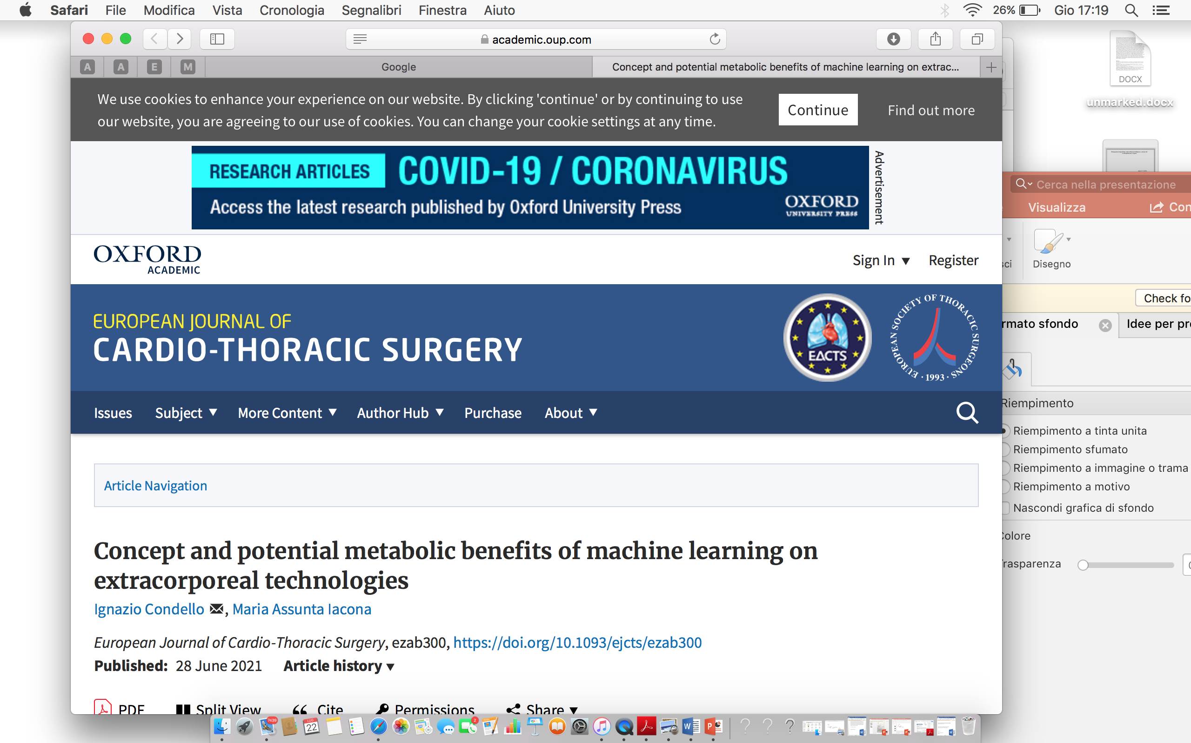
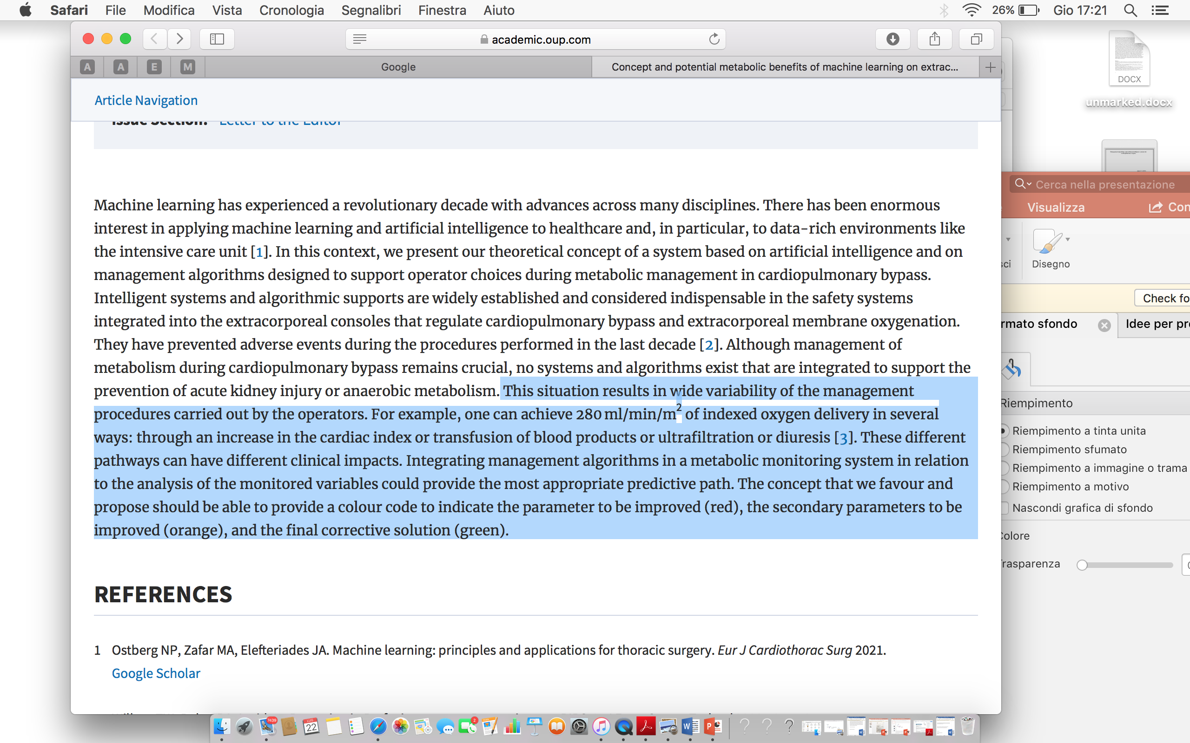
BACKGROUND

Slide 5
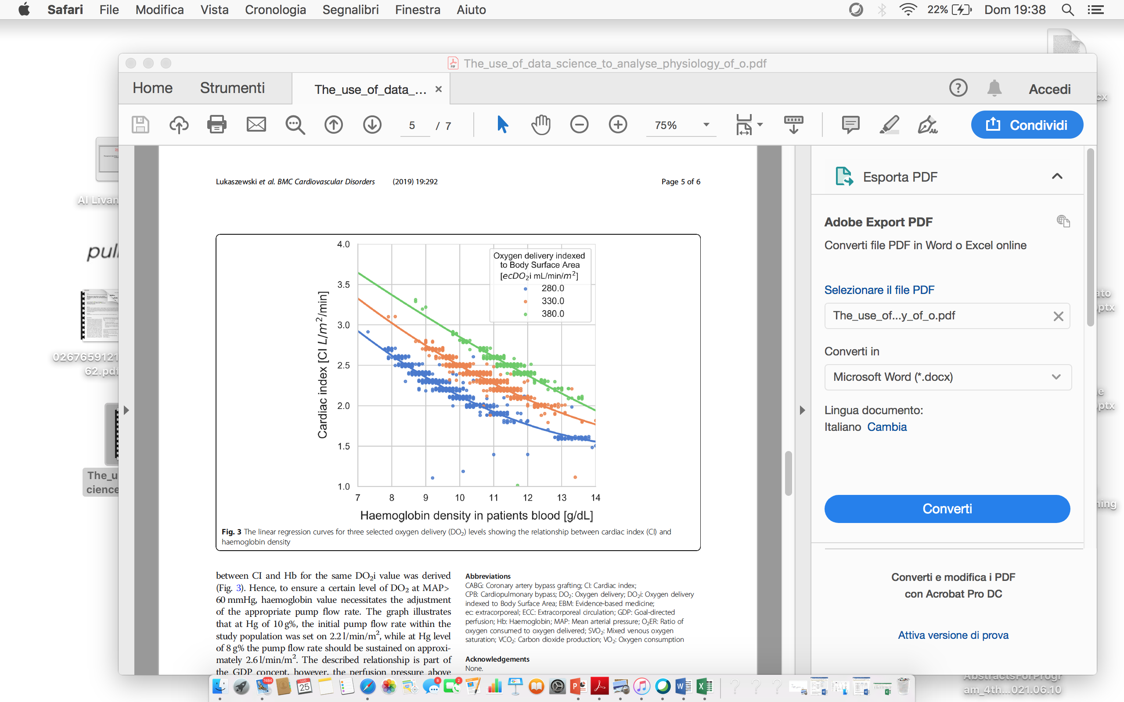
BACKGROUND

Slide 6
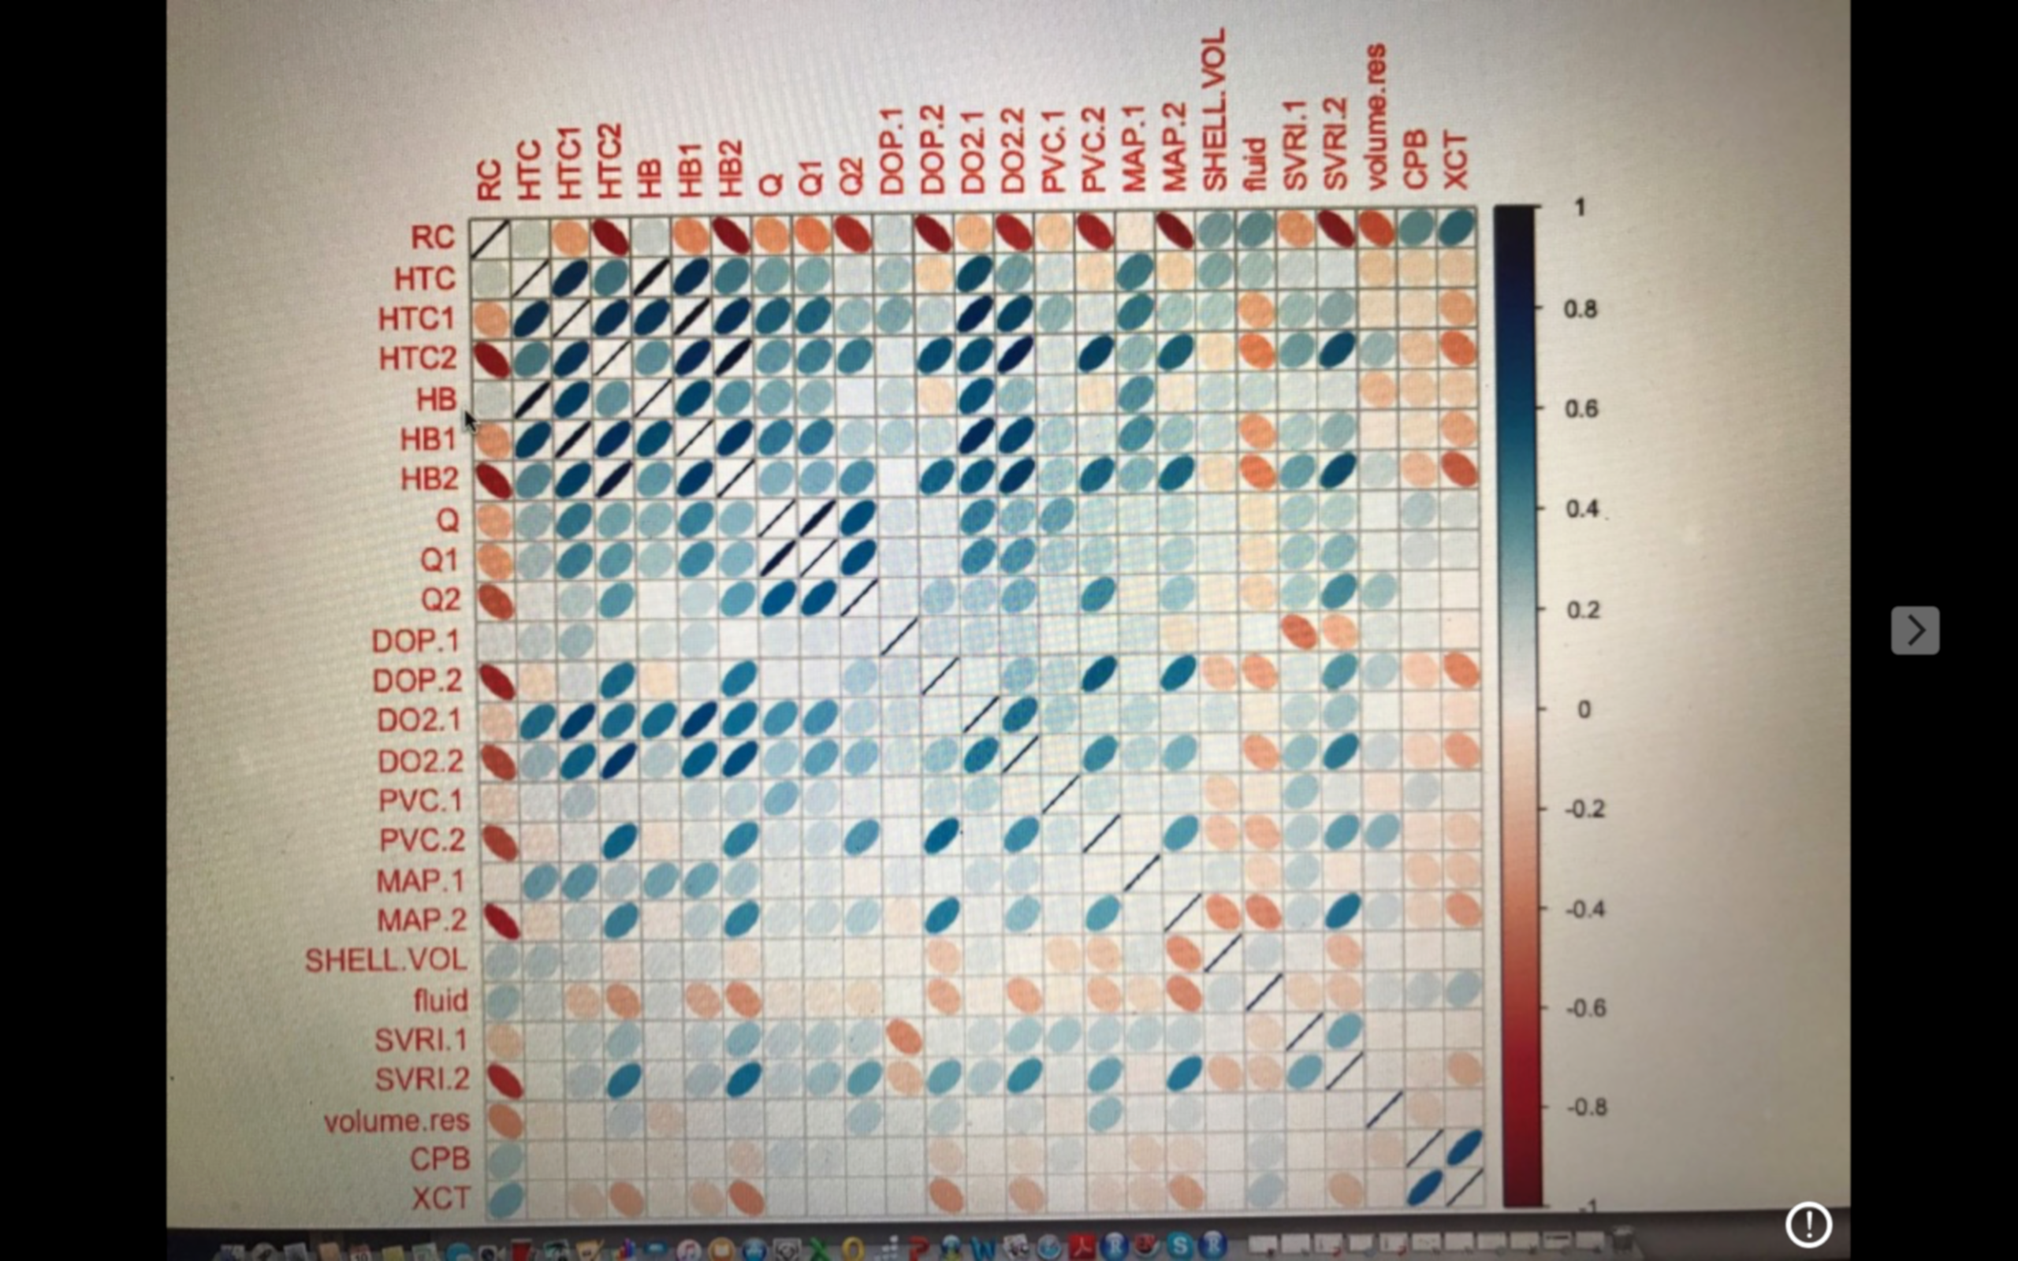

Slide 7
Translation, Modulation and Automatization
Translation and Modulation
PaO₂ and PaCO₂ Cruise Control
Threshold and Coast examples
PaO₂ lower 100 middle 110 upper 120 mmHg (Arterial Line)
PaCO₂ lower 40 middle 42 upper 45 mmHg VCO₂ (Oxygenator or Others)
Workstation Software
Algorithms
Automatic and Continuous Modulation of Air Flow and FiO2 in relation to:
Threshold (in relation to ischemia and reperfusion time or cerebral perfusion et al.)
Pump Flow
External administration of CO₂ in Surgical Field (Quantitative Estimation Formula of Real and Relative VCO₂ value)
Temperature
Ventilation Module

Slide 8
Translation, Modulation and Automatization
VAVD Cruise control
Threshold and Coast examples
VAVD lower -15 middle -30 upper -40 mmHg (on Venous Reservoir)
Workstation Software
Algorithms
Automatic and Continuous Modulation of VAVD in relation to:
Threshold
Venous return escursion (Volume Monitoring)
Flow variations
Pumps and aspirators
Ventilation Module

Slide 9
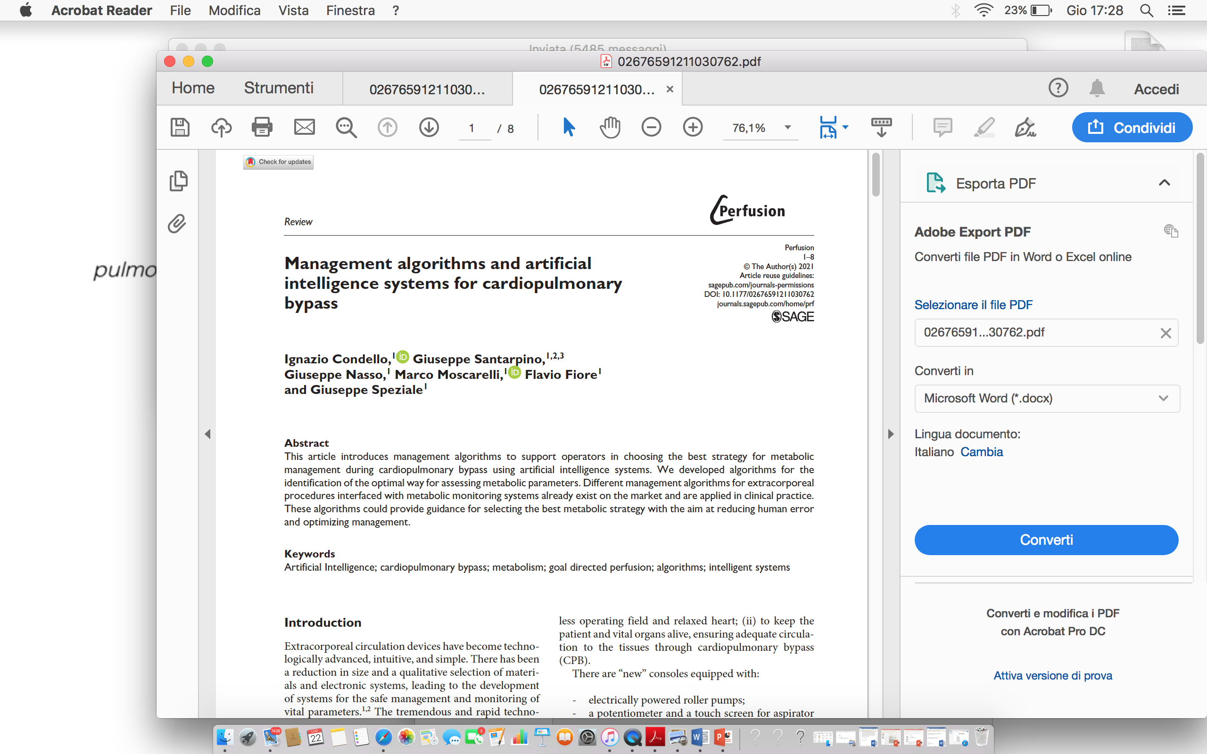

Slide 10
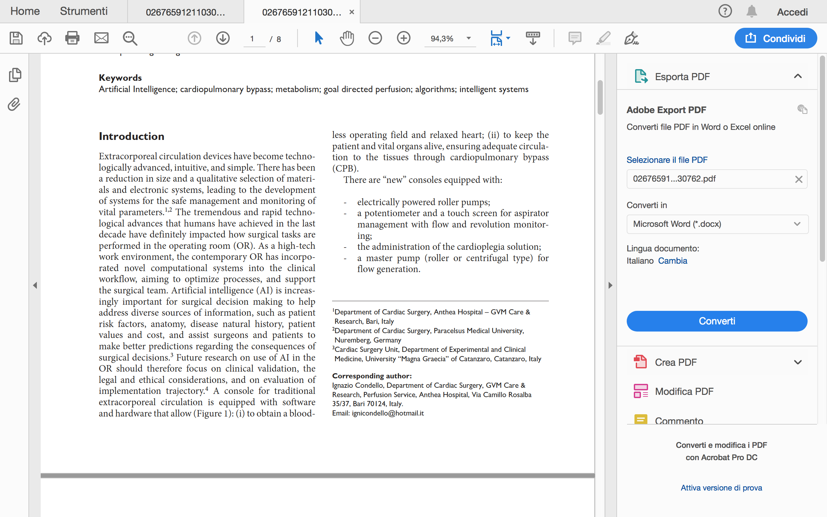

Slide 11
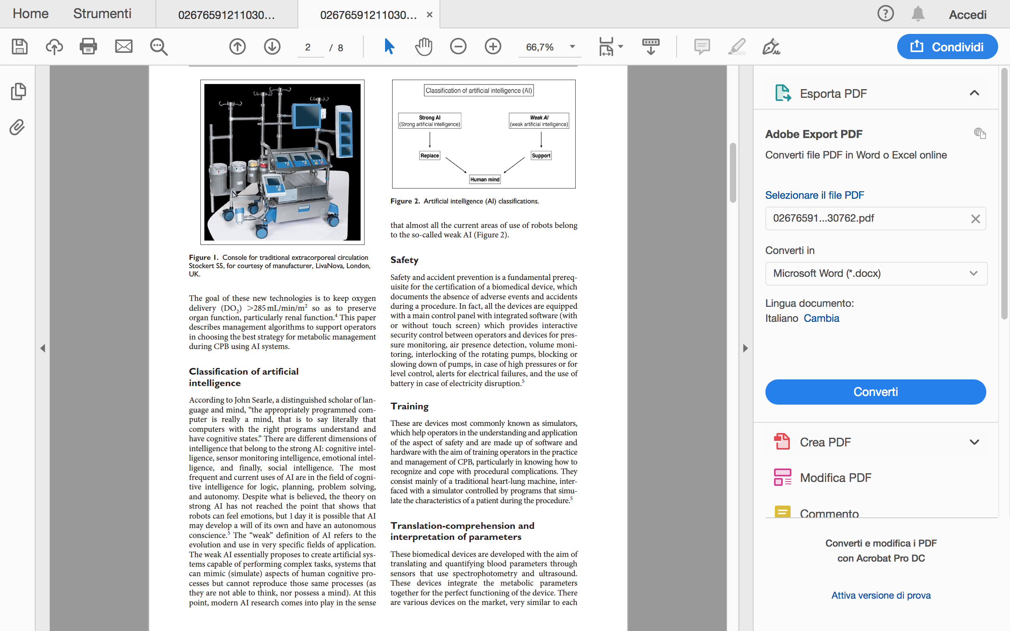

Slide 12
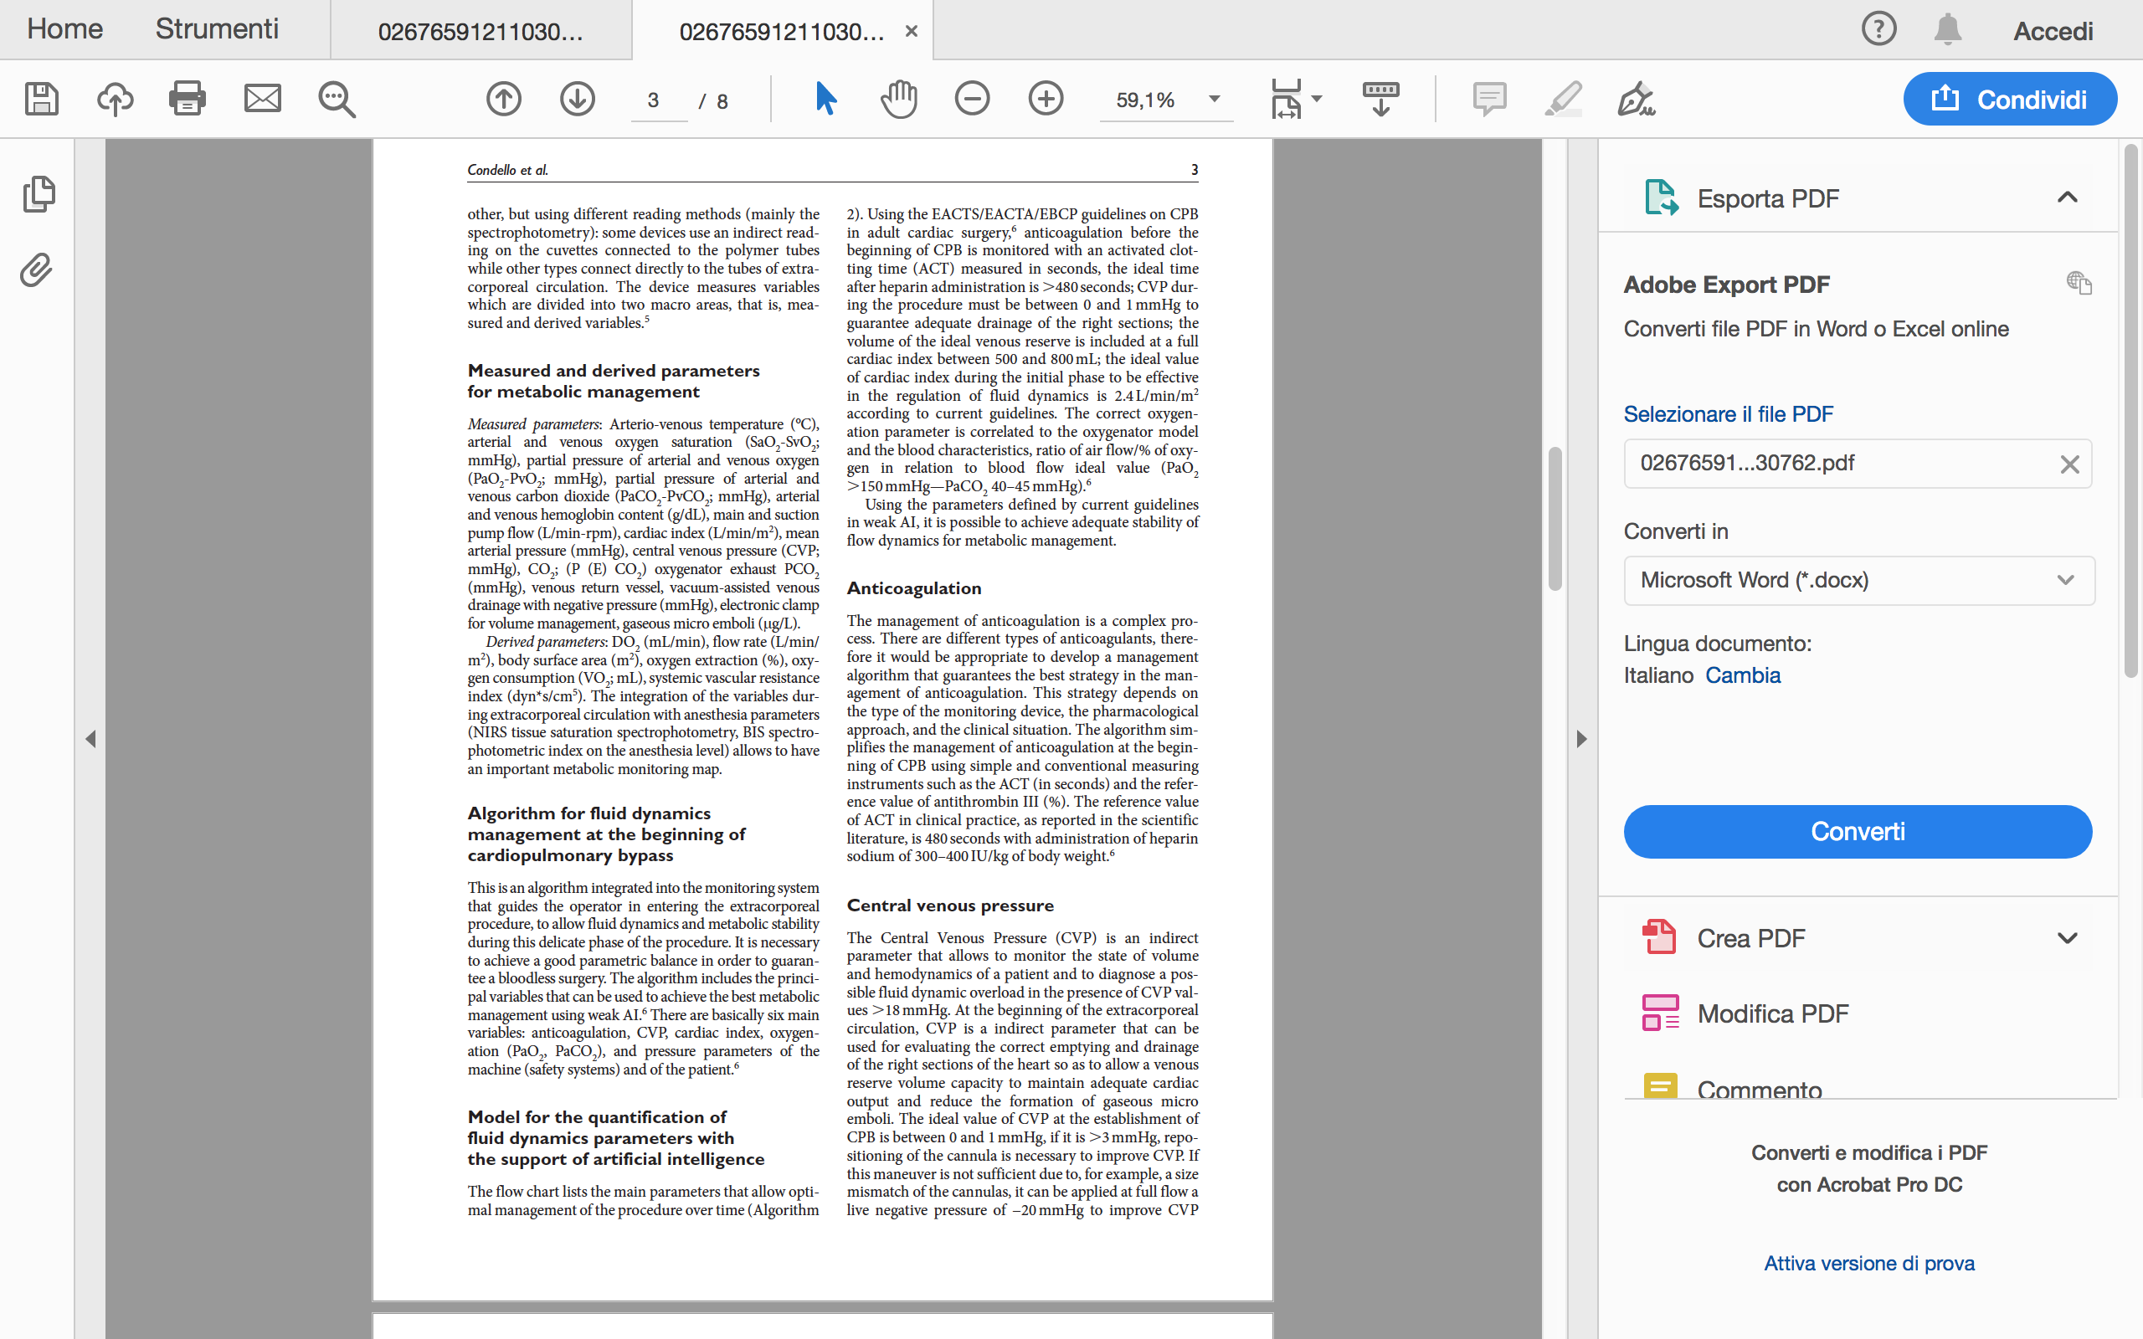

Slide 13
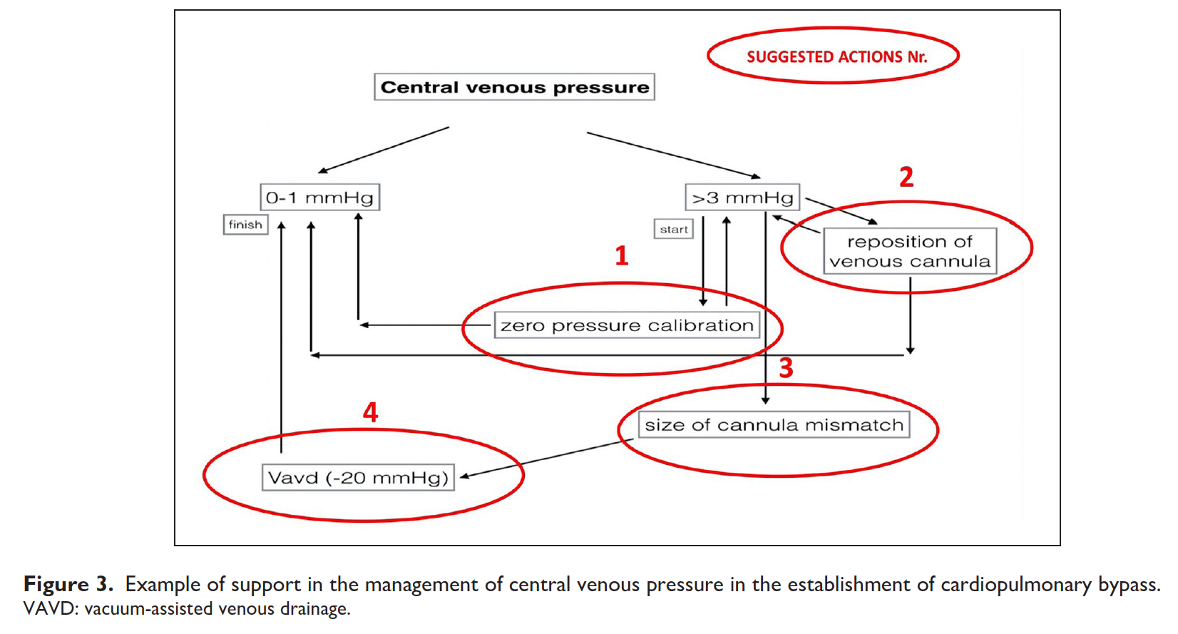
Training and Clinical Pratice

Slide 14
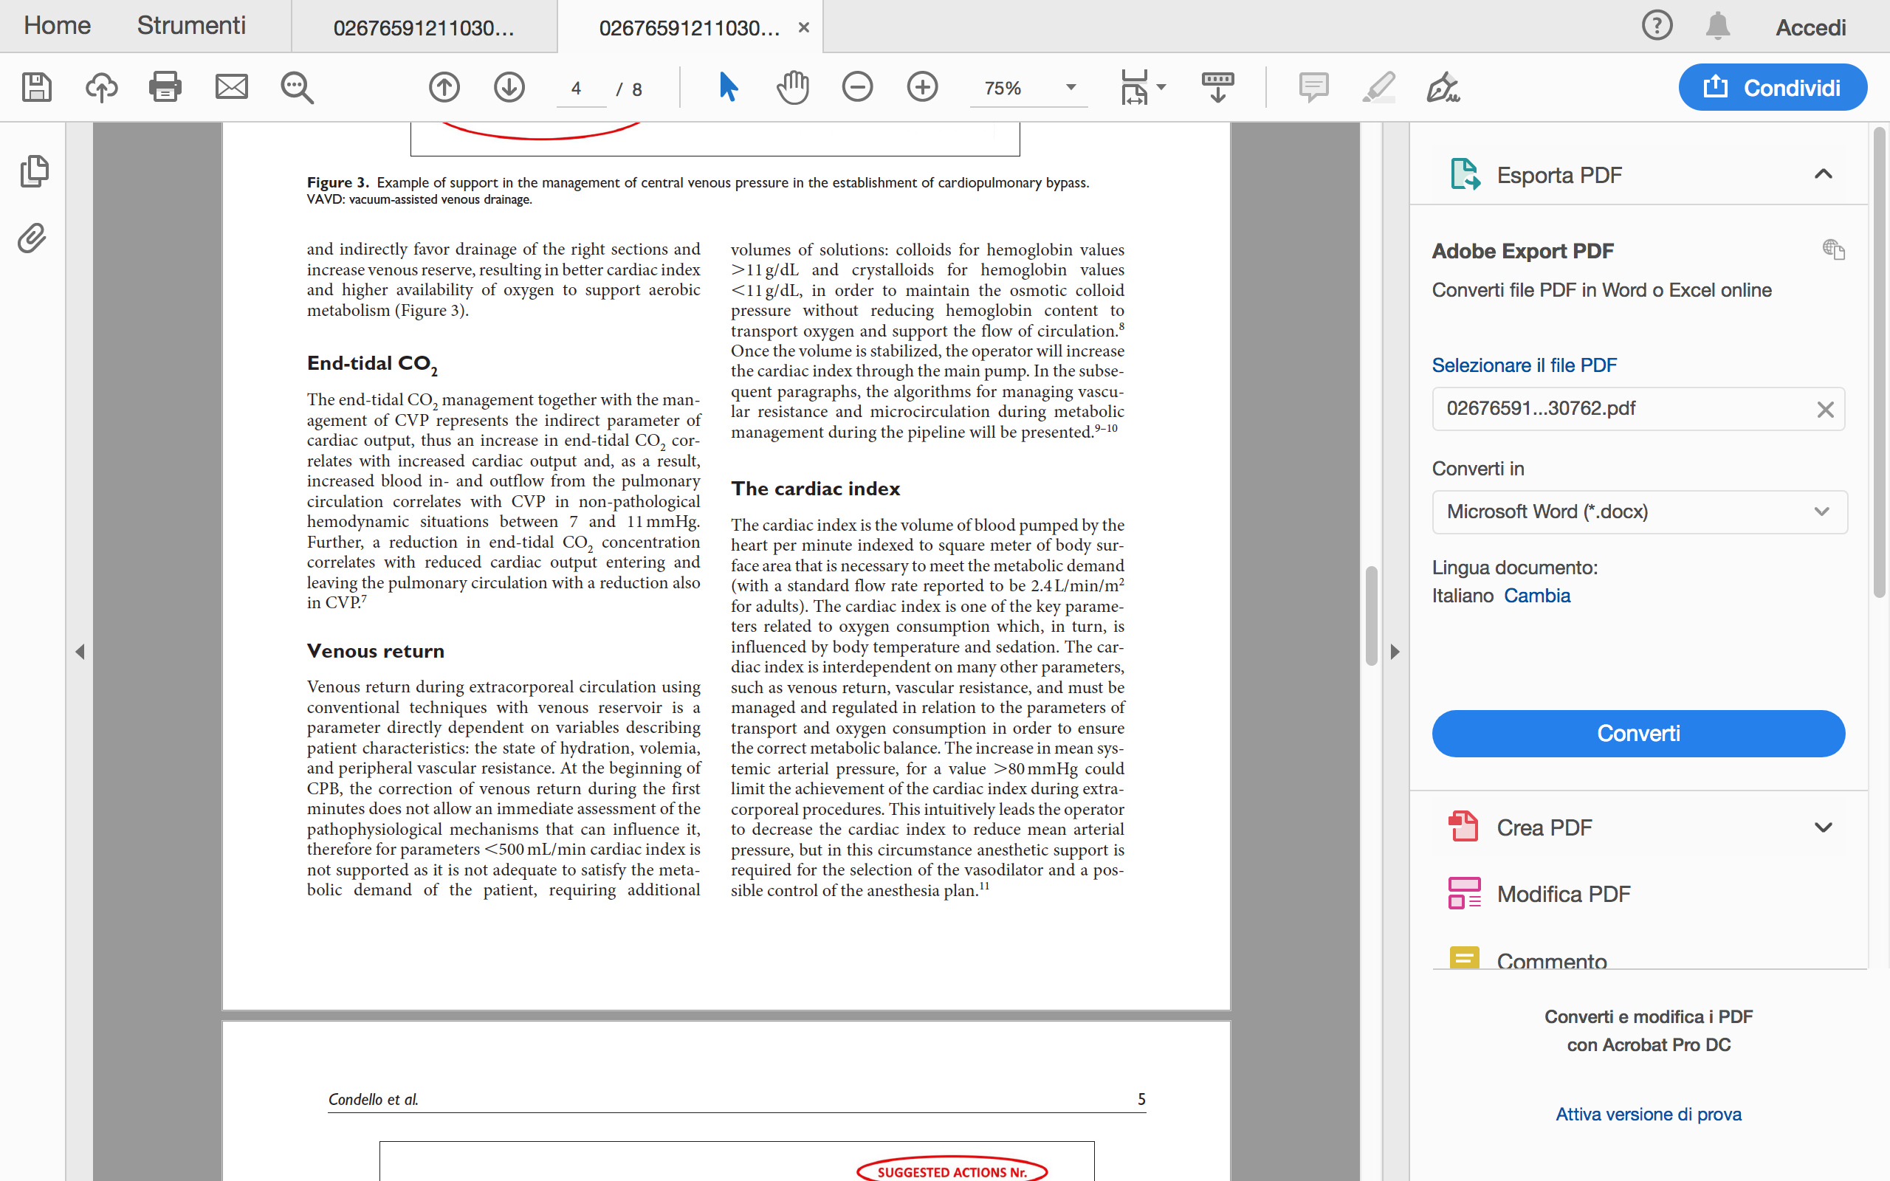

Slide 15
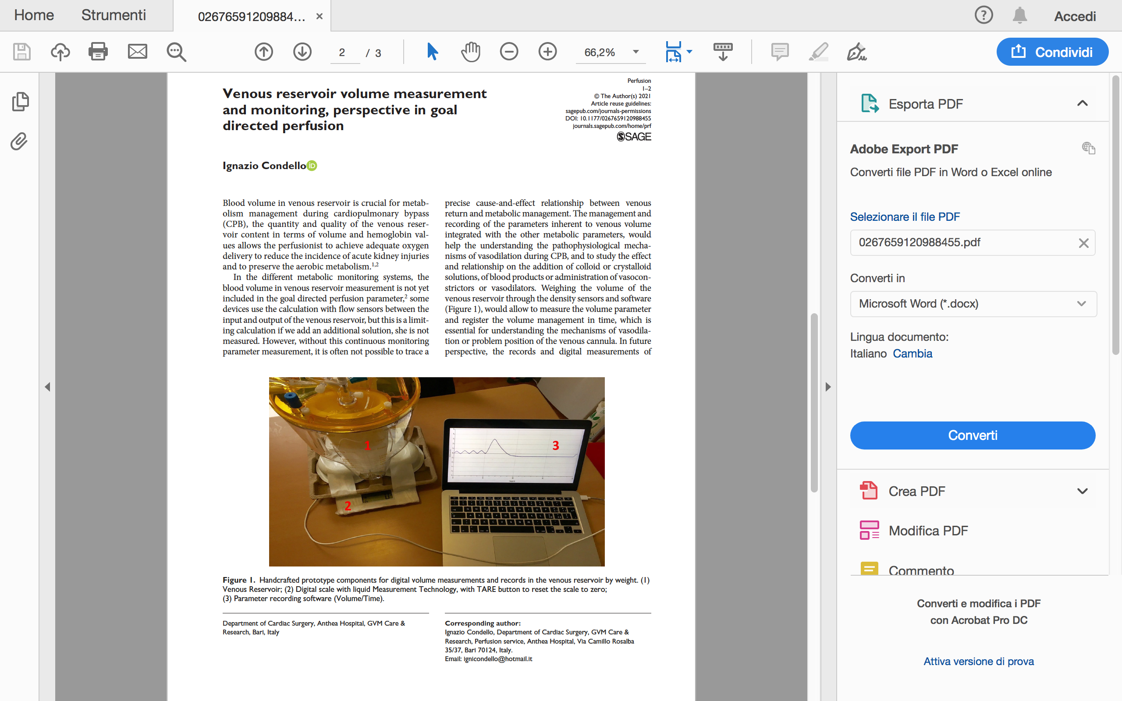

Slide 16
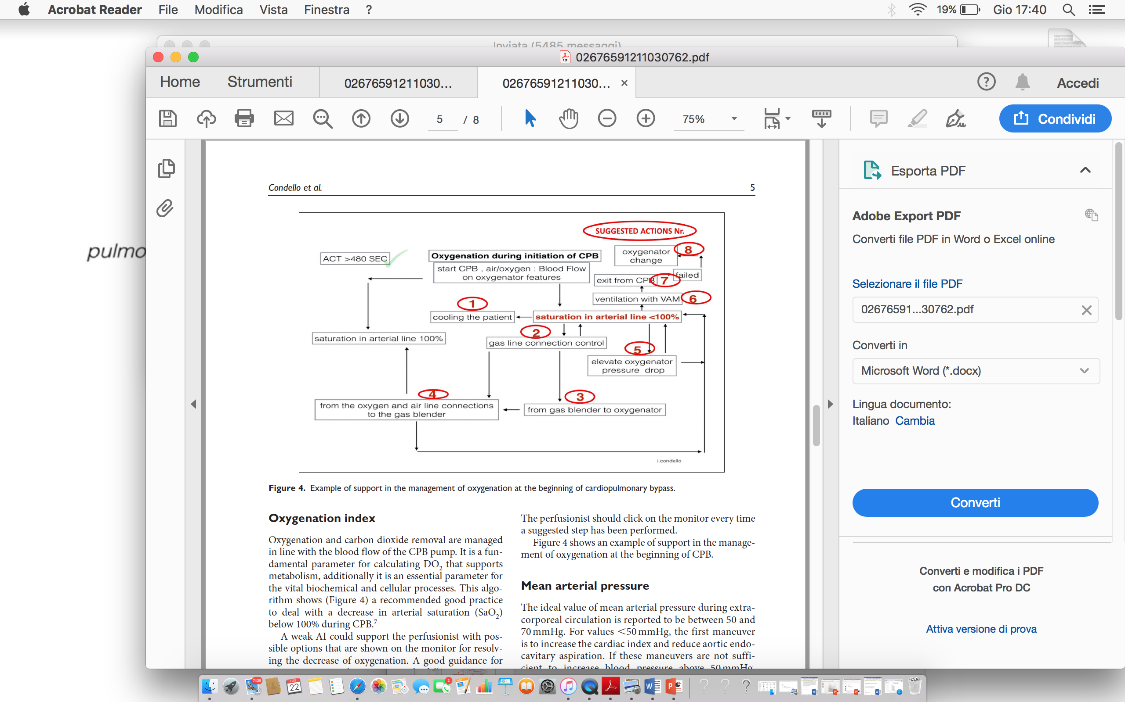
Training and Clinical Pratice

Slide 17
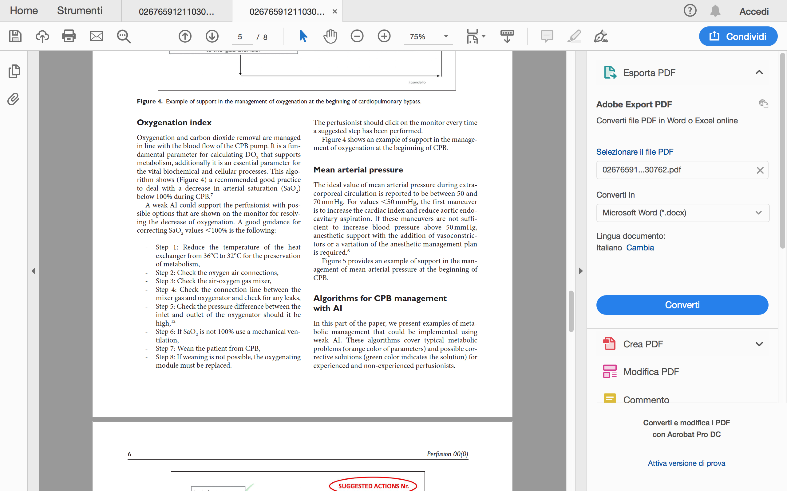

Slide 18
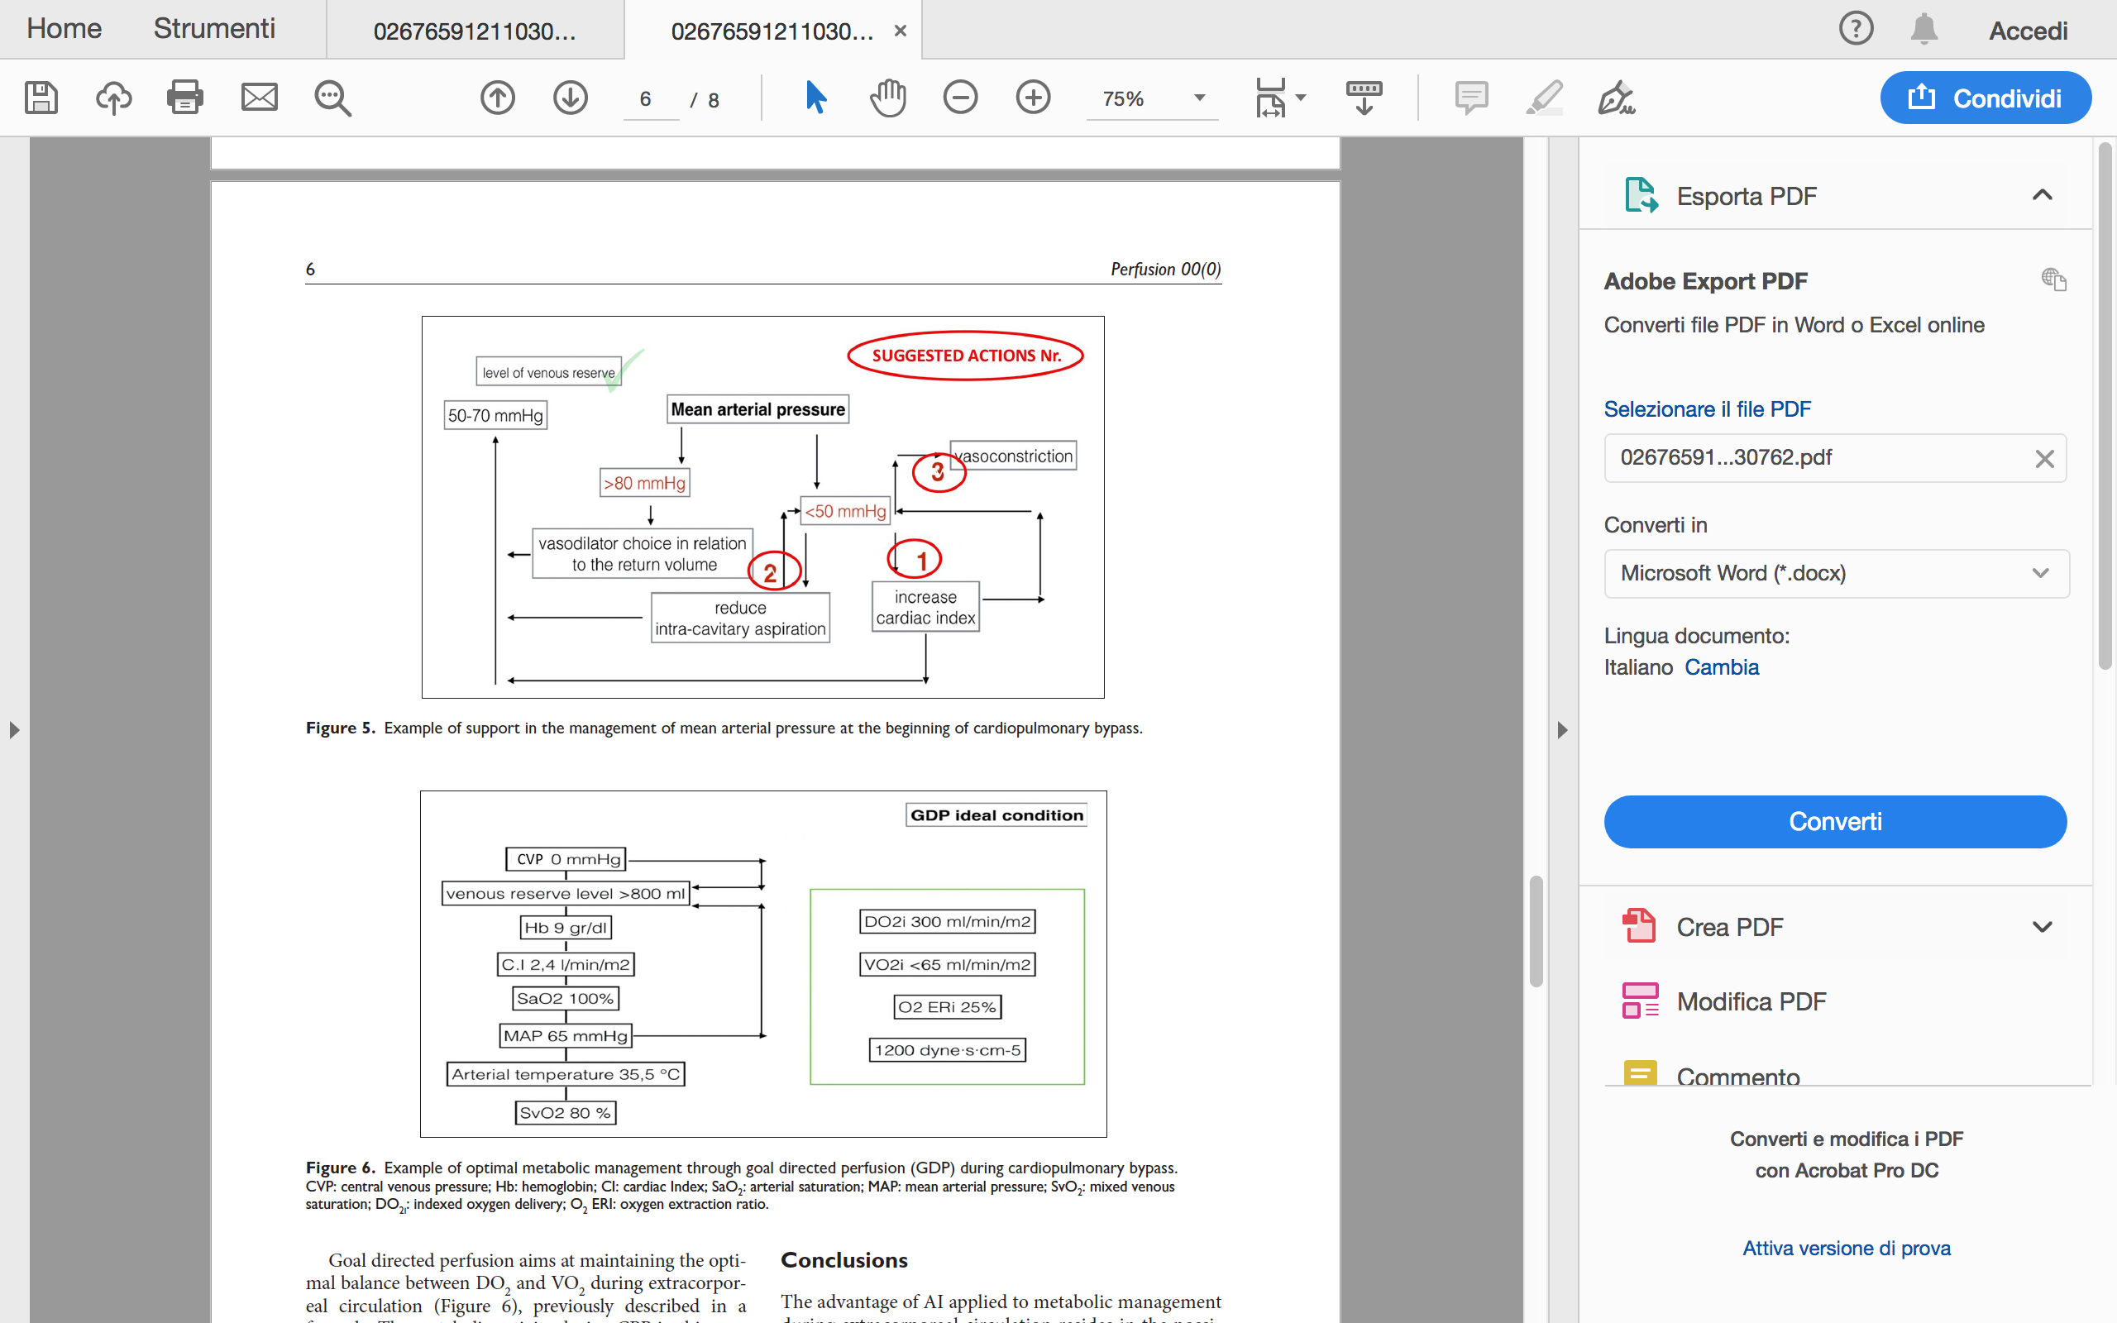
Training and Clinical Pratice

Slide 19
Training and Clinical Pratice

Slide 20
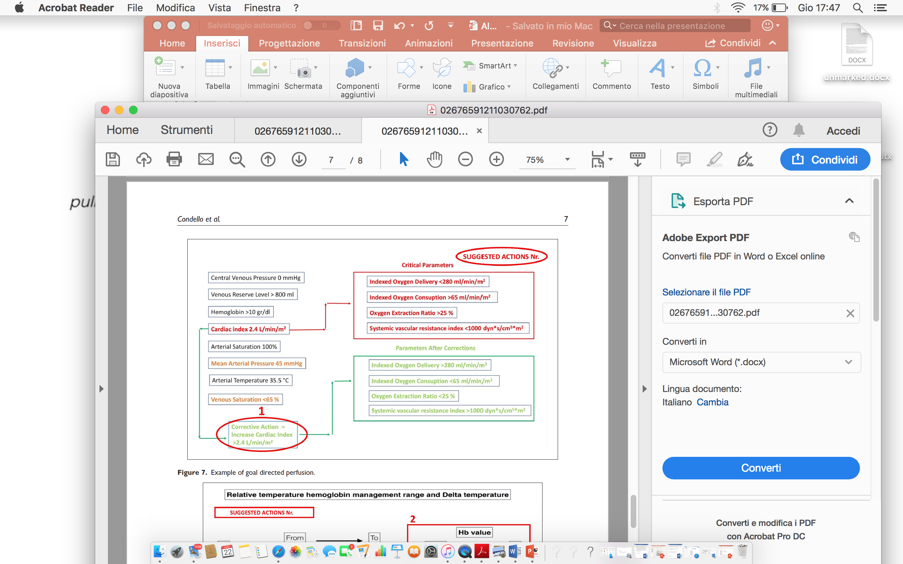
Training and Clinical Pratice

Slide 21
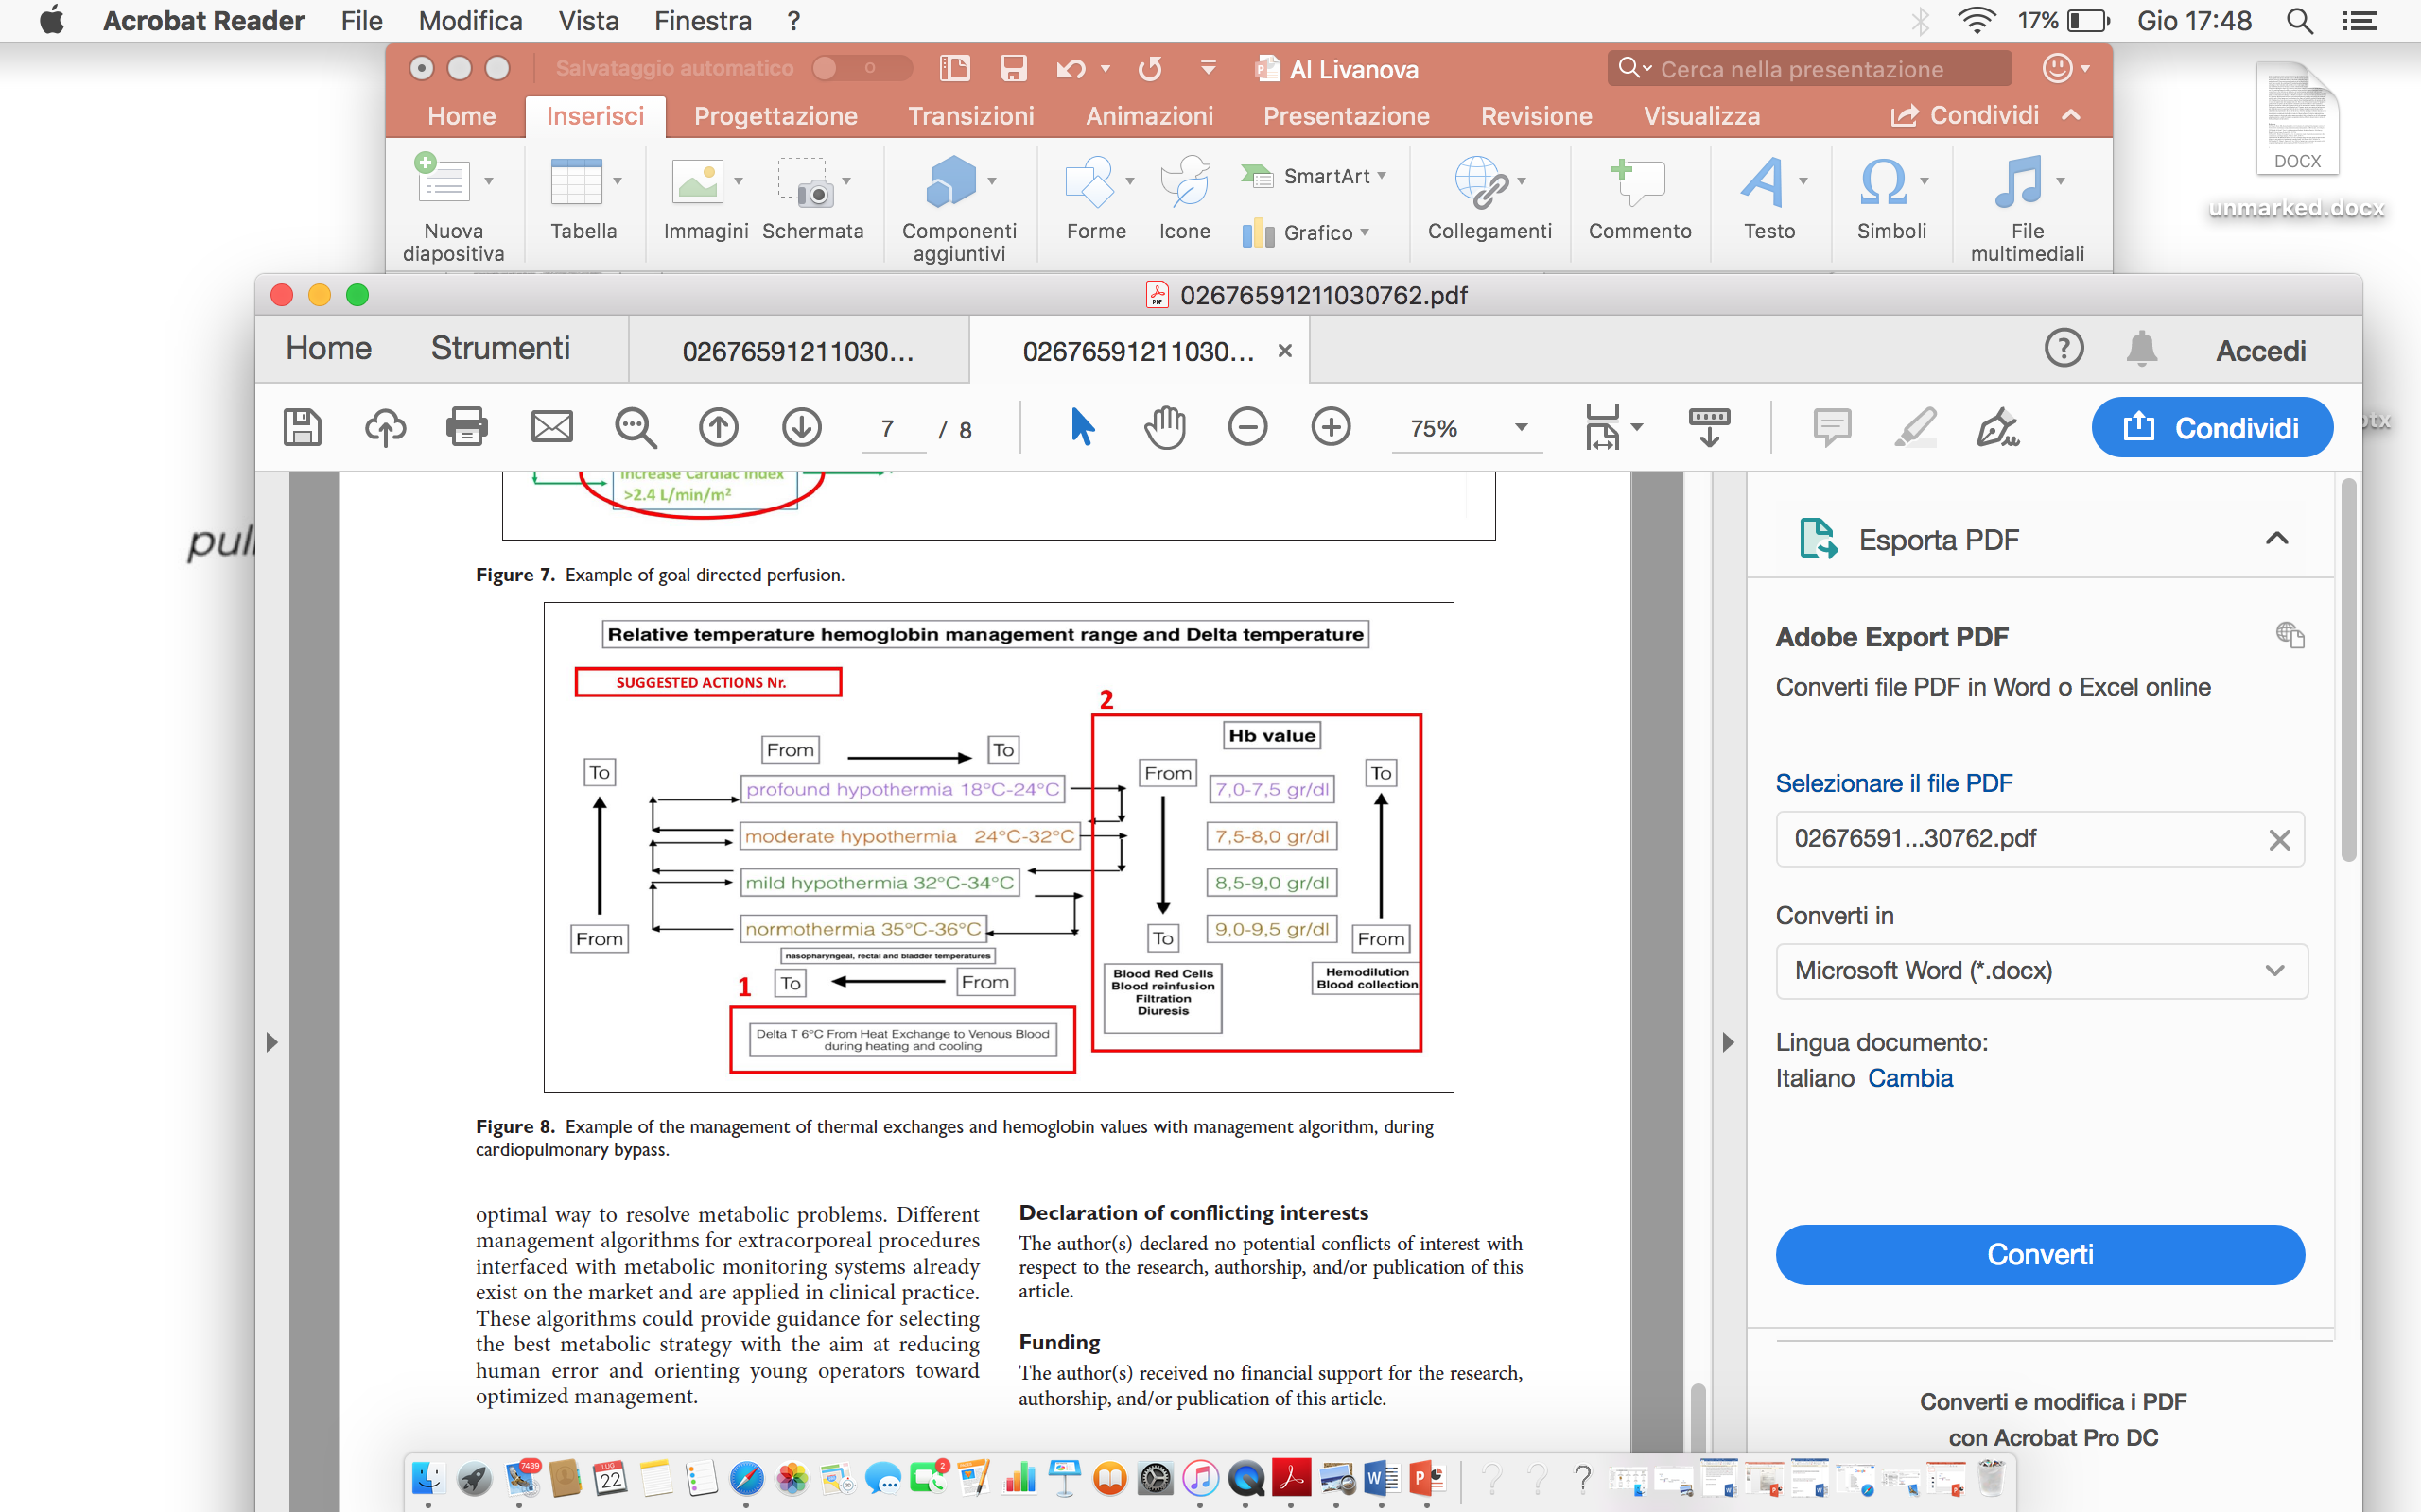
Training and Clinical Pratice

Slide 22
Conclusions
The advantage of AI applied to metabolic management during extracorporeal circulation resides in the possibility of integrating the calculated and highly variable
metabolic parameters into the monitoring systems. This management system remains flexible to the changes in internal data management parameters that can be expanded and modified by the staff, thus customizing the type of conduct based on the experience of the center. Goal directed perfusion has improved metabolic management resulting in a lower incidence of acute renal failure. However, there have not been systems with algorithms for the identification of the optimal way to resolve metabolic problems. Different management algorithms for extracorporeal procedures interfaced with metabolic monitoring systems already
exist on the market and are applied in clinical practice. These algorithms could provide guidance for selecting the best metabolic strategy with the aim at reducing
human error and orienting young operators toward optimized management.

Slide 23
THANK YOU
Ignazio Condello, PhD
Anthea Hospital,GVM Care & Research
Bari,Italy

