Slide 1
Pandemics & Response of Perfusionists
Ignazio Condello, PhD
Anthea Hospital,GVM Care & Research
Bari,Italy

Slide 2
Pandemics & Response of Perfusionists
Ignazio Condello

Slide 3
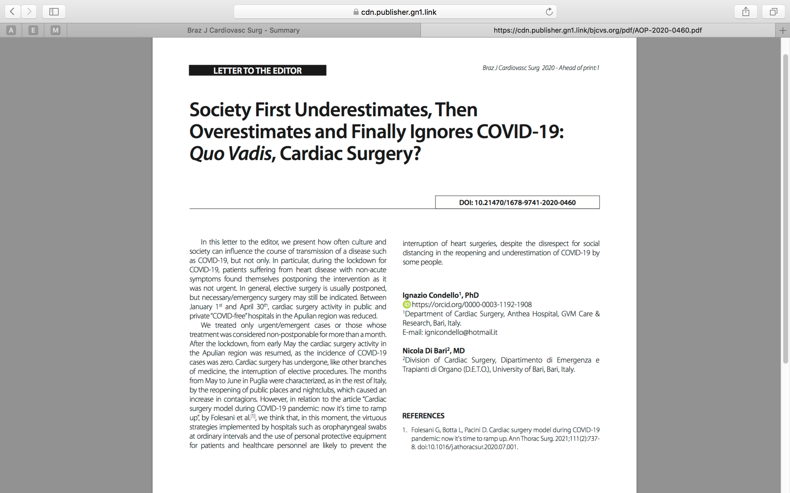

Slide 4
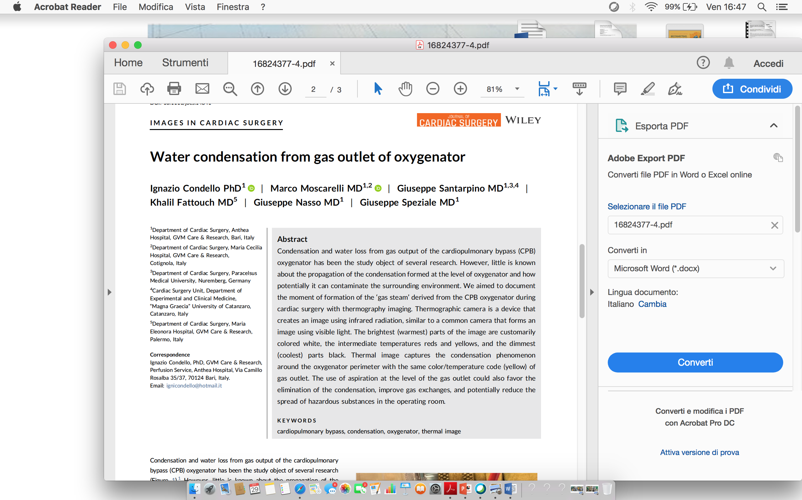

Slide 5
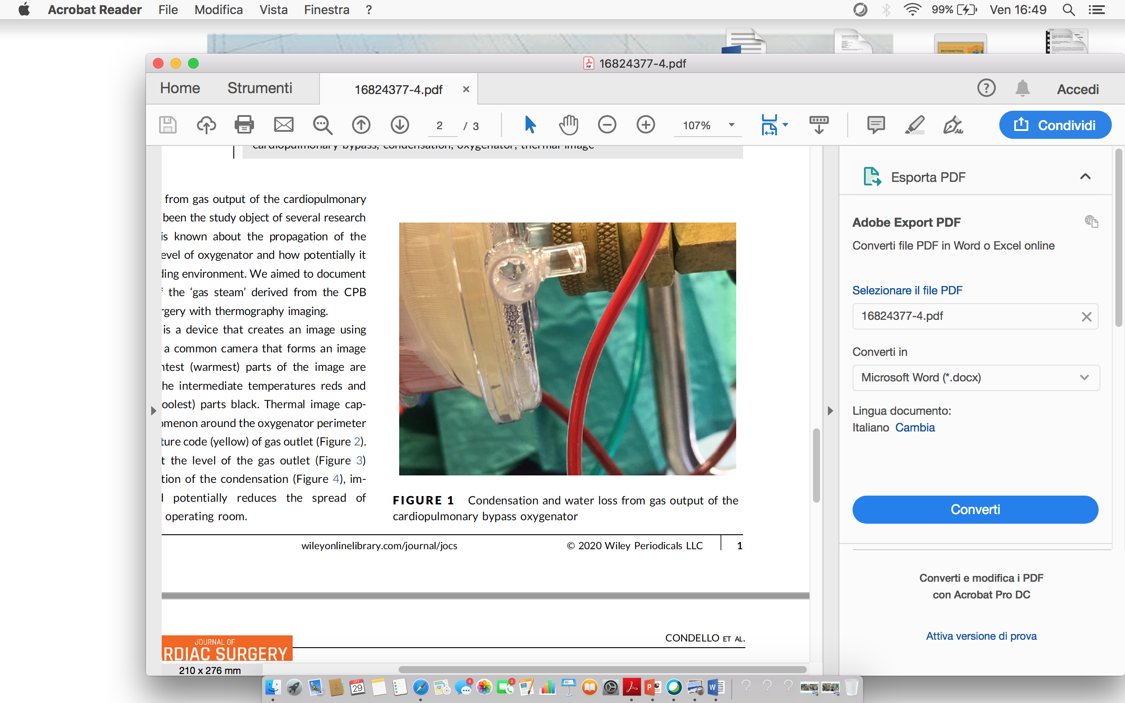

Slide 6
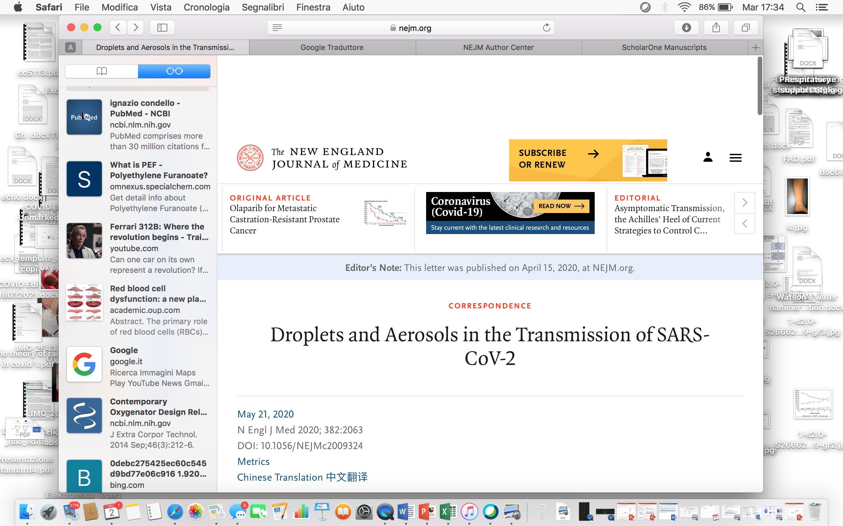
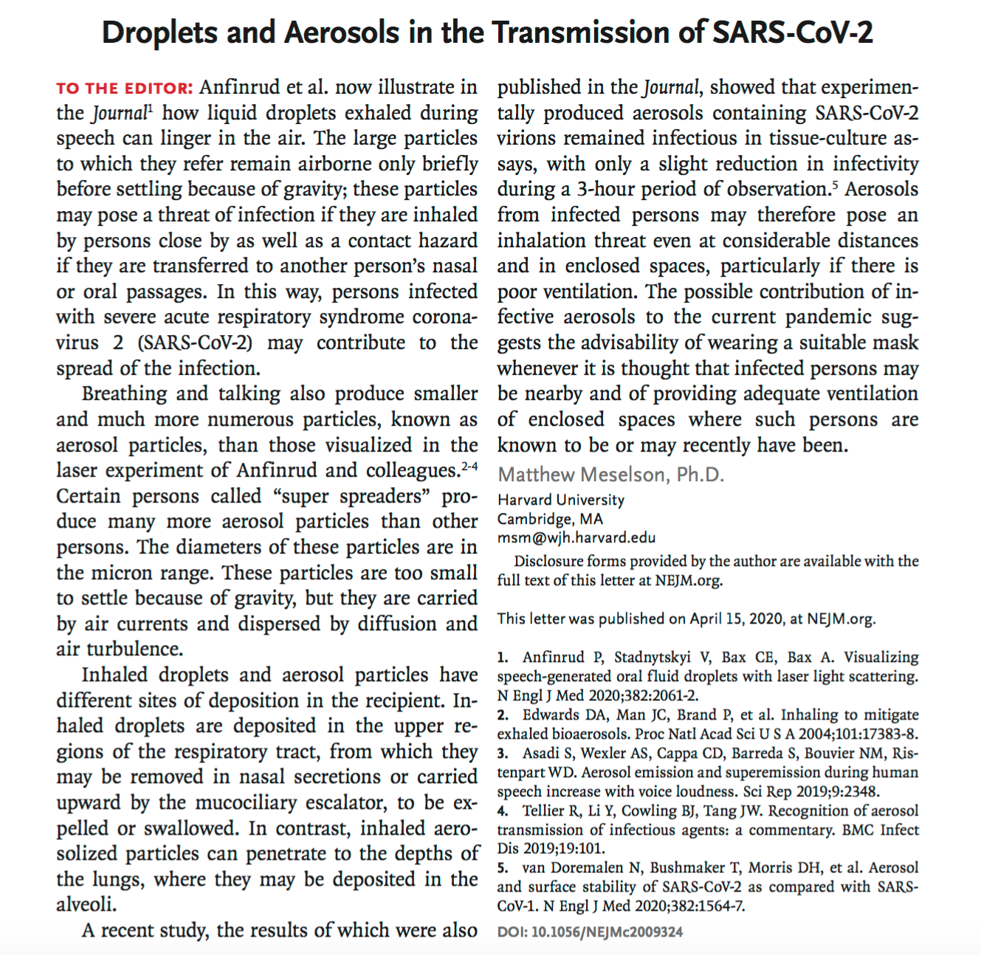
N Engl J Med 2020; 382:2063

Slide 7
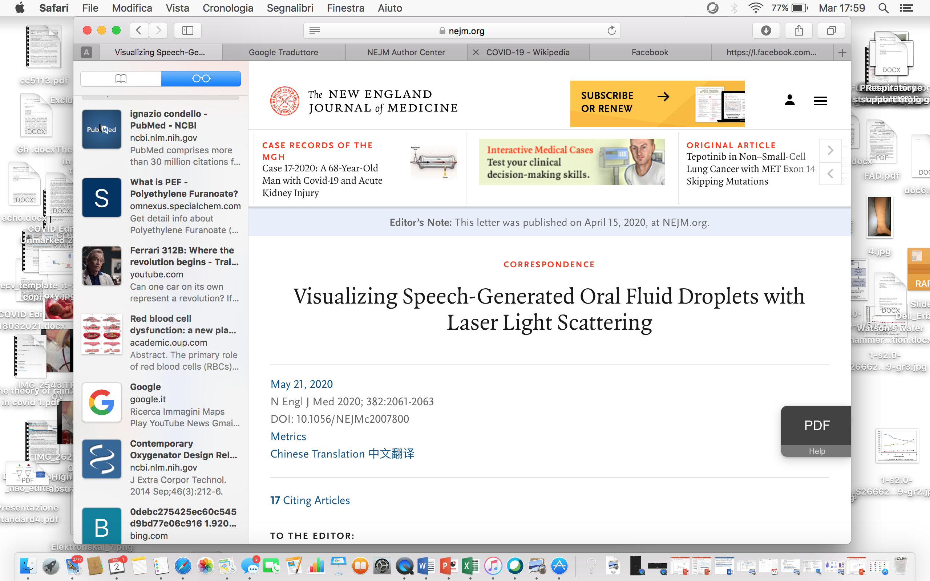
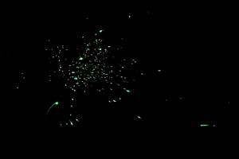
Laser Light-Scattering Experiment Showing Speech-Generated Droplets
Droplets generated during speech produced flashes as they passed through the light sheet in this experiment.
N Engl J Med 2020; 382:2061-2063

Slide 8
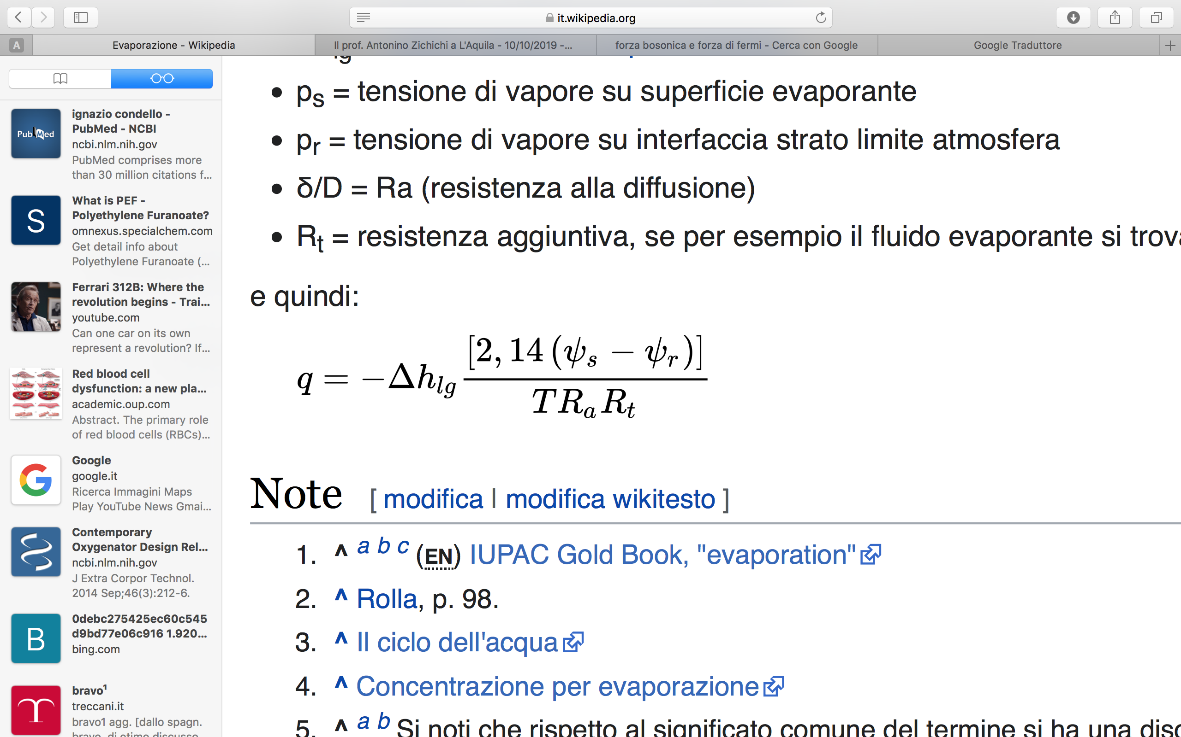

Slide 9
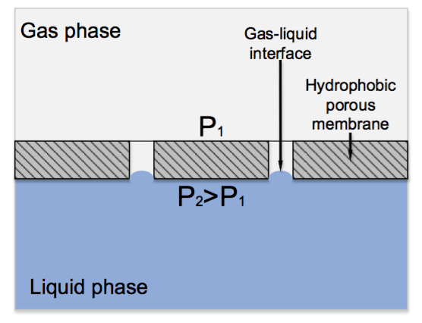
Fibers 2018, 6, 76; doi:10.3390/fib6040076

Slide 10
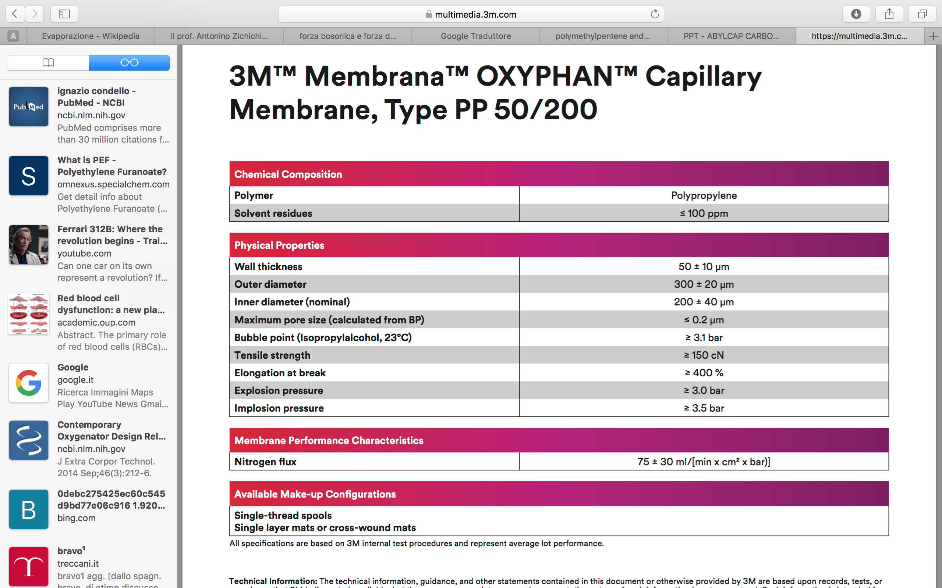
The highly branched, sponge-like pore structure makes it strongly resistant to entry of liquids and plasma breakthrough.

Slide 11
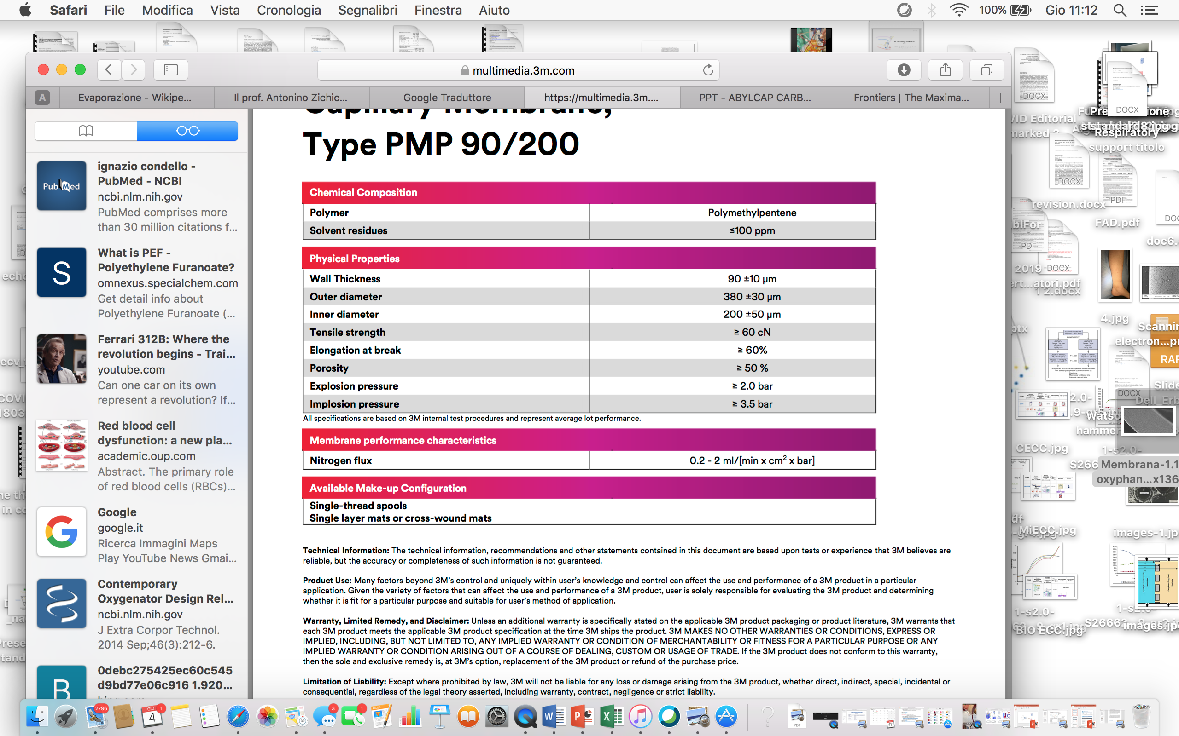
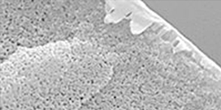
The dense outer skin prevents the passing of liquids like blood plasma or water into the pores even during prolonged application and avoids direct contact of the blood with air or oxygen.

Slide 12
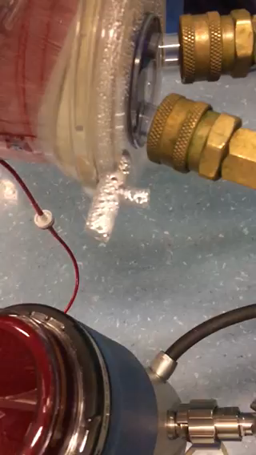
“Aerosol out from extracorporeal machine?” word of precaution

Slide 13
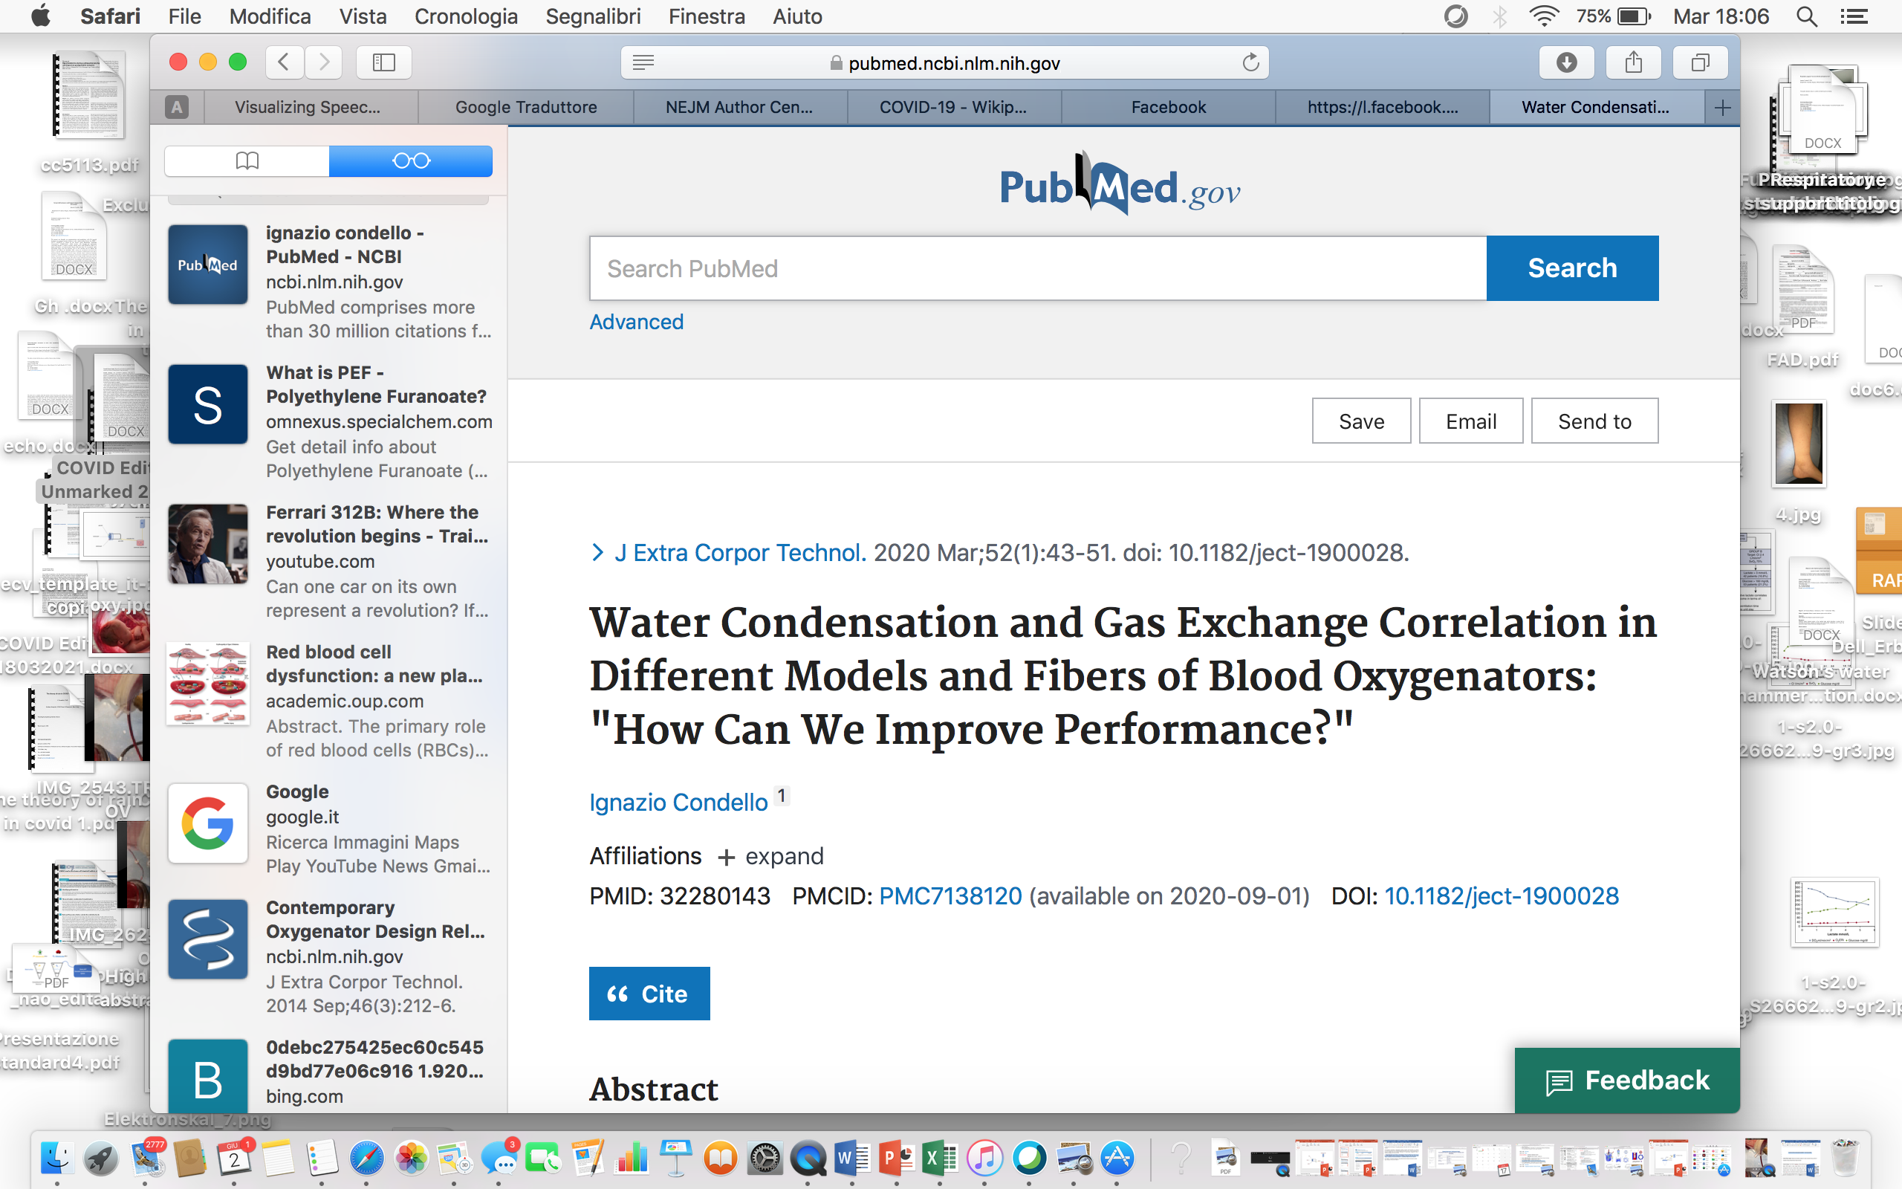
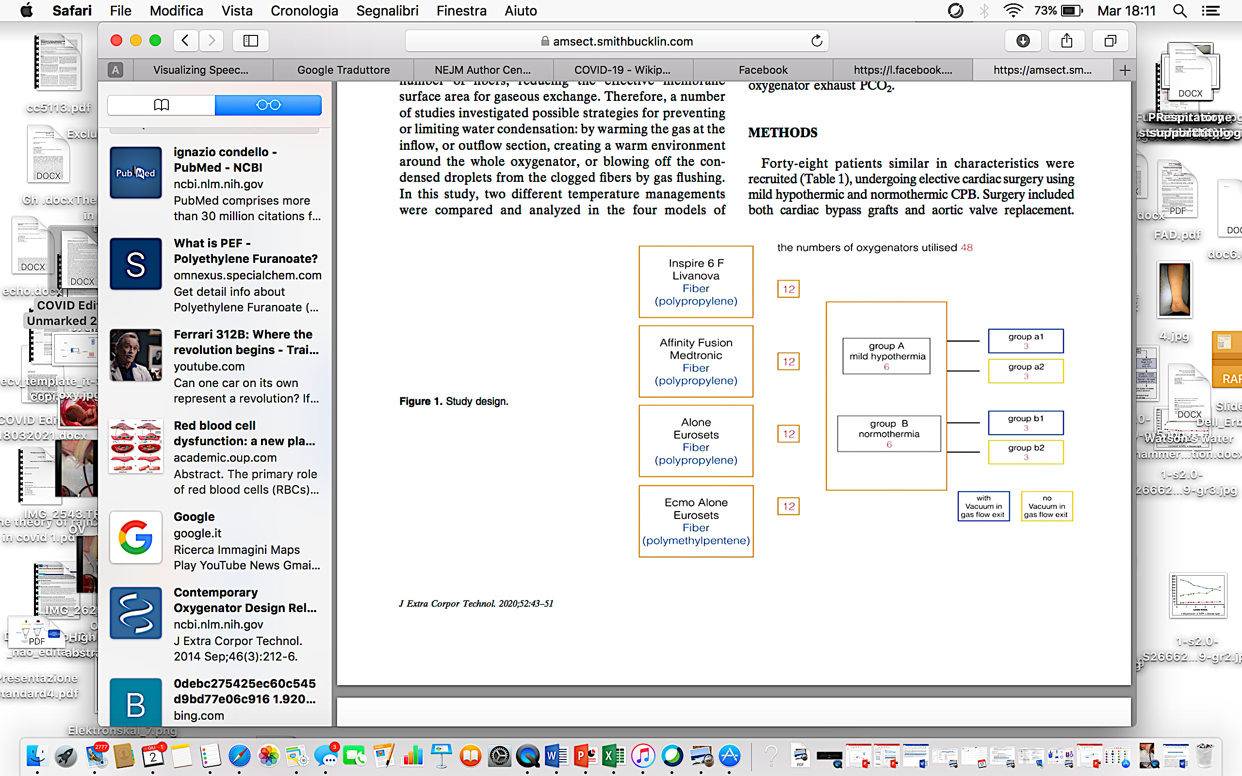
J Extra Corpor Technol. 2020;52:43–51

Slide 14
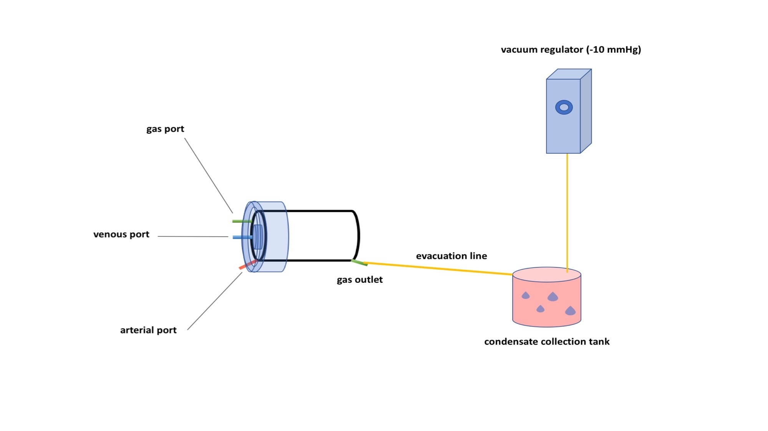

Slide 15
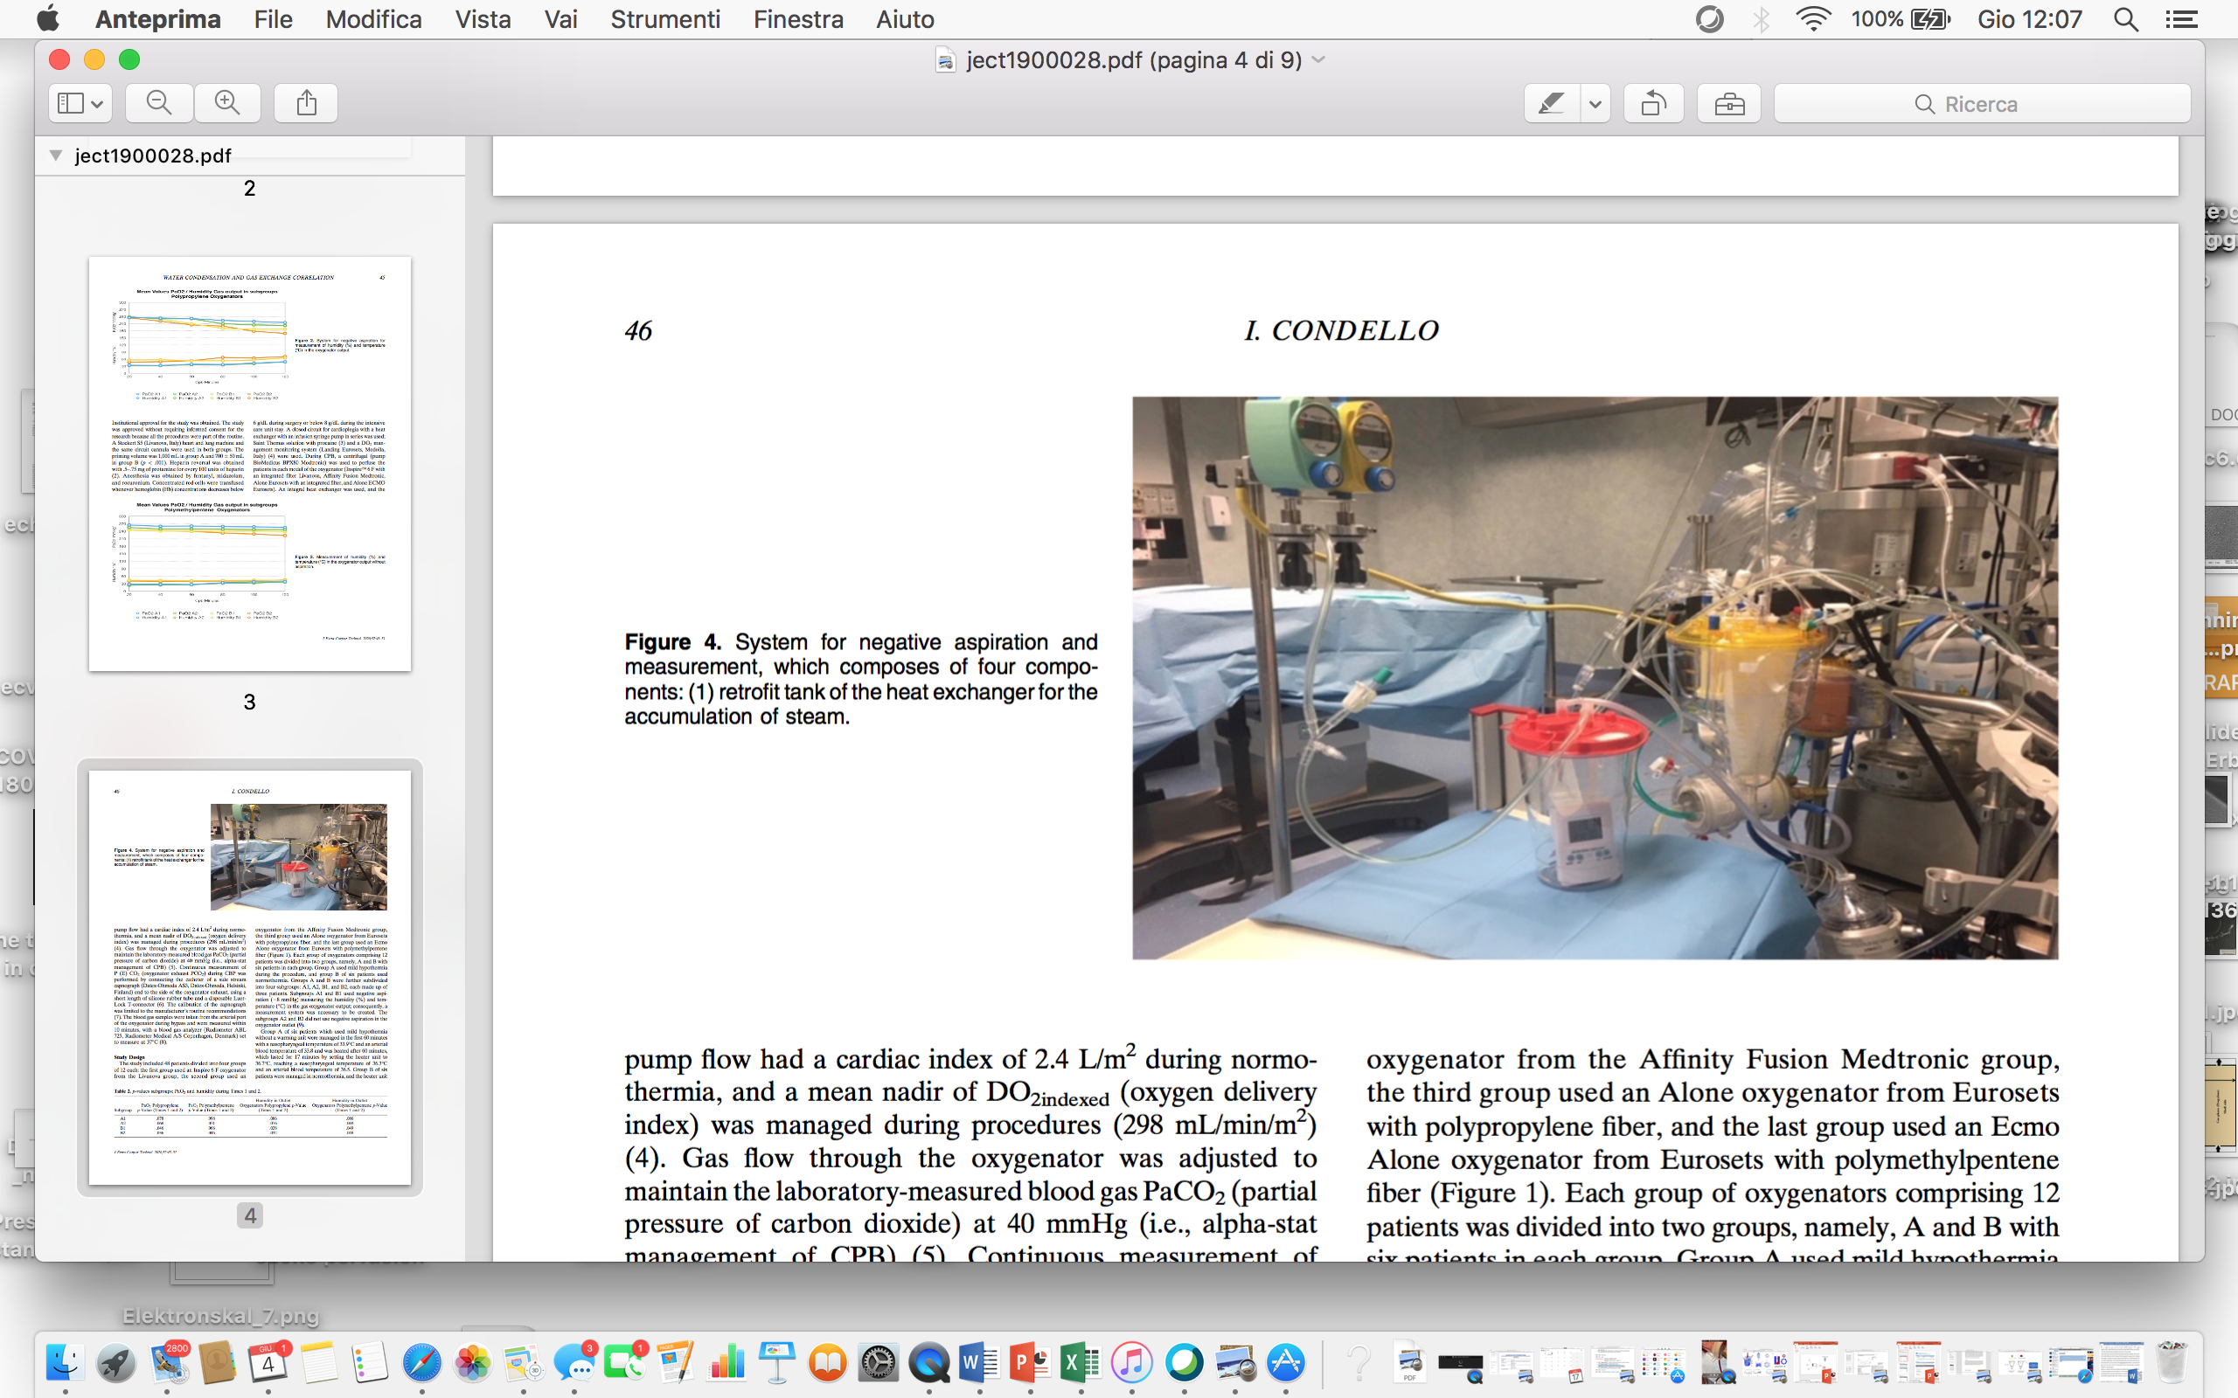
J Extra Corpor Technol. 2020;52:43–51

Slide 16
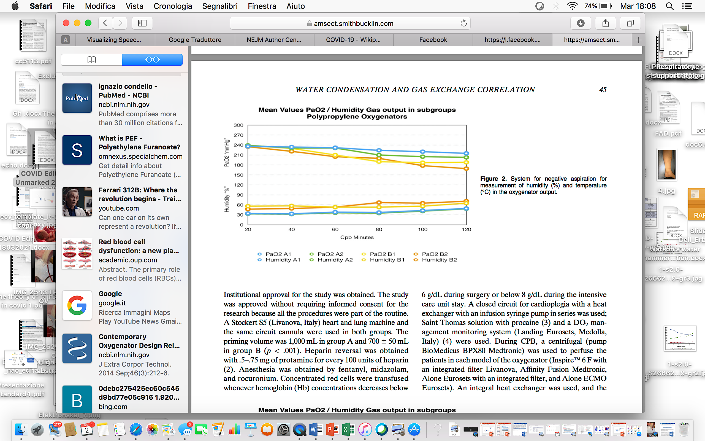
J Extra Corpor Technol. 2020;52:43–51

Slide 17
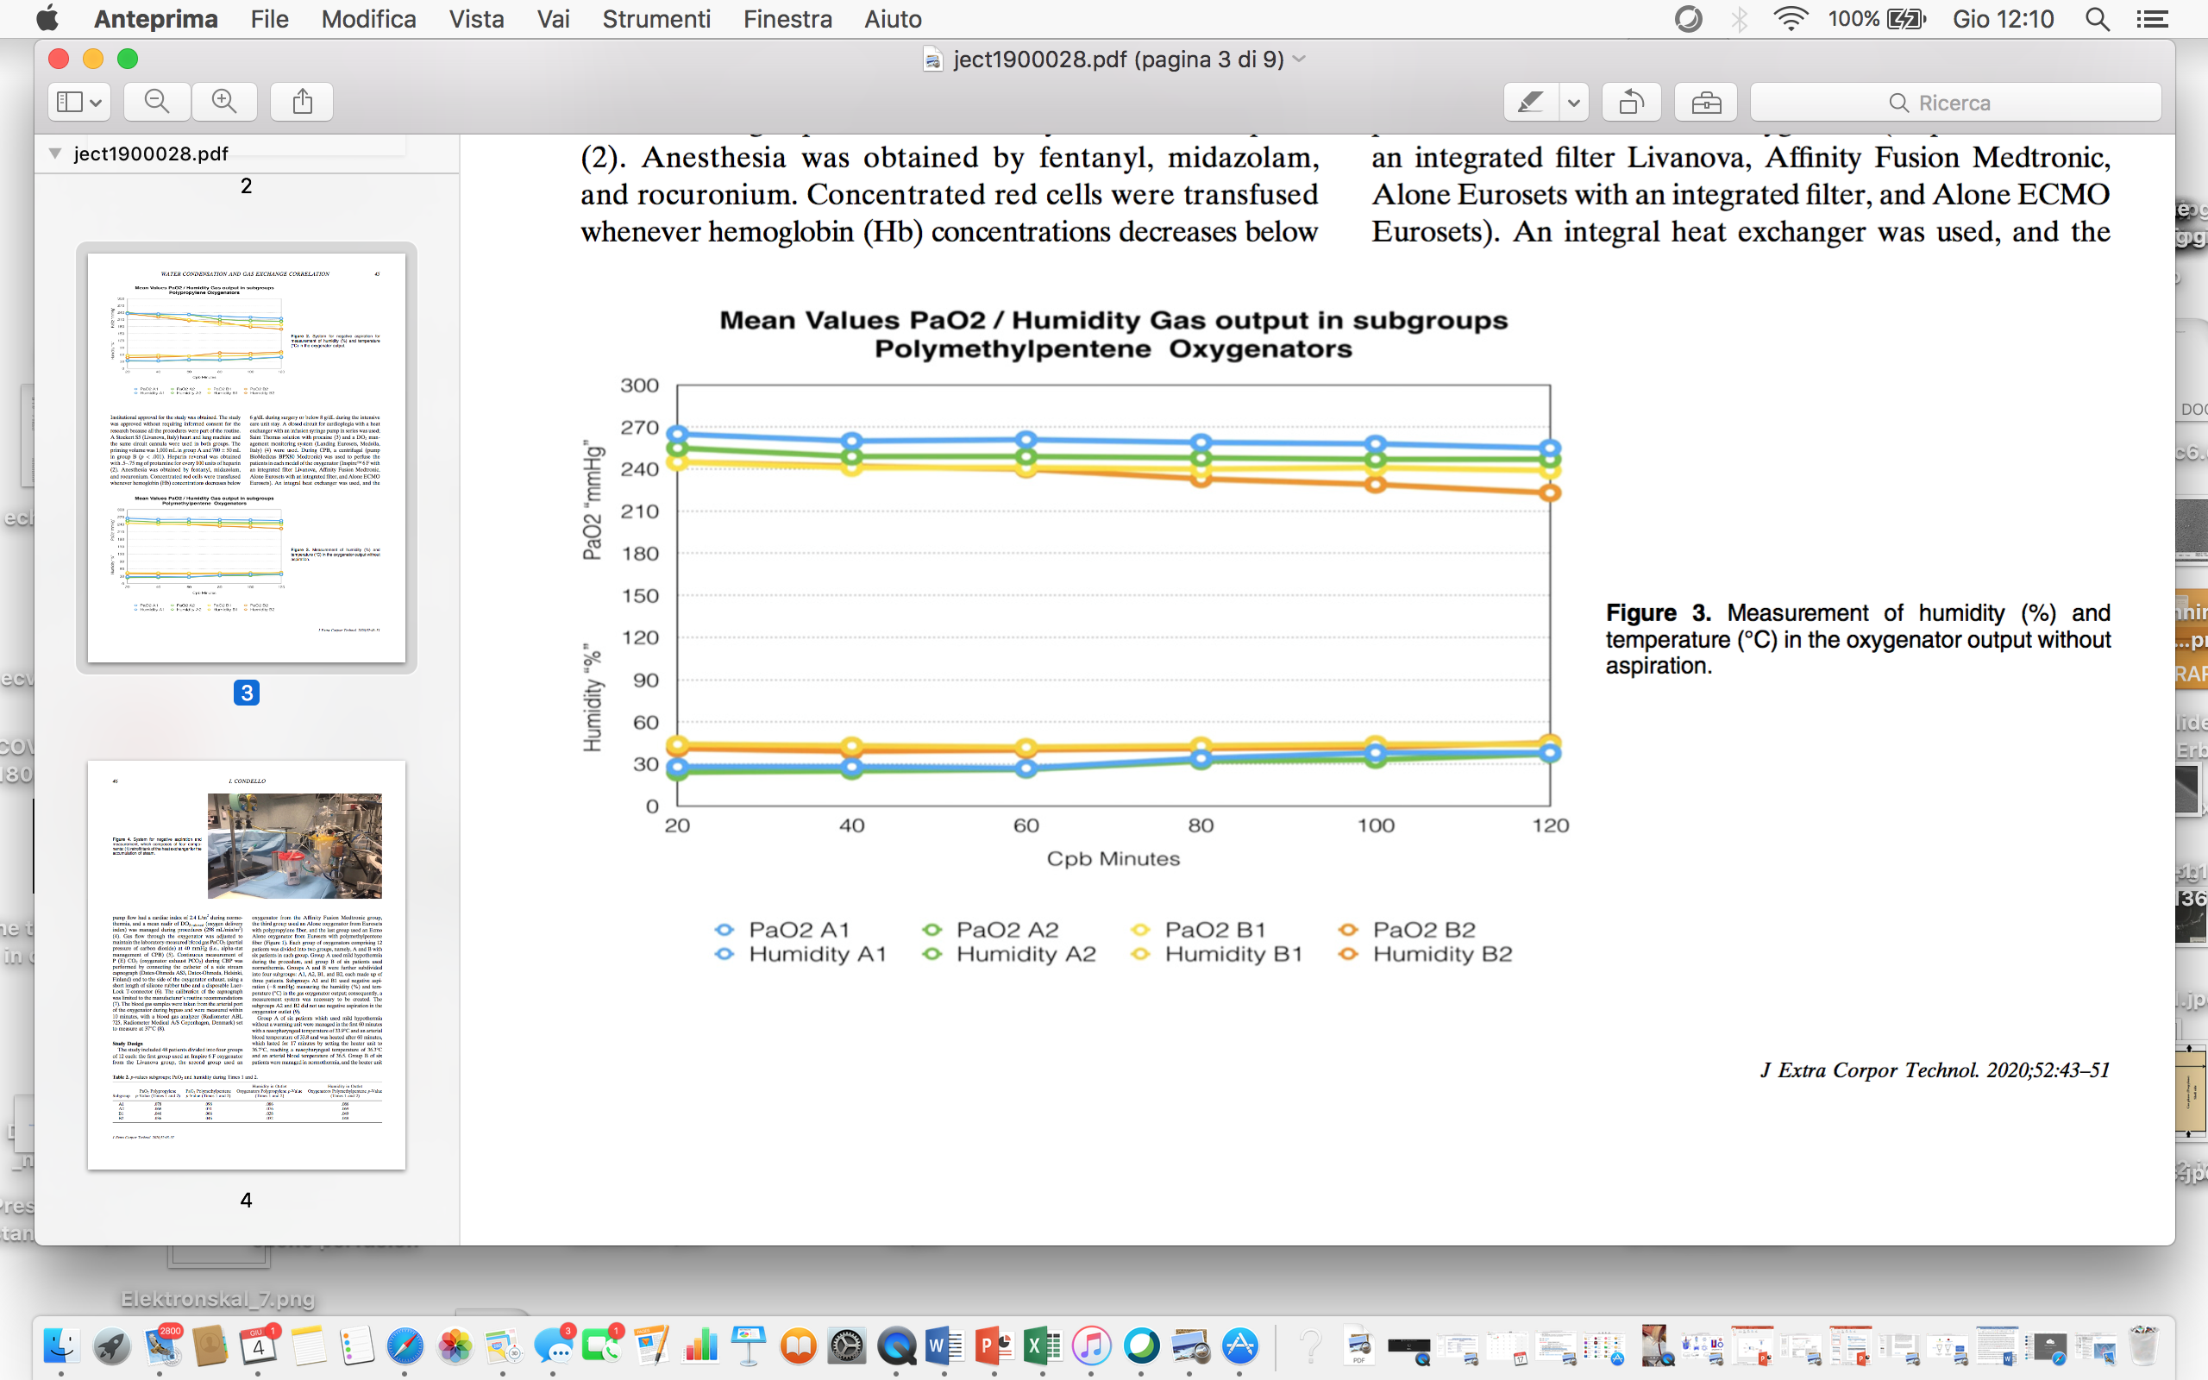
J Extra Corpor Technol. 2020;52:43–51

Slide 18
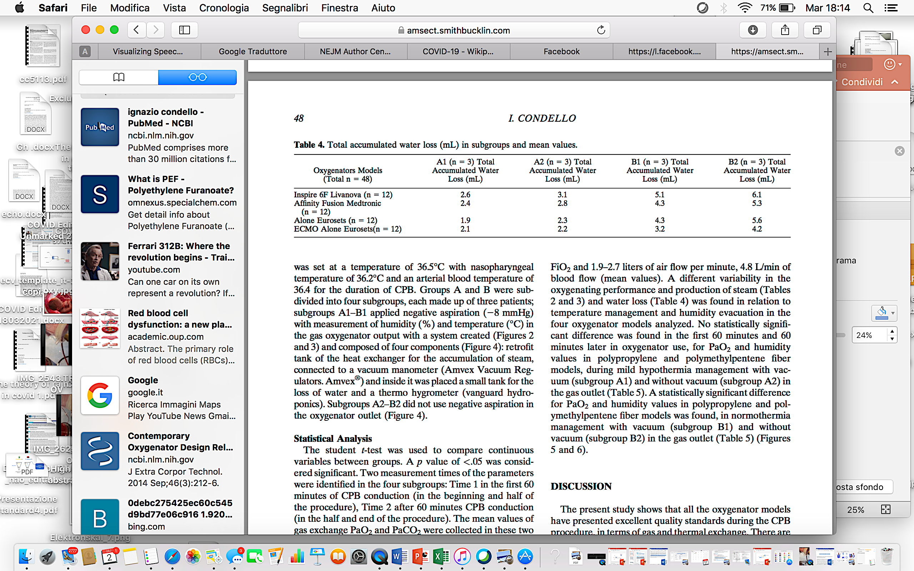
J Extra Corpor Technol. 2020;52:43–51

Slide 19
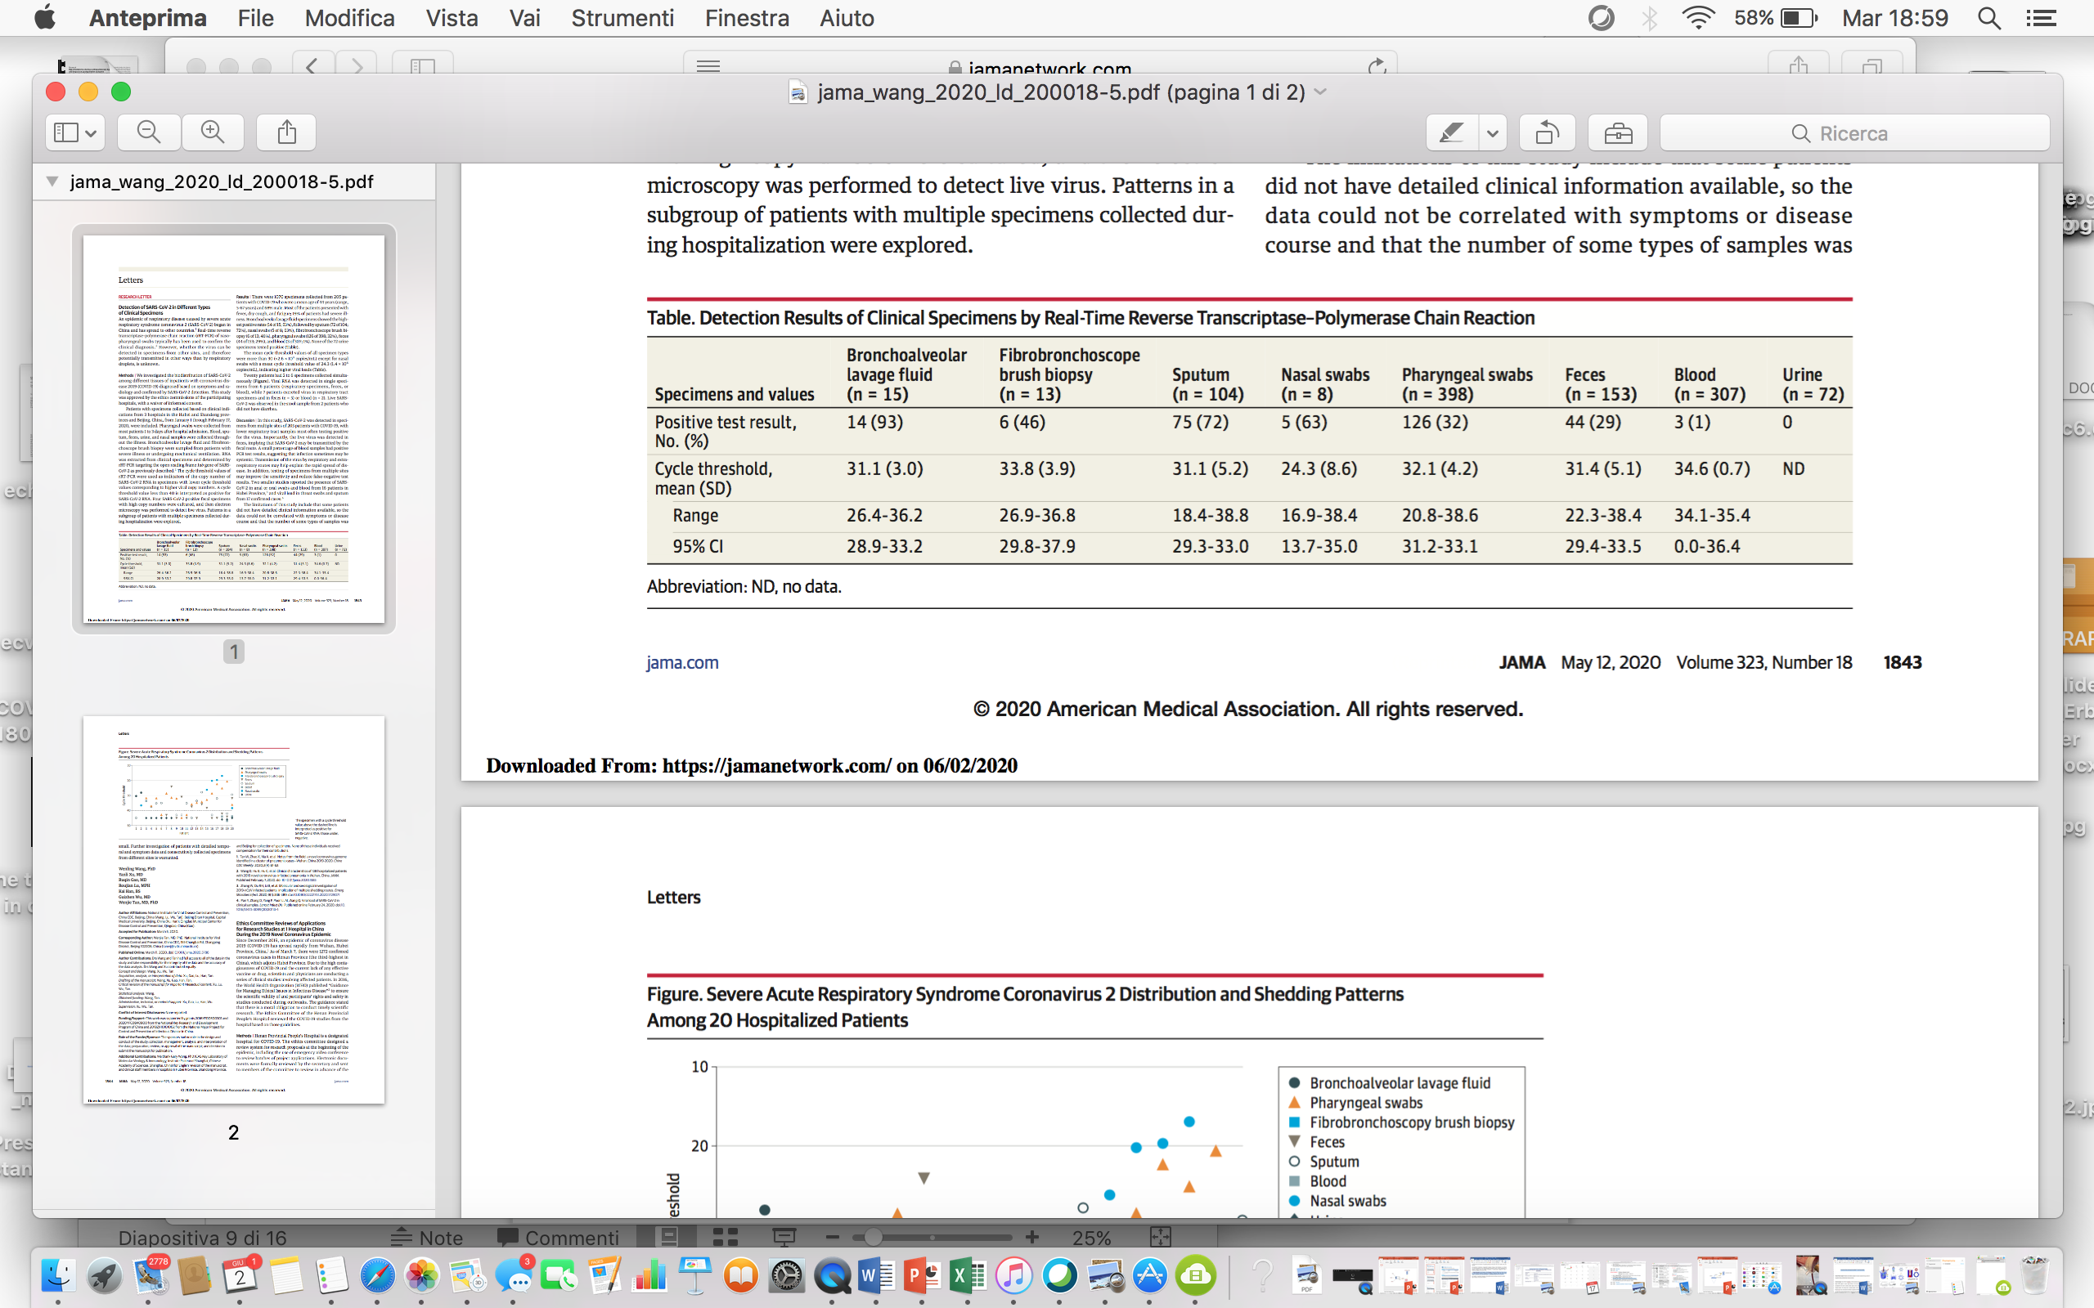
Detection of SARS-CoV-2 in Different Types of Clinical Specimens
JAMA. 2020;323(18):1843-1844.

Slide 20
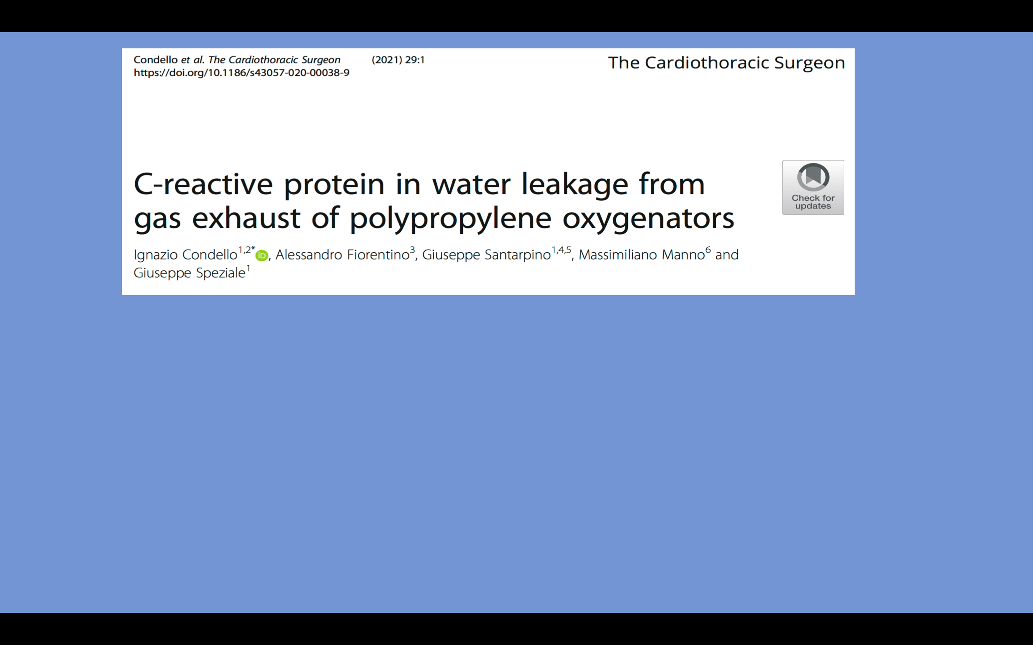
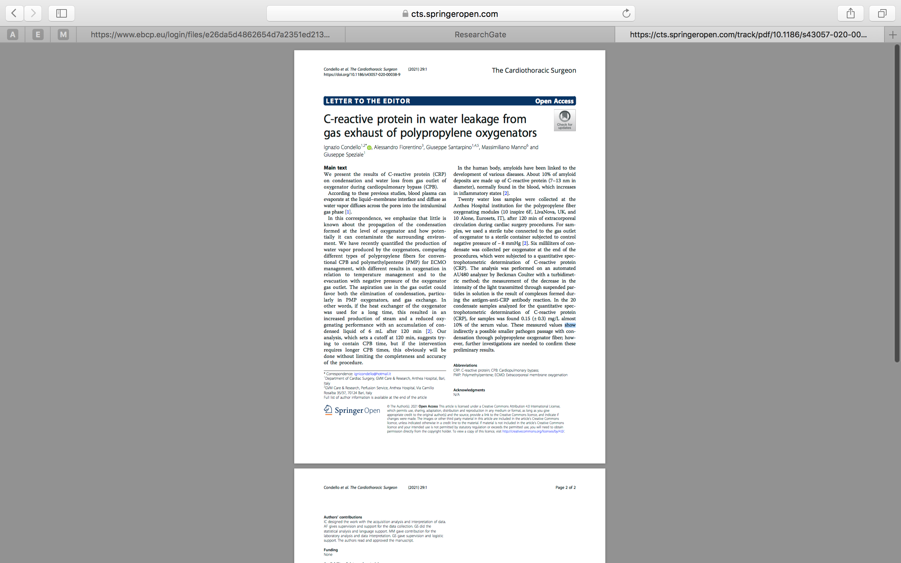

Slide 21
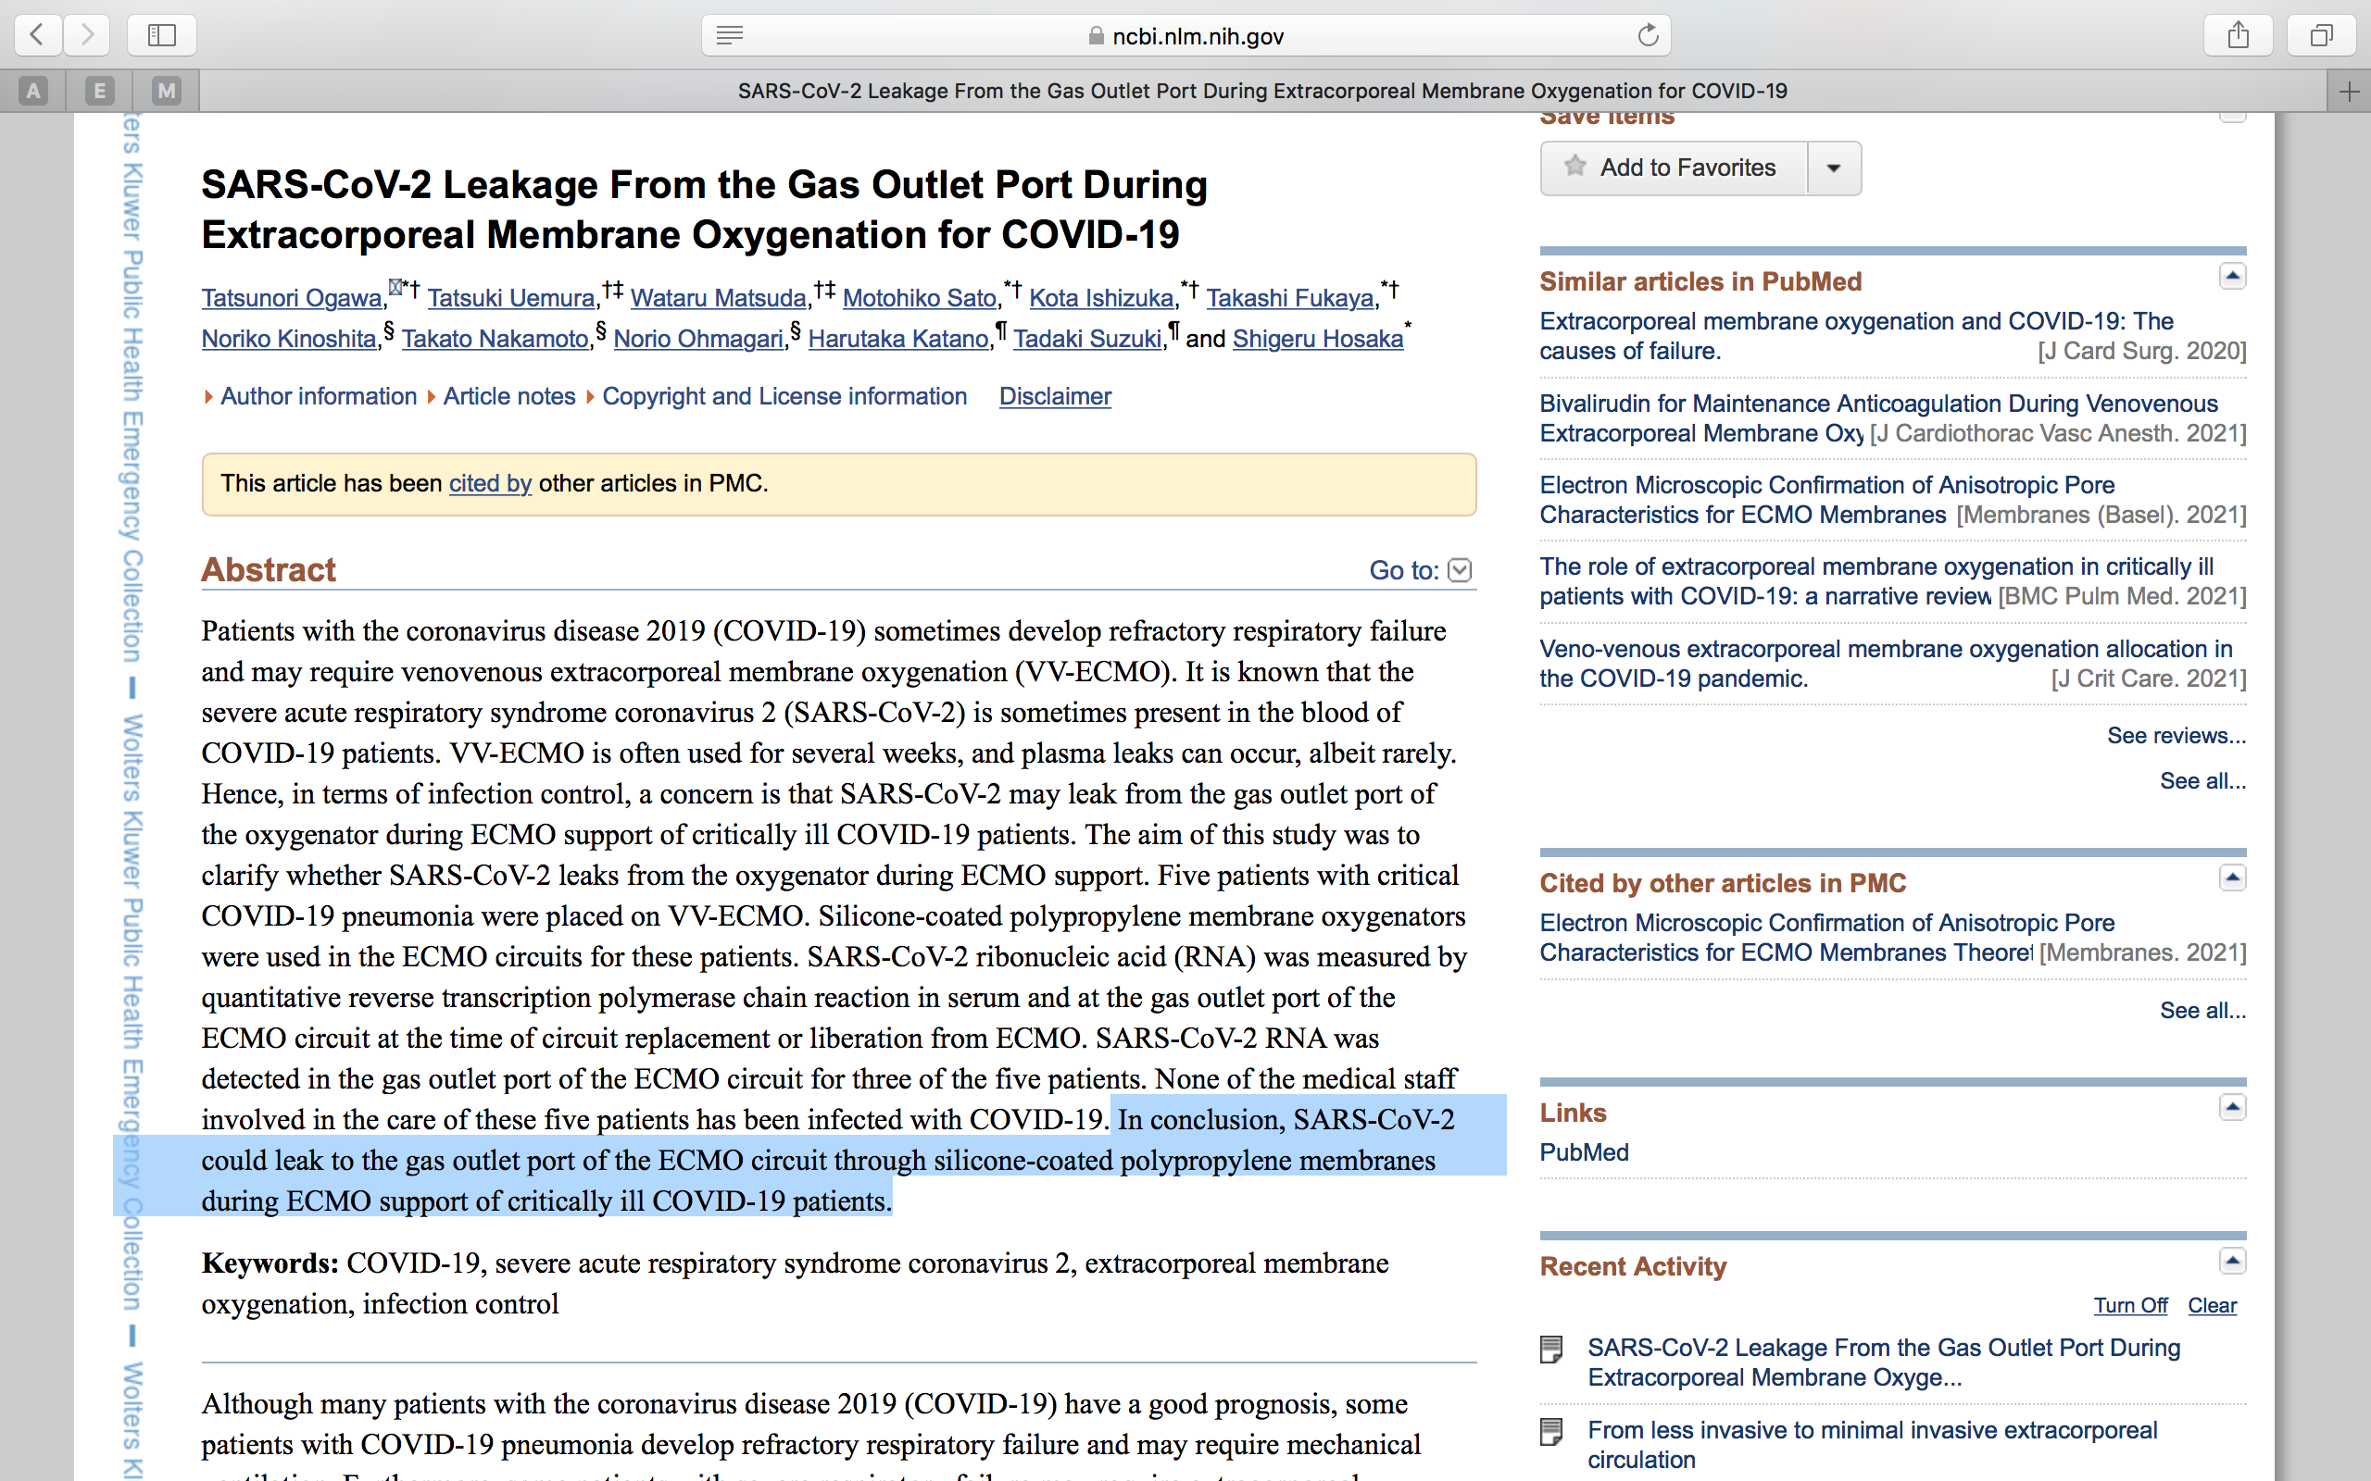

Slide 22
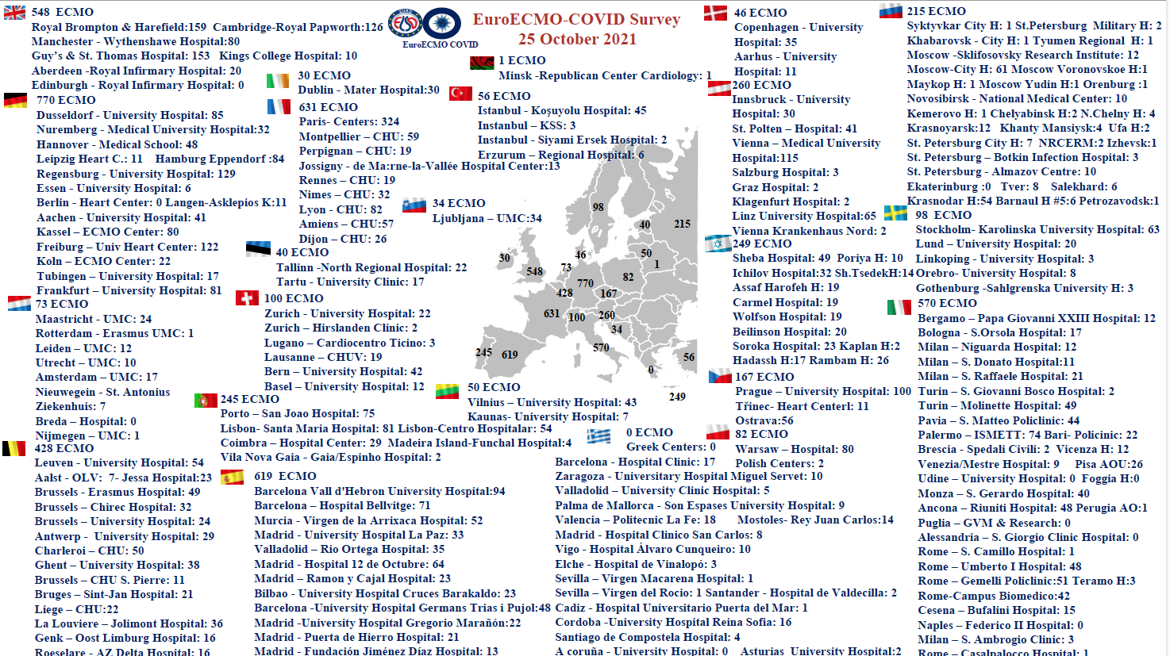

Slide 23
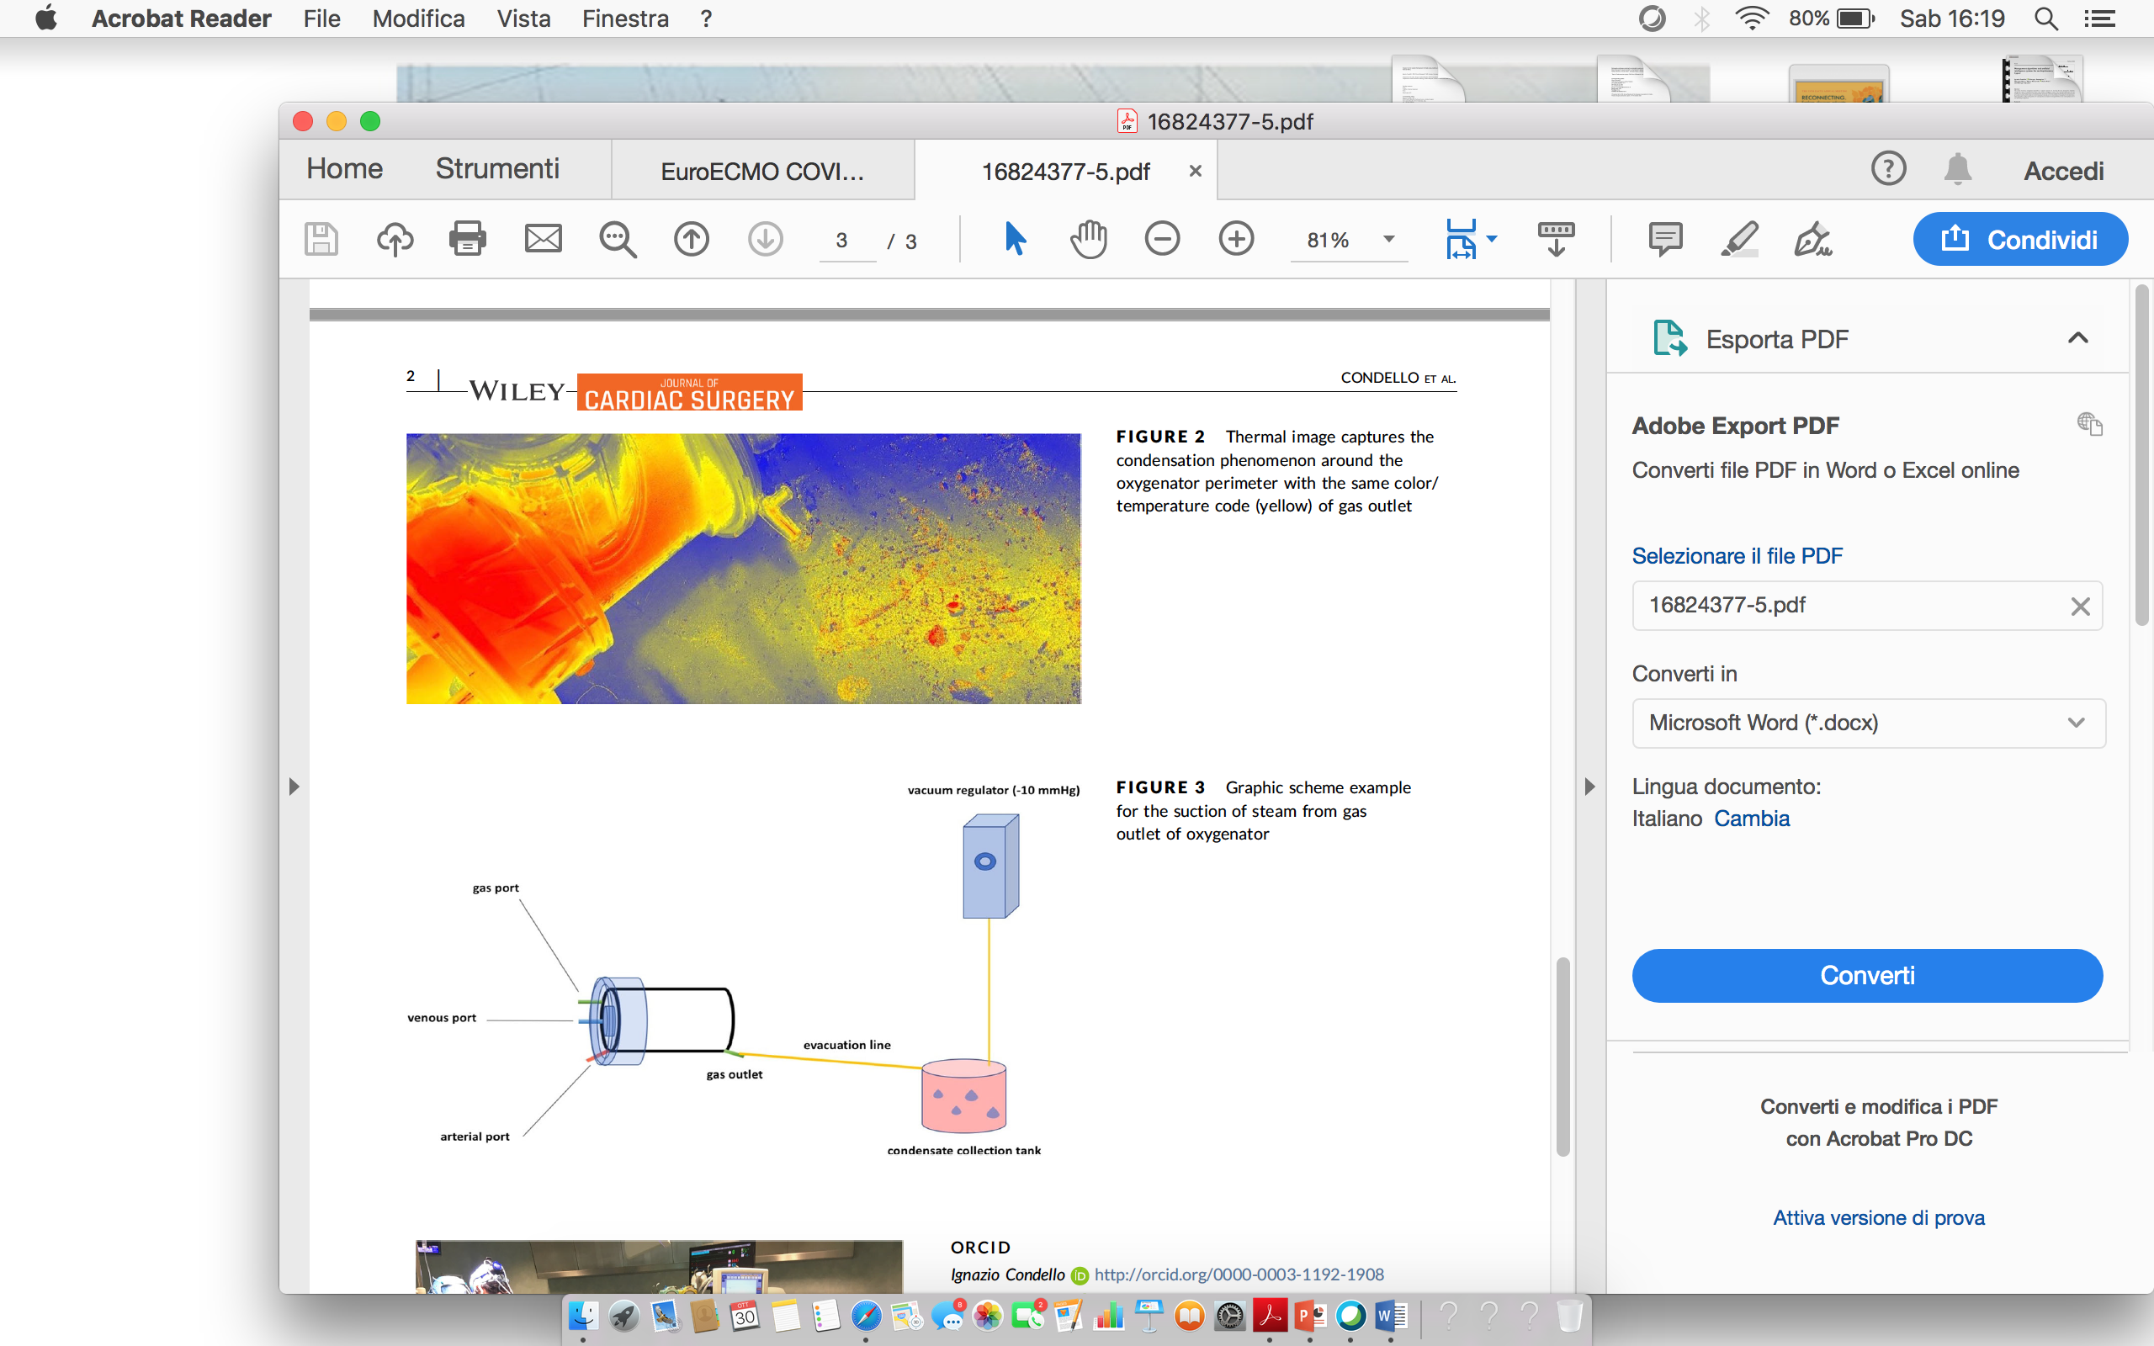
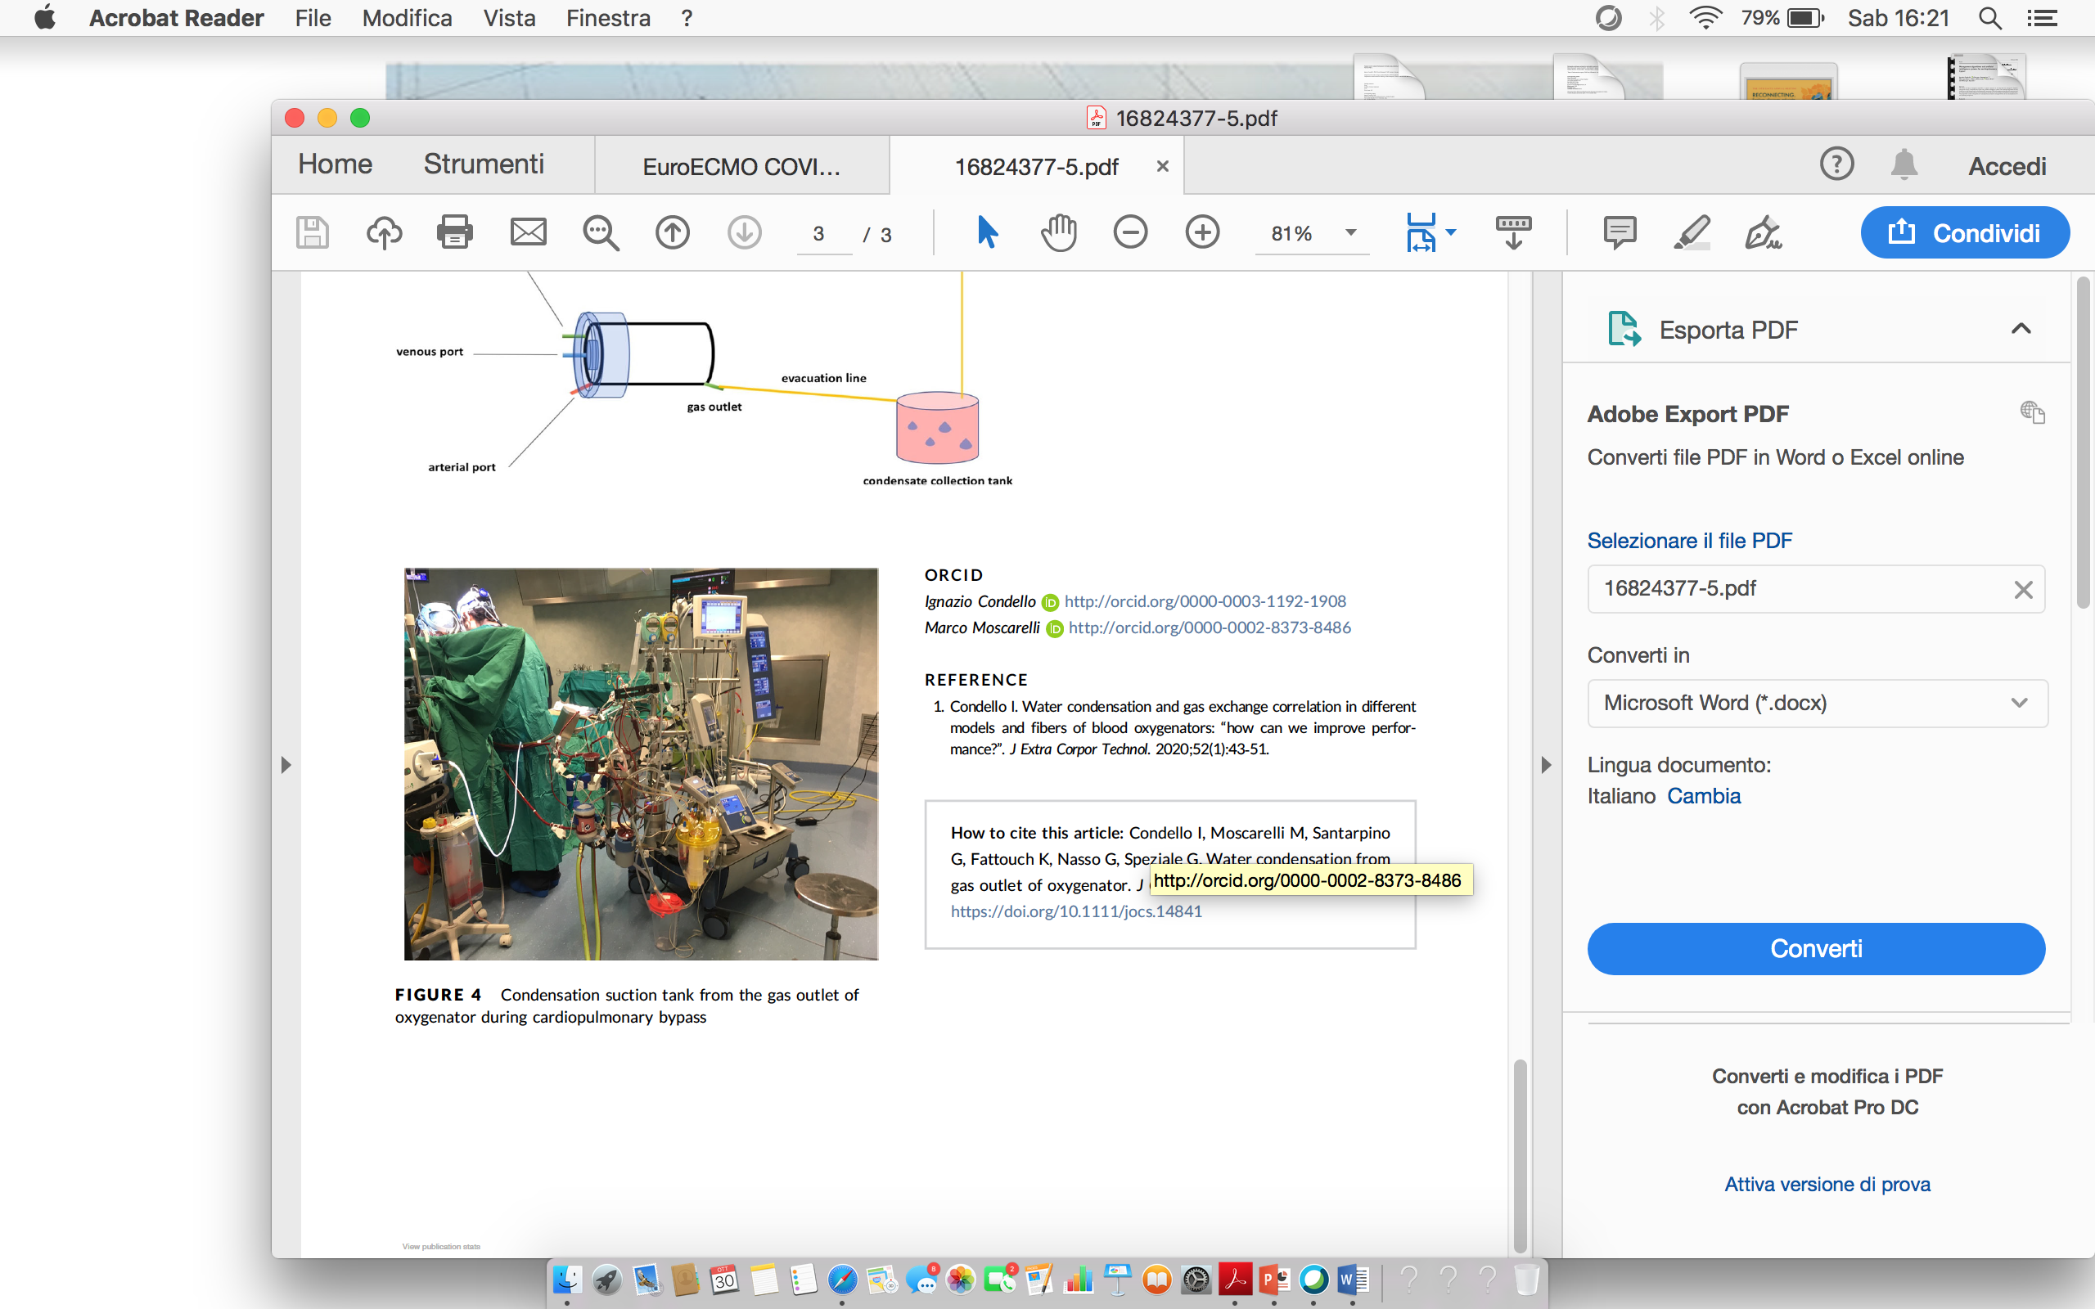
THANK YOU

