Slide 1
Perfusionist in Italy
Ignazio Condello, PhD
Anthea Hospital,GVM Care & Research
Bari,Italy

Slide 2
Perfusionist in Italy
Ignazio Condello, PhD
Anthea Hospital,GVM Care & Research
Bari,Italy

Slide 3
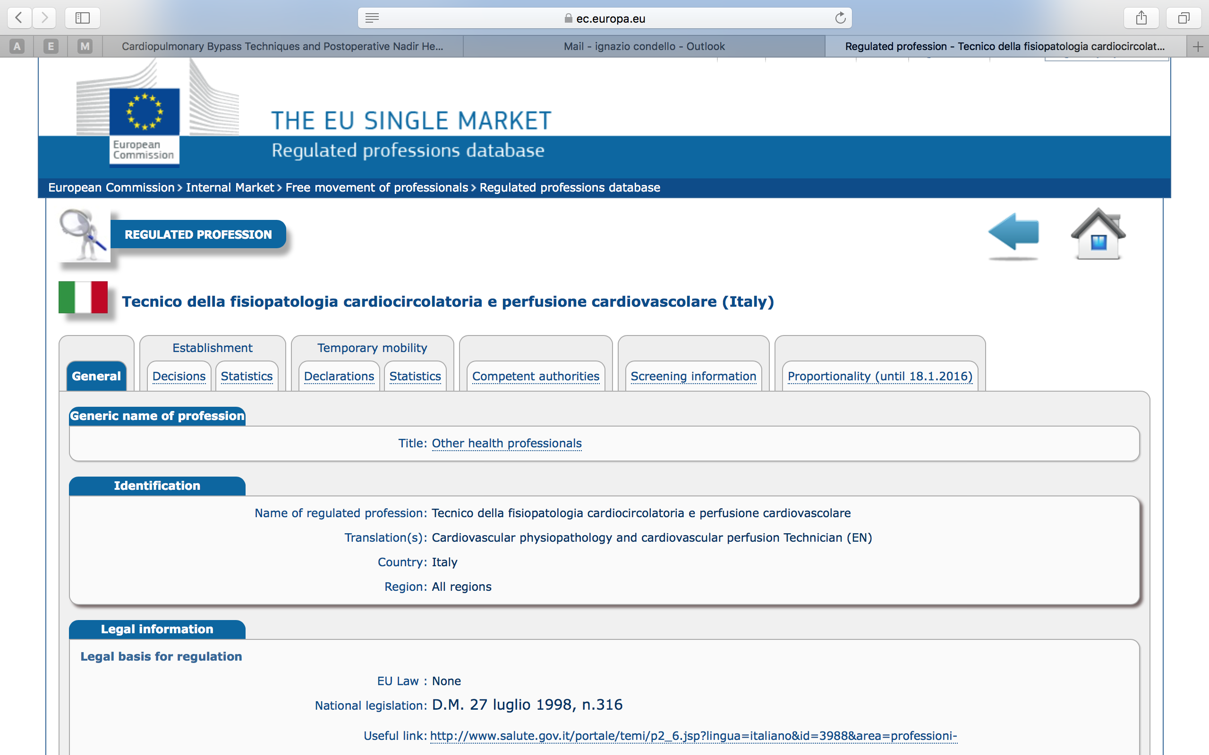
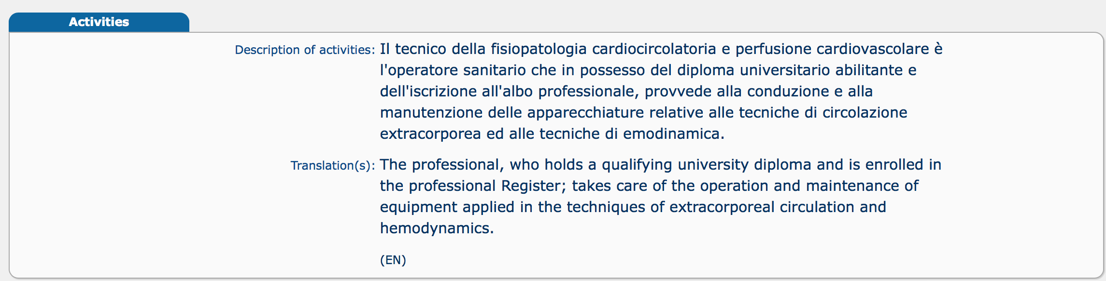

Slide 4
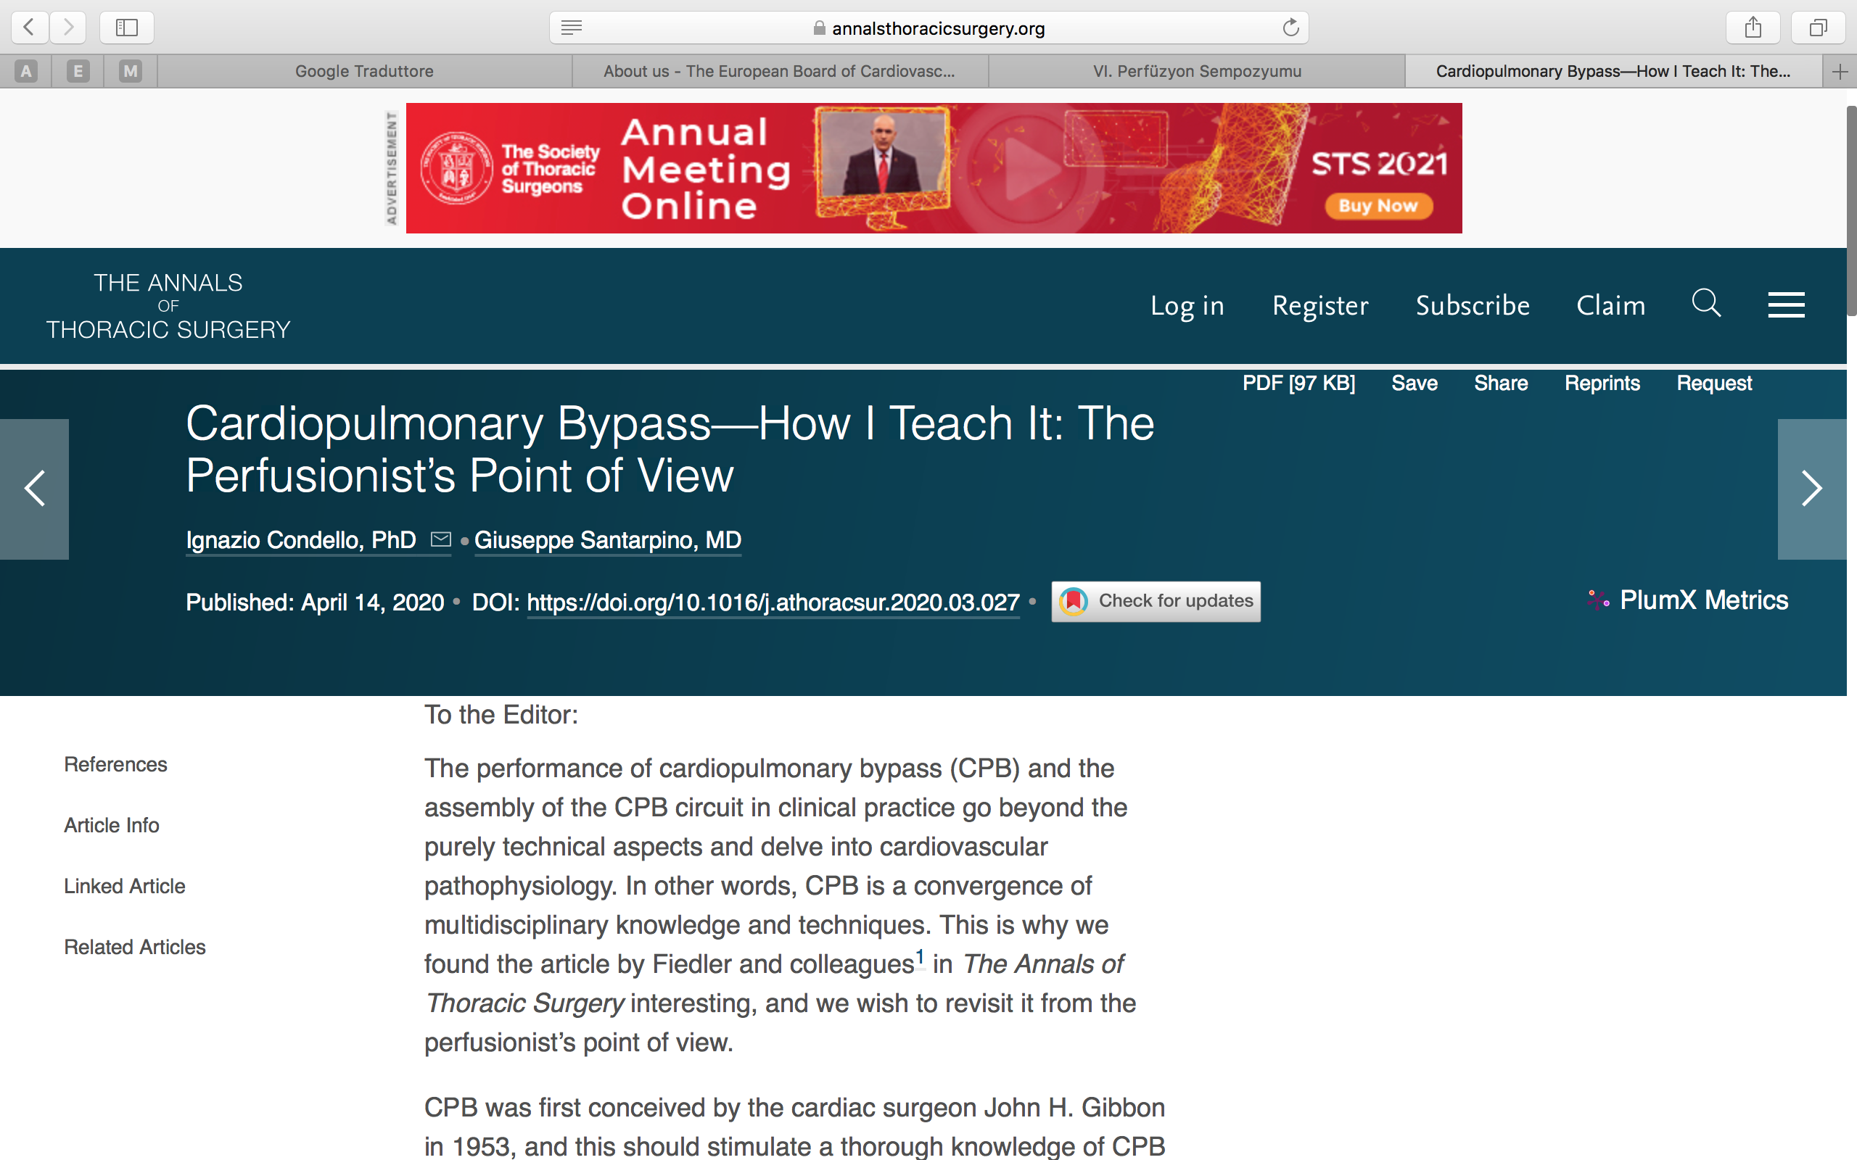
The performance of cardiopulmonary bypass (CPB) and the assembly of the CPB circuit in clinical practice go beyond the purely technical aspects and delve into cardiovascular pathophysiology. In other words, CPB is a convergence of multidisciplinary knowledge and techniques. Standardization of CPB techniques and materials has lowered curiosity, thereby automating this procedure and transforming—from the perspective of those who are outside the world of perfusion—what is actually complex into something all too simple. Although this standardization has rendered CPB more intuitive and safer, it has overshadowed the use of a tailored approach, particularly for the frailest patients.

Slide 5
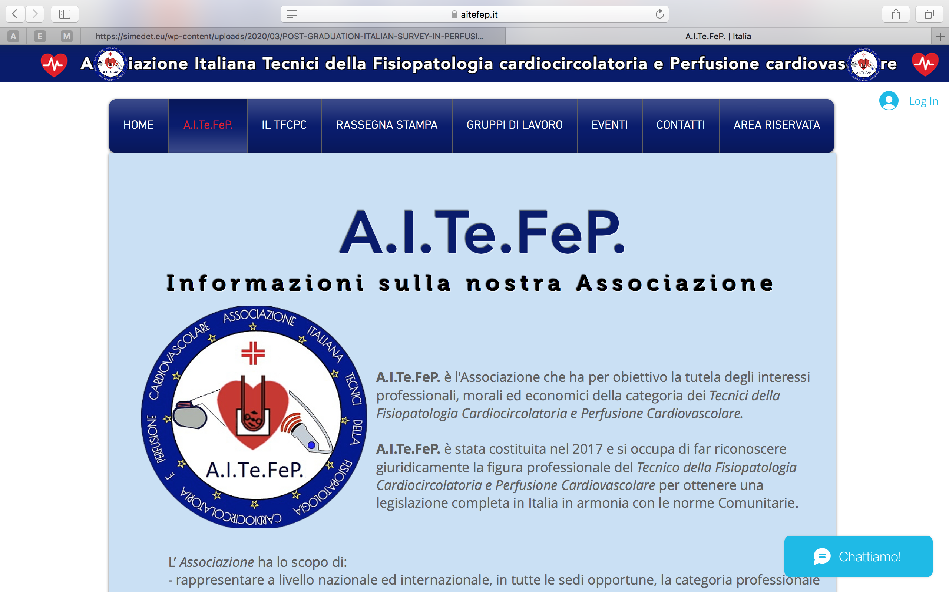
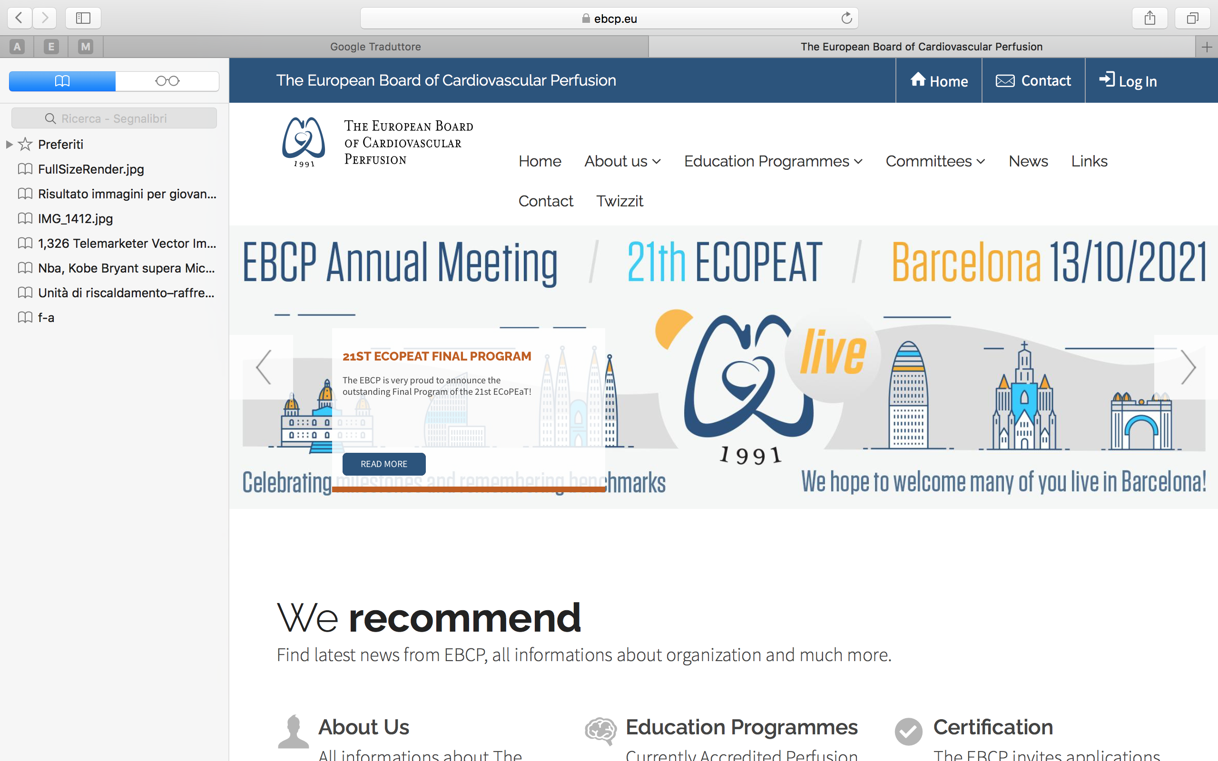
National Federation of Orders of Health Technicians in Medical Radiology, Technical Health Professions, Rehabilitation and Prevention (FNO TSRM PSTRP)
A.I.Te.FeP. is the Association that aims to protect the professional, moral and economic interests of the category of Cardiocirculatory Physiopathology and Cardiovascular Perfusion Technicians.
The European Board of Cardiovascular Perfusion was founded in 1991 in order to unite European perfusionists in their desire for equality of standards in both training and professional status.

Slide 6
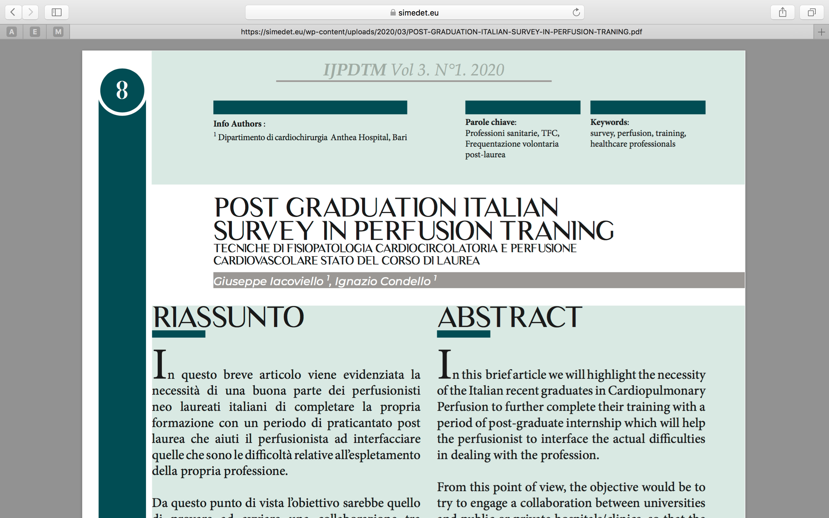
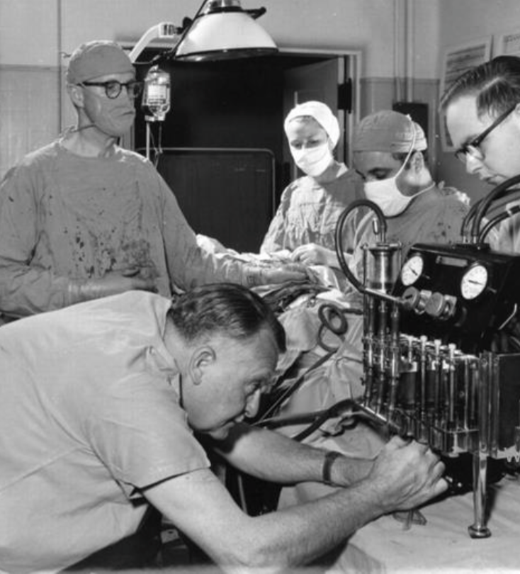
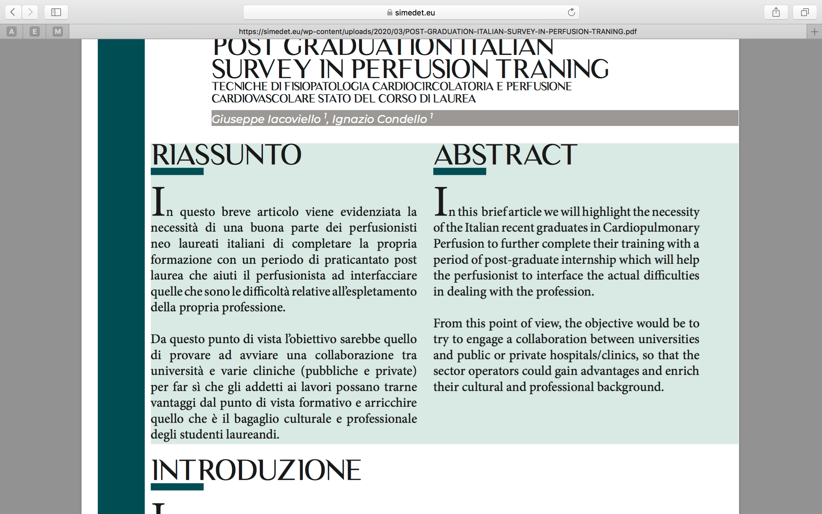

Slide 7
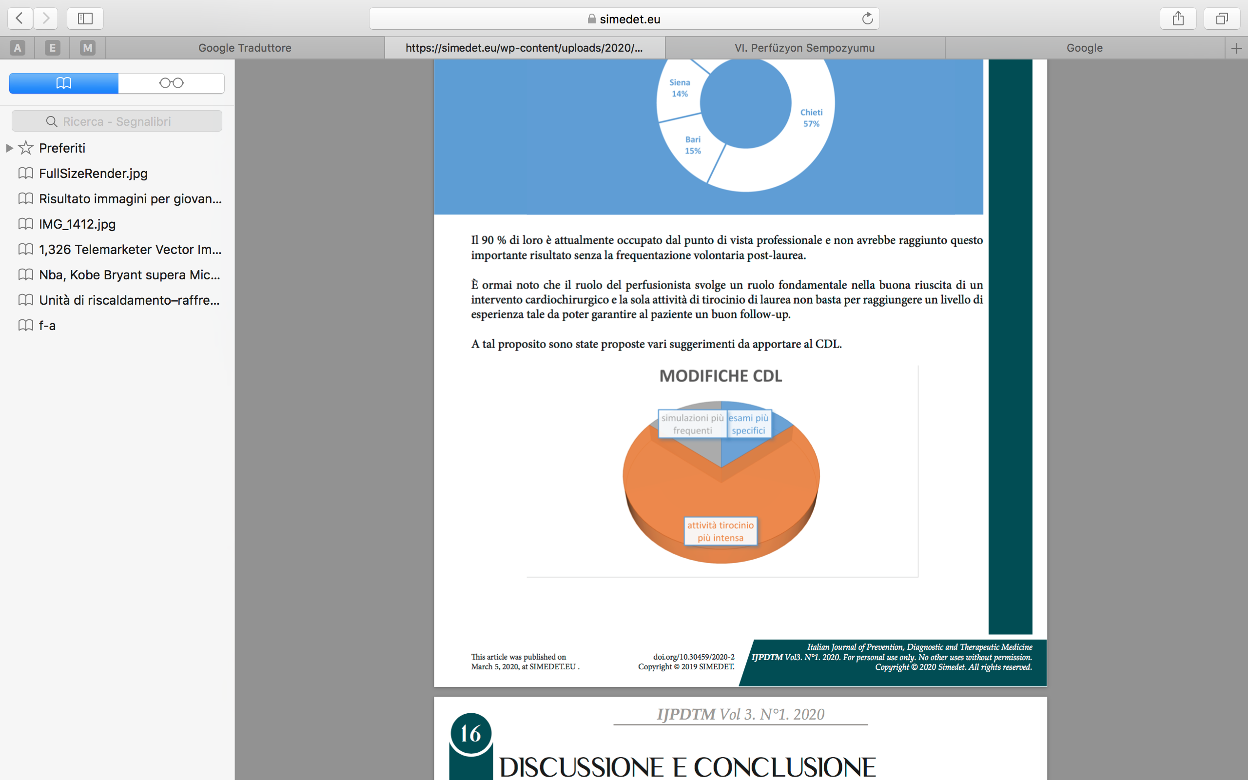
In Italy, a period of voluntary attendance is increasingly common for newly graduated perfusionists who are entering the world of work for the first time. The high workload in the highly specialized training of new graduates is very important as experience is essential to get to know the profession better. Given the difficulty of a good part of perfusionists to find work immediately in the period following graduation, a questionnaire was used to discuss this issue.

Slide 8
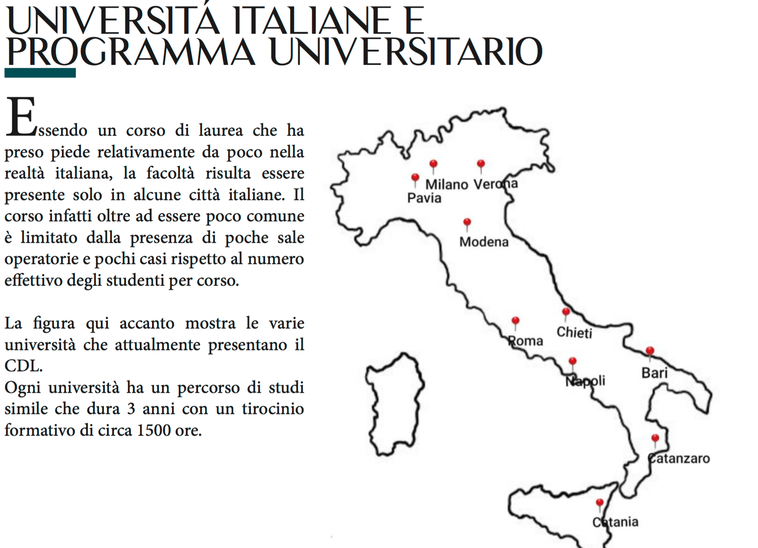

Slide 9
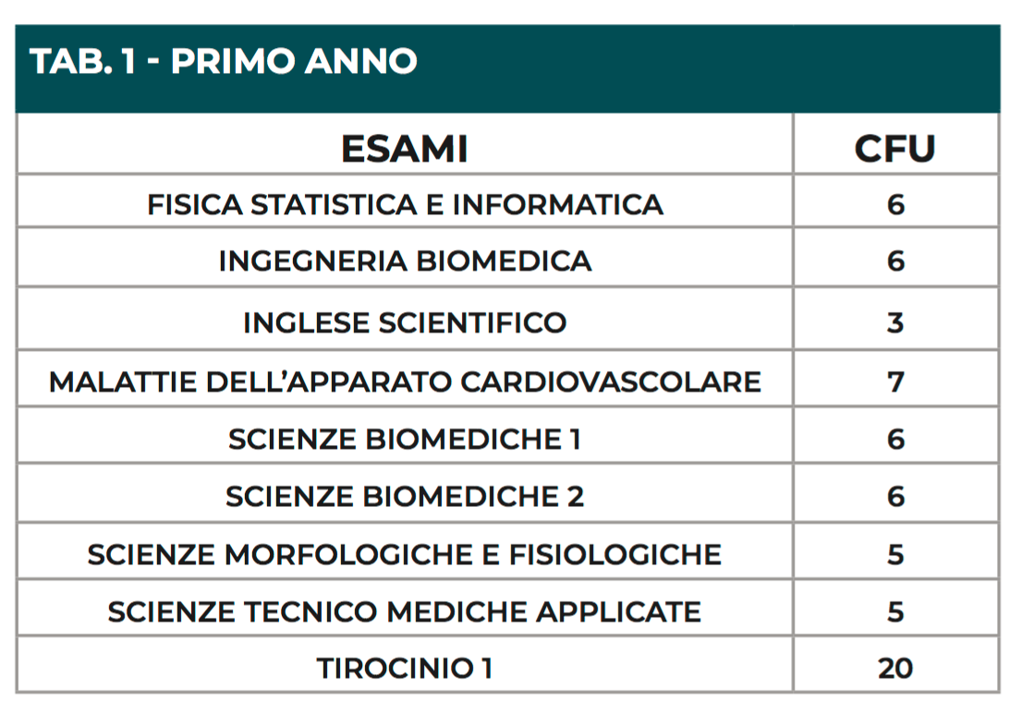
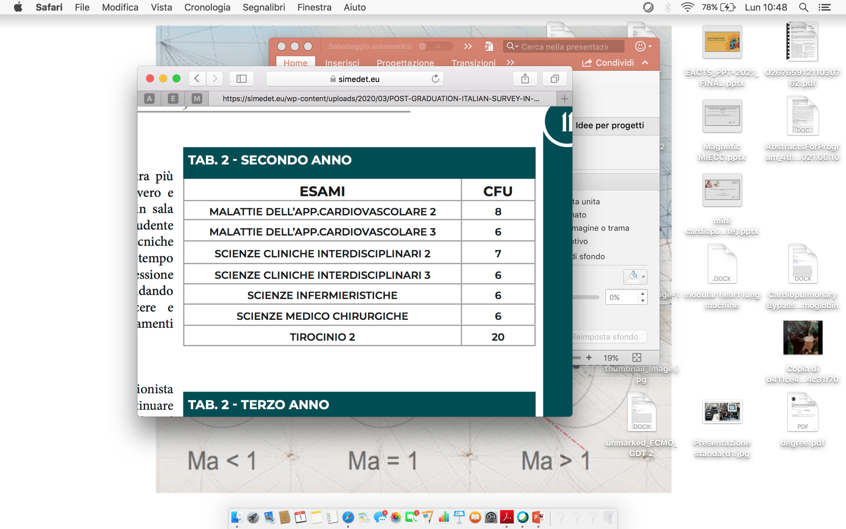
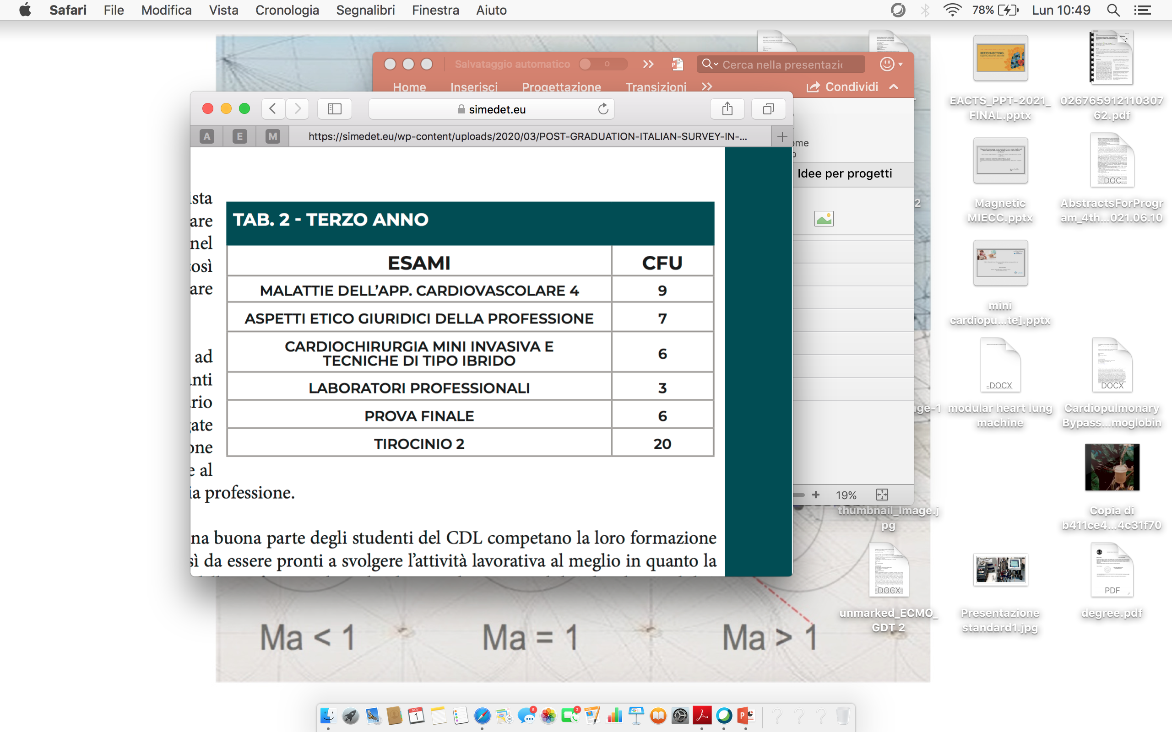

Slide 10
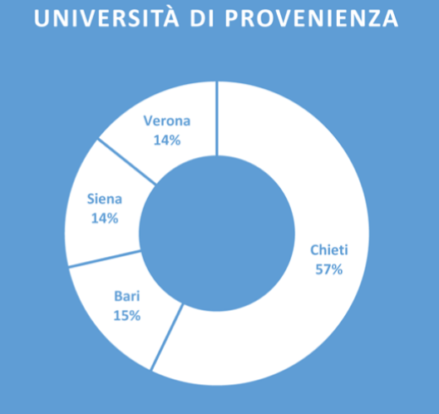

Slide 11
CORE COMPETENCE OF THE PERFUSIONIST IN ITALY
- Equipment and Materials Management
- Operate in Cardiac Surgery and Vascular Surgery
- Operate in Cardiology
- Operate in Electrophysiology and Cardiac Electrostimulation
- Operate in the Resuscitation Center
- Operate in the Transplant-Explant Center
- Operating in other areas: General Surgery, Orthopedics
- Operate in the Local Area
- Operate in the Organizational-Managerial Context

Slide 12
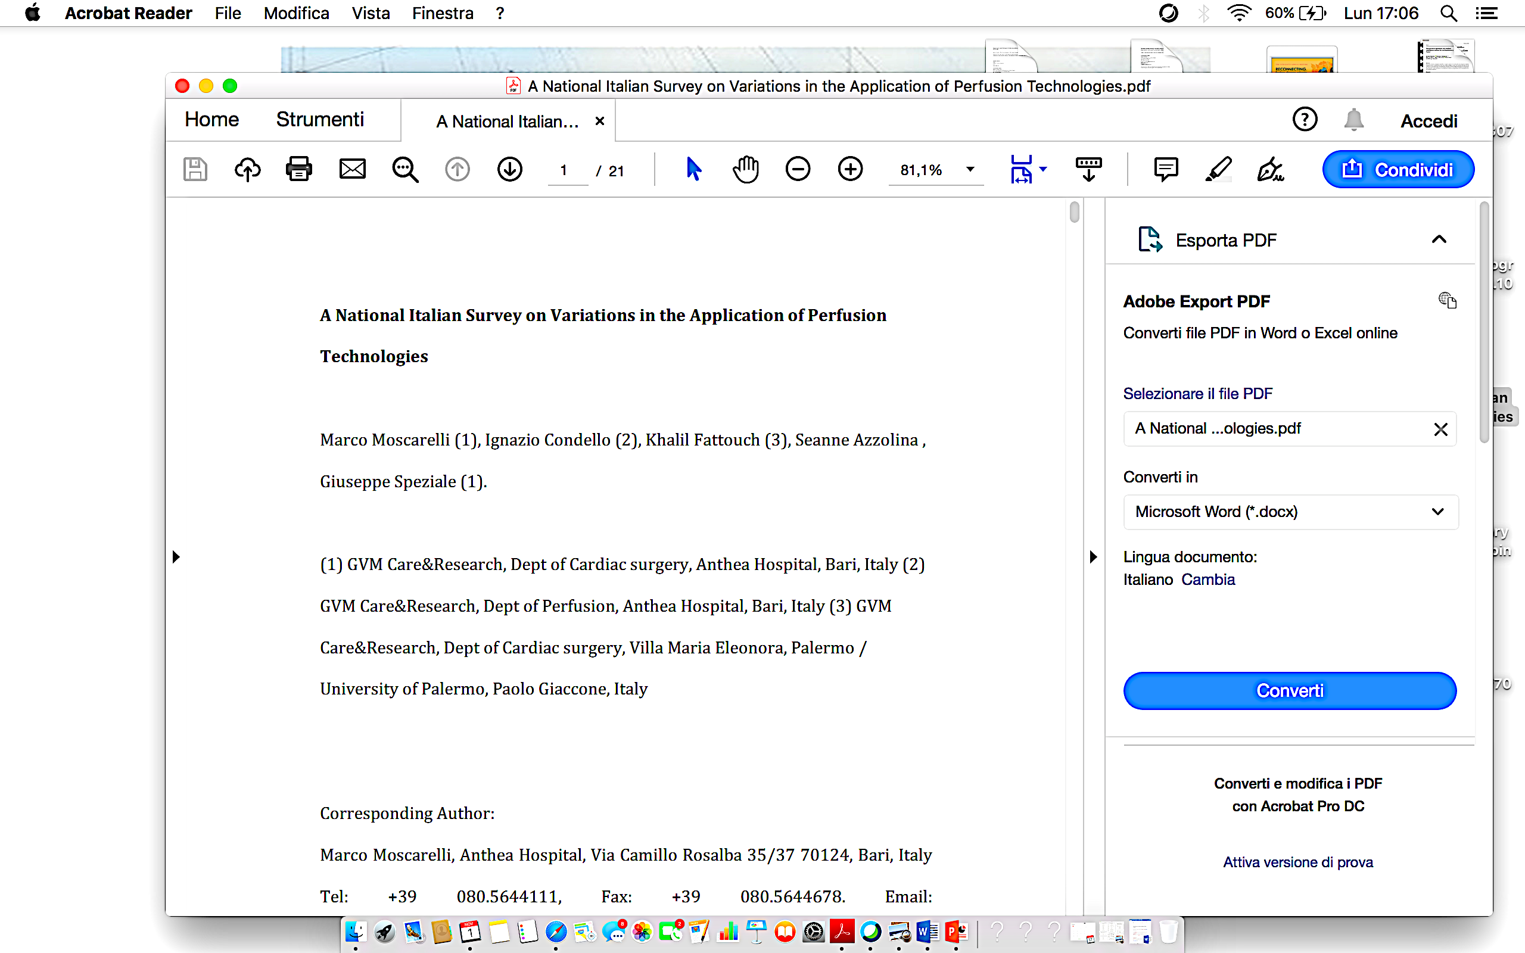

Slide 13
Aims
This study investigates variation in the application of different cardiopulmonary bypass techniques throughout Italy. Perfusion departments of adult cardiac surgery in Italy were asked to answer basic key questions about volume and type procedures equipment and technologies used during cardiopulmonary bypass.
Methods
The survey was carried out with SurveyMonkey. Each completed answer was coded to prevent duplication of responses. Data from completed surveys were uploaded in a computer and analyzed with R-project. (R Core Team, Vienna,Austria).
A National Italian Survey on Variations in the Application of Perfusion Technologies

Slide 14
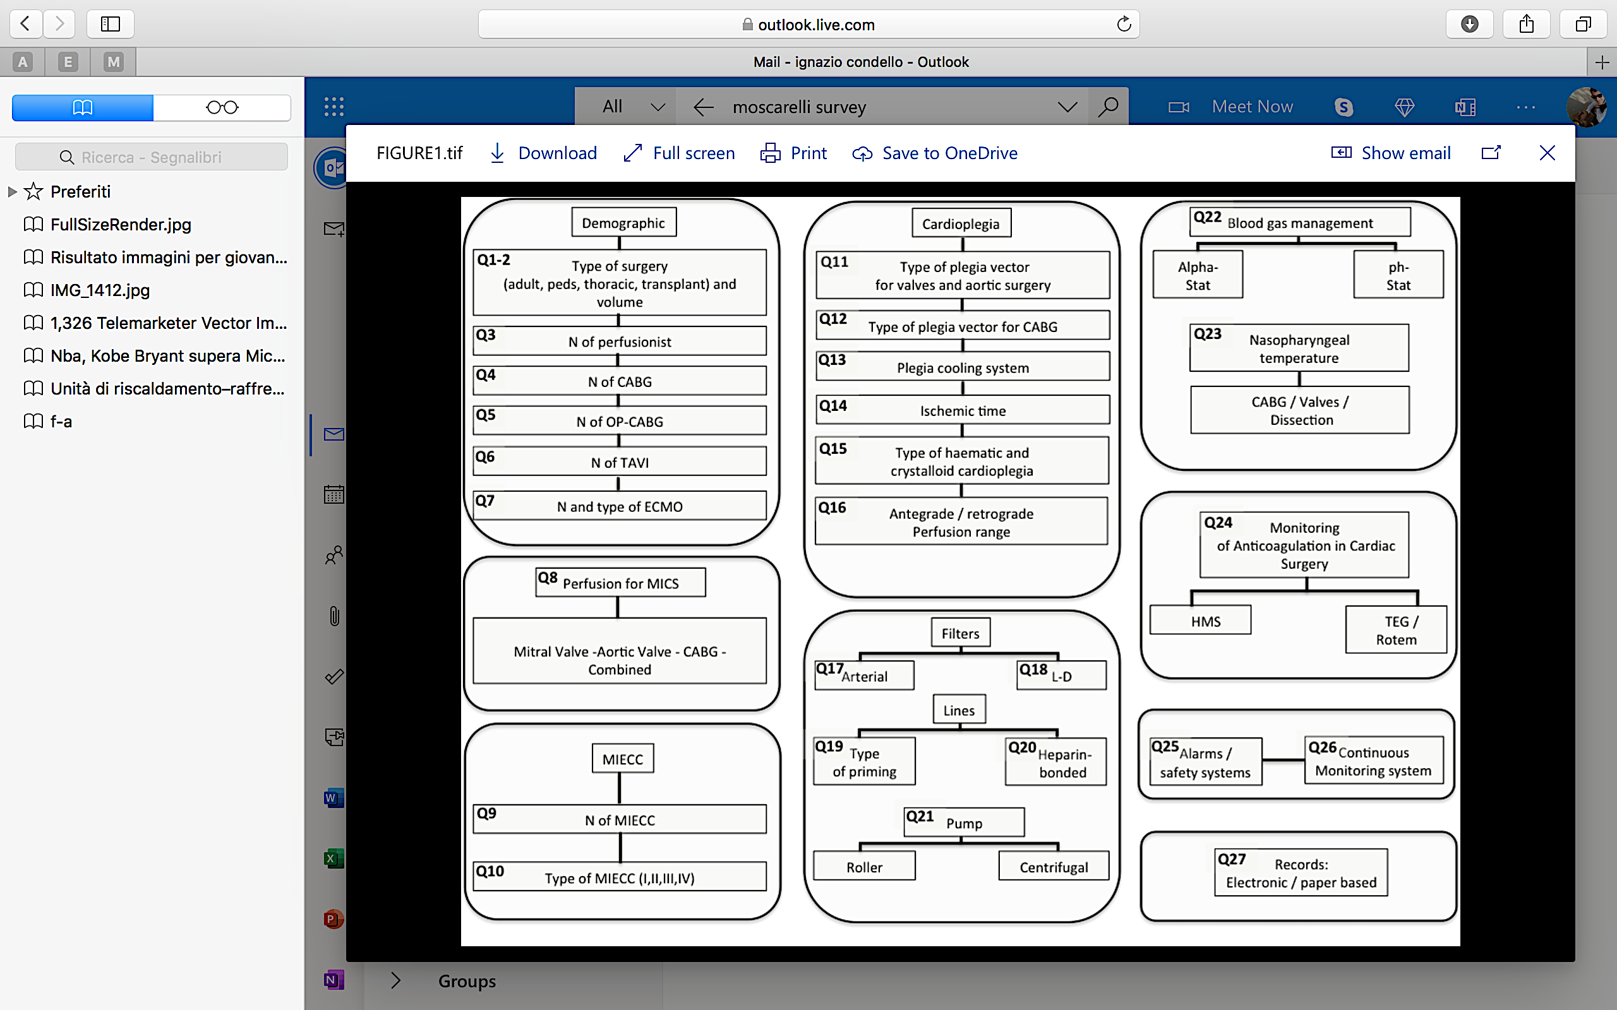
A National Italian Survey on Variations in the Application of Perfusion Technologies

Slide 15
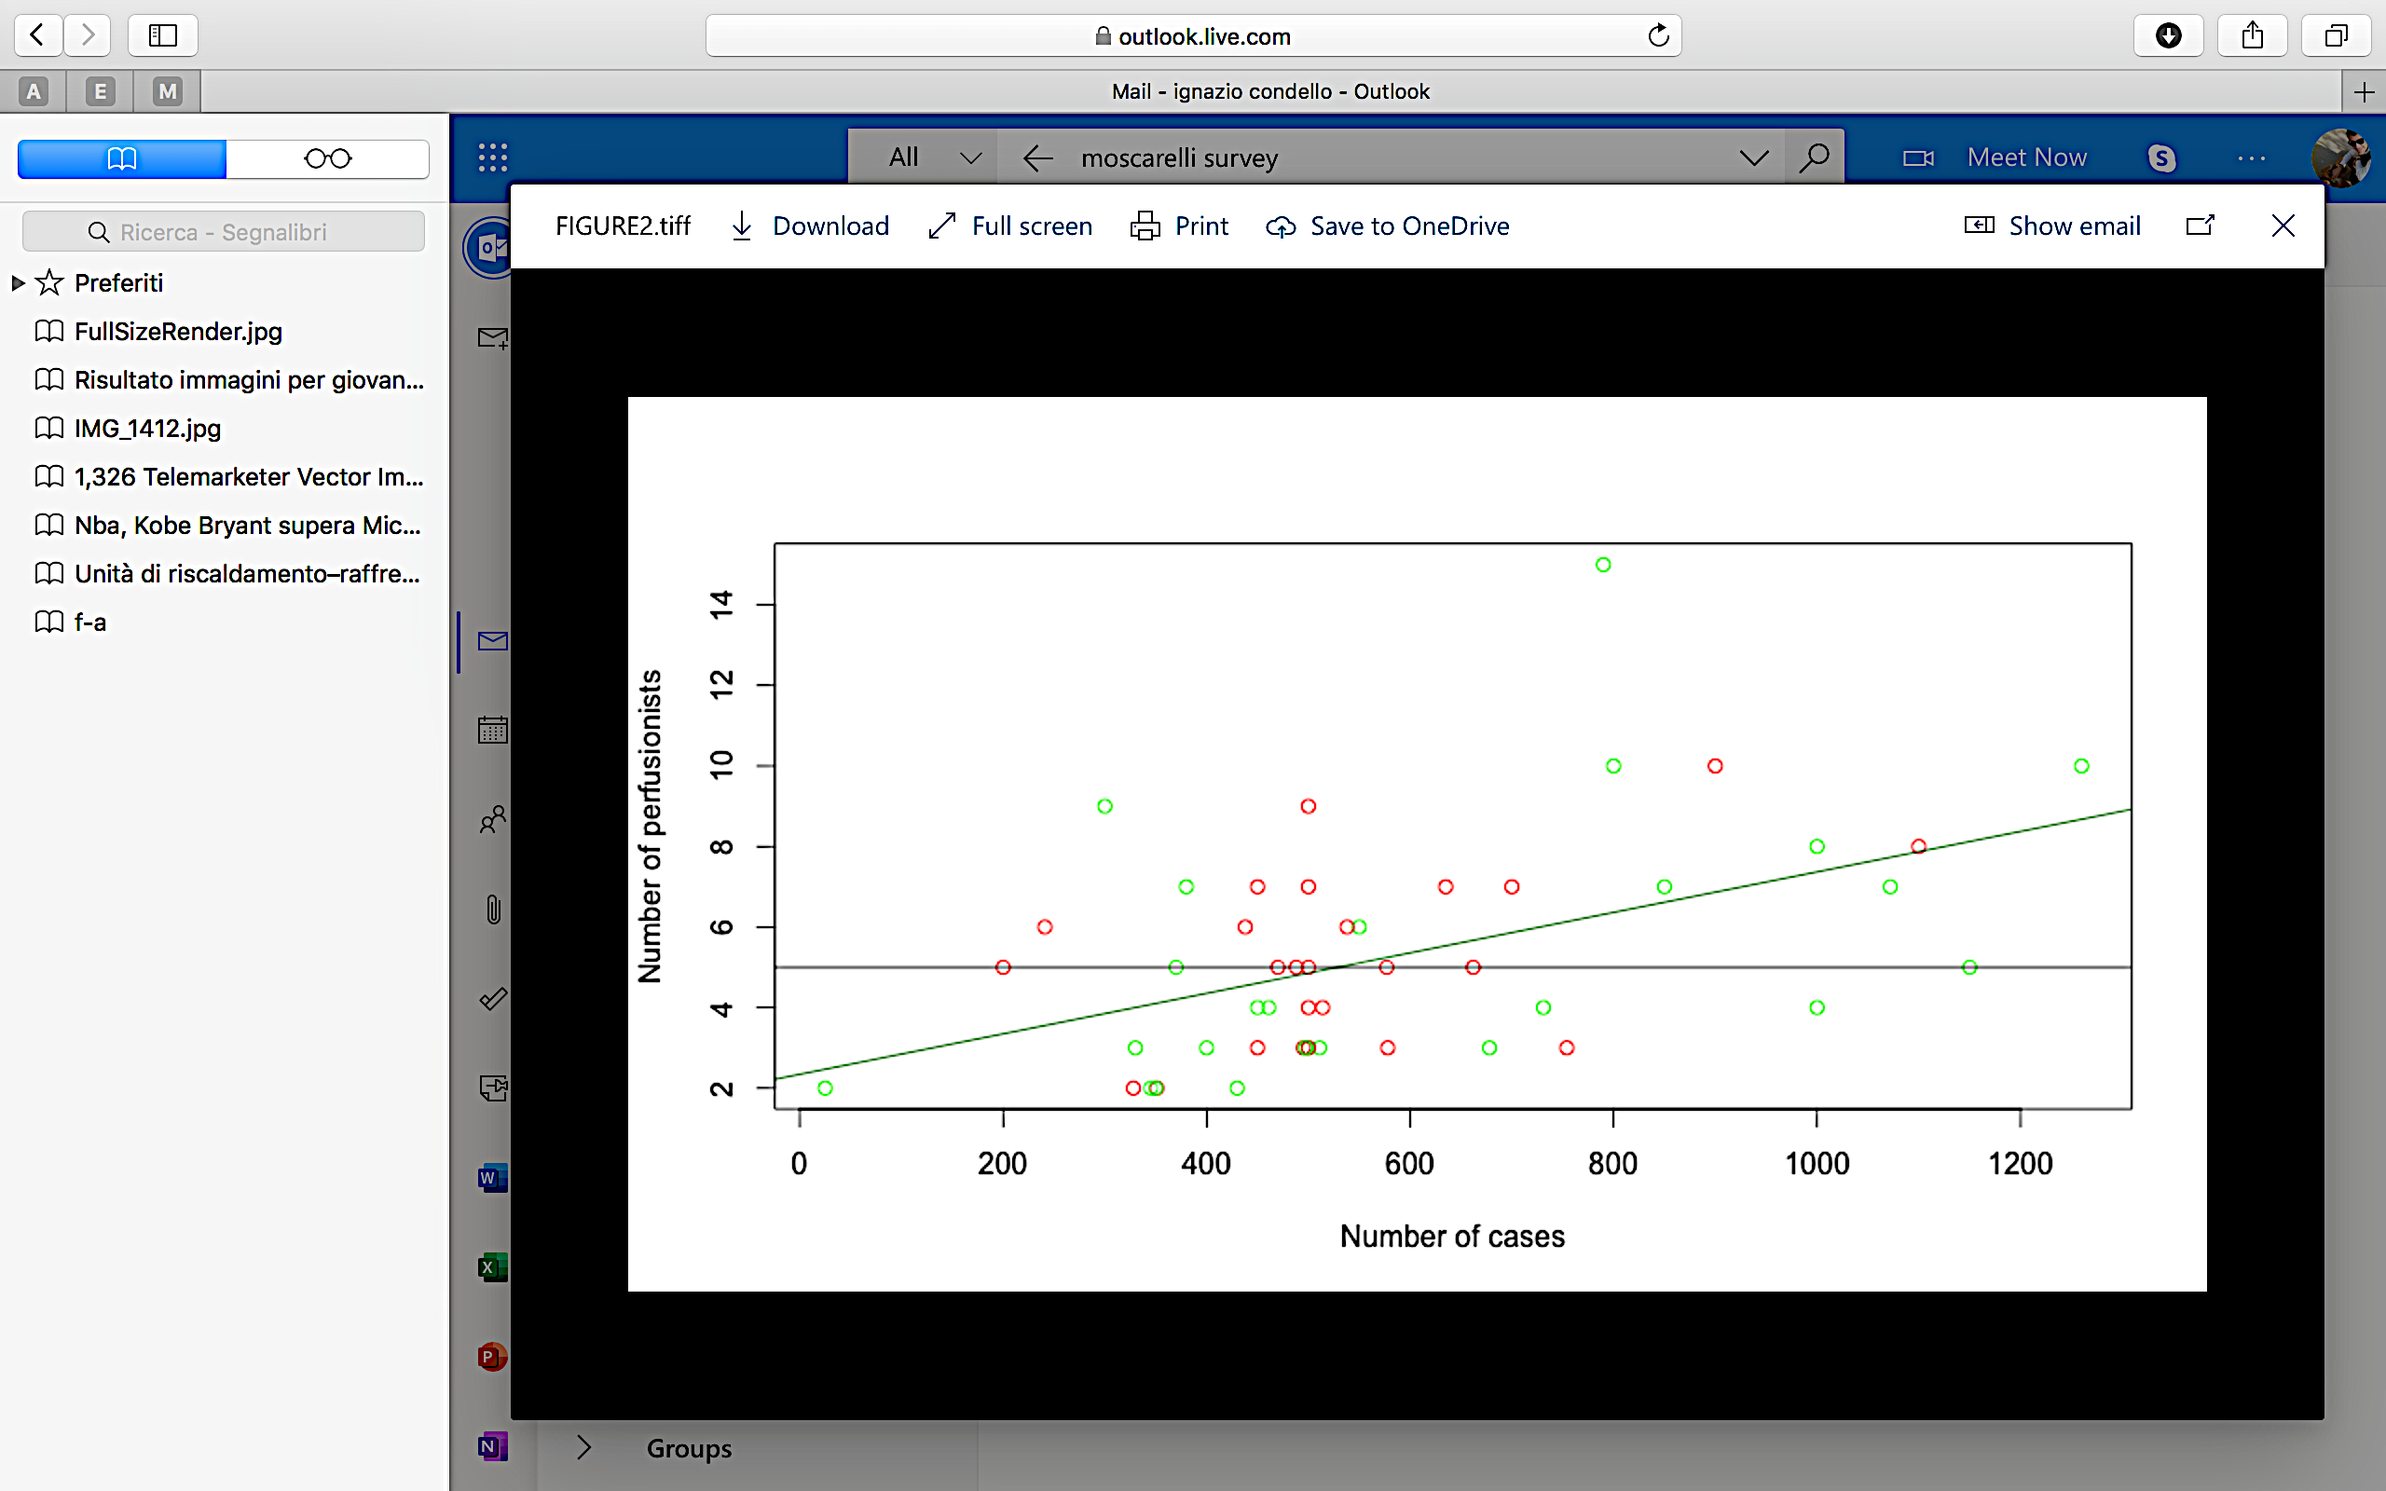
A National Italian Survey on Variations in the Application of Perfusion Technologies

Slide 16
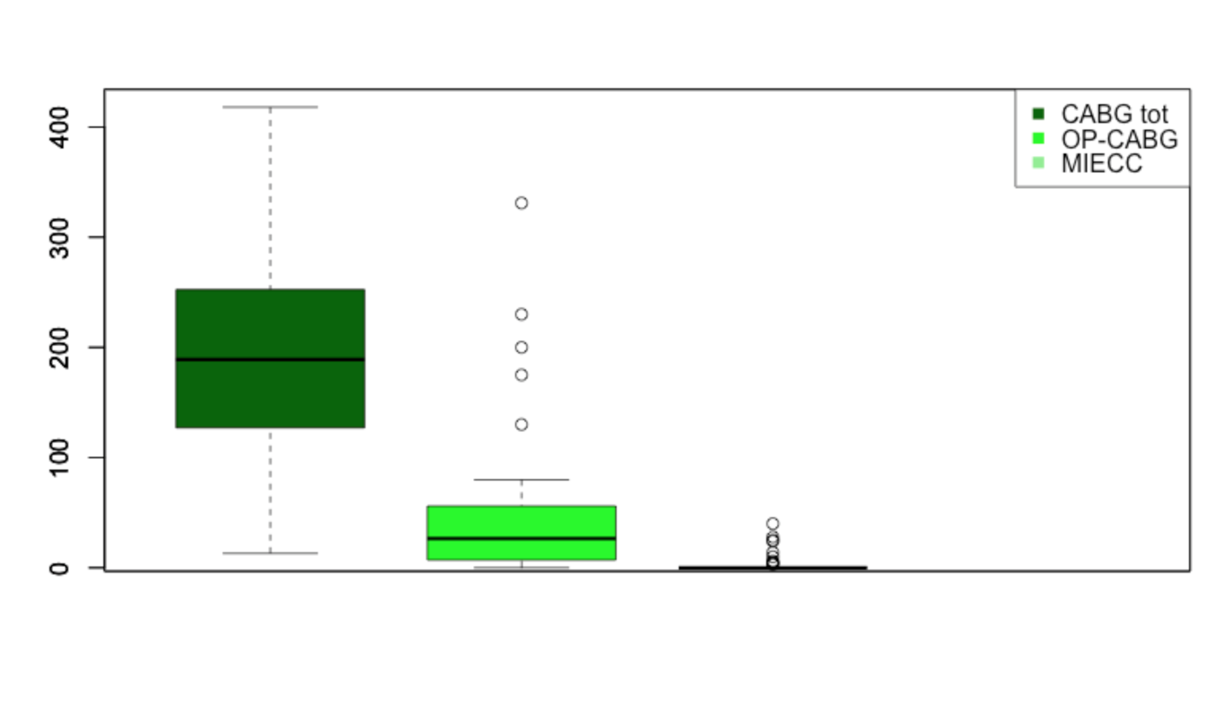
A National Italian Survey on Variations in the Application of Perfusion Technologies

Slide 17
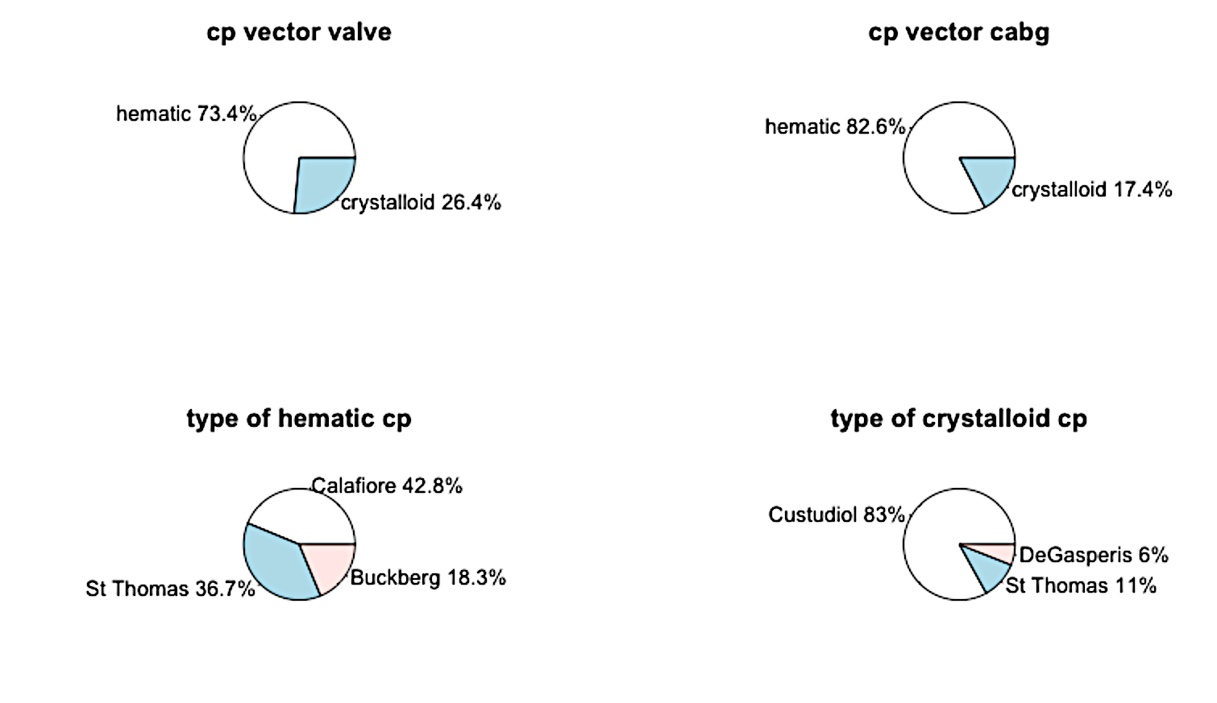
A National Italian Survey on Variations in the Application of Perfusion Technologies

Slide 18
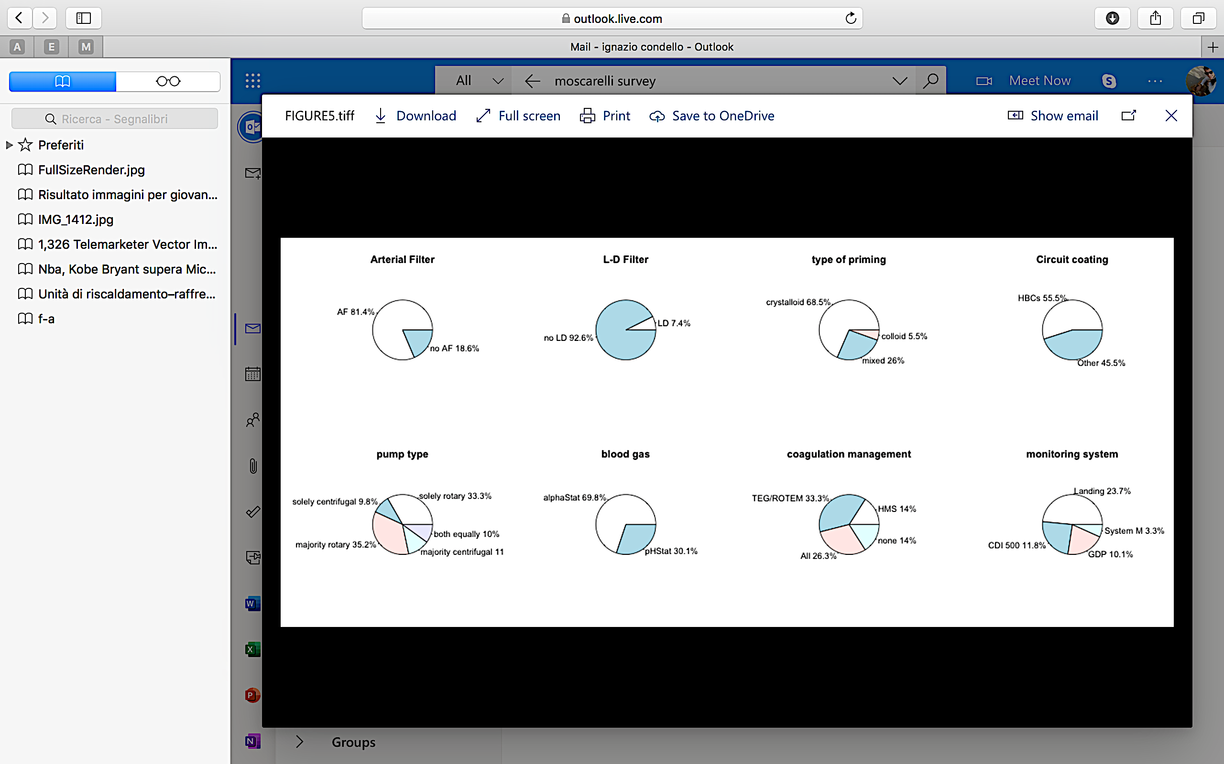
A National Italian Survey on Variations in the Application of Perfusion Technologies

Slide 19
Results
Sixty-one centers answered the questionnaire. Mean number of case 568.7 (SD 275.1), median 500 (IQR 284), max 1500, min 25 with a median of 5 perfusionists per center (min 2 max 15); 81.4% of units used a standard arterial line filter in all cases; 7.4% of units used leukocyte-depleting filters in various sites within the circuit; 55.5% always used some heparin-bonded circuit; 33.3% of units used use solely rotary pumps, 9.8% solely centrifugal pumps; hematic cardioplegia was the most used one. More than 50% of units used devices for continuous blood monitoring and for coagulation screening. Different safetysystems were in placed during the cardiopulmonary bypass. The adoption of minimal extracorporeal circulation and off-pump coronary procedure remainedlow.
Conclusion
This is the first survey in Italy of this kind and showed relatively low variation in the utilization of various technologies used in cardiopulmonary bypass and a awareness toward safety during procedures. This study may be useful for alerting clinicians, surgeons and perfusionists to gaps between evidence-based knowledge and clinical practice.

Slide 20
THANK YOU
Ignazio Condello, PhD
Anthea Hospital,GVM Care & Research
Bari,Italy

