Slide 1
Biocompatibility, fully coated system to improve patient outcomes
Perfusionist meeting, Izmir, 2019
Youssef El Dsouki

Slide 2
CHUV, Lausanne, Switzerland Cardiac surgery
Adult and pediatric cardiac surgery, 2017: 1850 cases
Heart and pulmonary transplant, 2017: 45 cases.
ECMO, LVAD unit.

Slide 3
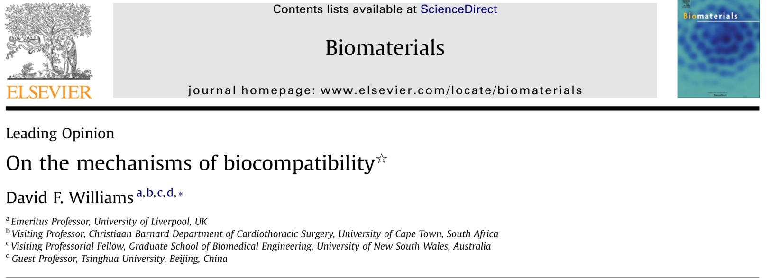

Slide 4
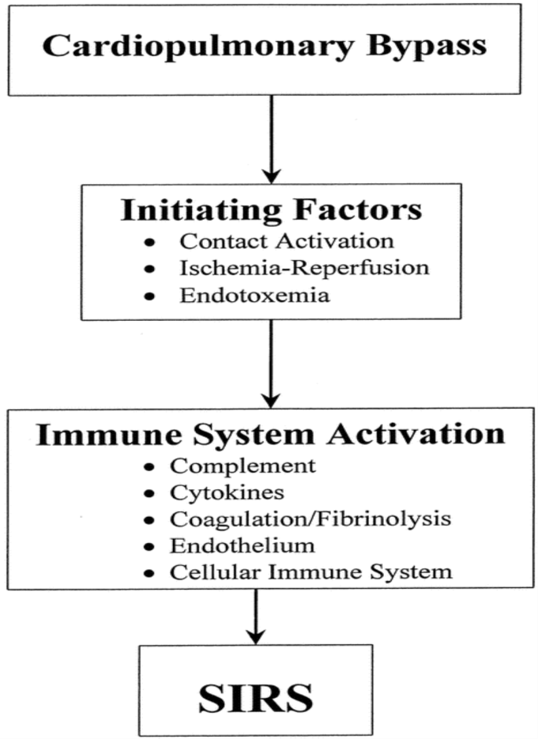
From: The Systemic Inflammatory Response to Cardiac Surgery: Implications for the Anesthesiologist
Anesthes. 2002;97(1):215-252.
Fig. 1. Schematic diagram of the sequence of events by which cardiopulmonary bypass (CPB) may lead to the development of systemic inflammatory response syndrome (SIRS).
Date of download: 2/13/2019
Copyright © 2019 American Society of Anesthesiologists. All rights reserved.

Slide 5
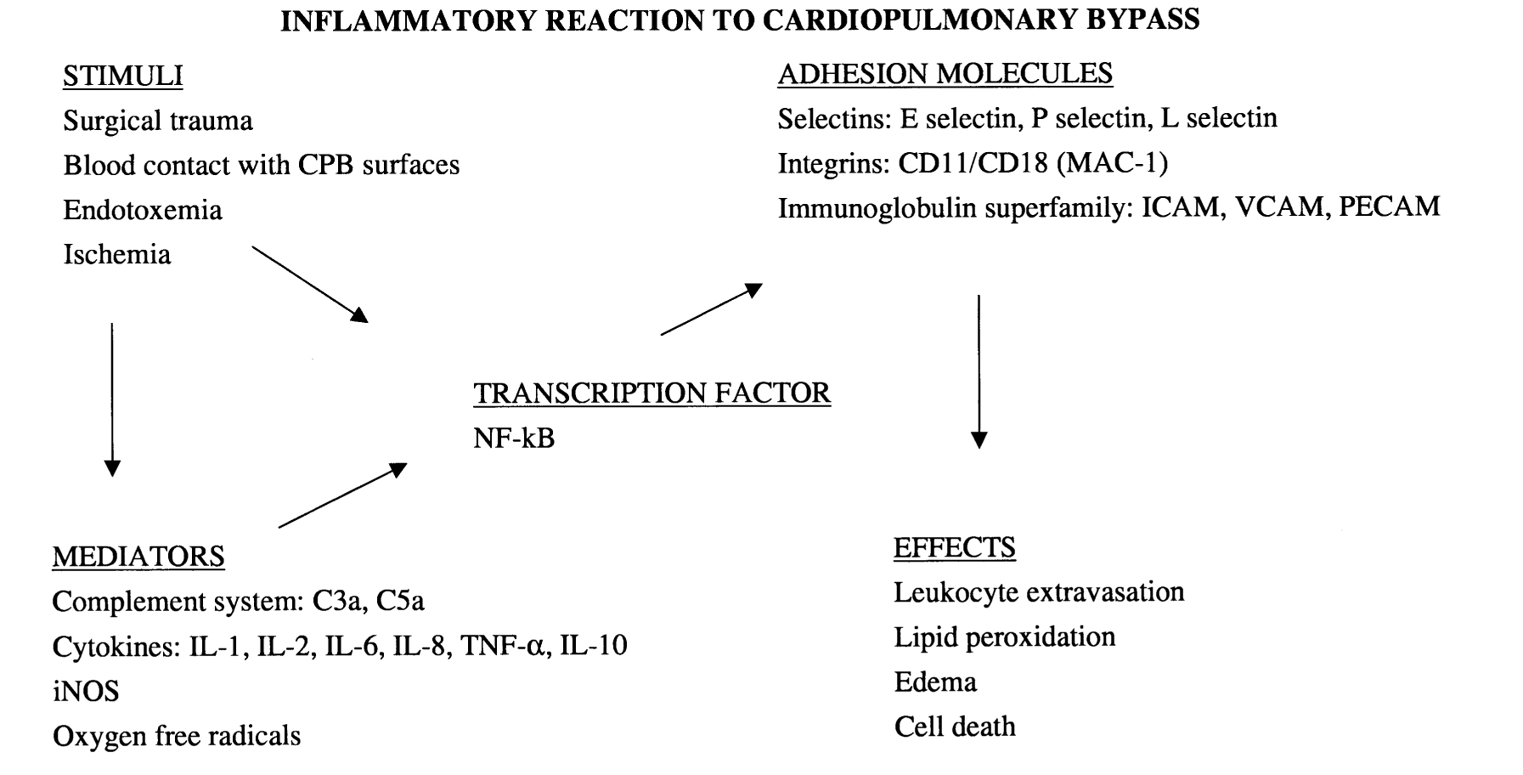
Paparella 2002

Slide 6
BACKGROUND
The continuous interaction of blood with artificial contact surfaces used in CPB leads to substantial damage of cells and plasma proteins, the release of various inflammatory cytokines and activation of coagulation and fibrinolytic systems.
To reduce the negative side-effects of the contact of blood to foreign surfaces, coating techniques have been developed
Hemo-biocompatibility, cellular and protein conservation are among the most important issues in recent Inflammatory response research

Slide 7
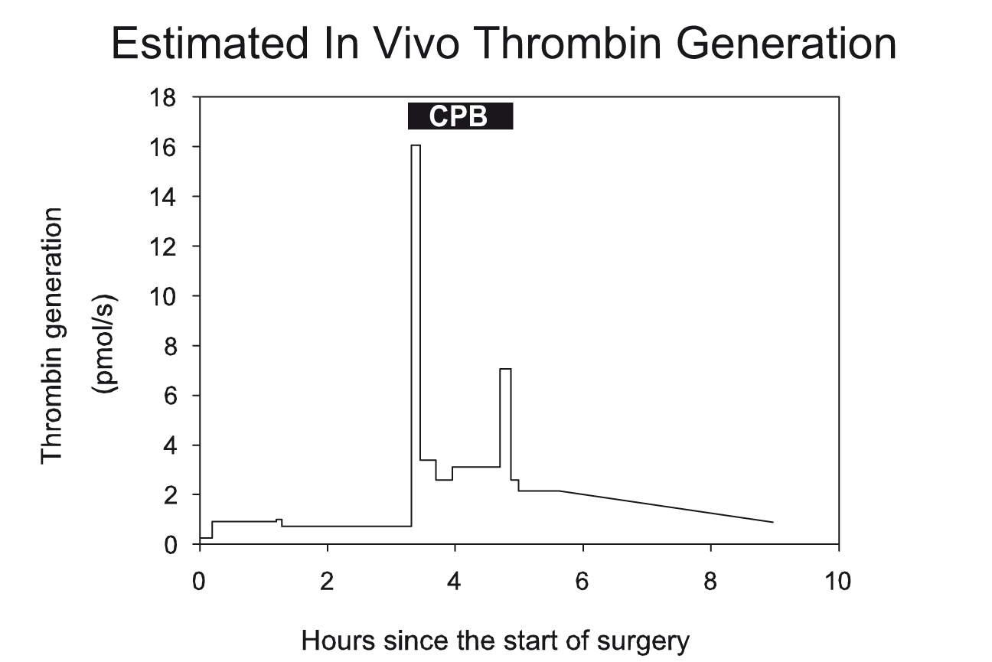
Sniecinski 2011

Slide 8
What Is Biocompatibility?
Inability to initiate thrombogenic phenomena
Inability to cause any haemolysis or activate the complement system
No chronic inflammatory response
No direct or indirect toxicity of products extracted by the biological medium in contact with the material
No generation of wear particles from the constitutive materials while medical devices are working
Chemical inertness to ensure that no toxic products are generated and that the material keeps all its properties

Slide 9
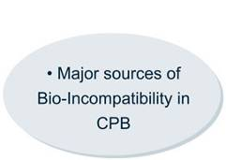
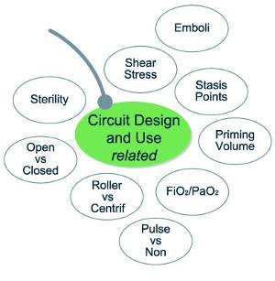
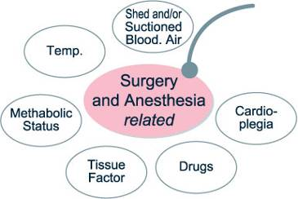
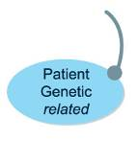
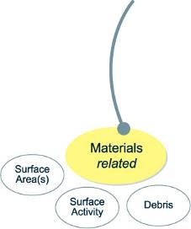
“Bio-INCOMPATIBILITY” during Cardiopulmonary Bypass

Slide 10
Phisio coating mechanism
Biomaterial / Blood Contact
Protein Adsorption
X
WBC Activation
Clotting Factors Activation
PLT Activation
RBC involvement
Complement Activation
Clotting Factors Activation
Inflammation
Thrombogenicity
Hemolysis
SISTEMIC INJURIES
Gravlee GP et al, “Cardiopulmonray bypass, principles and practice”, Third Edition, Lippincott Williams and Wilkins
Ratner BD et al, “Biomaterials science: an introduction to materials in medicine”, Elsevier Science & Technology Books
Notes:
10

Slide 11
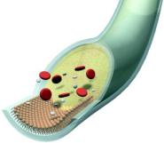
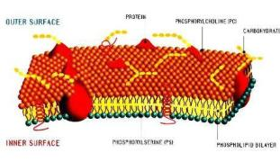
Phosphorylcoline PH.I.S.I.O coating
Uniform Coating
One solid biocompatible surface without reduction of gas transfer
Stable
Not leaching even during extended procedures
Phosphorylcholine
Physiological material
Bio-Mimicry
Imitation of physiological markers
Non-interfering
Biopassive, inert, not thrombogenic

Slide 12
Phisio Coating - Features and Benefits
Features
Uniform Coating – no reduction of gas transfer
Stable – not leaching, durable
Phosphorylcholine - physiological
Bio-Passive - inert, not thrombogenic and not toxic
Benefits – Preservation of hemostasis
Reduced platelet adhesion and activation
Lowered coagulation activation
Phosphorylcholine
Inert
Surface
In
Oxygenation
Notes:
12

Slide 13
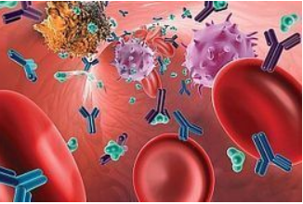
Enhanced biocompatibility: Impact of suction blood and microemboli
Pericardial suction blood separation attenuates inflammatory response and hemolysis after cardiopulmonary bypass.
Skrabal CA et al, Scand Cardiovasc J. 2006 Aug;40(4):219-23
“Cardiotomy suction is a major cause of hemolysis and contributes significantly to the systemic inflammatory response“
Tissue factor as the main activator of the coagulation system during cardiopulmonary bypass
F. De Somer et al, J Thorac Cardiovasc Surg 2002;123:951-8
“Aspirated blood contaminated by tissue contact is the most important activator of the coagulation system and the principal cause of hemolysis during cardiopulmonary bypass. Contact with a foreign surface is not a main variable in the procoagulant effect of bypass. Mimicking the outer cell membrane structure resulted in decreased platelet activation and decreased blood loss“
Hemodynamic effects of cardiotomy suction blood
M. Westerberg et al, J Thorac Cardiovasc Surg 2006;131:1352-70022-5223
“The results suggest cardiotomy suction blood is vasoactive and might influence vascular resistance and blood pressure during cardiac surgery. The observed vasodilation is proportional to the inflammatory activation of suction blood and can be reduced by processing suction blood with a cell-saving device before retransfusion“

Slide 14
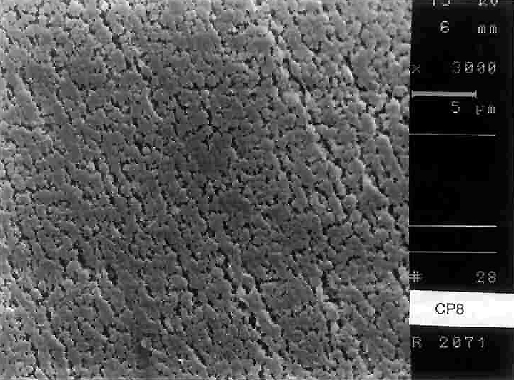
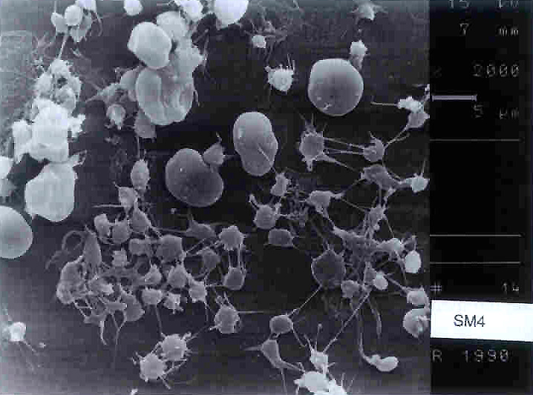
Surface Coatings
Baykut 2001

Slide 15
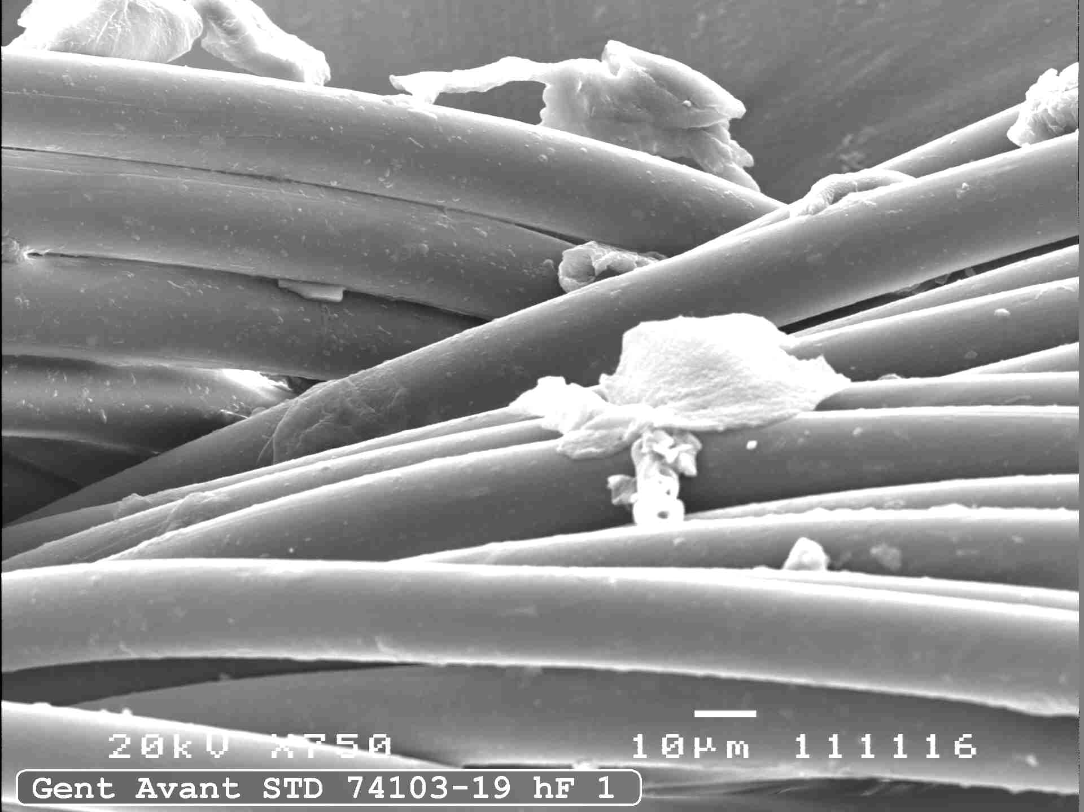
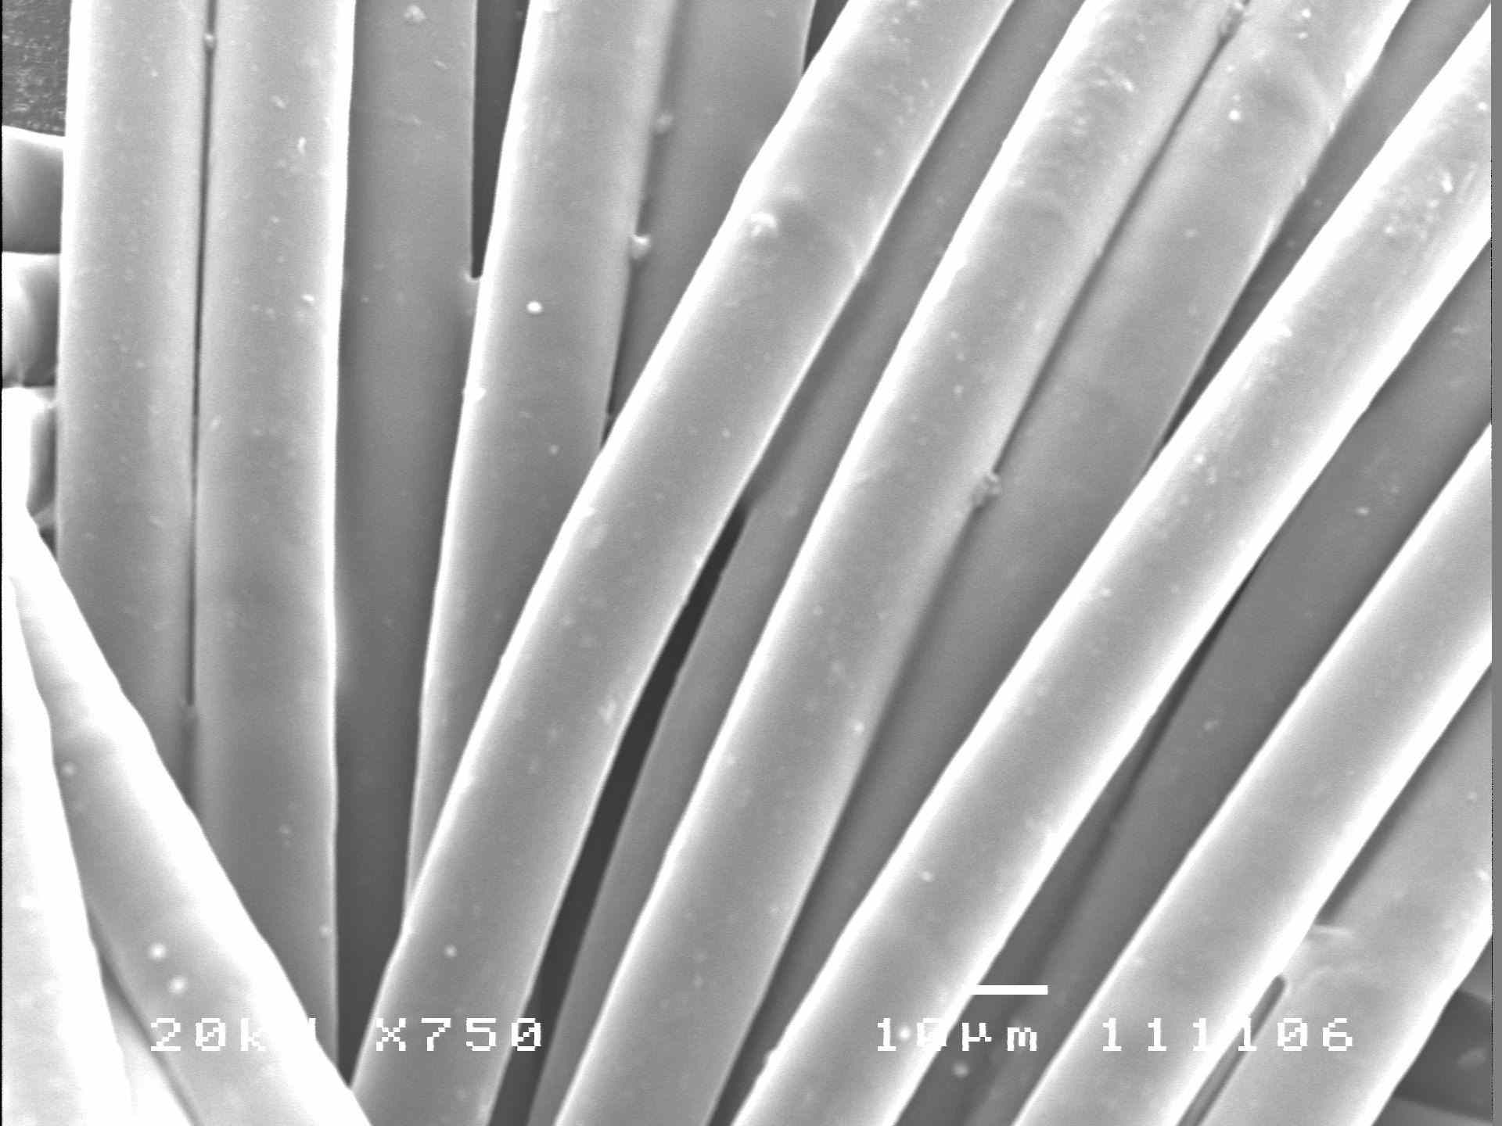
Phisio Coating - SEM analysis – hollow fibres
Hollow fibres
Uncoated
Hollow fibres
Phisio coated
Notes:
15

Slide 16
Competitors’ Profile
MEDTRONIC Carmeda
Trillium
MEDOS Rheoparin
Bioline
MAQUET (Jostra)
Safeline / Softline
TERUMO X-coating
LivaNova Smar_{x}t
LivaNova Phisio
EUROSETS Agile
ACTIVE
PASSIVE
Notes:
16

Slide 17
CLINICAL EXPERIENCES
Available since 1998
Over 90% of LivaNova oxygenators are now Phisio coated (approx 350’000 /yr)
Over 60% of LivaNova PTS (approx 200’000 /yr) are Phisio coated, in the international 20% only.
ALL ECMO oxygenators, centrifugal pump heads and tubing sets are coated
Notes:
17

Slide 18
Inflammatory Response
Further studies have demonstrated the clinical benefits of optimized bypass in terms:
Higher on pump HCT, reduced platelet activation and reduced
occurrence of systemic inflammatory response.
Reduction of coagulative response and monocyte-platelet interaction
following the use of fully coated system in cardiac surgery.

Slide 19
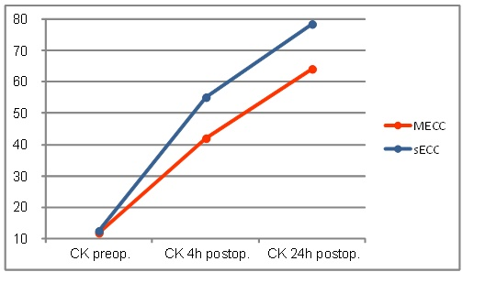
CK Level
CK U/L
Coated
non coated
Hours
M. Lisy, E. Schmid, J. Kozok, P. Rosenberger, U.A. Stock, G.Kalender
Department of Thoracic, Cardiac and Vascular Surgery, University Hospital Tuebingen, Germany. Publisher Id: TOCMJ-10-148 DOI: 10.2174/1874192401610010148

Slide 20
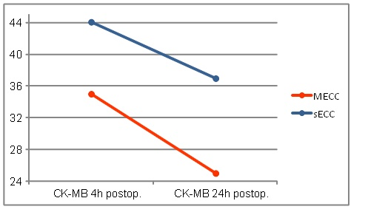
CK-MB Level
CK_MB ng/ml
Coated
Non coated
Hours
M. Lisy, E. Schmid, J. Kozok, P. Rosenberger, U.A. Stock, G.Kalender
Department of Thoracic, Cardiac and Vascular Surgery, University Hospital Tuebingen, Germany. Publisher Id: TOCMJ-10-148 DOI: 10.2174/1874192401610010148

Slide 21
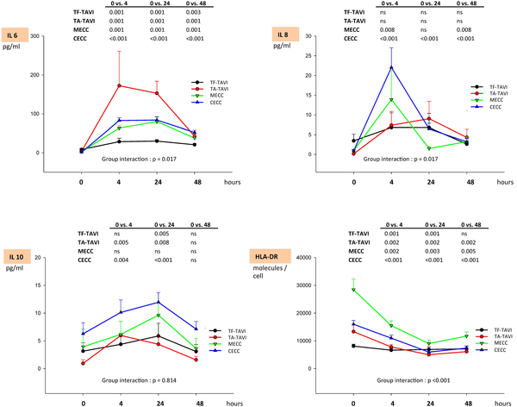
Inflammatory Indicator
M. Lisy, E. Schmid, J. Kozok, P. Rosenberger, U.A. Stock, G.Kalender
Department of Thoracic, Cardiac and Vascular Surgery, University Hospital Tuebingen, Germany. Publisher Id: TOCMJ-10-148 DOI: 10.2174/1874192401610010148

Slide 23
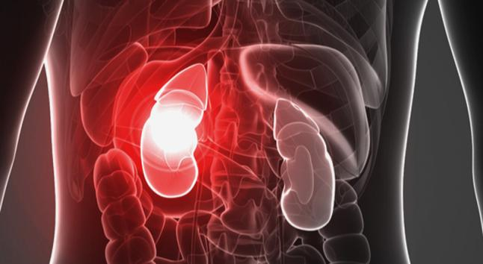
Acute Kidney Injury impact on clinical and economic outcome
Acute kidney injury after cardiac surgery: focus on modifiable risk factors
Karkouti et al, Circulation. 2009 Feb 3;119(4):495-502
Cardiopulmonary bypass-associated acute kidney injury
Kumar et al, Anesthesiology. 2011 Apr;114(4):964-70
“The development of AKI after CPB is associated with a significant increase in infectious complications, an increase in length of hospital stay, and greater mortality when compared with patients without AKI-CPB. The incidence of AKI-CPB averages 20–30%..”
“The unacceptably high morbidity and mortality of AKI-CPB, despite the advent of RRT and intensive care unit care, highlight the importance of this problem. Perioperative management strategies include identifying high-risk patients, optimizing cardiac output and renal perfusion pressure…”
Acute kidney injury and prognosis after cardiopulmonary bypass: a meta-analysis of cohort studies
Pickering et al., Am J Kidney Dis. 2015;65(2)283-292
“46 studies with 47 unique cohorts comprising 242,388 participants were included. The pooled rate of CPB-associated AKI was 18.2%, and of renal replacement therapy, 2.1%.”
“CPB-associated AKI was associated with early mortality (risk ratio [RR], 4.0…)”
“CPB-associated AKI is associated with a more than 2-fold increase in early mortality regardless of AKI definition”

Slide 24
Fully coated system for better outcome

Slide 25
How to make CPB more biocompatible ?
Suggested combination of various strategies:
Reduction of sucker blood retransfusion
Reduction of blood-air interfaces
Coating of CPB circuits
Re-design and Miniaturization of CPB circuits
Reducing hemodilution and blood transfusion
Therapeutic Filtration
Pharmacological interventions

Slide 26
Conclusion
Biocompatible circuit had high performance and clear advantages were demonstrated by in vitro and ex vivo experiments, applying very unique technology :
blocks initiation of platelet adhesion and clot activating factors
reduces adsorption and degeneration of proteins
minimizes attachment of cells in the oxygenator
Low toxicity and leaching

