Slide 1
The interest of use of ATS in Cardiac surgery
Perfusionist meeting, Izmir, 2019
Youssef El Dsouki

Slide 2
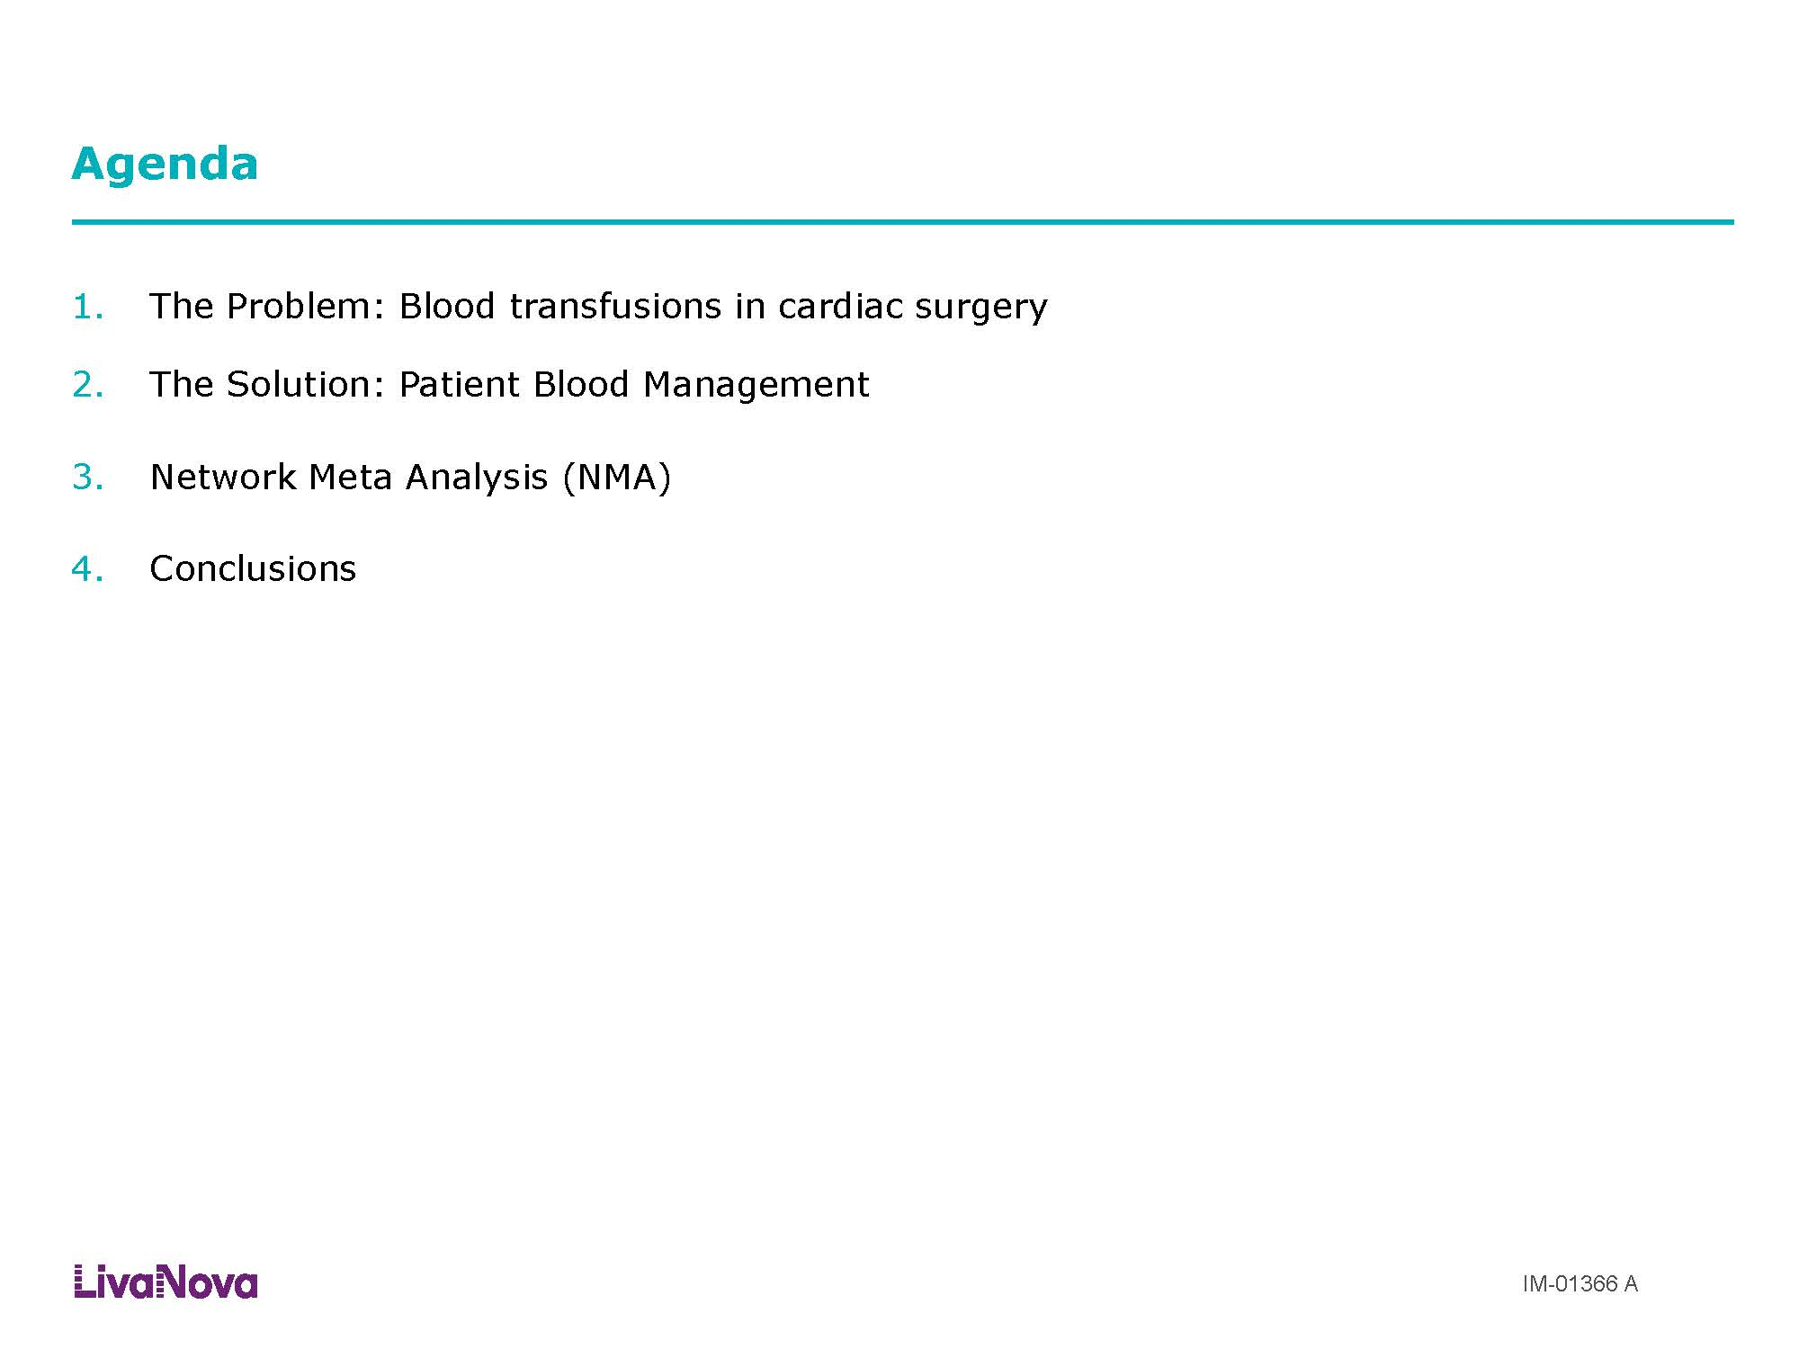

Slide 3
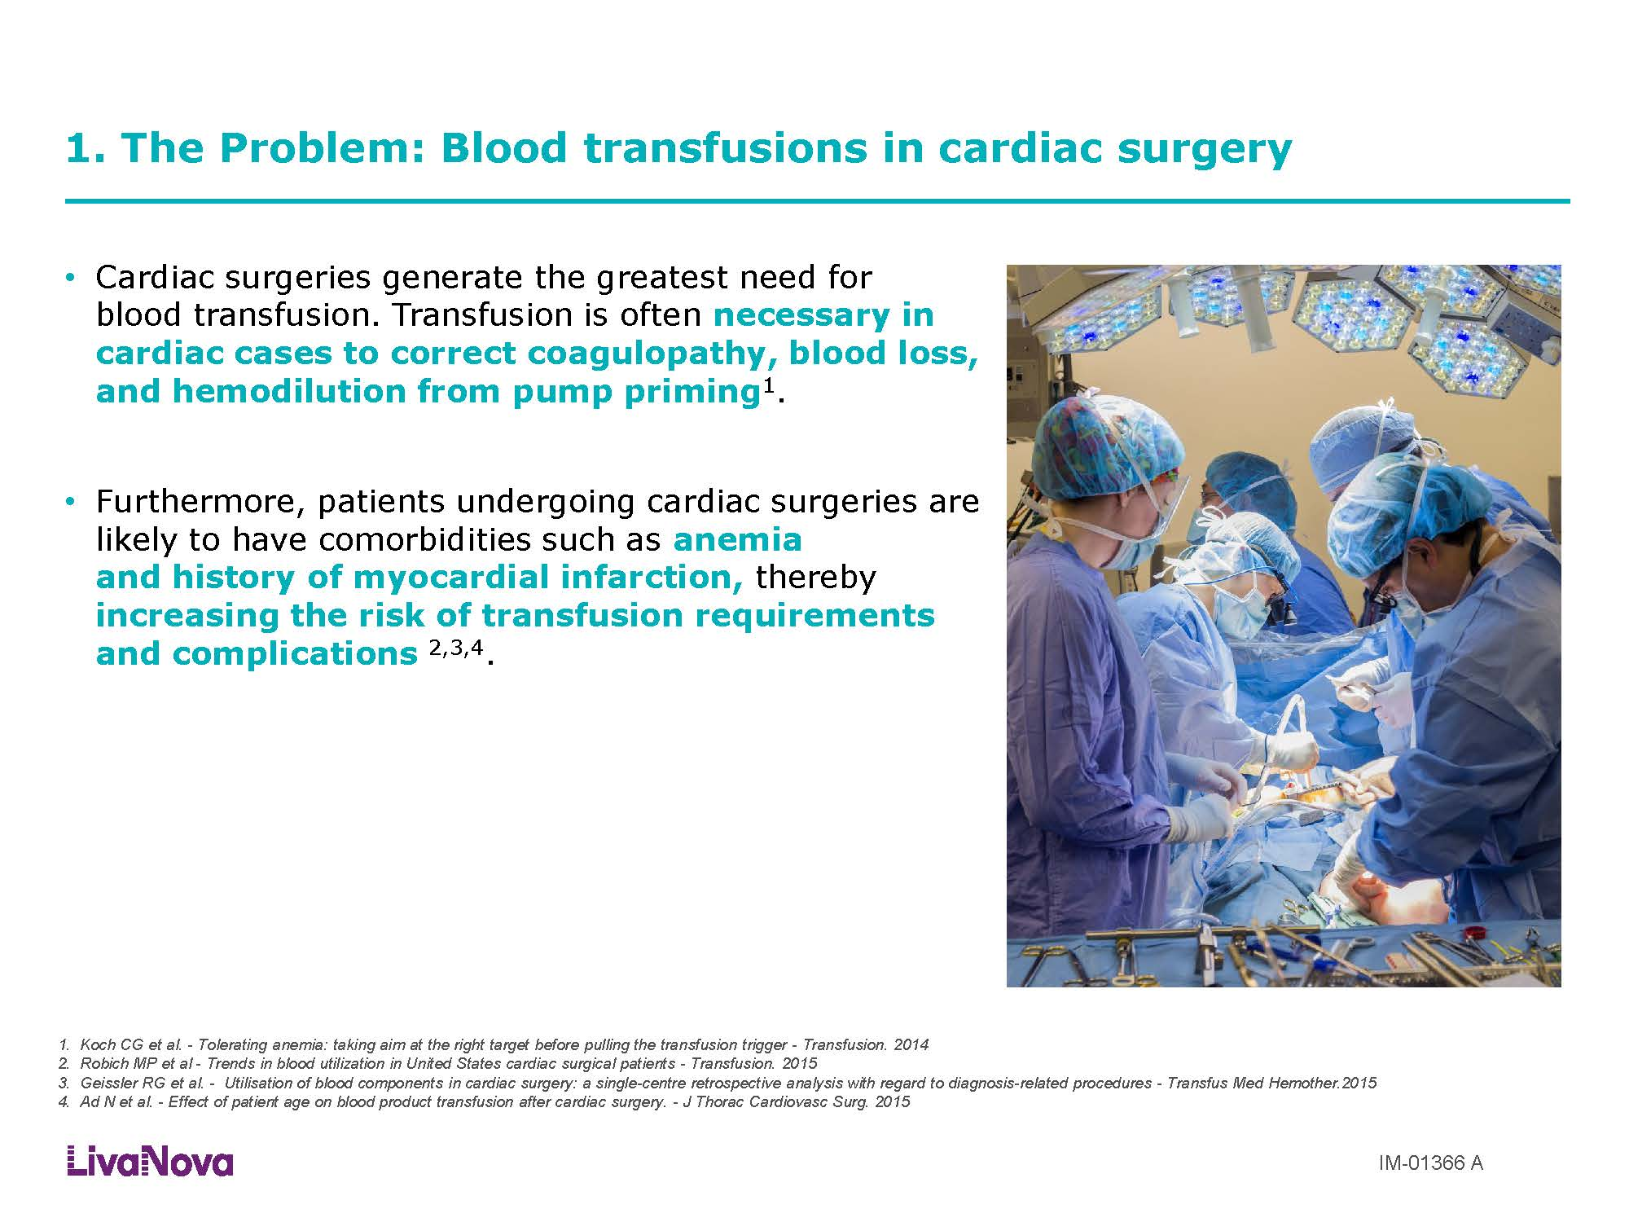

Slide 4
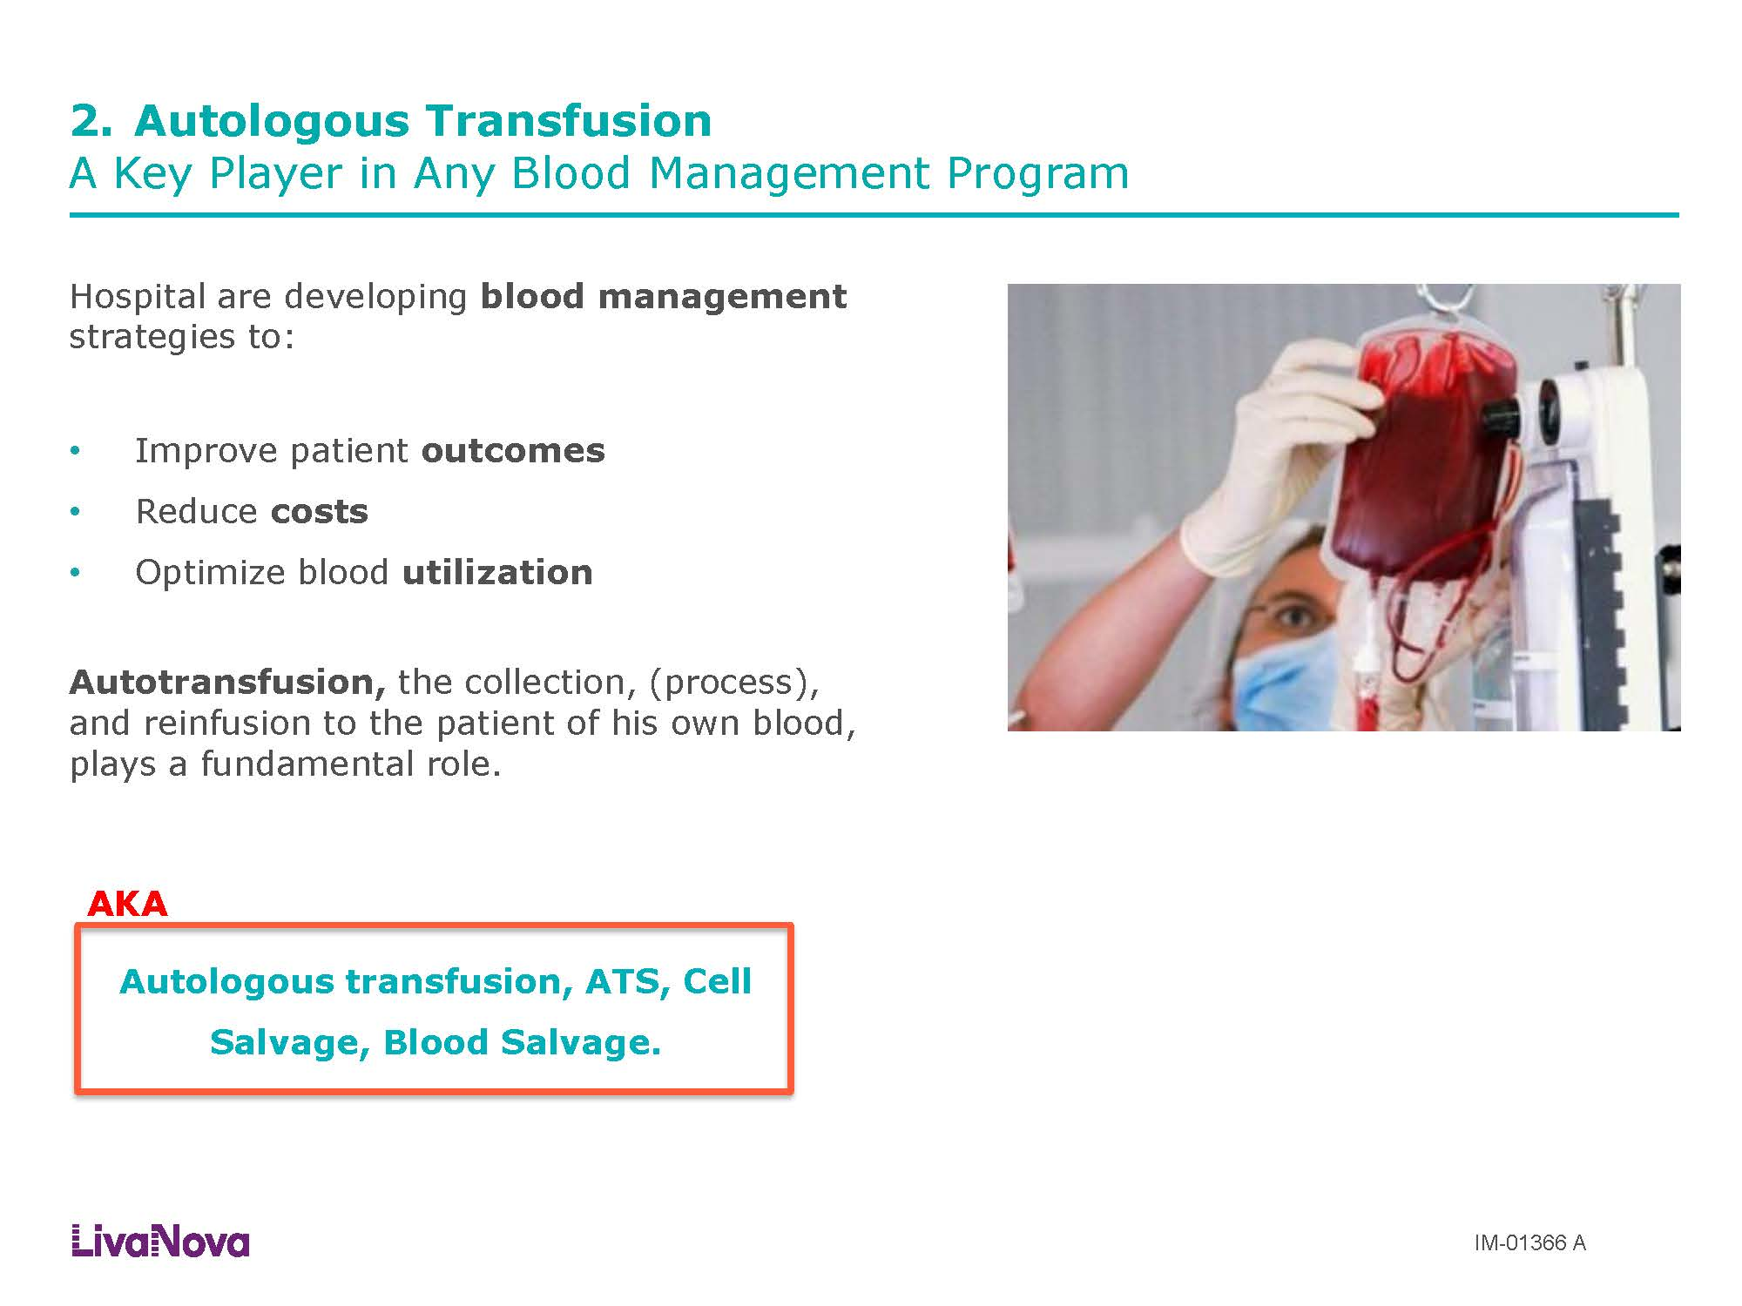

Slide 5
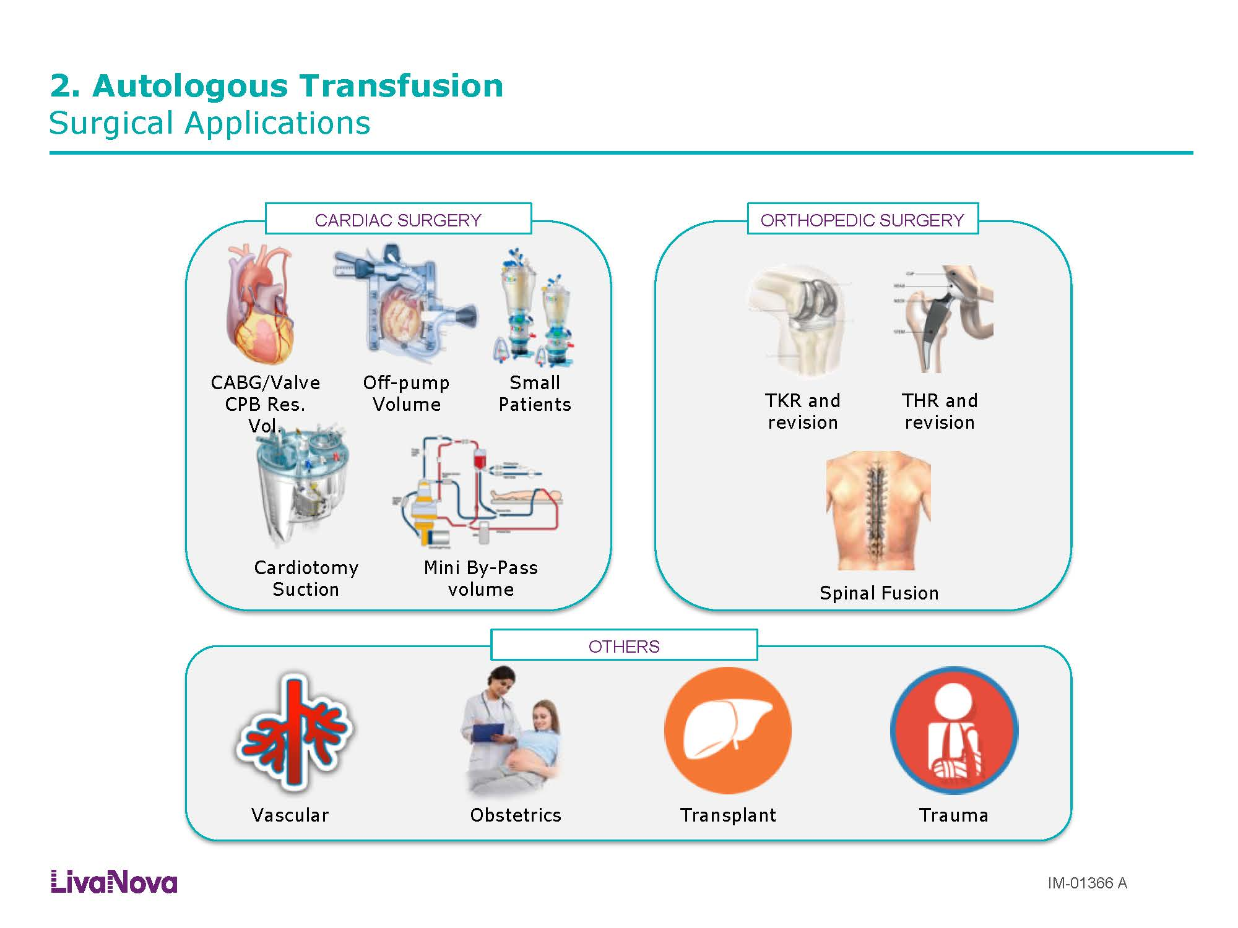

Slide 6
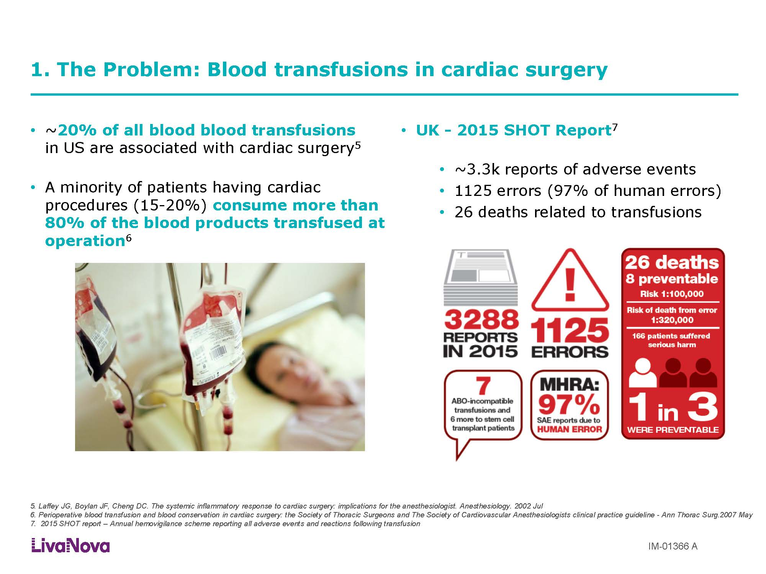

Slide 7
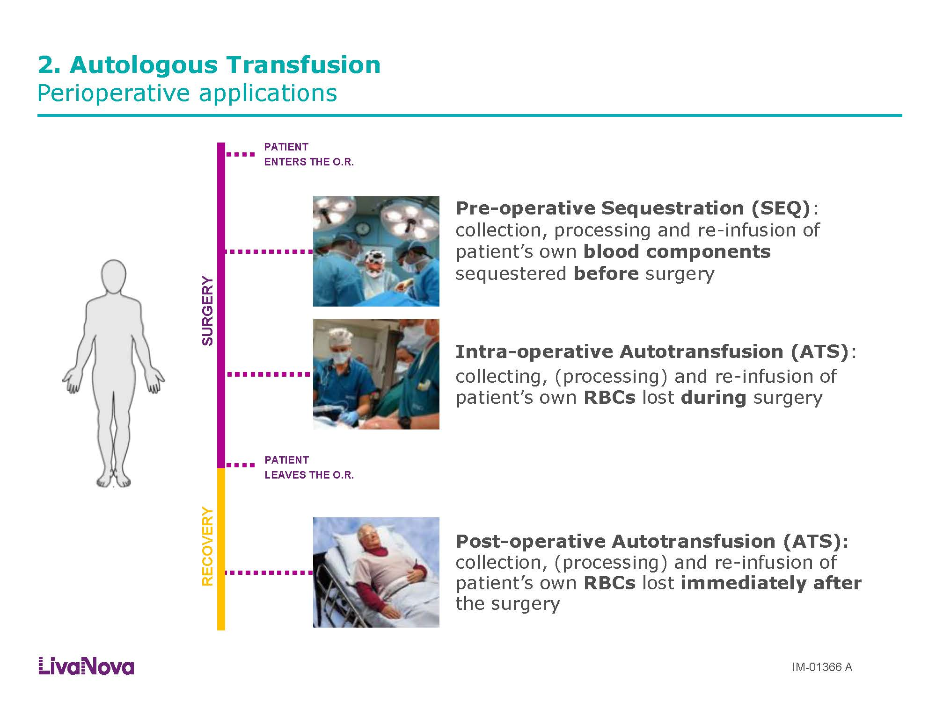

Slide 8
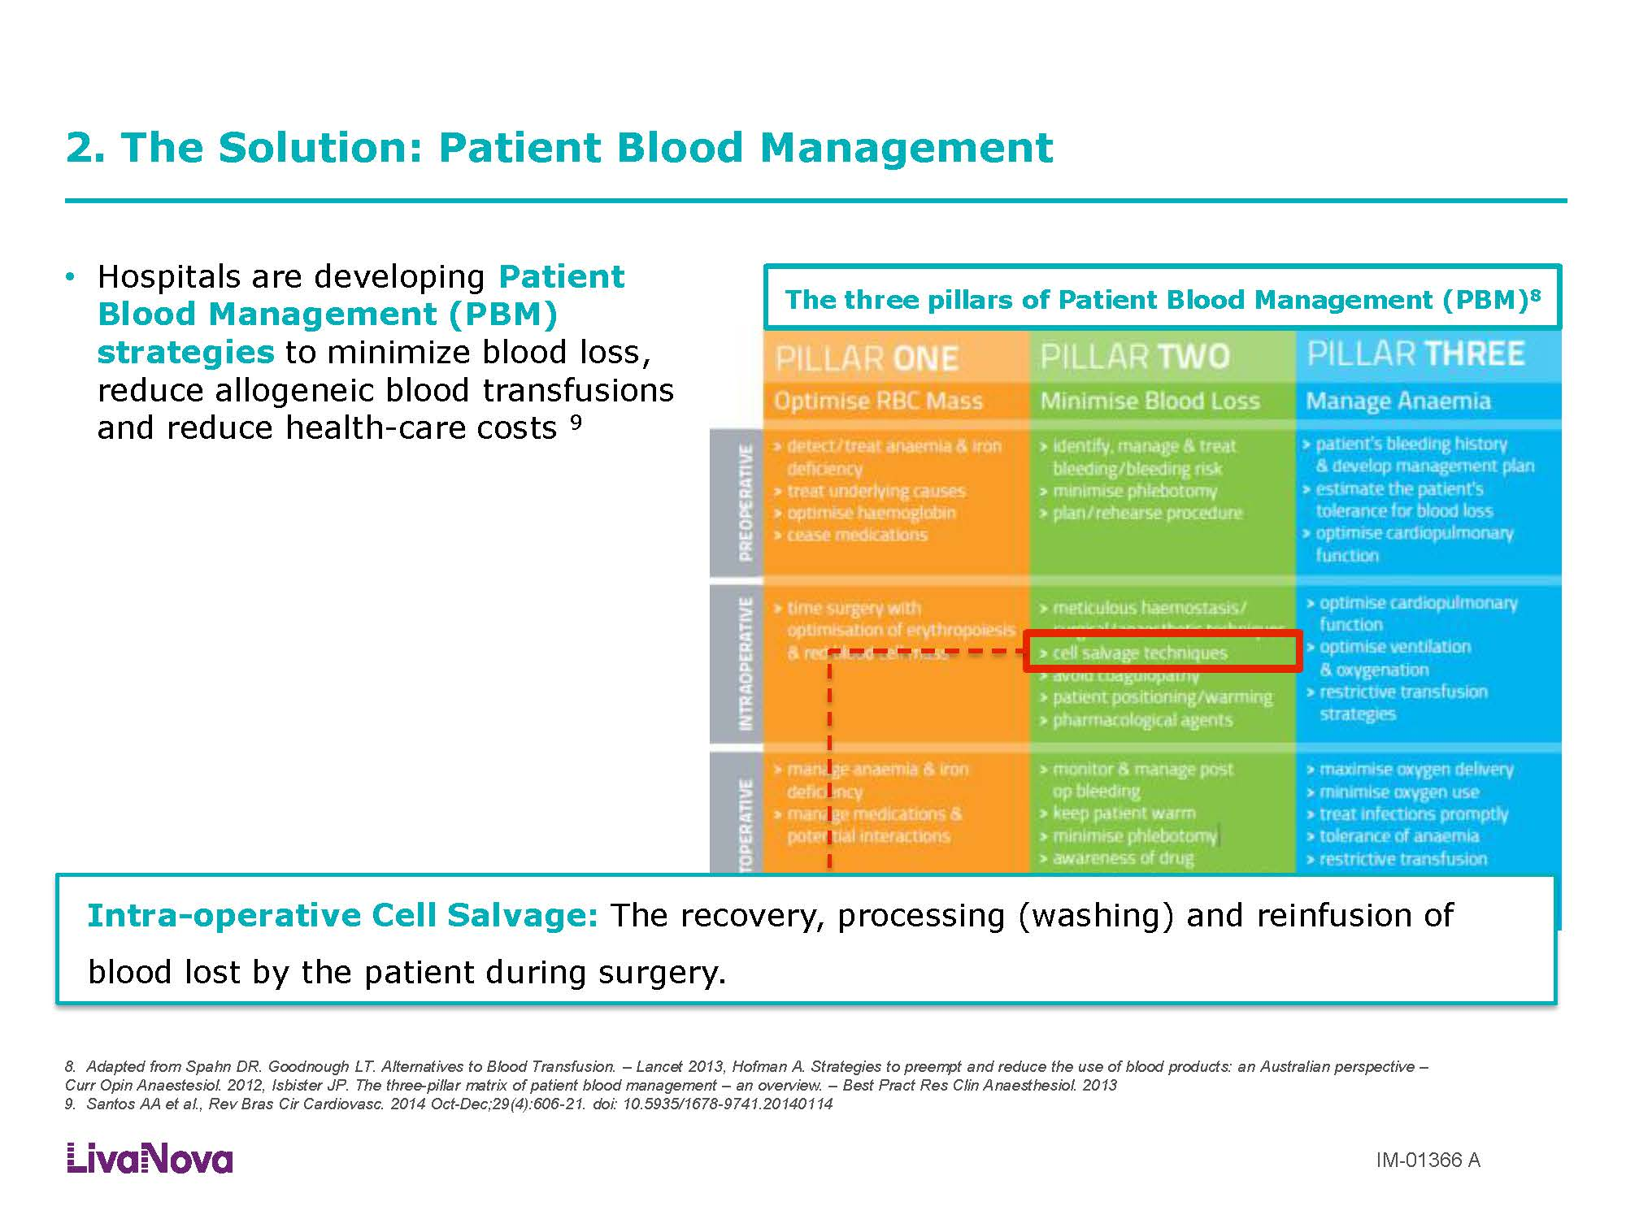

Slide 9
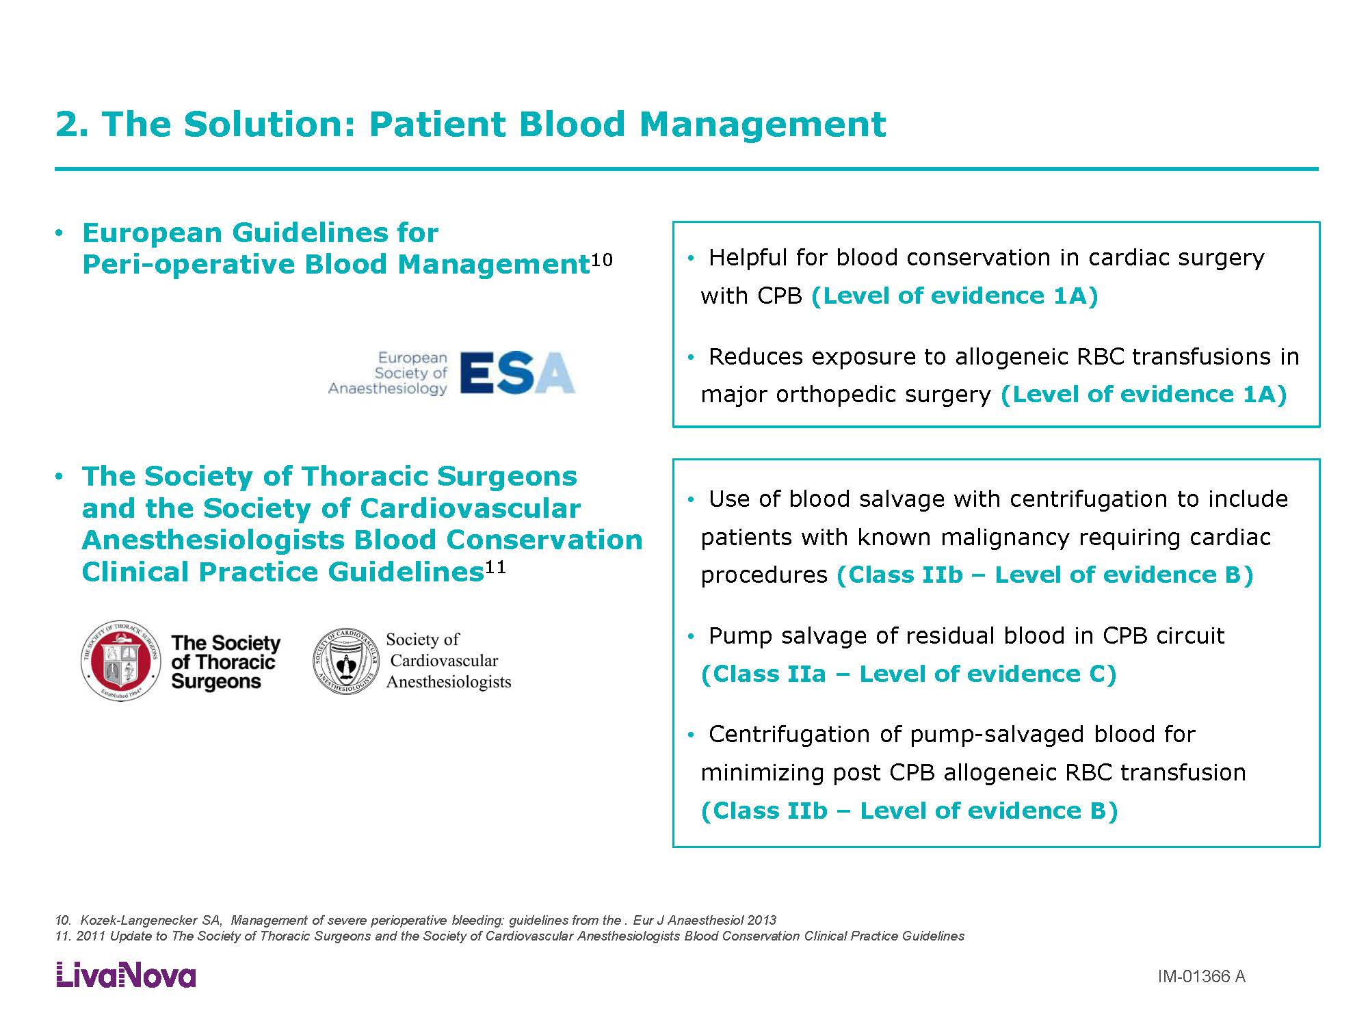

Slide 10
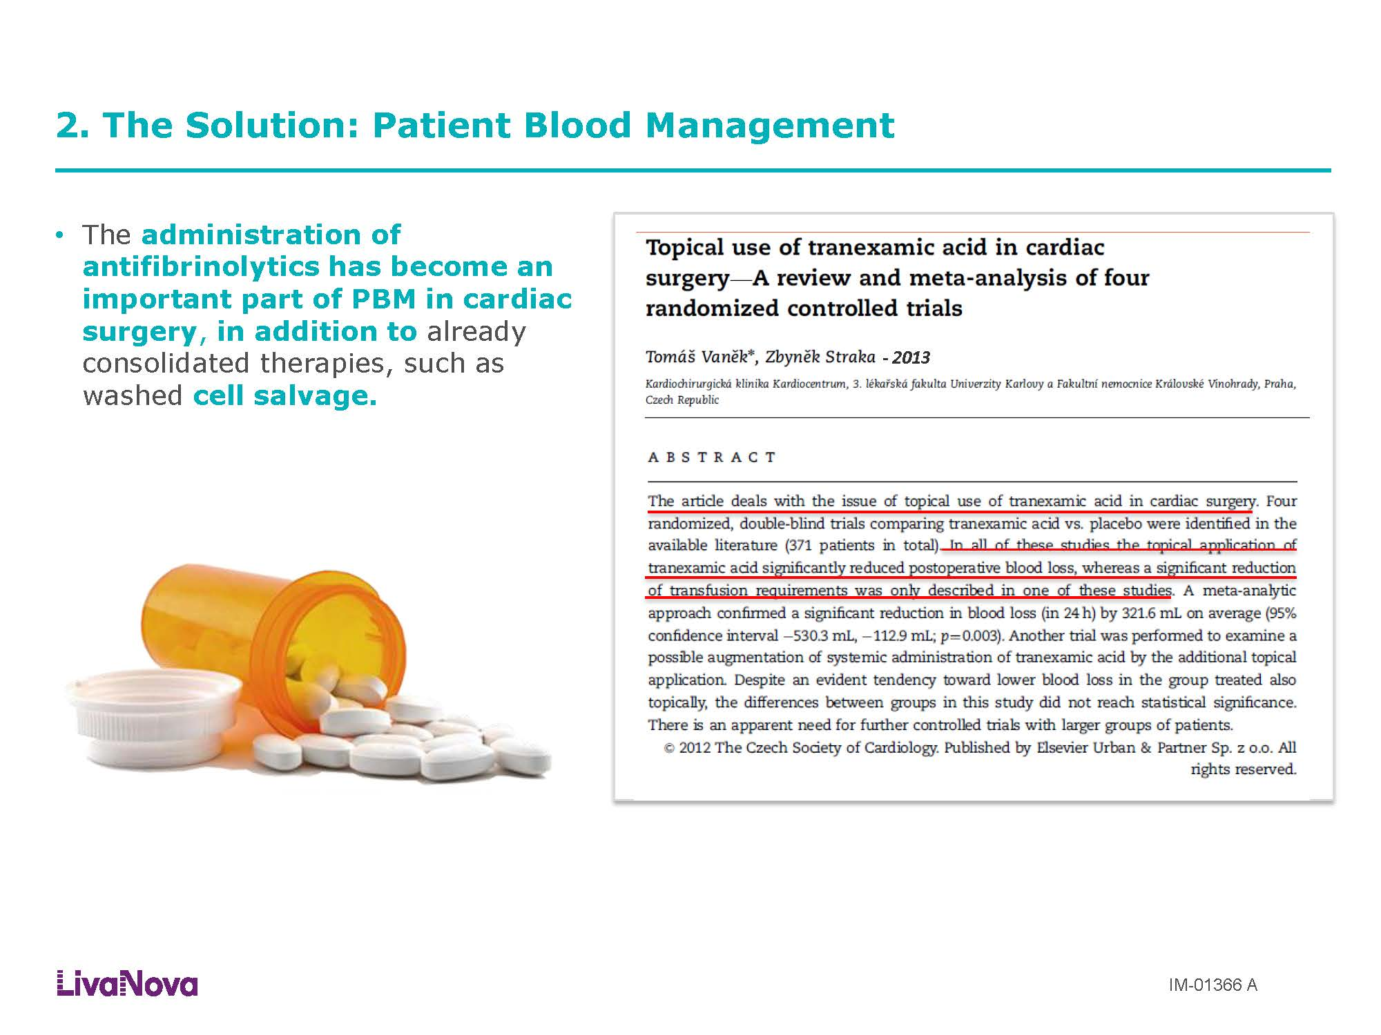

Slide 11
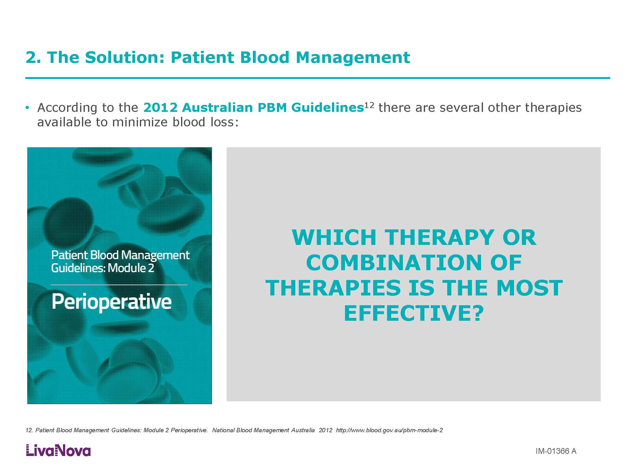

Slide 12
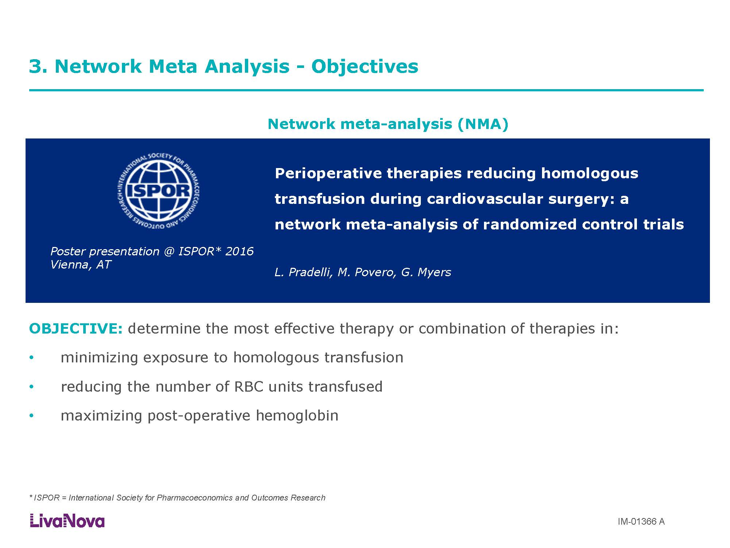

Slide 13
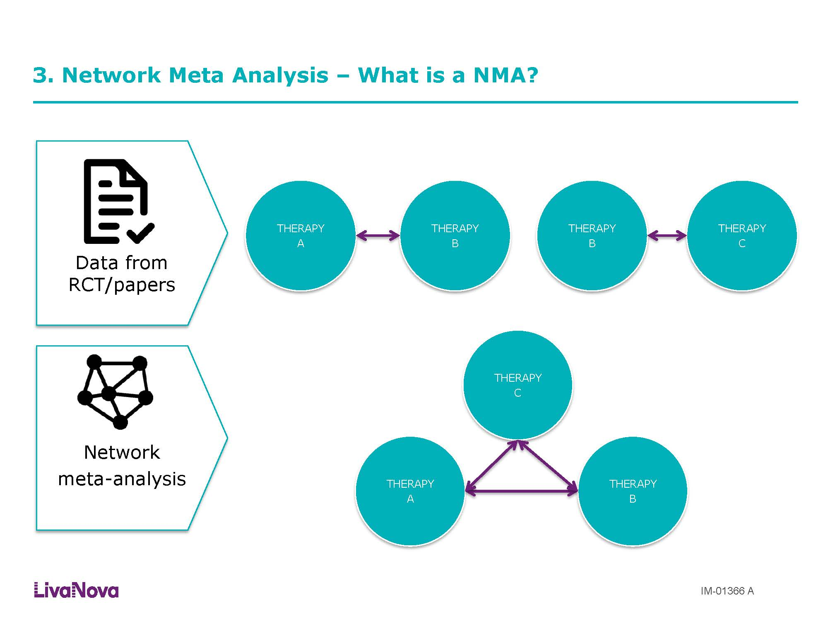

Slide 14
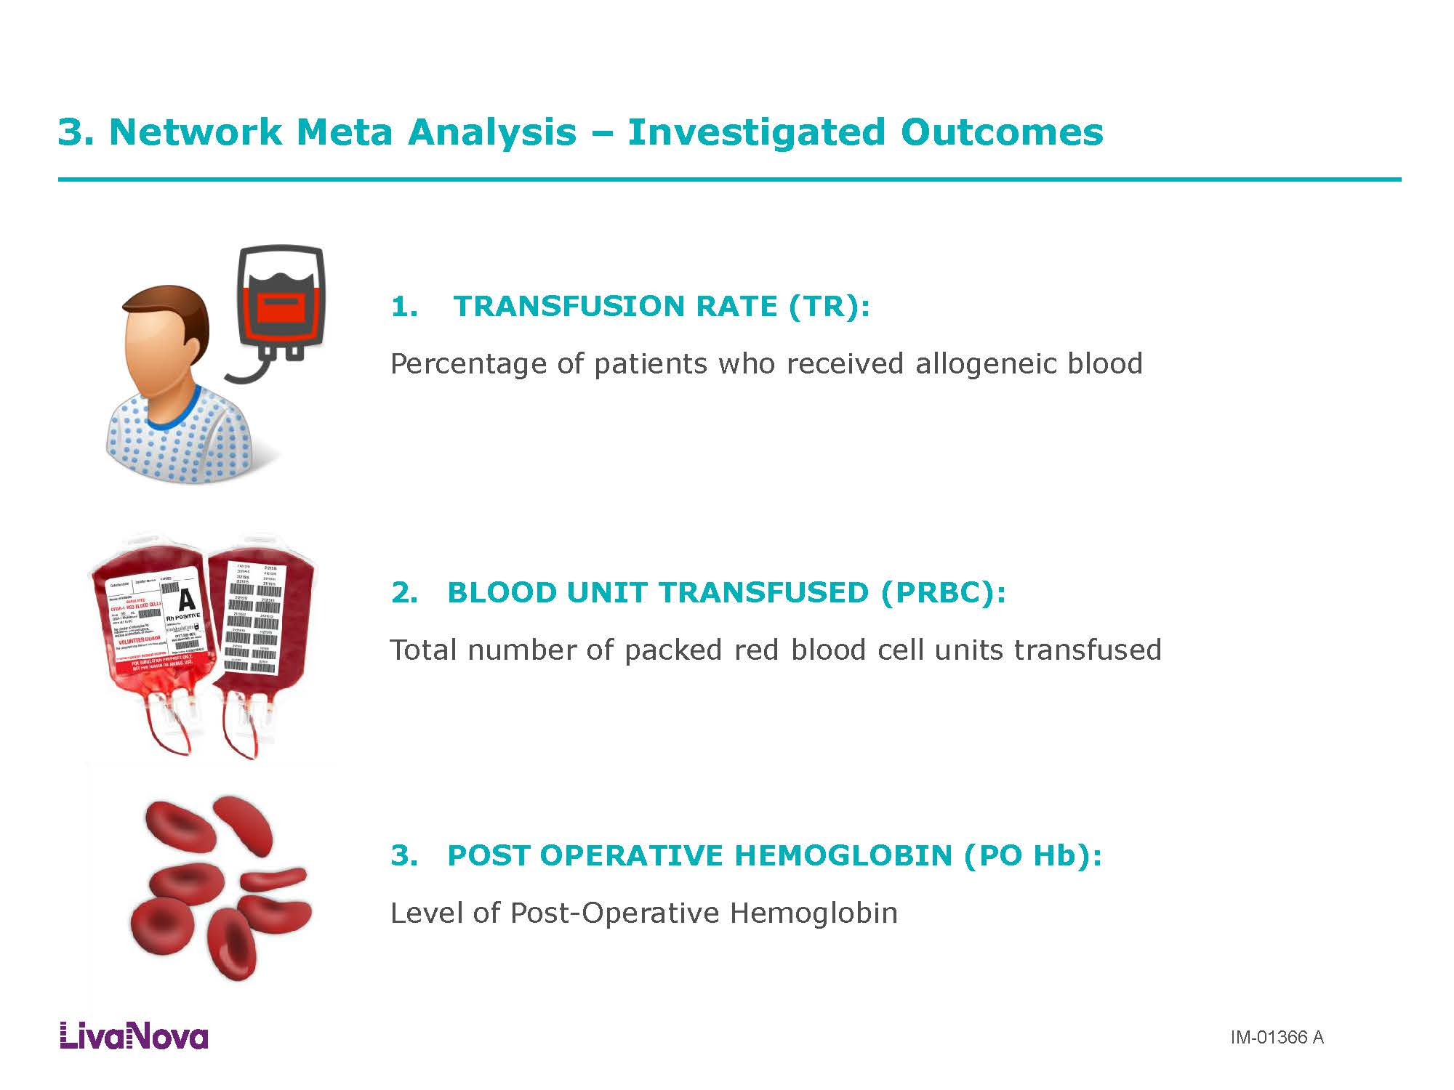

Slide 15
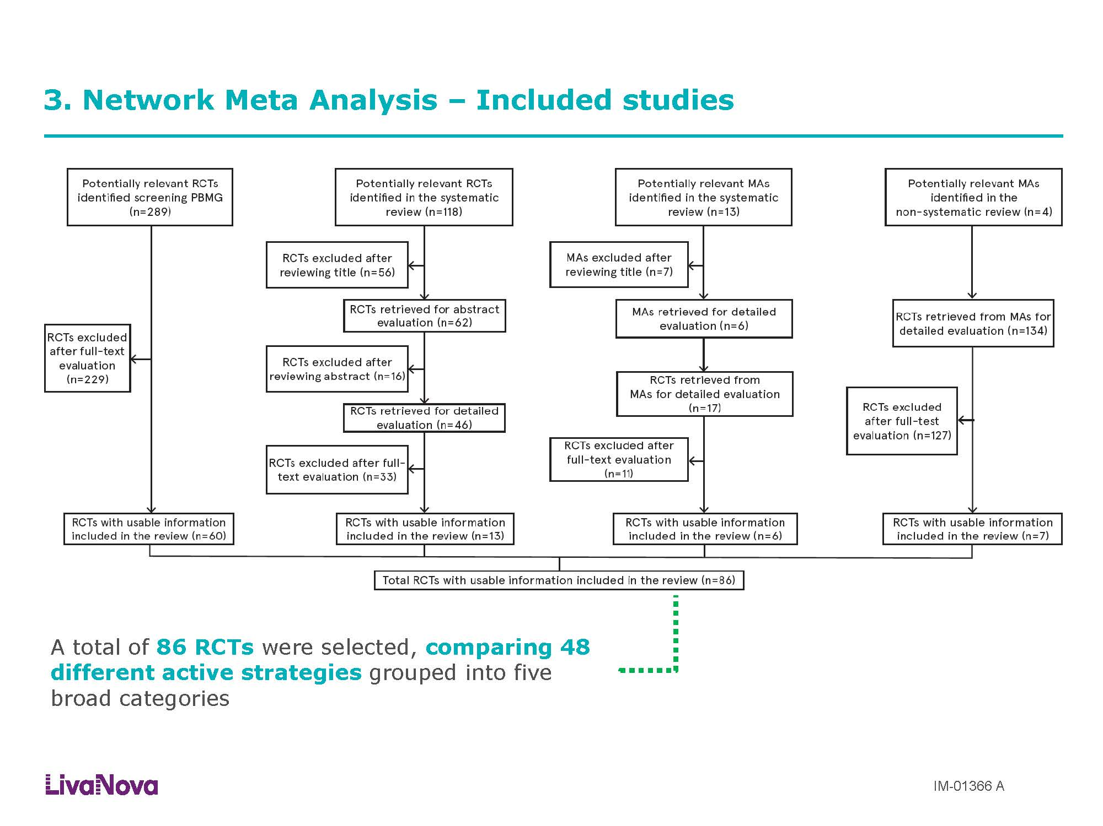

Slide 16
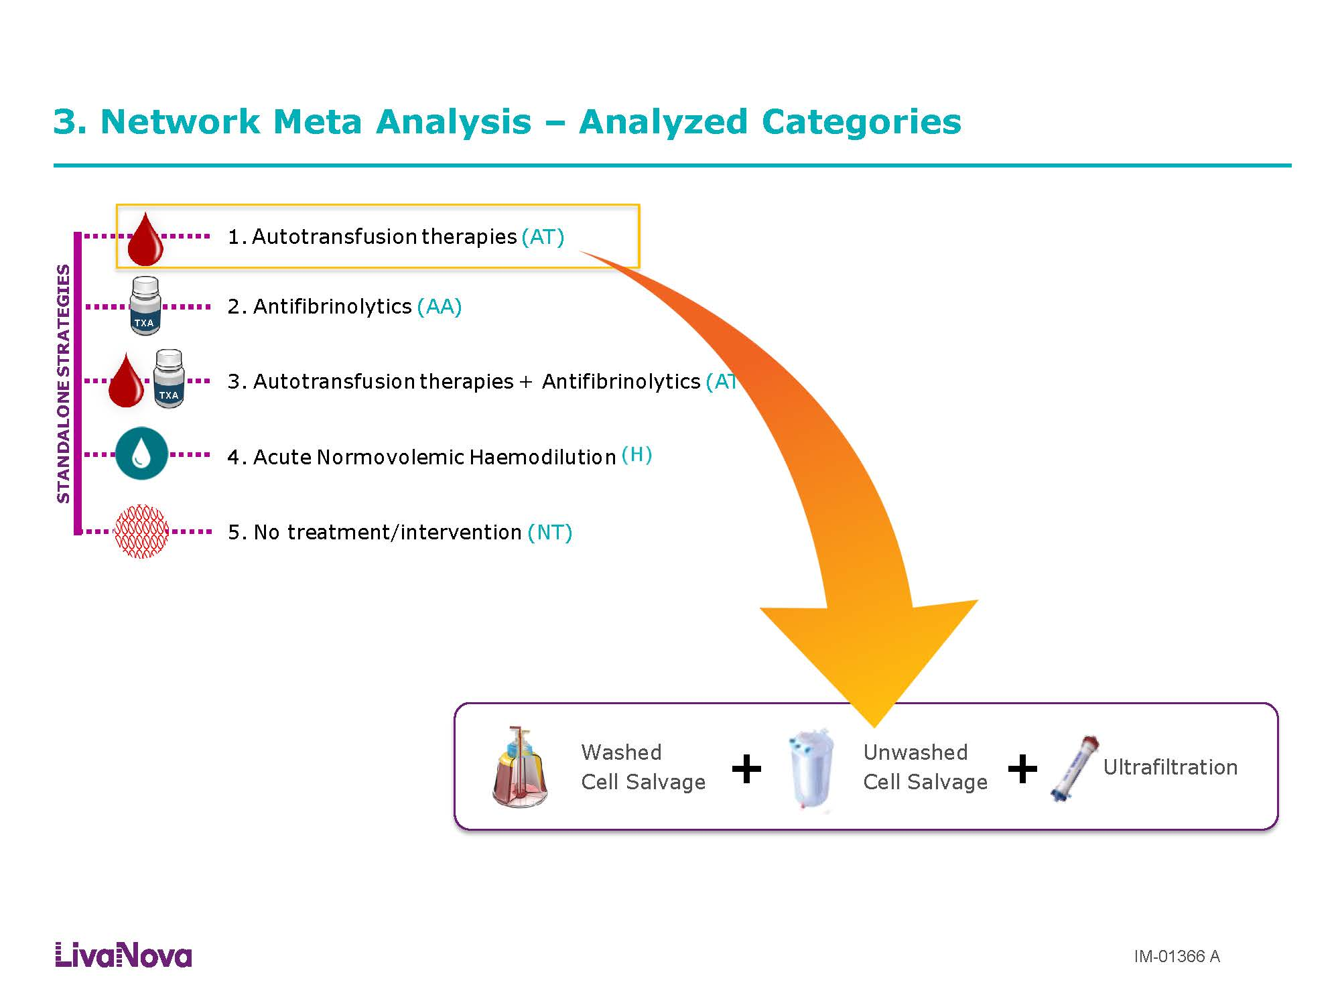

Slide 17
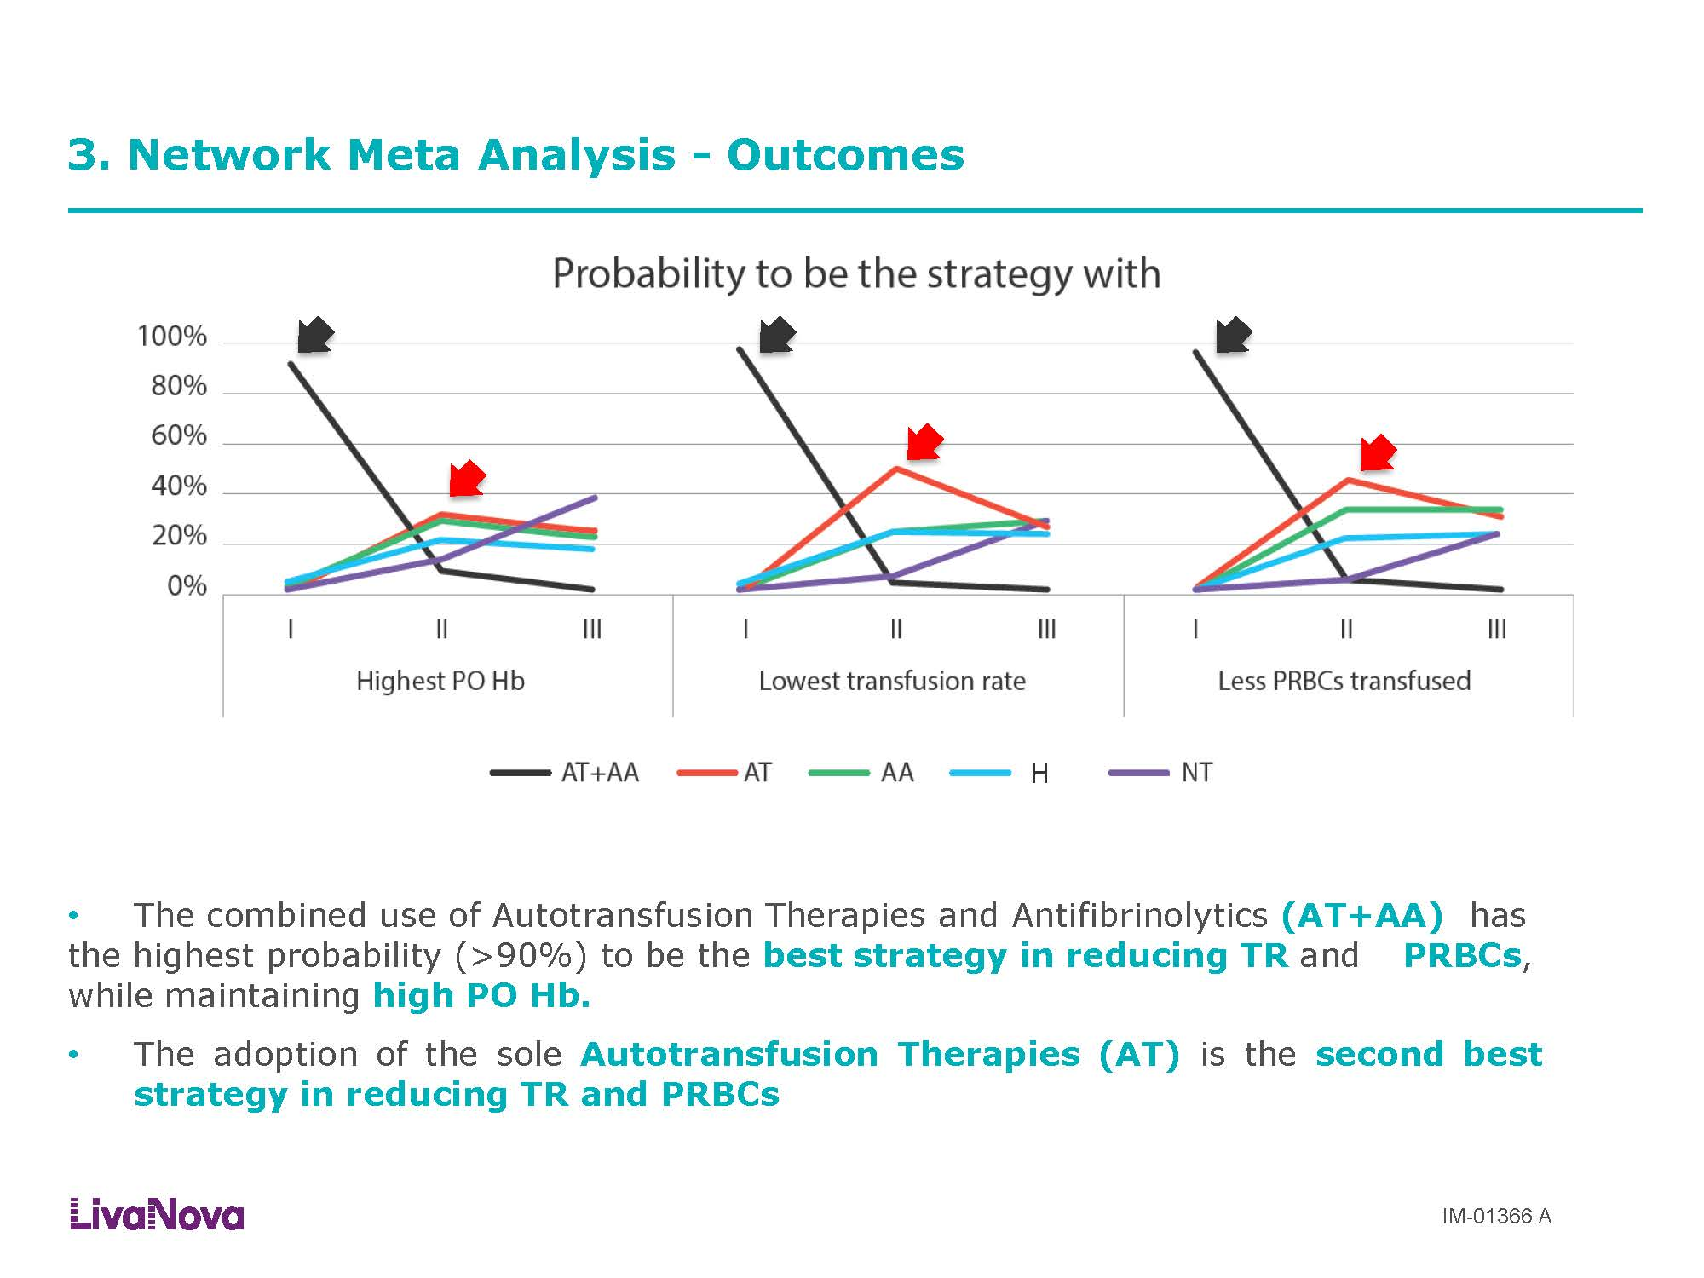

Slide 18
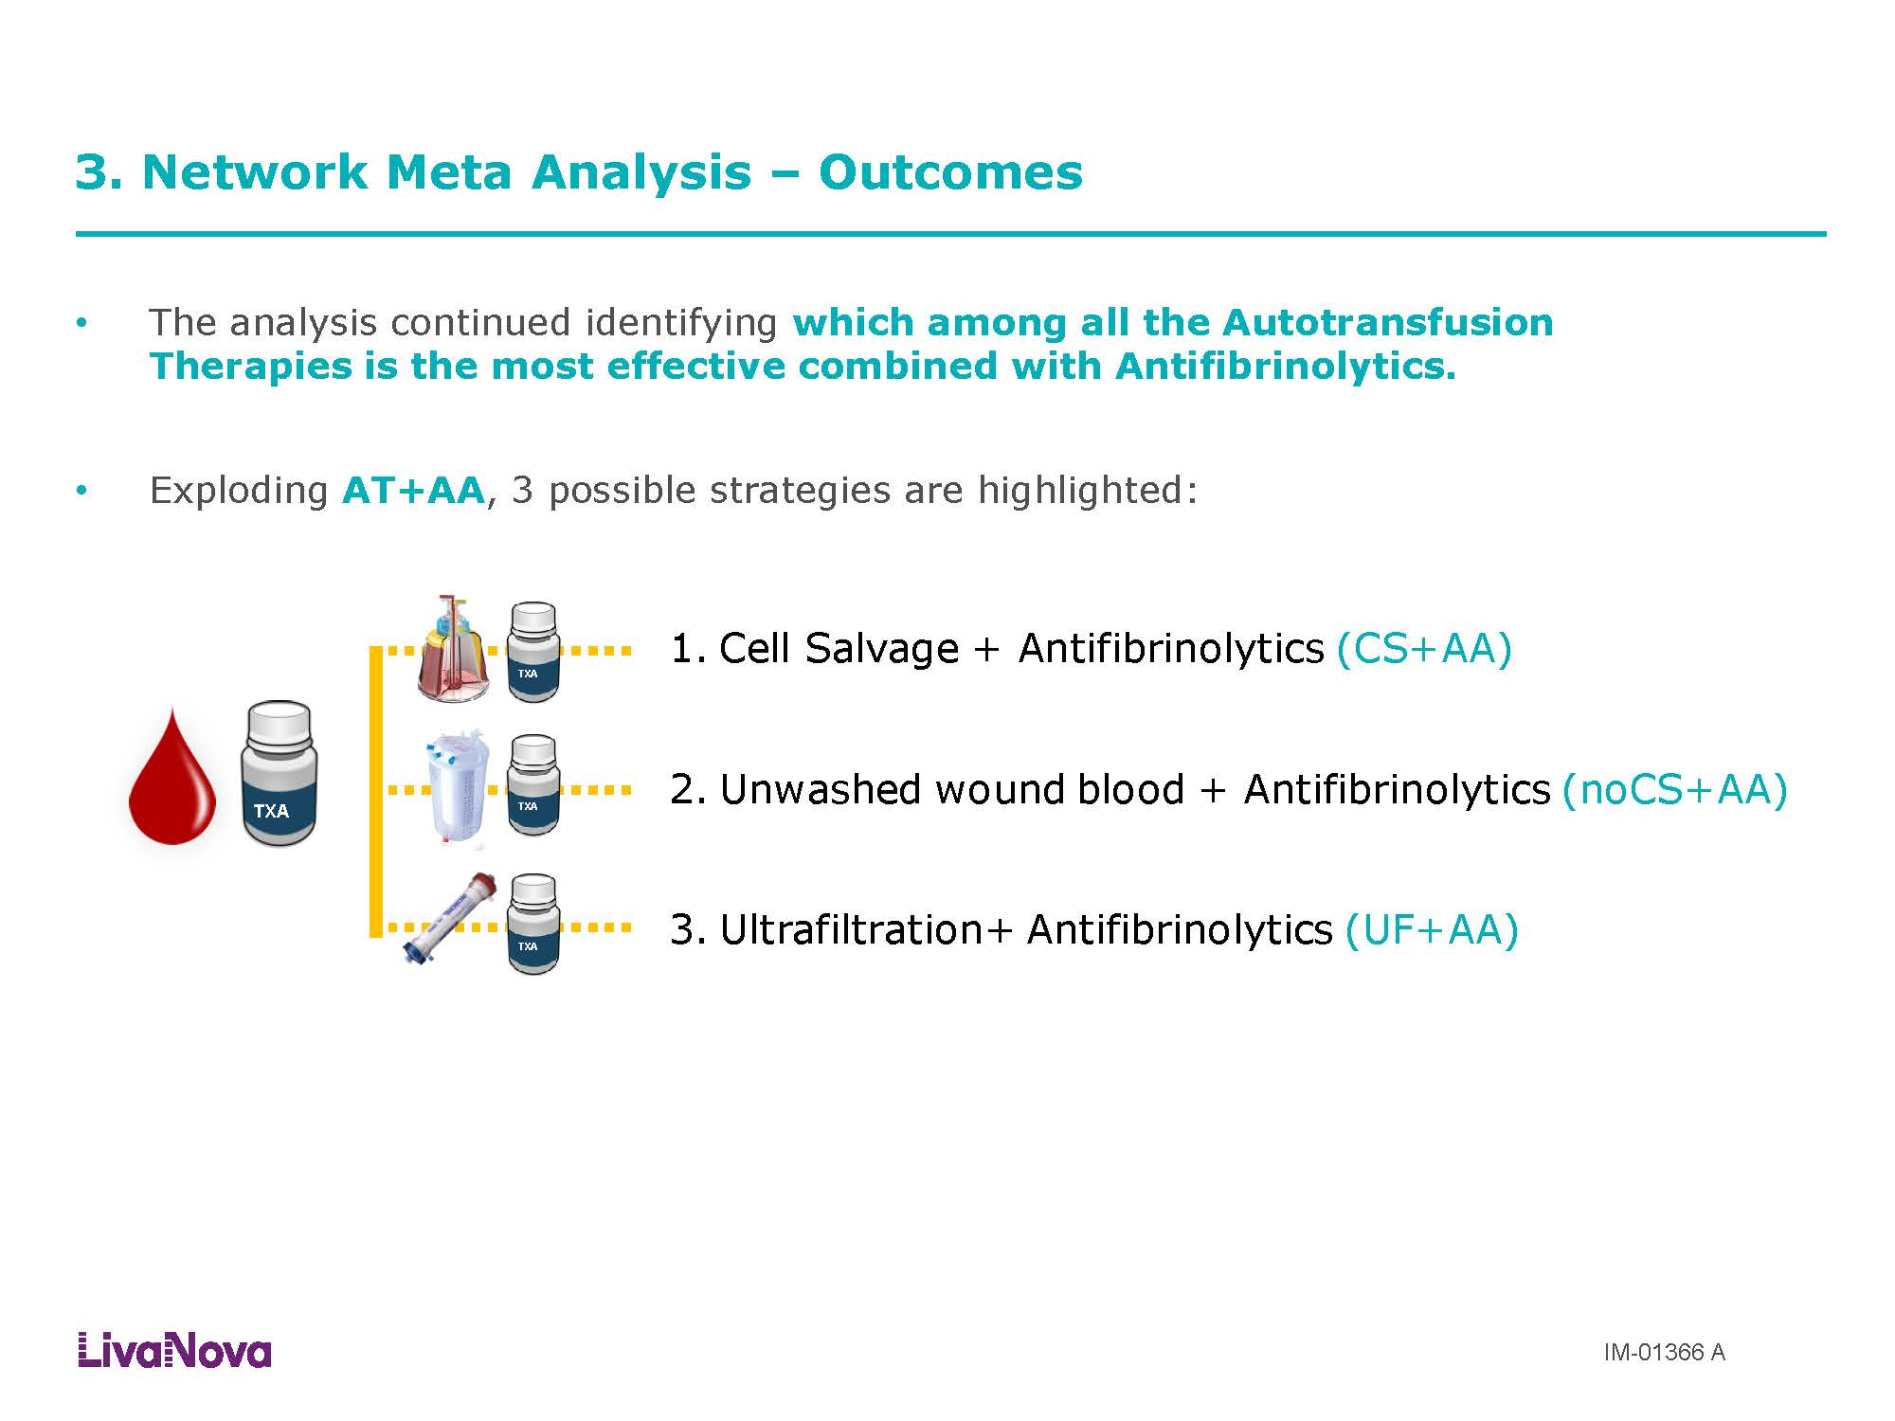

Slide 19
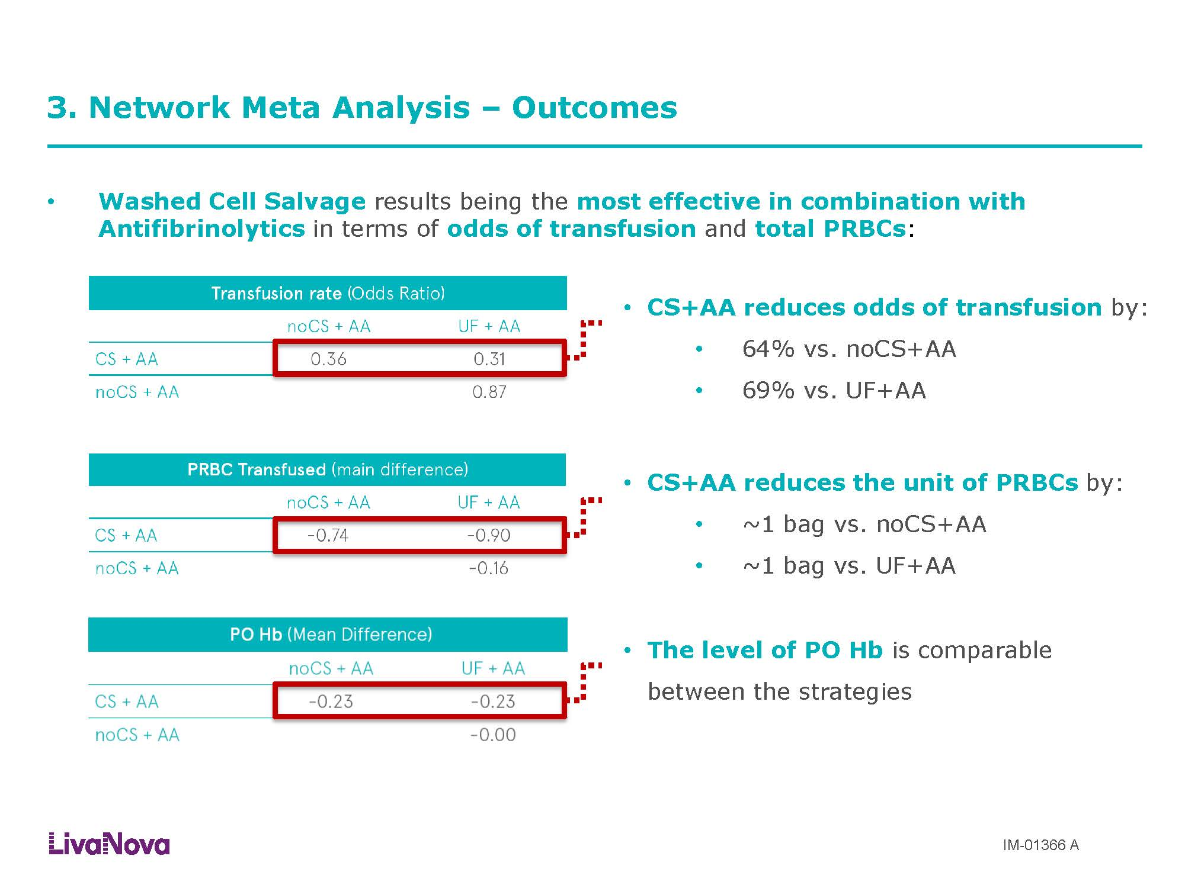

Slide 20
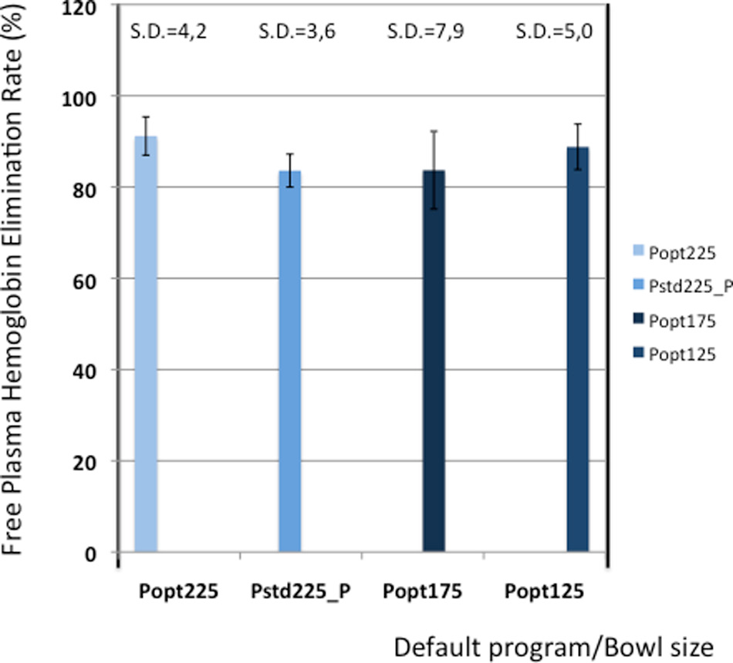
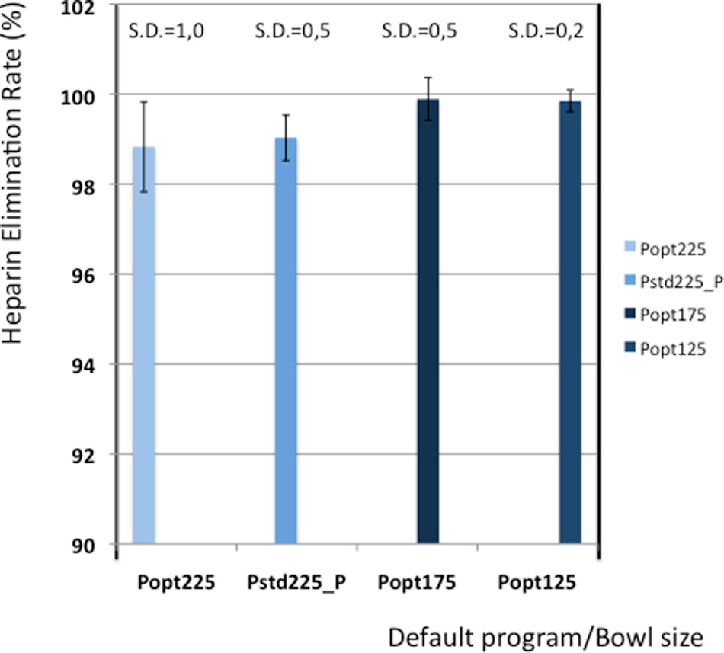
Elimination rates
Clinical evaluation of the Sorin Xtra® autotransfusion system
EP Overdevest1, PWJ Lanen1, JCM Feron,1 JWH van Hees1 and MESH Tan2
Perfusion , 27(4) 278–283 © The Author(s) 2012
Reprints and permission: sagepub. co.uk/journalsPermissions.nav
DOI: 10.1177/0267659112442222
prf.sagepub.com

Slide 21
Elimination rates (in %)
Group Proteins(n=62) Albumin(n=62) Heparin(n=62) PFH(n=62)
Popt225 98.3 (1.0) 98.1 (1.4) 98.8 (1.0) 91.2 (4.2)
Pstd225 96.8 (2.1) 96.5 (0.5) 99.0 (0.5) 84.6 (3.6)
Popt175 99.2 (0.3) 98.6 (0.8) 99.9 (0,5) 83.7 (8.5)
Popt125 98.5 (0.7) 97.6 (1.0) 99.9 (0.2) 88.8 (5.0)
Clinical evaluation of the Sorin Xtra® autotransfusion system
EP Overdevest1, PWJ Lanen1, JCM Feron,1 JWH van Hees1 and MESH Tan2
Perfusion , 27(4) 278–283 © The Author(s) 2012
Reprints and permission: sagepub. co.uk/journalsPermissions.nav
DOI: 10.1177/0267659112442222
prf.sagepub.com

Slide 22
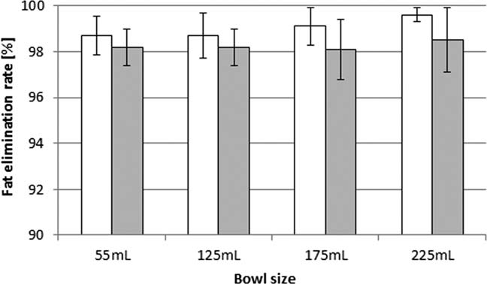
Fat removal during cell salvage
PFAT Protocol
The removal of fat during cell salvage
is important to ensure the safety of
autologous blood.
The retransfusion of fat particles can
lead to cerebral and pulmonary
dysfunction.
Fat removal during cell salvage: an optimized
Program for a discontinuous autotransfusion device
Timo F. Seyfried, Michael Gruber, Anita Breu, Christoph
Aumeier, Nina Zech, and Ernil Hansen
From the Department of Anesthesiology, University
Hospital Regensburg, Regensburg, Germany.
Received for publication June 27, 2015; revision received
July 20, 2015; and accepted July 20, 2015.
doi:10.1111/trf.13286
VC 2015 AABB
TRANSFUSION 2015;00;00–00
Fig. 1. Fat removal with the optimized fat elimination program
Pfat in XTRA. Test blood of a Hct of 10% (w) or a Hct
of 25% ( ) containing 1.25% fat was processed with Pfat and
four different bowls.

Slide 23
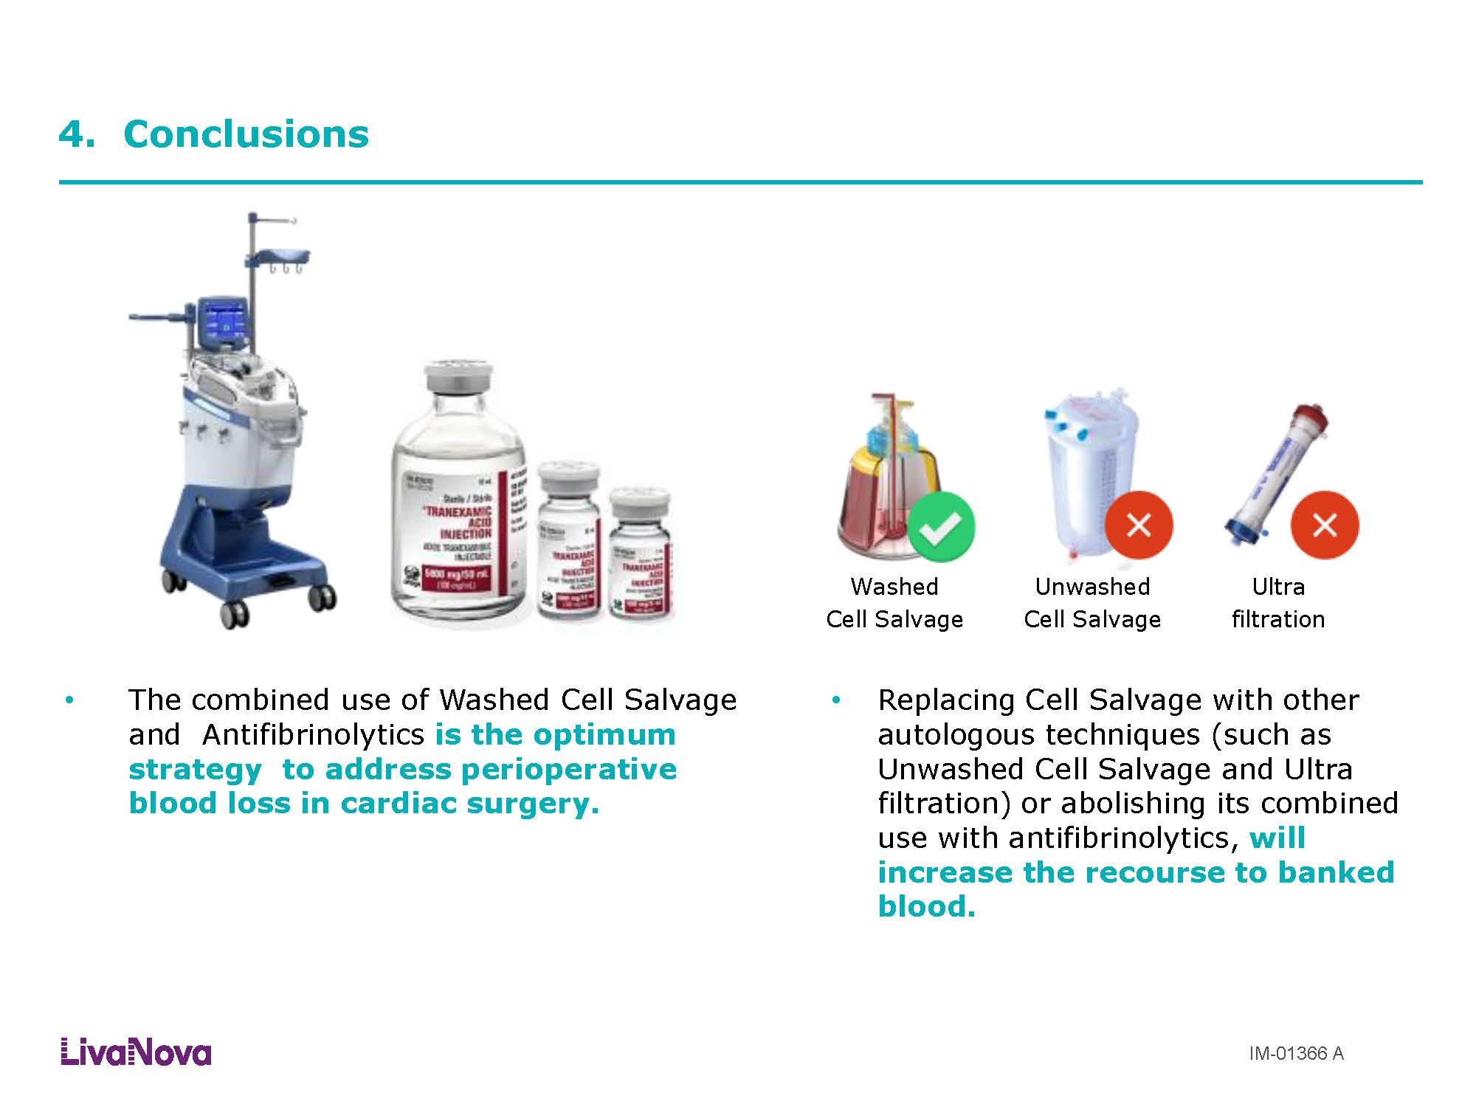

Slide 24
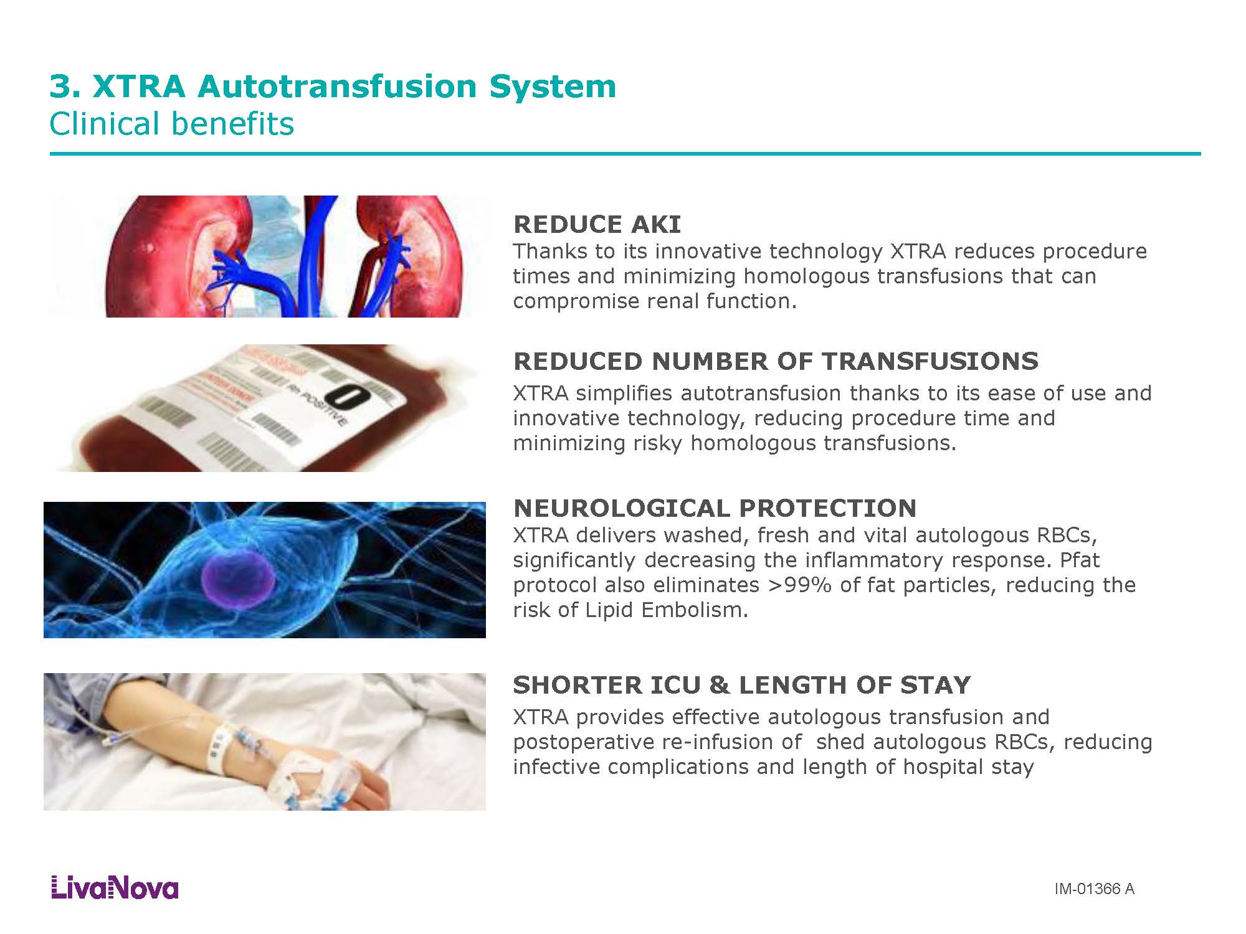

Slide 25


